Slide 1
Animal Behavior and Restraint
Equine
Notes:
March 2014
During animal health emergencies involving equine species, tasks requiring the handling and restraint of the animals are likely. Having a basic understanding of equine behavior and restraint will allow for more effective efforts thereby minimizing stress on the animals and reducing the risk of injury to responders. This Just-In-Time training presentation will overview basic equine behavior as well as handling and restraint measures that may be needed for animal health emergencies.

Slide 2
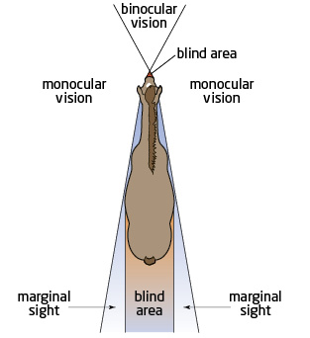
Equine Characteristics
Prey animals
Grazers
Fight or flight
Monofocal and biofocal vision
  Blind spots
    Directly in front
    Directly behind
Notes:
Equids, including horses, mules and donkeys, are grazers and prey animals. As such their “fight or flight” reaction is prominent, and their senses are developed to rapidly detect changes in their environment. This acute ability to detect movement, often results in equids to be “spooked” easily.
Horses have widely spaced eyes, and as a result have a large field of peripheral vision; however, this area is only monofocal (one-eyed vision), so their depth perception is poor. This one-dimensional view is another contributing factor for horses to “overreact” to objects or sounds things behind or beside them. Horses do have some areas of binocular vision (where it sees with both eyes at once) but this area is very small, and includes the area directly in front of them. Horses have two “blind spots” – a small spot directly in front of their nose and directly behind them. These are important characteristics to keep in mind when approaching and moving equine.

Slide 3
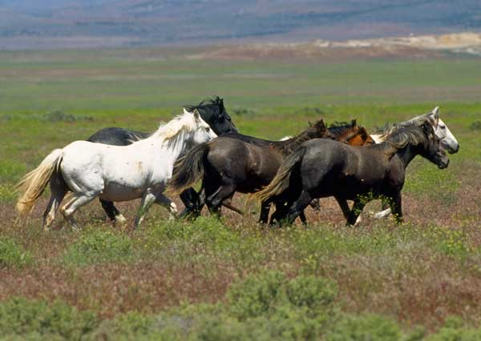
Normal Equine Behavior
Herd animals
  Group together
  Follow herd leader
Anxious when
isolated from herd
Mothers will protect young
  Avoid separating mare-foal pairs
Notes:
Equids have a very strong herd instinct and try to stay together in a group, especially when they are frightened. There is a distinct social order within equine herds. This can be used to an advantage in moving large groups of horses at one time. Equids will follow the lead horse, (e.g., stallion or dominant mare); however, it is important to be aware that the dominant horse will also strive to protect the herd, so must be handled with care. The social nature of equids makes them very nervous in situations where they may become isolated from the group. Most equids when frightened will flee, but if they are isolated and or cornered, they may strike out with their hooves or teeth. Always move with caution when working with a mother and her young because she could injure herself or the handler if she feels her foal is in danger. Avoid separating mare-foal pairs if possible.
[Photo: A herd of mustangs. Source: Wikimedia Commons]

Slide 4
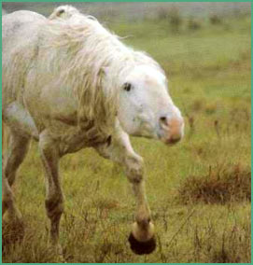
Body Language
Both ears back
  Angry, threatened, warning
Ears slightly back
or forward
  Listening
  Attentive
Tail swishing
  Agitated
Notes:
An important step when moving equine is to be aware of their body language. This can provide insight and perhaps a warning should the animal strike out in fear. When a equid lays its ears back, it usually means the animal is angry or feeling threatened. The animal may also swish its tail when it is agitated. Caution should be used if either of these signs are noted. If the equid has one or two ears slightly back, it means the animal is listening. If both ears are forward, the animal is attentive and listening. When approaching the animal, always make sure it sees you. Avoid the animal’s blind spots. Use caution when working around the horse’s head, legs, and tail. If it becomes startled or irritated, the horse may move suddenly and injure the handler. [Photo: An irritated horse – the ears are laid back against the head. Source: Rutgers/New Jersey Agricultural Experiment Station. The Basics of Equine Behavior Fact Sheet #525 at http://www.esc.rutgers.edu/publications/general/fs525.htm]

Slide 5
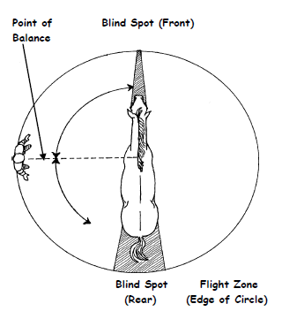
Flight Zone
Animal’s personal space
Indicator or possible threat
Size determined by
  Tameness
  Degree of excitement
Animal moves
away from things
in the flight zone
Notes:
The flight zone is important to consider when approaching horses. The flight zone is the animal’s personal space, and is used as an indicator of impending threats. The size of the flight zone depends on temperament of the horse and its experience with people. With frequent handling the flight zone will decreases in size and may even disappear, but if a horse hasn’t had much handling or is constantly approached head on, it will have a much larger flight zone. When a person moves into the flight zone, the animal will move away from the person (or threat). The handler should avoid deep invasion of the flight zone. This can cause an animal to panic. In an attempt to escape, it may run away or turn back and possibly charge the handler if provoked.
To determine the edge of an animal’s flight zone, slowly walk up to the animal. The point at which the horse begins to move away is the edge. This is the best place for a handler to work. The point-of-balance, which is located at the shoulder, perpendicular to the body, is used to move horses back or forward. To make the horse move back, the handler should stand in front of the point-of-balance, and to make the horse move forward they should stand behind the point-of-balance
This diagram shows the flight zone of a animal. Note the blind spot behind the animal (light gray), this area should be avoided. [Illustration: Equine flight zone. Source: American Youth Horse Council. Approaching a Horse Safely. Available at: http://ayhc.com/uploads/approaching-a-horse-safely-2011.pdf]

Slide 6
Herding & Moving Equine
Startled by sudden movements and loud noises
Avoid
  Abuse
  Loud noises, yelling
  Isolating animals
  Distractions
Use slow movements
Easily dominated by humans
Notes:
Equids are easily dominated by humans when handled properly and gently. However, most equine are startled by sudden movements and loud noises. Avoid approaching the animal from the rear or directly in front; it is best to approach at an angle from its shoulder. Give the animal a chance to see you. Use slow movements when moving equine. Be aware of the animal’s surroundings and ensure there is nothing in the movement path that could cause them to startle. Frightened and startled equine may react by spinning or bolting; responders should keep an escape route in sight at all times to avoid being trampled or kicked by a startled animal. Avoid isolating the animal from its herd. Keeping equids in familiar groups can help to reduce stress on the animals.

Slide 7
Capture & Containment
Tame horses
  Used to humans
  Easily penned
Wild horses
  Other horses should be used in containment
  Avoid running them
Use food to entice them
Be alert of surroundings
Makeshift corrals can be used
Wire fencing should be avoided
Notes:
Methods of capturing and containing equids will vary depending on their familiarity with humans and being handled. Animals that are used to human contact will generally be easily haltered, and lead to the necessary location.
In situations involving equids that are less familiar with human handling (e.g. wild horses), herding using other horses may be most effective. Slow, deliberate movement using the herd flight zone will be most effective. Avoid chasing or running the animals as this will cause an unorganized and stressed herd and may lead to injuries to the animals and/or handlers.
When capturing equine that aren’t accustomed to human contact, use of food in a bucket may entice them to come to the handler. The handler should shake the bucket so the animal hears the food in the bucket and will come closer to be haltered. After the animal is haltered, be very aware of the surroundings and the animal’s movement and be prepared for sudden changes in their movement if something frightens them. Makeshift corrals or stalls made from portable gate panels can be used to contain the equine in a safe area. Any kind of wire fencing should be avoided due to the danger of injury to excited animals unfamiliar with fences. Be sure that gates of any kind are securely fastened so no further escape can occur.

Slide 8
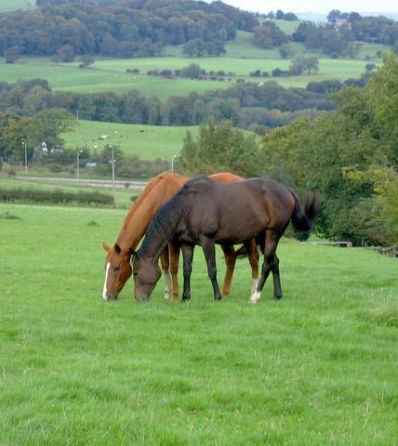
Behavior After Handling
Allow access to feed, water, and shelter
Extra caution should
be taken with stallions
Social order must be
re-established
Be alert of any injuries
Notes:
Once the animals have been moved to the safe and desired location, allow plenty of access to feed, water and shelter. Adequate space should be provided for them to exercise and lie down if they will be housed in this location for any length of time. Stallions should always be approached with caution, particularly in stressful conditions, and should not be contained together as this will only result in more problems. If new groups of equine are mixed, allow abundant space to re-establish the social order of the new herd. Also, be alert of any injuries that any of the animals may have acquired during the movement process. [This photo shows two horses grazing. Source: Wikimedia Commons]

Slide 9
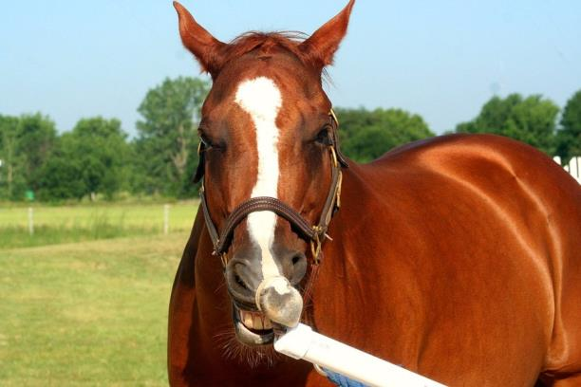
Restraint
Minimal movement
  Stocks/Chute
  Hobbles
  Twitch
  Halter with chain
  lead shank
Full movement
  Stalls
  Corrals
Notes:
Restraint may be needed for diagnostic sampling (e.g., blood collection) or vaccination or treatment. There are many ways to restrain equine depending on their familiarity with human contact. For situations requiring minimal movement of the animal, chutes or stocks can be used to restrain the animal. Hobbles can be put on equid legs to keep them from moving as well, while still allowing them to eat grass if it is available. A nose twitch made of soft rope can be wrapped around the end of the animal’s nose to keep it still. When handling stallions, a halter with a chain lead shank can be used to control the animal’s head. In situations requiring maximal restraint, tranquilization or sedation may be necessary. Many protocols are available depending on the depth and length of sedation required. [Photo: Horse with a twitch on its lip. Source: Andrew Kingsbury/CFSPH]

Slide 10
Special Considerations
Monitor in conditions of high heat or extreme cold
Farrier needs
Winter weather requires special equipment
  Heaters or wind break
  Gritty, non-slip substances
  Blankets
Notes:
When possible, avoid moving equine under hot conditions. Move them in the early morning or late evening hours. In times when this is not possible, move animals slowly and offer water and breaks often. In cold conditions, use caution when moving animals on slick or icy surfaces. If necessary, use a gritty, non-slip, non-toxic material if ground surfaces are icy to improve traction. If the horses will be housed for long periods of time, hoof care will be needed, especially for horses with shoes. A wind break should be provided during winter weather; heaters or blankets may also be needed.

Slide 11
Safety
Avoid injuries from equine
  Kicks
  Striking
  Rearing
  Biting
  Can inflict injuries with head
  Will run over you if desperate
Notes:
Horses can cause injuries in many ways with many parts of their body. They can kick with their back feet and strike with their front feet, both ways inflicting a lot of pain, especially when standing close to them. Rearing can also cause injuries to handlers if the animal were to land on them. Equids have teeth on both their upper and lower jaws which can bite with extreme force. They can also cause injuries with their head by throwing it around and possibly hitting the handler. If desperate, cornered, or isolated, equine will run over or through their handlers if there is no other way out. When working with these animals, avoid quick movements and always have an escape route planned when working in close quarters.

Slide 12
Additional Information
Approaching a Horse Safely. American Youth Horse Council.
http://ayhc.com/uploads/approaching-a-horse-safely-2011.pdf
Approaching, Catching, and Haltering Horses Safely. Rutgers Cooperative Extension. http://nasdonline.org/static_content/documents/1043/d000837.pdf
Techniques for Safely Handling Horses. Oklahoma Cooperative Extension Service. http://pods.dasnr.okstate.edu/docushare/dsweb/Get/Document-2755/E-960.pdf
Notes:
For more information on equine behavior and restraint, see the following resources.

Slide 13
Acknowledgments
Development of this presentation was by the Center for Food Security and Public Health at Iowa State University through funding from the Multi-State Partnership for Security in Agriculture
Authors: Abbey Smith, Glenda Dvorak, DVM, MPH, DACVPM
Notes:
Information provided in this presentation was developed by the Center for Food Security and Public Health at Iowa State University College of Veterinary Medicine, through funding from the Multi-State Partnership for Security in Agriculture.

