Slide 1
Animal Behavior and Restraint
Companion Animals
Notes:
June 2013
During a disaster response, tasks such as rescuing displaced or injured animals or administering first aid or other medical treatment will require the handling of companion animals. Understanding proper handling and restraint methods will minimize stress on the animals and reduce the risk of injury to responders. This Just-in-Time presentation will overview basic companion animal behavior as well as handling and restraint measures that may be needed during a disaster response.

Slide 2
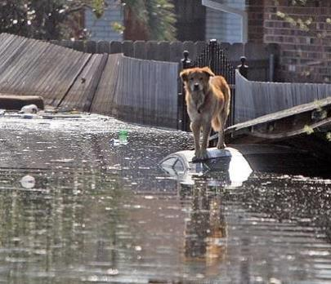
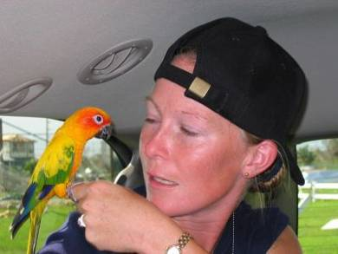
Companion Animals
Domesticated species
Dogs, cats, rabbits, rodents, birds
Exotic pet species
Reptiles, amphibians, small mammals, monkeys,
Wildlife or farm animals
Service animals
Remain with owner at human shelters
Notes:
More than 60% of U.S. household have at least one pet and they are often considered family members. As a result these companion animals may be encountered during disaster response situations. A variety of animal species are kept as pets. The majority include traditional domesticated animals such as dogs, cats, and pet birds. However, specialty species such as rabbits, ferrets, and pocket pet rodents – including hamsters, gerbils and guinea pigs - are also common. Many pet owners have exotic species, including reptiles, amphibians, monkeys, and non-traditional rodents, such as hedgehogs or sugar gliders. Even some species of wildlife or farm animals are kept as pets. Additionally, some companion animal species serve as service animals and are essential for the function and independence of their owners. These animals may be encountered during response efforts and will require special consideration by emergency responders due to the important role they play in their owners lives. [The top photo shows a dog on a submerged vehicle; the bottom photo shows a pet bird that has been rescued. Photo source: Dr. Garry Goemann, VMAT]

Slide 3
Animal Facilities
Local animal facilities
Animal shelters, kennels, pet stores, animal research facilities
Illegal animal activity
Hoarding, animal fighting operations, illegal exotic animal breeding, illegally kept exotic or native wildlife
Notes:
In addition to household pets, there may be a variety of animal facilities in the community that house companion animal species. If impacted during an animal health emergency, assistance from emergency responders may be required. These companion animal facilities may include animal shelters, kennels, pet stores, or animal research facilities. Additionally, during a disaster response, it is possible to encounter sites involving illegal animal activity including animal hoarding, dog fighting operations, or sites of illegal exotic animal or wildlife breeding or housing. Animals in these situations may be less familiar with human handling and pose a safety risk to responders.

Slide 4
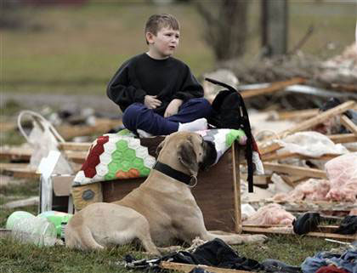
General Companion Animal Behavior
Most approachable, non-aggressive
Disaster situation may behavior changes
Fear, injury, protective nature make animals more likely to bite
Notes:
Most companion animals are accustomed to people and will be approachable and non-aggressive. However during an emergency or disaster situation, animals may be fearful, injured or protective of their home. In any of these instances, these animals may be more likely to bite if proper handing and restraint measures are not taken. [Photo source: Kitten: LA Times blog at http://latimesblogs.latimes.com/photos/uncategorized/2008/07/29/a_kitten_roams_in_a_quakedevastated.jpg; Boy and dog tornado photo: http://standeyo.com/News_Files/Food/DFSP_pics/Feb.2008.tornado.boy-dog.jpg]

Slide 5
Approaching an Unknown Animal
Safety first
Watch animal’s body language
Cues to demeanor of animals
Approach from the side
Avoid cornering the animal
Avoid direct eye contact
Expect the unexpected
Notes:
Regardless of the animal species, when approaching an animal to rescue or handle, safety for the responder and the animal is always the first concern. Next, observing the animal’s body language will give cues to the demeanor of the animals. Avoid approaching the animal head on – as this can be perceived by the animal as threatening; approach the animal from the side if possible. Avoid cornering or backing the animal into a space where it feels trapped. When possible let the animal come to you. Avoid prolonged direct eye contact as this can be threatening to the animal. Know your limitations in animal handling and remember that some animals may be better off left alone.

Slide 6
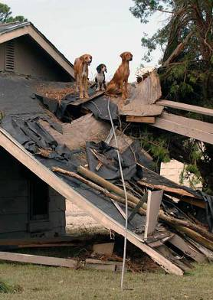
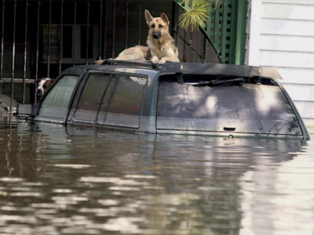
Dogs
Notes:
Let’s first look at handling and restraint measures for dogs.
[Photos show dogs waiting to be rescued. Source: National Geographic News at http://news.nationalgeographic.com/news/2005/09/photogalleries/hurricane_katrina_pets/photo3.html

Slide 7
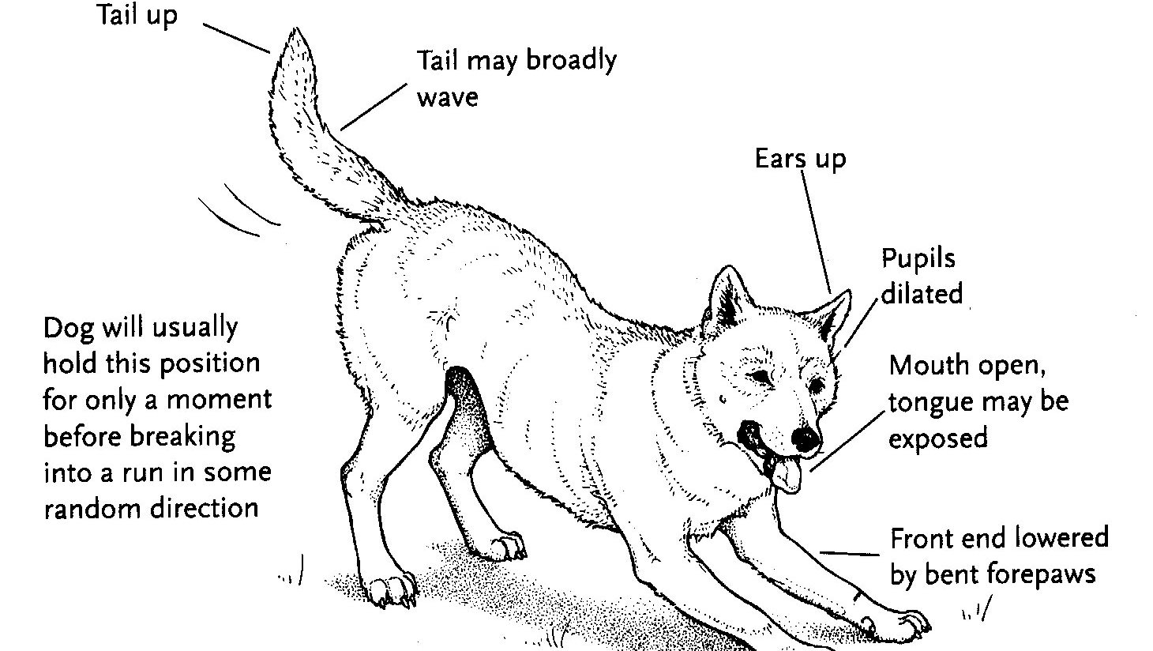
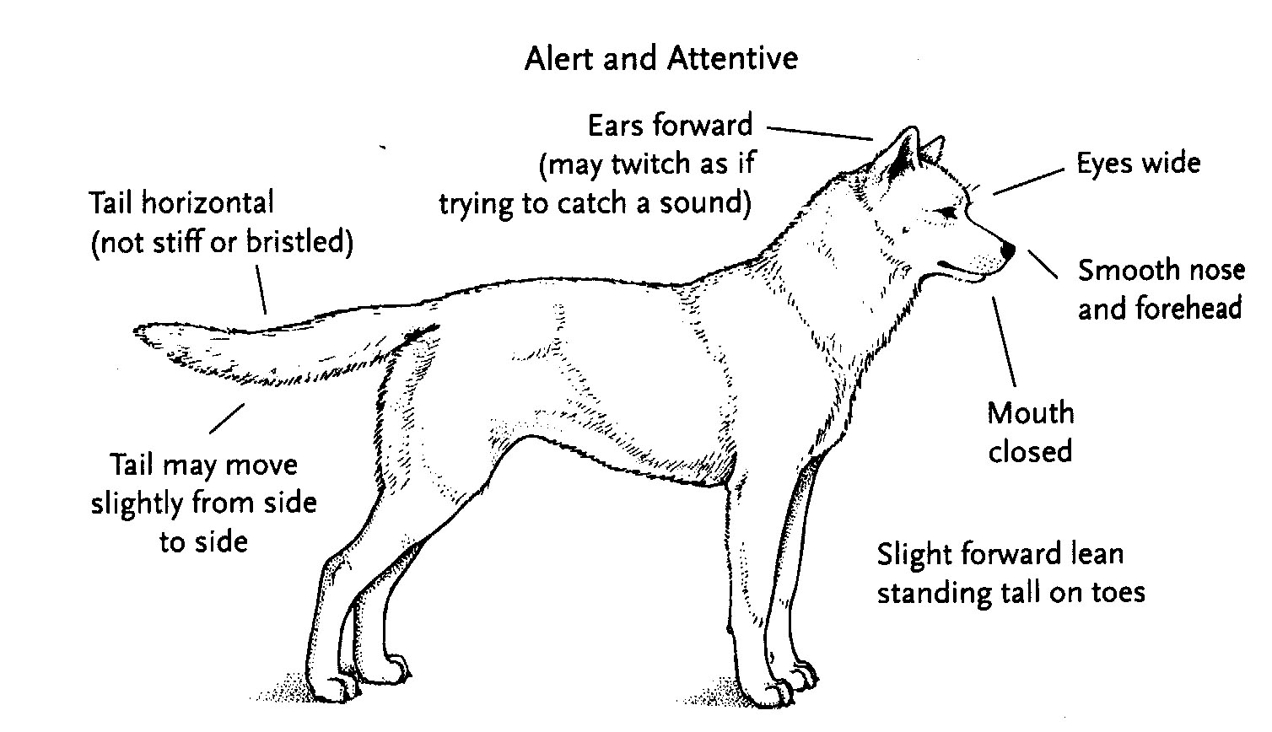
Dog Body Language: Playful and Attentive
Playful
Alert and Attentive
Graphic illustrations from FEMA CERT Animal Response Module I and II
Notes:
While many dogs will be approachable, others may be frightened or aggressive. Understanding a dog’s body language will help to determine the best way to approach the animal. Behavioral cues are reflected in the animal’s facial expressions (such as the barring of teeth), head and body position, as well as ear and tail position, and possibly vocalizations or sounds.
A playful dog will have his ears up, pupils dilated, mouth open and tongue may be exposed. The front end will be lowered by bent forearms. Tail will be up and may broadly wave. The dog will usually hold this position for only a moment before breaking into a run in some random direction.
An alert and attentive dog will have ears forward which may twitch as if trying to catch a sound, eyes are wide open, the skin of the nose and forehead is smooth, and the mouth is closed. The dog may be leaning slightly forward standing tall. Its tail is horizontal, not stiff or bristled and may move slightly from side to side.
Dogs displaying playful or attentive mannerisms should generally be approachable. [These graphics show the body language postures for playful and alert and attentive dogs. Photo source: Federal Emergency Management Agency (FEMA) Community Emergency Response Teams (CERT) Animal Response Module II]

Slide 8
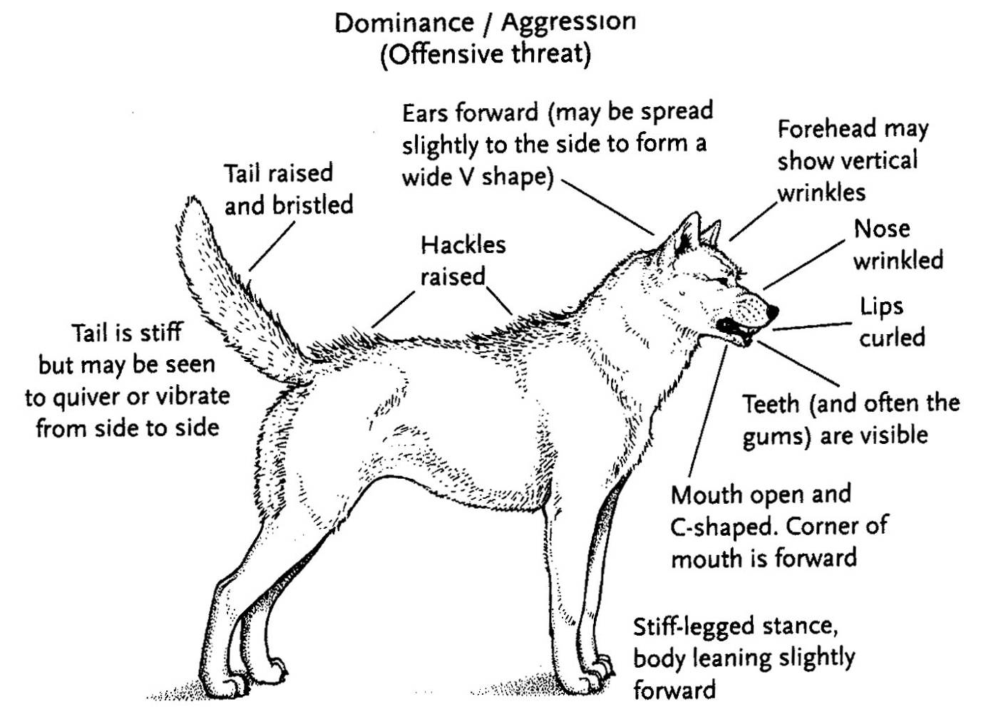
Dog Body Language: Fearful or Aggressive
Fearful – Defensive Threat
Aggressive - Offensive Threat
Graphic illustrations from FEMA CERT Animal Response Module I and II
Notes:
In contrast, a dog that is fearful or aggressive, will display much different body language. Many animals in disaster situations will be frightened or aggressive, especially if the dog is protecting its home or property. Dogs showing either of these behaviors should be approached with caution. A dog in either situation may act aggressively towards responders in emergency situations.
A dog that is fearful (shown in the left illustration) will have its ears laid back against its head, the pupils will be dilated, and nose wrinkled. The corners of the mouth will be pulled back with lips slightly curled and teeth may be somewhat visible. The dog’s body will be lowered and the tail is tucked between the hind legs with little or no movement. Hackles – or fur on the dog’s back - are raised.
A dog exhibiting an aggressive posture (shown in the right illustration) will have its ears turned forward to form a wide V shape. The dog’s forehead and nose will be wrinkled up. The dog’s mouth will be open, lips curled and the corners of the mouth will form a C-shape. The teeth and often the gums are visible. The dog will have a stiff-legged stance, with its body leaning slightly forward. The tail is stiff, raised and bristled and may be seen to quiver or vibrate from side to side. The dog’s hackles (or fur on its back) will be raised.
[These graphics show the body language postures for fearful (defensive threat) and aggressive (offensive threat) dogs. Photo source: Federal Emergency Management Agency (FEMA) Community Emergency Response Teams (CERT) Animal Response Module II]

Slide 9
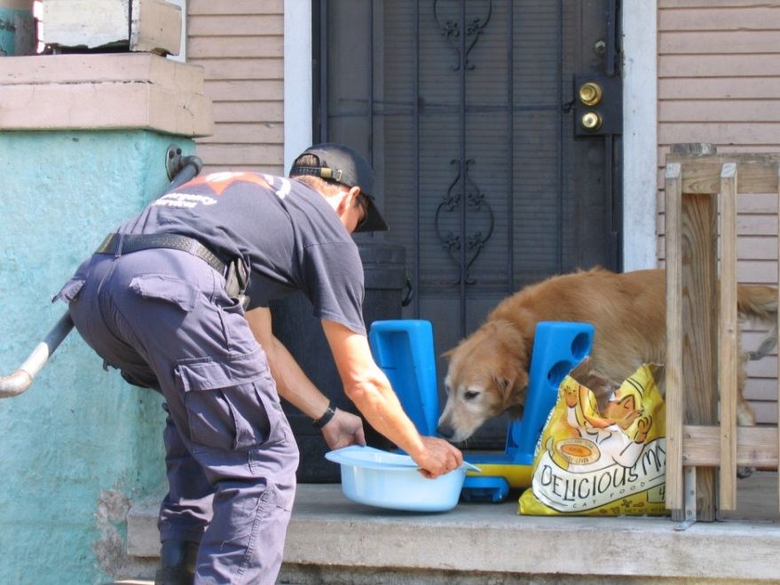
Dogs Not Showing Aggression
Call the animal using a soft voice and relaxed posture
Approach slowly
Place slip leash without physical contact
Avoid grabbing collar or standing over dog
Avoid loud noises, flashing lights
Minimize people in area
Offer a treat or food
Attempt basic obedience commands
Minimize arm and hand movements
Notes:
To approach a dog that is not showing signs of aggression, first get the animal’s attention. Call the animal and encourage it to come to you. If the pet doesn’t come, approach the dog slowly with a non-threatening stance – either by standing sideways or by crouching down. Never surprise the animal by approaching from behind. To gauge the situation and gain an animal’s confidence, you might offer a treat or attempt basic one-word obedience commands, such as sit, down. Do not offer treats by hand, but gently toss a treat to the ground near the dog. Minimize arm and hand movement when you toss the treat. Extend your hand, palm down. Curling your fingers into a fist can prevent injuries if bitten. Let the animal sniff your hand, then slowly move your hand to touch the side of the face, then stroke the top of the head. Always use a soft voice and maintain a relaxed posture. Whenever possible control the environment to minimize loud noises, flashing lights and the number of people in the area. To control the dog, apply a slip leash over its neck without making physical contact. Do not attempt to attach the leash to the collar if one is present. Avoid looming over the dog or grabbing the dog by the collar. [This photo shows an emergency responder coaxing a dog for rescue. Photo source: American Humane Association at http://site.americanhumane.org/redstartimeline/rstl35.jpg]

Slide 10
Frightened or Aggressive Dogs
Best approached by experienced dog handler
Two or more people
Move slowly
Avoid direct eye contact
Stand sideways
Calm, quiet voice
If possible, get the dog to come to you
Notes:
Frightened or aggressive dogs are best approached by experienced personnel. Avoid approaching frightened dogs unless there are people nearby who can assist you. Two or more people should be involved in the situation, so that if one person gets injured, the other can help or get help. Any movements should be slow. Avoid looking at the dog directly in the eye and approach with a sideways stance. Never allow the dog between you and your escape route. Use a calm, quiet voice to get the dog to come to you, if possible.

Slide 11
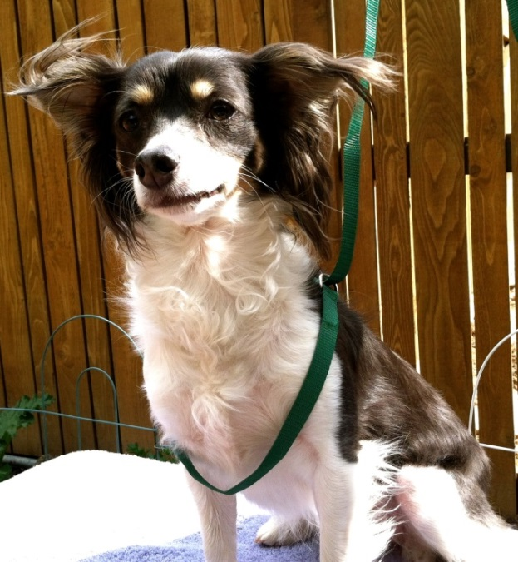
Dog Restraint Devices
Slip leashes
Only if non-aggressive
Loop around neck, slip to tighten
Do not attach leash to the collar
Do not drag dog on leash
Do not leave dog in slip leash unattended or tied to any object
Snare or catch pole (Rabies stick)
Aggressive dogs
Notes:
In some instances, dog restraint devices may be necessary to minimize injury to the animal as well as responders. When used appropriately, restraint devices will not harm the animals physically or psychologically. The use of leashes can help to control the movement of a dog. Slip leashes that loop around the dogs neck and slip to tighten are the most secure and effective. You can improvise a leash using rope, twine or other materials. Apply and use a leash only if the dog is not behaving aggressively. Try to keep the dog calm before and during the time you slip the leash over its head. Avoid attaching a leash to the collar if one is present as the collar may be lose and could fall off the dog’s neck. Never over tighten or drag a dog using a slip leash. Never leave the dog in a slip leash unattended or tied to any object. Slip leashes can be used to hold the dogs head away from the handler while the dog is grasped.
For very aggressive dogs, especially large dogs, a snare or catch pole may be needed to handle the animal in a manner that it and responders do not get hurt. Whenever possible, catch poles should only be used by experienced personnel. In some situations, 2 catch poles (one person on each side) may be needed if the dog is very large. Care must be taken when using this equipment so as not to choke the animal. Animals should never be lifted with a catch pole. [This photo shows a slip leash being applied around a dog’s neck. Photo by Katie Steneroden, Iowa State University]

Slide 12
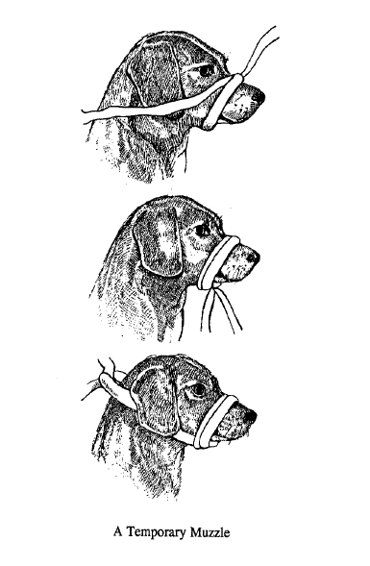
Dog Restraint Devices
Muzzles
Cloth, leather
Gauze, rope, twine
To prevent bites
Do not restrict open-mouth breathing
Especially in hot weather
Do not leave muzzled dog unattended
Should not be on for long periods of time
Notes:
It may be necessary to apply a muzzle to preventing biting while carrying or transporting the dog. Animals that have been injured may be more likely to bite. Dog muzzles can be purchased or improvised with rope, gauze or twine. The FEMA Emergency Preparedness CERT Animal Response Module recommends the following to improvise a temporary muzzle:
• Begin with a roll of 3- to 4-inch-wide gauze (doubled for strength) or a piece of rope 3 to 4 feet long.
• Have someone restrain the dog’s head as you slip a loop of the material around the dog’s nose.
• Tighten the loop around the dog’s closed mouth.
• Loop the rope downward on each side and tie it under the dog’s nose and mouth.
• Maintain tension and tie the ends of the rope around the back of the dog’s head, securing with a simple tie knot and bow.
• Muzzles should be tied securely but for easy release; the dog should be able to breathe through its nose.
• Until the dog is otherwise contained or controlled (caged, leashed), you must continue to restrain the dog’s head and front legs or it will immediately remove the muzzle.
• Note: This muzzle will not work on short-nosed dogs such as pugs.
It is important to remember to avoid placing muzzles that restrict the dog’s ability to open-mouth breathe. This is especially important in hot weather condition so the dog does not overheat. Muzzles should not be placed on the dog for extended periods of time. They should only be used for the minimal time necessary. A muzzled animal should never be left unattended.
[Illustrations from FAZD Center: Veterinary Science: Preparatory Training for the Veterinary Assistant – Handling and Restraining Dogs and Cats.]

Slide 13
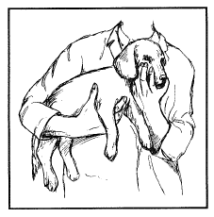
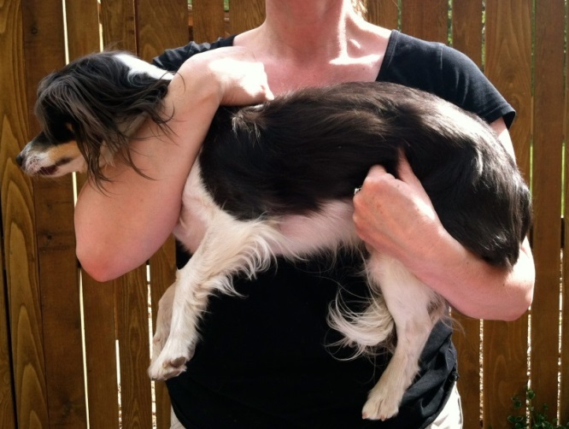
Lifting and Carrying Dogs
Support chest and hindquarters
If bite potential, muzzle prior to lifting
Small dogs
Lift under abdomen
Hand between front legs
Medium dogs
Cradle arms around chest and haunches
Large dogs
Two people
Notes:
When lifting and carrying dogs, it is important to use proper technique to avoid injury to the animal and the responder. The dog’s chest and hindquarters should always be supported. Note: If the dog’s back or hindquarters have been injured, lifting could be painful for the animal. If a dog shows any indication of fear or aggression, it should be muzzled prior to lifting. For small dogs lift under the abdomen, placing one hand between the front legs for support (see top right illustration). For medium sized dogs, cradle the animal with one arm around the chest and the other behind the haunches. For large sized dogs, lifting should be done by two persons, one controlling the head and front portion or chest area, the other person lifting the abdomen and hindquarters. When lifting large to medium sized dogs, use safe lifting technique (start from a squatting position, using your knees not your back) to avoid injury. [The top photo shows the lifting and carrying technique for small dogs. Photo source: Restraint of Domestic Animals (1991) by TF Sonsthagen. The bottom photo shows the lifting and carrying technique for a medium sized dog. Photo by by Katie Steneroden, Iowa State University]

Slide 14
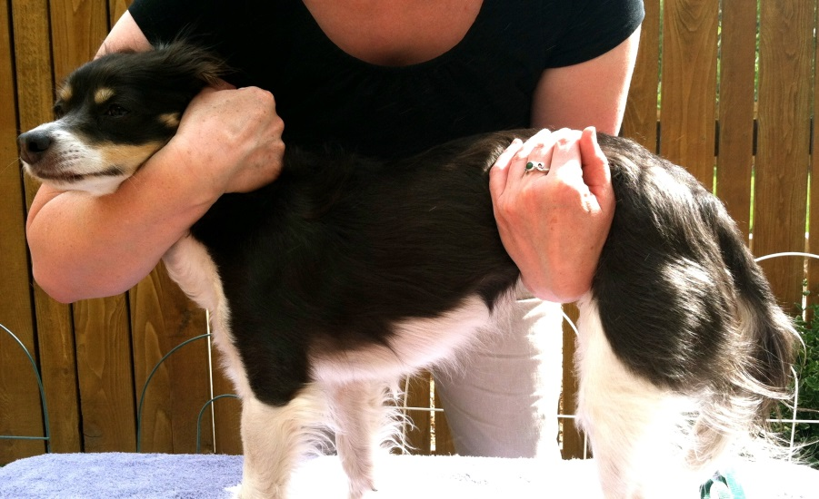
Standing Restraint for Dogs
Place one arm under the dog’s neck
Other arm behind the rear legs or under dog’s abdomen
Pull dog’s head snug against shoulder
Notes:
Manual restraint for dogs can be as simple as holding a dog’s collar or leash, or using more secure methods such as standing or lateral restraint techniques. To manually restrain a standing dog, place one arm under the dog’s neck and the other arm behind the rear legs or under the dog’s abdomen. Pull the dog’s head snug against your shoulder, without choking the animal. If the dog shows any indication of fear or aggression, it should be muzzled prior to handling. Avoid excessive restraint. With any type of physical restraint, use the least amount of restraint necessary to control the dog. Excessive restraint becomes a test of wills; the more you attempt to restrain the animal the harder it will resist, and the more unpleasant and dangerous the experience may become. [This photo shows standing restraint positioning. Photo by Katie Steneroden, Iowa State University]

Slide 15
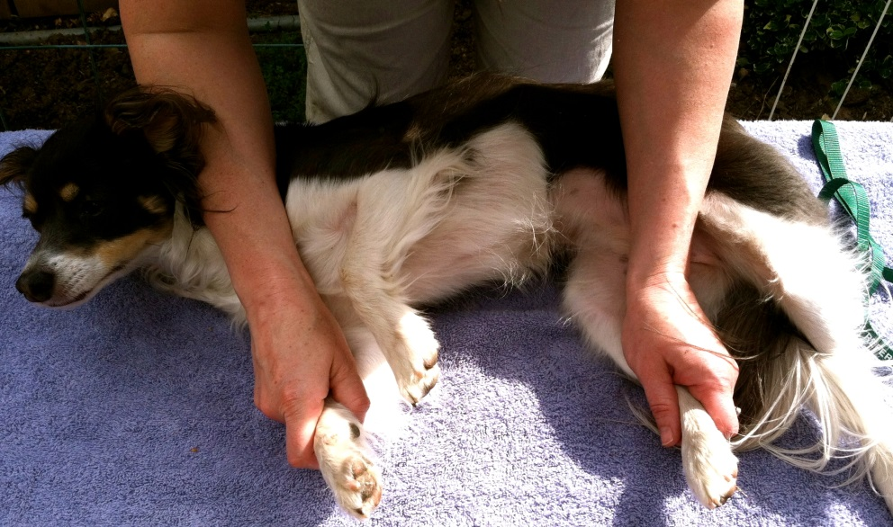
Lateral Restraint for Dogs
Gently lay dog on its side
Stand against dog’s back
Place arms across the dog’s neck and hindquarter
Grasp bottom legs
Notes:
To restrain a dog in a lateral position, lay the dog on its side. Stand against the dog’s back. Placing one arm over the shoulder/neck area, grasp the front leg closest to the table surface. Place your arm over the flank or hindquarter, again grasping the lower leg (leg against the table surface). Use the least amount of physical restraint as necessary to control the dog. If the dog shows any indication of fear or aggression, it should be muzzled prior to handling. [This photo shows the lateral restraint of a dog. Photo by Katie Steneroden, Iowa State University]

Slide 16
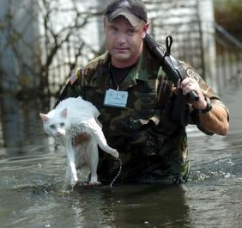
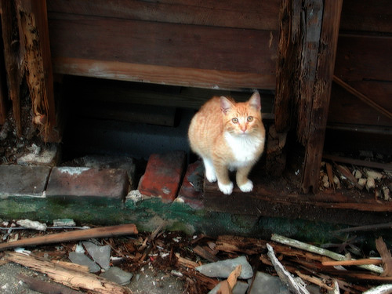
Cats
Notes:
Now let’s look at handling and restraint procedures for cats. [Photos show cats in need of rescue. Photo source: University of Missouri, College of Veterinary Medicine at http://www.cvm.missouri.edu/news/movcc07.htm]

Slide 17
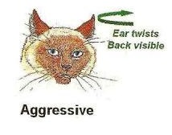
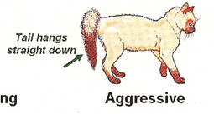
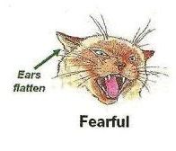
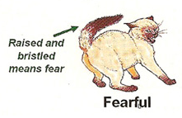
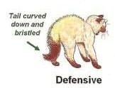
Cat Body Language
Aggressive
Rear elevated
Ears out to side
Direct eye contact
Hair raised on back
Relaxed
Calm posture, relaxed tail
Ears pointing up and out
Notes:
Just as body language gives clues about dog behavior, similar cues can be obtained for cats. Following a disaster situation, cats can be aggressive, fearful and defensive. These situations can lead to bites or scratches to responders if precautions are not taken. Cats that are aggressive, fearful or defensive will have raised fur on their back and/or tail. Their ears will be turned backward, sideways or flat against the head when irritable, angry or frightened; this is in contrast to them having their ears forward when alert and happy. The tail position can help further differentiate the cats demeanor. If the tail is hanging straight down, it indicates an aggressive mood; if the tail is down and bristled, the cat is in a defensive stance; if the tail is raised and bristled, it is fearful. A relaxed cat will have a relaxed tail with ears pointing forward. [Photos depict various cat body behaviors. Photo source: Thunder Bay Veterinary Clinic, http://www.tbvet.com/cat_body_language.php]

Slide 18
Handling Cats
Approach in crouch or sideways
Move slowly
Speak slowly and softly
Offer food
Aggressive or fearful cats
Allow cat time to calm down
Use double thick or armored gloves and eye protection
Attempt capture with nets, blankets, traps
Work with a partner
Notes:
Cats, unlike dogs, will not generally come when called and must be approached to be handled or restrained. To be perceived as less threatening to the cat, make your body appear small by crouching and approaching the cat using a sideways stance. Any actions taken should be done slowly so as not to alarm or frighten the cat. Talk in a soft, slow voice to calm the cat. Offering food or tapping a cat food can may encourage the cat to come near you. Work in teams whenever possible. For cats that are showing fear or aggression, allow the animal time to calm down. Capture methods may include the use of nets, blankets or traps. If possible, leave the capture of extremely fearful or aggressive cats to professional animal handlers, such as animal control officers. You may need to use double thickness gloves and eye protection when handling fearful or aggressive cats.

Slide 19
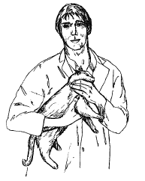
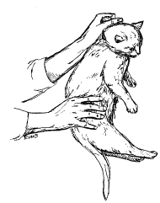
Carrying and Transporting Cats
One hand restrains the forelegs
Arm crosses flank to hold body
Other hand gently holds the head
Scruffing by loose skin at neck
Minimize noises and bright lights
Gloves or blanket can protect from bites and scratches
Transport in appropriate carrier
Lower cat hind feet first
Pillowcases can be used as carriers
Notes:
To carry or transport a cat, hold the cat close to your body with your hand restraining the forelegs from underneath. The arm crosses the flank to help trap the body against yours. Hind legs are free. Using your other hand, gently hold the head as shown in the top photograph. Be aware that cats may become frightened by unexpected stimuli such as loud noises or bright lights and can bite or scratch. Wearing heavy leather gloves or throwing a blanket over the cat can help to protect your hands and forearms from being bitten and scratched. Cats can also be grasped firmly by the loose skin behind the neck; this is called scruffing. The other hand directs the hindquarters (and claws) away for safety.
When transporting cats to additional locations, they should be placed in a carrier of appropriate size. Many cats will resist being placed head first into a carrier. Lowering the cat hind feet first into the carrier will often work well. If a carrier for the cat is not available, a pillowcase can be used to transport a cat in an emergency situation. [These illustrations show two cat carrying and restraint techniques. Photo source: Photo source: Restraint of Domestic Animals (1991) by TF Sonsthagen.]

Slide 20
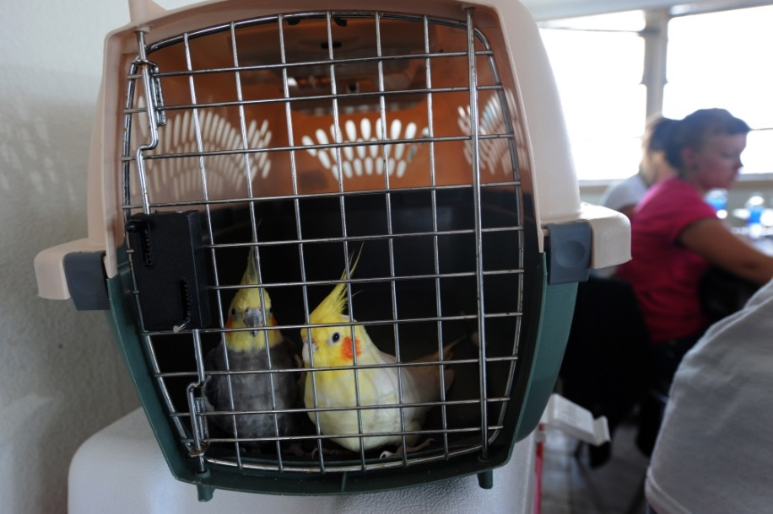
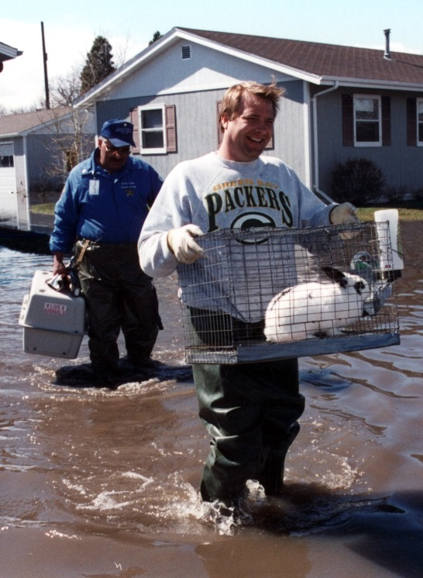
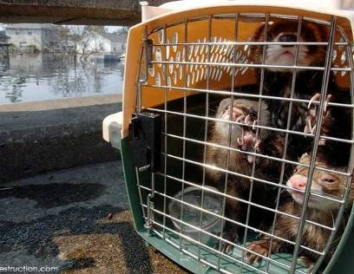
Other Species
Notes:
While dogs and cats will be the most commonly encountered companion animal during emergency situations, handling of other animals species may be required. The following are some general guidelines for handling other types of companion animals. However, whenever possible, handling of animals should be conducted by personnel experienced with a particular species.

Slide 21
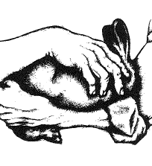
Rabbits
Grasp the scruff of the neck
Lift quickly
Always support the hindquarters
Never grab by ear or tail
Carry a rabbit with feet pointing away from your body
A light towel or blanket
Notes:
Rabbits will normally be docile. However, their claws are sharp and scratches can occur. To handle and transport rabbits, grasp the scruff of the neck and lift quickly. The back legs of rabbits must be fully supported at all times. Never grab a rabbit by its ears or tail.
When carrying a rabbit, point the feet of the rabbit away from your body to avoid injury. If the rabbit seems nervous or scared, covering the rabbit with a towel or blanket can help to calm the animal. [These illustrations show two rabbit carrying and restraint techniques. Photo source: Restraint of Domestic Animals (1991) by TF Sonsthagen.]

Slide 22
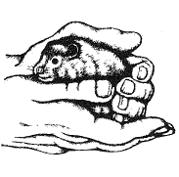
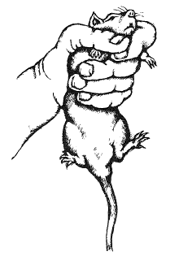
Rodents and Ferrets
Make sure awake
Hold in one hand, cup other over its head
Wrap thumb and index finger around neck and under chin
Do not over tighten fingers around chest as this can impair breathing
Notes:
Before touching or handling rodents or ferrets, make sure they are awake. These animals, when startled, will bite. Small mammals can be held in one hand, with the other hand cupped over the animal’s head and body to prevent it from escaping (top illustration). Alternatively, a hand can be placed around the chest, wrapping the thumb and index finger around the neck and under the chin. Do not over-tighten fingers around the chest as this can impair breathing. Ferrets can be scruffed like rabbits. Never grasp rodents or ferrets by their ears. [These illustrations show two rodent carrying and restraint techniques. Photo source: Restraint of Domestic Animals (1991) by TF Sonsthagen.]

Slide 23
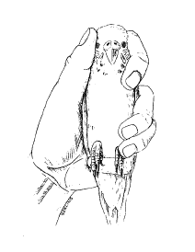
Birds
Trained personnel
Can stress easily
Do not squeeze thorax
Sensitive to overheating
Small to medium sized
Grasp from behind, finger and thumb on sides of head, others around body
Large birds require 2 hands
Towel can also be used
Notes:
If pet birds are encountered during an animal health emergency, it is best to have trained personnel handle the birds. Birds are very sensitive and can stress easily; some can die suddenly from this stress. Birds are also very sensitive to overheating. A light hand towel can be used to capture a caged bird. Once covered, the bird usually holds still so you can grasp it.
Small to medium-sized bids can be caught with one hand by approaching from the back of the bird, then quickly and firmly grasping the body, placing the index finger and thumb on either side of the head, the other fingers encircling the thorax, and the little finger encircling the legs. Be careful not to exert too much pressure on the thorax, as you may cause the bird to suffocate. Light leather gloves can be worn to protect from bites and scratches.
Large birds will require two hands. Approach from the back, with one hand grasping the back of the head, then quickly secure the wings with the other hand. Heavy leather gloves should be worn when handling these birds as they can crush fingers or inflict severe wounds with their beaks. If a bird is antagonistic, you can divert its attention with a glove or towel. While the bird is biting the object, quickly grasp the bird as previously described. [This illustration shows a bird handling and restraint technique. Photo source: Restraint of Domestic Animals (1991) by TF Sonsthagen.]

Slide 24
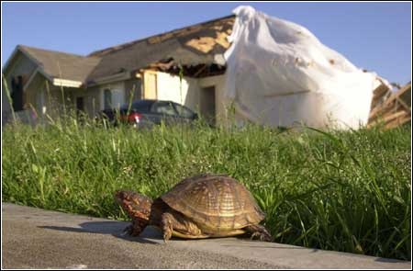
Reptiles and Amphibians
Range from small and delicate to large and dangerous
Temperature-sensitive
Different species
Different temperatures
Avoid getting too cold or too hot
Skilled professionals for handling
Notes:
Reptiles and amphibians kept as pets can range from small and delicate species (e.g., frogs) to large and dangerous species (e.g., iguanas). It is best to have personnel skilled in reptile and amphibian handling address these species. Whenever possible, these species should be carried in a sturdy container, with a lid (and air holes). Reptiles and amphibians are very temperature sensitive, so any handling or transport efforts must take environmental conditions into consideration. Reptiles and amphibians must be handled cautiously to avoid any injuries to their skin surface. Some reptiles and amphibians can bite and scratch. Gloves can be worn to avoid being bitten.

Slide 25
References and Resources
FEMA CERT Animal Response Training Modules I and II available at: http://www.fema.gov/community-emergency-response-teams/training-materials
AVMA Emergency Preparedness and Response Guide available at: https://www.avma.org/kb/resources/reference/disaster/pages/default.aspx
Restraint and Handling of Wild and Domestic Animals, 3rd Edition by M Fowler
Restraint of Domestic Animals by TF Sonsthagen

Slide 26
Acknowledgments
Development of this presentation was by the Center for Food Security and Public Health at Iowa State University through funding from the Multi-State Partnership for Security in Agriculture
Authors: Katie Steneroden, DVM, MPH, PhD, DACVPM; Glenda Dvorak, DVM, MPH, DACVPM
Notes:
Information provided in this presentation was developed by the Center for Food Security and Public Health at Iowa State University College of Veterinary Medicine, through funding from the Multi-State Partnership for Security in Agriculture.

