Slide 1
Animal Behavior and Restraint
Cattle
Notes:
During animal health emergencies involving cattle, tasks requiring the handling and restraint of the animals are likely. Having a basic understanding of cattle behavior will allow for more effective efforts thereby minimizing stress on the animals and reducing the risk of injury to responders. This Just-In-Time presentation will overview basic cattle behavior, handling and restraint measures that may be needed for animal health emergencies.

Slide 2
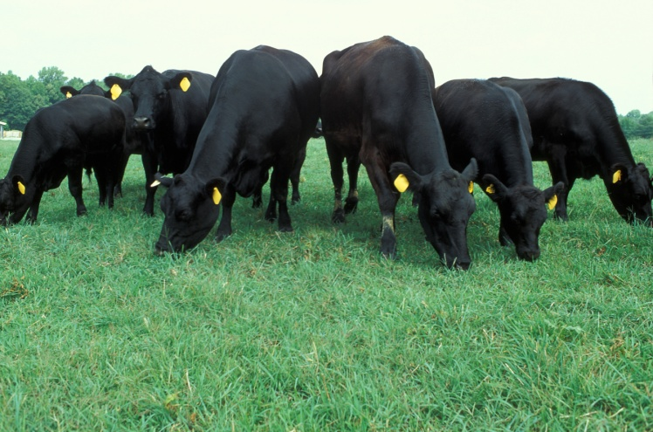
Cattle Characteristics
Prey animals
Grazers
Poor depth perception
Panoramic vision
  310-360°
  Blind side behind them
Keen hearing
Curious
Notes:
Cattle are grazers and prey animals by nature. Their senses are developed to rapidly detect changes in their environment. While they have poor depth perception, they have excellent hearing and a panoramic field of vision (meaning they can see in all directions – except behind them – without moving their head). They have a natural curiosity, but may be excited and frightened by new persons or things in their midst.

Slide 3
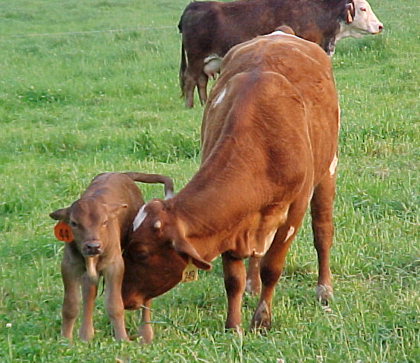
Normal Cattle Behavior
Herd animals
  Will follow the leader
  Will eventually group
  Frightened by intruders
  Anxious when isolated
Isolated animals
more dangerous
Mothers will protect
their young
  Avoid separating cow-calf pairs
Notes:
Cattle are gregarious and have a strong herd instinct. When other cattle are seen, they will seek their company. For this reason, individual animals become anxious in situations that lead to isolation from the herd. An agitated or excited lone animal can be very dangerous and may charge at people or injure itself trying to rejoin the herd. This “social” nature can be an advantage when handling cattle, if used properly. Cows with young will exhibit strong maternal instinct and can be difficult to handle if she feels her calf or calves are being threatened. Always move with caution when working with a mother and her young. Avoid separating them if possible.

Slide 4
Handling & Moving Cattle
Utilize cattle’s routine
Avoid
  Abuse
  Loud noises, yelling
  Isolating animals
  Distractions
Use slow, deliberate movements
Balking
Notes:
Cattle respond negatively to abuse, loud noises, and other confusing situations. Keep noisy equipment away from cattle. Yelling at cattle only increases the stress levels of both cattle and handler and can lead to unpredictable and damaging behavior. Cattle are creatures of habit, and an established daily routine will ease handling. Handlers’ movements should be slow and deliberate to avoid stressing or frightening the herd. If cattle still refuse to move, look for distractions that are causing them to balk, such as patches of shadows, rattling chains, flapping cloth, or other responders in the flight zone.

Slide 5
Flight Zone
Animals are handled easily if flight zone is understood
  Animal’s personal space
  Indicator of possible threat
Size of flight zone determined by
  Tameness
  Degree of excitement
Move away from things in flight zone
Notes:
Calm animals can be easily herded and moved by people who have an understanding of the principles of flight zone of cattle. The flight zone is the animal's personal space. Cattle use their flight zone as an indicator of impending threats. The flight zone can range from 5 to 25 feet for feedlot cattle and as much as 300 feet for range cattle. The size of the flight zone is determined by both the animal’s temperament and the degree of excitement and agitation. For example, dairy cattle who are handled daily will generally have a smaller flight zone as compared to range cattle who are minimally handled. When a person is outside the flight zone, the animals will turn and face the person. When the flight zone is entered, most cattle will turn around and move away. The handler should avoid deep penetration of the flight zone. Deep invasion of the flight zone may cause an animal to panic. In an attempt to escape, it may run away or turn back and possibly charge the handler.

Slide 6
Flight Zone
Notes:
This diagram shows the flight zone of a cow. Note the blind spot behind the animal (light gray), this area should be avoided. To make an animal move forward, the handler should enter the edge of the flight zone behind the “point of balance” or shoulder. It is best to work at a 45-60º angle behind the animal’s shoulder, moving back and forth parallel to the direction you would like the animal to move in. The ideal location for the handler is between positions A and B on the edge of the flight zone. Move toward B to start the movement, move to A to stop the animal’s movement. If a handler walks deep into the flight zone, cattle will have a tendency to move in a direction opposite of the handler’s movement (e.g, an animal will usually move forward if the handler moves from the head toward the rear). To make an animal move backwards, the handler must move in front of the point of balance. Handlers who understand these principles can quietly move cattle and other livestock off of roads and other dangerous places.
Graphic from Center for Food Security and Public Health, Iowa State University. Adapted from Temple Grandin

Slide 7
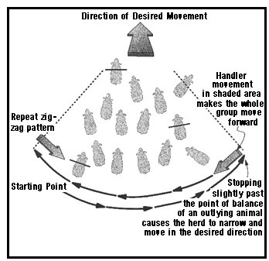
Herd Flight Zone
Same as individual
Collective flight zone
Move in slight arc, gradually tightening to obtain desired movement
Take your time
Ignore stragglers
Notes:
As with individuals, moving a herd of cattle can be done in a similar manner, but by using the “collective” flight zone. Start by getting cattle into a loose bunch by making wide back and forth movements on the edge of the herd in a straight or very slight arc (like a giant windshield wiper). The movement should not exceed a quarter circle. Take your time and ignore any stragglers – they will be attracted to the herd by herd instinct and will rejoin the group. Once the majority of animals are together, increase pressure can be made in the collective flight zone to initiate movement in the desired direction. Whether moving a herd or individuals, the basic principle is to alternately penetrate and withdraw from the flight zone to get the desired movement. Animal movement should occur at a slow but steady pace. Running indicates panic and will lead to unpredictability in the animal’s behavior.[Graphic from “Low Stress Methods for Moving and Herding Cattle on Pastures, Paddocks, and Large Feedlot Pens http://www.grandin.com/B.Williams.html]

Slide 8
Capture & Containment
Dairy cattle
  Used to humans
  Easily penned
Beef cattle
  Feeding practices aid in containment
Range cattle
  Horses should be used in corralling
Notes:
Additional methods for capture and containment can be used depending on the type of cattle being handled. Dairy cattle are used to caretakers and are somewhat socialized to humans, this generally makes them easy to pen. Beef cattle are commonly fed hay and grain in or around a barn or corral, this method can aid in drawing animals in to pen them. Animals not routinely handled, such as range cattle, should be driven with minimal excitement to a corral. Range cattle are not easily driven and may be dangerous to persons on foot, making it desirable to have horses available.

Slide 9
Capture & Containment
Makeshift corrals can be used
  Runways and chutes can also be added
Wire fencing should be avoided
Chemical tranquilizers should be a last resort
Notes:
If a preexisting structure is not in place, a temporary corral can be built with portable gate panels. Fencing, such as barbed wire and woven wire, should be avoided because of the danger of injury to excited animals and animals unfamiliar with fences. The portable corral also lends itself to the development of runways and chutes for restraint. In cases where it is not possible to corral the animals, it may be necessary to chemically immobilize them through use of a tranquilizer gun.

Slide 10
Behavior After Handling
Cattle adjust well if given proper feed, water, and shelter
Extra caution should be taken with bulls
Social order
must be
re-established
Notes:
Once cattle have been moved to the desired location, most when given hay, water, and a space to stand or lie down, will acclimate well with their surroundings. The more antisocial animals, especially bulls, may not become content as quickly and may attempt escape. Bulls should always be approached with caution, particularly under stressful conditions. Mixing groups of cattle can add to the stress of animals, making handling more difficult. If groups of cattle are mixed, provide plenty of space to allow the groups to interact and start to develop a social order. This is particularly true with bulls.

Slide 11
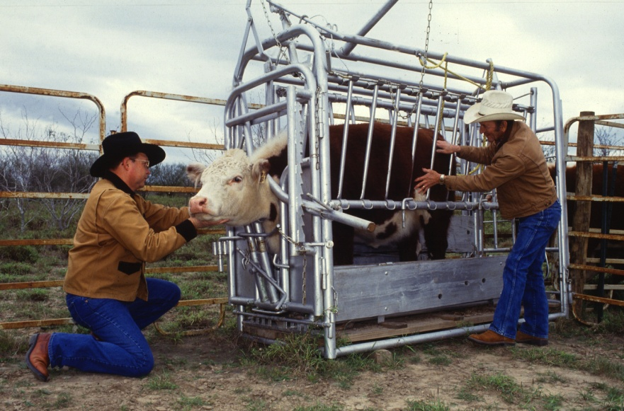
Restraint
Squeeze chute
  Portable cattle chutes with head restraint are most desirable
  Head can be restrained with halter
Lariat and halter
Chemical sedation
Notes:
One of the most common methods of restraint for cattle is the squeeze chute. To avoid injury, responders need to be aware of the positioning of handles that open and close the head gates, sides and tail gates as well as pinch points in the chute. When an animal is being held in a squeeze chute, the handler should stand outside the flight zone as much as possible. If the head needs to be restrained, a halter may be use and is preferred to nose tongs. [Nose tongs require substantial skill and much practice to be utilized effectively]. In situations requiring maximal restraint, tranquilization or sedation may be necessary. Many protocols are available depending on the depth and length of sedation required.

Slide 12
Special Considerations
Monitor cattle in conditions of high heat and/or humidity
Winter weather requires special equipment
  Heaters
  Gritty, non-slip substances
  Antifreeze
Notes:
When possible, avoid moving cattle under hot conditions. Move cattle in early morning or late evening hours. If this is not possible monitor them frequently for signs of heat stress. During winter weather, use caution when moving animals on slick surfaces. Use a gritty, non-slip, non-toxic material if ground surfaces are icy to improve traction.

Slide 13
Safety
Avoid Injuries from Cattle
  Kicks
    Cows kick with back feet
  Crowding
  Crushing
  Can inflict injuries with head
  Don’t bite
  Will run over you if desperate
Notes:
Although cattle don’t bite, they can cause injury in several other ways. They kick with their back feet, especially if startled by someone or something in their blind spot. While they usually kick with just one foot, sometimes they can use both. Cattle are “masters of the roundhouse”, meaning they can kick with great force out to the side instead of just straight back. Cattle can also force handlers into a corner or against a wall or fence and use their weight to crush the handler. Regardless of if the animal is horned or polled, they can inflict damage with their heads. If desperate, cornered, or isolated, cattle will run over or through their handlers if there is no other way out. When working with cattle, avoid quick movements and always have an escape route planned when working in close quarters with these animals.

Slide 14
Additional Information
Recommended Basic Livestock Handling: Safety Tips for Workers
Temple Grandin, PhD
  http://www.grandin.com/behaviour/principles/principles.html
Low Stress Methods for Moving and Herding Cattle on Pastures, Paddocks, and Large Feedlot Pens, by Temple Grandin
  http://www.grandin.com/B.Williams.html
Understanding Livestock Behavior
The Ohio State University Extension
  http://nasdonline.org/static_content/documents/1704/d001709.pdf
Cattle Handling and Working Facilities.
The Ohio State University Extension
  http://ohioline.osu.edu/b906/
Cattle Handling Safety in Working Facilities.
Oklahoma Cooperative Extension Service
  http://pods.dasnr.okstate.edu/docushare/dsweb/Get/Document-4821/BAE-1738web.pdf
Notes:
For more information on the Incident Command System and its implementation for an animal health emergency response, see the FEMA and USDA NAHEMS/FAD PReP websites.

Slide 15
Acknowledgments
Development of this presentation was by the Center for Food Security and Public Health at Iowa State University through funding from the Multi-State Partnership for Security in Agriculture
Authors: Shaine Devoe; Glenda Dvorak, DVM, MPH, DACVPM
Notes:
Information provided in this presentation was developed by the Center for Food Security and Public Health at Iowa State University College of Veterinary Medicine, through funding from the Multi-State Partnership for Security in Agriculture.

