Slide 1
Surveillance
During Animal Disease Emergencies
Overview
Notes:
June 2010
During an animal disease emergency, surveillance measures will be an essential component of the response activities. This Just-In-Time presentation will overview the importance and role of surveillance activities during an animal disease emergency situation, as well as key factors and considerations during surveillance activities.

Slide 2
Surveillance
Ongoing, systematic collection, analysis, and interpretation of health-related data
Essential for planning, implementation, and evaluation
Disease prevention and control measures
Notes:
Surveillance involves the ongoing, systematic collection, analysis and interpretation of health-related data. Information gathered will be essential for the planning, implementation, and evaluation of actions necessary for disease prevention and control.

Slide 3
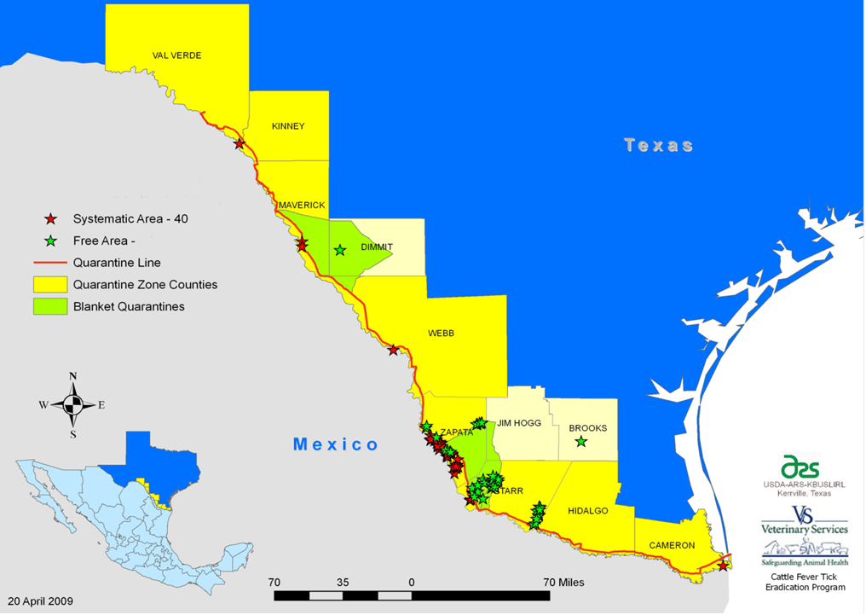
Role of Surveillance
Estimate location
and distribution
Detect infected
animals/premises
Monitor changes
Facilitate response
planning
Evaluate outbreak
control strategies
Prove location is free of the disease
Notes:
Surveillance measures needed during an animal disease emergency will be determined by the situation and the goal of the response. However, surveillance efforts will be ongoing throughout any response. Early in the response, surveillance efforts will be required to determine the extent of the outbreak so appropriate control areas can be defined. Detection of infected animals or premises provides valuable data about the magnitude and distribution of the outbreak. This information will aid in developing the response actions and control measures needed for the situation. As the response progresses, surveillance information will help to monitor for any changes in the distribution of cases and aid in evaluating the effectiveness of the outbreak control strategies. Ultimately, surveillance data will help prove a location, whether it is a premise, state, or the nation, is free of the disease so that any trade limitations or restrictions that were made during the response can be lifted. [The map shows the reported cases (stars) of cattle tick fever and quarantine zones (yellow) established in Texas in 2009 to prevent further spread of the disease and its vectors – Source: USDA-APHIS-VS-ARS http://www.aphis.usda.gov/vs/ceah/ncahs/nsu/outlook/issue23_dec09/outlook_dec09_cattle_tick_surveillance.pdf]

Slide 4
What You Will Need To Know
Target disease
  Organism
    Animal only
    Zoonotic
    Level of PPE
    Biosecurity
  Incubation period
    Trace back
    Trace forward
  Transmission route
    Trace additional cases
    How pathogen spreads
      Animals
      Fomites
      Vectors
Notes:
Before conducting any surveillance activity, it is important to know what your goal and role will be. This will include knowing what information you will need to collect based on the goals of the response and the targeted disease. First you must know what the suspected or confirmed disease you are dealing with is. This will be important for determining how easily the organism is spread, and whether or not it affect humans (i.e., zoonotic ). Answers to these questions will help determine the level of personal protective equipment and biosecurity measures needed during surveillance activities. What is the incubation period for the pathogen? This information will help when determining how far forward or backward to go when gathering information during trace forwards or trace backs. How is the pathogen spread or transmitted? This will help to identify potential sources of the microorganism as well as potential means of spread to additional locations.

Slide 5
What You Will Need To Know
Type of data needed
  Visual Inspection
  Diagnostic testing
  Survey - Review records
    Vaccination status
    Environmental exposure
    History
Notes:
You will also need to know what type of data you need to be collecting. Will you be conducting visual inspections of animals looking for signs of illness? Will you need to collect specific diagnostic samples? If so, what are the sampling requirements. Will you be conducting farm surveys to determine parameters such as vaccination status, or environmental exposure to a particular disease vector, or any recent importation history.

Slide 6
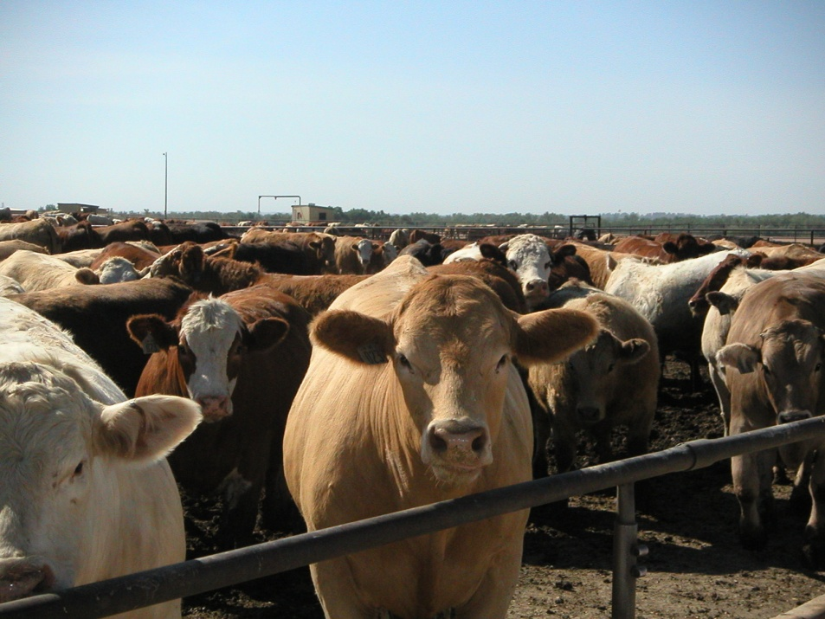
Data Collection
Sample parameters
  Susceptible animals
    Including wildlife
  Population size
  Sampling method
  Sample size
  Sampling frequency
  Sampling unit
    Individual
    Pooled samples
Notes:
If and when samples are collected, you will need to know what animals you need to collect from; this may include susceptible wildlife species. What is the sampling method? Will you be collecting blood samples, tissue samples? What is the needed sample size for a particular premises and should samples be from individual animals or are pooled samples needed? What will the sampling frequency be? Will it be daily, every other day, weekly? Much of this information will depend on the target pathogen and population size as well as the type of laboratory testing. The number of available personnel will also impact the level of and frequency of sampling that can be done. [Photo from Renee Dewell, Iowa State University]

Slide 7
Case Definition
Clinical criteria
  Clinical signs in individuals
Epidemiological criteria
  Mortality rates
  Morbidity rates
Laboratory criteria
  Screening test
  Confirmatory test
Definition should include
  Species
  Location
  Time
Notes:
An essential component of any surveillance activity is the case definition. This information establishes a set of uniform criteria used to define what information or cases will be included (or not included) in the collection. A case definition is based on clinical, epidemiological and/or laboratory parameters, such as clinical signs, morbidity and mortality rates or diagnostic test results, and should include the species to be tested, the specific geographic location, and the sampling time period based on the particular incubation period of the disease.

Slide 8
Case Classification
Negative Case
  No clinical signs
  No positive lab results
Suspect Case
  Has clinical signs
  No confirmed lab result
Presumptive Positive Case
  Has clinical signs
  Has a positive lab result
Confirmed Positive Case
  Agent has been isolated and identified
Notes:
Cases are classified depending on specific criteria which represent increasing levels of certainty of a disease or pathogen’s presence. Case classifications include negative, suspect, presumptive positive and confirmed positive. A negative case will be an animal that does not show any clinical signs consistent with the disease and has no positive laboratory results. A suspect case is an animal that has clinical signs consistent with the disease but, at that time, no confirmed laboratory result. A presumptive positive case is an animal that has clinical signs consistent with the disease and case definition in addition to a positive laboratory result and additional epidemiological indicators of infection. A confirmed positive case is an animal that has clinical signs consistent with the case definition and a positive isolation and identification of the particular pathogen.

Slide 9
Case Classification and
Case Definition Example
Highly Pathogenic Avian Influenza (HPAI)
  Suspect Case
    Bird/animal with clinical signs consistent with HPAI
  Presumptive Positive Case
    Bird/animal with clinical signs consistent with HPAI AND a positive laboratory result AND additional epidemiology indicative of HPAI
  Confirmed Positive Case
    Bird/animal that has clinical signs consistent with HPAI AND from which HPAI was isolated and identified in a USDA laboratory
Notes:
As an example, let’s look at a sample case definition for highly pathogenic avian influenza, a highly contagious viral disease of poultry. Here the definition of a suspect case includes any bird or animal with clinical signs consistent with HPAI. Note: clinical signs of the disease must be known and usually accompany a case definition. A presumptive positive case is one where the bird or animal has clinical signs, but there is also a positive laboratory result (commonly a screening type test) as well as epidemiological indication of the disease (e.g., contact with infected animal). A confirmed positive case is one in which the diagnostic laboratory has completed the confirmatory testing, which is generally isolation and identification of the pathogen.

Slide 10
Premises Classification
Infected Premises
  A presumptive positive or confirmed positive case exists
Contact Premises
  Susceptible animals exposed directly or indirectly to IP
Suspect Premises
  Susceptible animals under investigation for clinical signs compatible to case definition
At-Risk Premises
  Geographically close to infected premises
  Susceptible animals but none have clinical signs compatible with disease
Free Premises
  No contact with infected premises and no suspect case
Notes:
Based on the classification of a particular case, the premises housing the tested animals will also be classified. Premises may be classified as infected, contact, suspect, at-risk or free. These designations are important as it will determine the response activities required to contain and further control the spread of the disease (e.g., quarantine, depopulation). It can also have trade implications locally or internationally. Infected premises are those on which there is a presumptive positive or confirmed positive case (disease has been confirmed by laboratory result). A contact premises is one where susceptible animals have been exposed directly or indirectly to animals, contaminated animal products, fomites, people or aerosol from an IP. A suspect premises is a location where susceptible animals are under investigation for clinical signs compatible to the case definition. At-risk premises are those that are in close contact geographically with the infected premises but have no reported infections or clinically compatible signs of the disease. Premises outside the surveillance zone, that have had no contact with an infected premises, and have no suspect cases under investigation are classified as free premises.

Slide 11
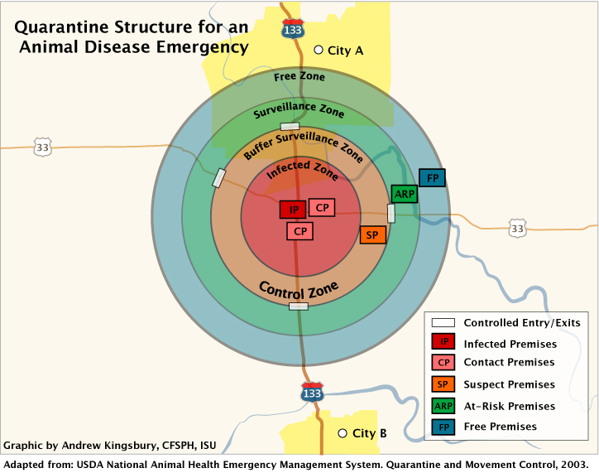
Notes:
Once a case and premises is classified, response actions will be necessary and initiated. This usually involves some level of quarantine measures, especially in cases of highly contagious or foreign animal disease. Zones are designated to define infected areas (which will typically be quarantined) or those areas in need of additional surveillance or assessment. This graphic shows a sample quarantine structure for an animal disease emergency. The infected premises is designated by the IP in the red box. Those farms or locations close to the infected premises are called Contact Premises (CP); two are shown in the pink boxes. The area around an infected and suspected premises is called the Infected Zone. Outside this zone is an area where surveillance efforts may detect additional suspect, contact or at-risk premises through tracing investigations. Farms with no indication of the disease that have had no contact with an infected premises, may be considered a free premises within the free zone. During a response, the Infected Zone and the Buffer-Surveillance Zone are jointly called the Control Zone. The boundaries of these zones may be modified as the outbreak progresses or draws to an end.

Slide 12
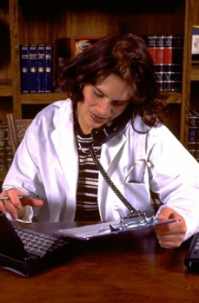
Contact Tracing
Trace-backs
  Tracing origin of animals brought onto infected premises
Trace-forwards
  Tracing locations of animals that have left infected premises and might be infected
Notes:
Once suspected or positive cases are identified, efforts to trace additional cases must then be taken. The goal of tracing is to identify all possible contact premises in a timely manner after identifying infected premises. Epidemiological tracebacks involve finding and following the origins of animals brought onto the infected premises before the disease was noticed. These may be the source of infection. Their origin must be identified, together with any other locations that they may have infected during transit. Traceforwards involve the efforts to find and follow any animals that have left infected premises during the critical period (which is defined by the disease of concern) when they may have been in contact with infected animals. These animals may be spreading the disease to new areas so that the premises to which they have gone must be identified and investigated.

Slide 13
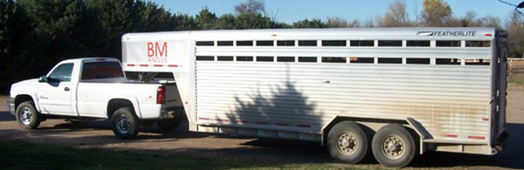
Contact Tracing
Complete contact tracing will include
  Animals
  Vehicles
  People
  Food products
  Animal products
Take into account modes of transmission
Notes:
Complete contact tracing will involve assessment of anything that could potentially spread the pathogen. This not only includes the infected or susceptible animals, but also any vehicles used to transport or that have had contact with the animals or premises. The movement of people on and off the farm must be accounted for, as should any transport or distribution of food or animal products.

Slide 14
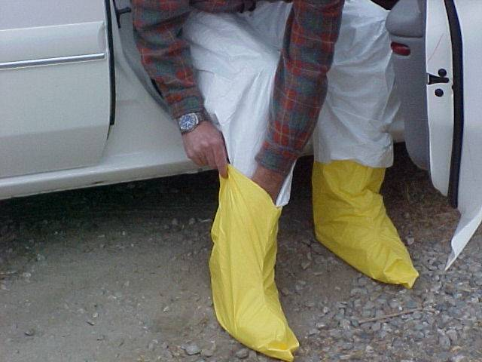
Biosecurity and Safety
Biosecurity:
  Prevent spread
Safety
  Zoonotic disease
Personal Protective
Equipment
  Coveralls, boots, gloves
  Zoonoses: masks or respirators
  Sample collection: goggles or face shield
Disinfection
Notes:
Surveillance efforts will require entry onto premises of unknown disease status. For this reason biosecurity and safety measures are warranted to prevent the spread of pathogens or potential exposure in the case of zoonotic diseases. Personal protective equipment (PPE) should include coveralls and boots that can be either disinfected or disposed of. If animals, tissues or fluids will be handled gloves must also be worn. If the disease of concern is zoonotic, enhanced PPE may include goggles and an appropriate respirator (e.g., N-95). All equipment used on the farm, including PPE, must be properly cleaned and disinfected prior to leaving the farm.

Slide 15
Public Interaction
Access to private premises
  Owners may react differently
Guidelines
  Travel in teams
  Cell phones are necessary
  Introduce yourself and purpose
  Avoid confrontation
  Leave if safety concerns exist
Notes:
Surveillance activities will involve interactions with the public, primarily producers, but also local veterinary practitioners and possibly the press. Good communication will be essential. Farm owners may react to teams requesting entry onto their property in many different ways, depending on the nature of the incident (e.g., natural disaster, highly contagious disease outbreak) and the work to be performed (e.g., examination and testing of animals, depopulation).
When interacting with owners, use the following guidelines:
Always travel in teams. No one should be in the field alone.
All field teams must have a cell phone and phone number list.
Upon arrival at the farm, approach the residence and knock on the door (or ring the doorbell).
Introduce yourself as a member of the response team and explain the reason for being at the premises.
Avoid any confrontations. If the individual become threatening or confrontational, leave the premises immediately and contact your supervisor. Personal safety is always the first priority.

Slide 16
References
USDA Resources for Conducting Animal Health Surveillance
  Surveillance and Data Standards
  Guidelines for Developing Animal Health Surveillance Plans
  http://www.aphis.usda.gov/vs/nahss/resources.htm
Animal Disease Surveillance Survey Systems, MD Salman Editor. 2003. Blackwell Publishing, Ames
Notes:
For additional information on surveillance activities and methods, see the USDA website.

Slide 17
Acknowledgments
Development of this presentation was by the Center for Food Security and Public Health at Iowa State University through funding from the Multi-State Partnership for Security in Agriculture
Authors: Sarah Viera, MPH, Glenda Dvorak, DVM, MPH, DACVPM
Notes:
Information provided in this presentation was developed by the Center for Food Security and Public Health at Iowa State University College of Veterinary Medicine, through funding from the Multi-State Partnership for Security in Agriculture.

