Slide 1
Diagnostic Sampling
Collection, Packaging, Shipping
Overview
Notes:
October 2010
During an animal disease emergency, diagnostic sampling will be needed to determine the disease as well as identify infected animals. This Just-In-Time training presentation will overview basic points to be aware of when collecting and packaging diagnostic samples and shipping requirements.

Slide 2
Sample Collection
Notes:
The diagnostic sample type and collection method needed for an animal disease emergency will depend on the disease of concern, the species of animal(s) involved and the diagnostic tests to be performed.

Slide 3
Before You Begin
Test specifications from laboratory
  Samples needed, any special media
  Temperature
Gather all supplies
  Pre-label specimen containers
Gather PPE
  Coveralls, footwear, gloves
  Respirators, face shields
Notes:
Regardless of the diagnostic sample to be collected, a few steps should be followed before you begin any sampling procedure. First, check with the diagnostic laboratory (or your Team Leader) to determine the appropriate samples to collect as well as how they should be handled, including any selective or transport media, or temperature requirements. Gather the necessary supplies you will need for sample collection as well as any personal protective equipment (PPE) needed. In the event of a highly contagious or foreign animal disease, strict biosecurity measures will be essential, and will therefore require PPE such as gloves, coveralls and footwear that can be disinfected or disposed of following the sample collection process. In the case of zoonotic disease, additional PPE such as respirators or face shields may be needed.

Slide 4

Labeling
Pencil, waterproof ink
  Clear, legible
Ability to trace sample
  Animal, group, or premise identification
  Sample type
    Swab location
    Tissue or organ
  Date
Notes:
If possible, pre-label specimen containers to ensure all required samples are collected. All samples must be labeled clearly and legibly with pencil or waterproof ink. The label should contain sufficient information to allow trace-back of the sample to the premises and individual animal or pen from which the sample was taken. When a variety of sample types are taken, such as swabs from multiple locations, or tissue samples from more than one organ, the label should clearly identify the origin of the sample. The date the sample was taken should also be included on the label. A sheet may be included with a group of samples from a single premises to aid in matching the sample with the animal, pen, or group number, and to add additional information such as sex or age of the animal. [Photo from Jane Galyon, Iowa State University]

Slide 5
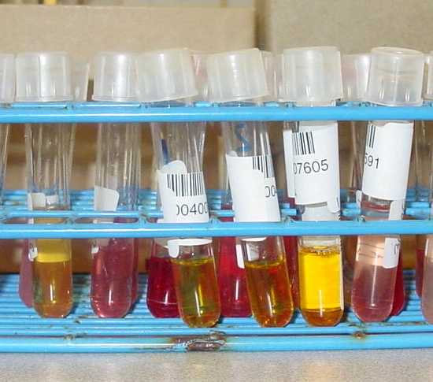
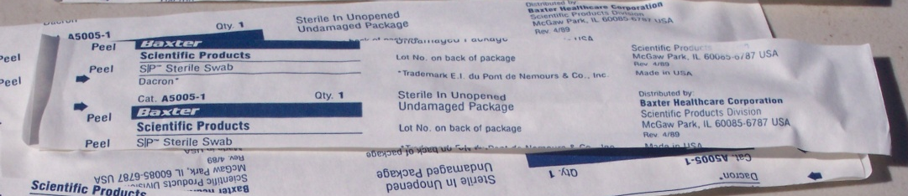
Sample Types
Whole blood or serum
  Blood tube type
Swabs
  Culture
  PCR
Skin samples
Tissues
  Formalin
  Refrigerated
Notes:
Samples to collect may include whole blood or serum, culture swabs, skin samples, or tissue samples.
If whole blood or serum samples are required, ensure the correct blood collection tube is used. Blood tubes contain different types of additives which can affect the diagnostic tests. Most blood tubes can be distinguished by the color of the tube top.
Swabs of the mouth, nose, or rectum may be requested for some diseases. Individually packaged swabs with culture media or sterile swabs with or without preservative may be provided for diagnostics. With either type, be sure to avoid touching the swab tip to anything other than the sample area being swabbed, and place the swab back into the sterile vial immediately after collection.
Skin samples (e.g., skin scrapings, ear punches, or ear notches) may be needed, and should be packaged as instructed.
Lastly, tissues samples collected during necropsy may be requested. These samples may need to be submitted in a preservative such as formalin, refrigerated, frozen or a combination of methods. [Photos: Top-serum samples, Danelle Bickett-Weddle, Iowa State University; Bottom-tissue sample collection, Tim Smith, Iowa Department of Agriculture and Land Stewardship]

Slide 6
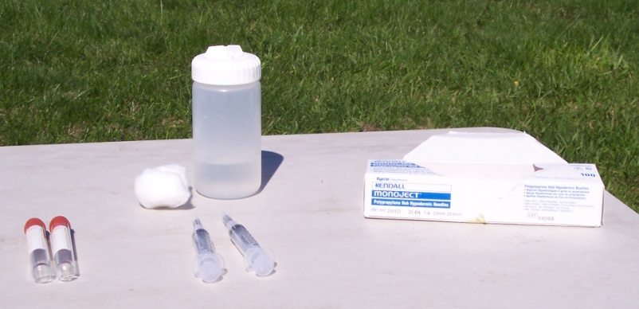
Sample Collection & Handling
From individual animals, not groups
Prevent sample degradation
  Selective or transport media
  Ice packs or dry ice
  Formalin
    At least 1:10
    ratio of
    sample:formalin
Notes:
Each sample should come from an individual animal, not a pool of animals, unless specified by the receiving diagnostic laboratory. Samples must be collected and handled in a manner to prevent degradation and maintain the integrity of the sample. This may involve placing the sample in selective or transport media or keeping it chilled. Samples preserved with formalin must be in a sample jar that contains at least 10 parts liquid to one part tissue. [Photo Jane Galyon, Iowa State University]

Slide 7
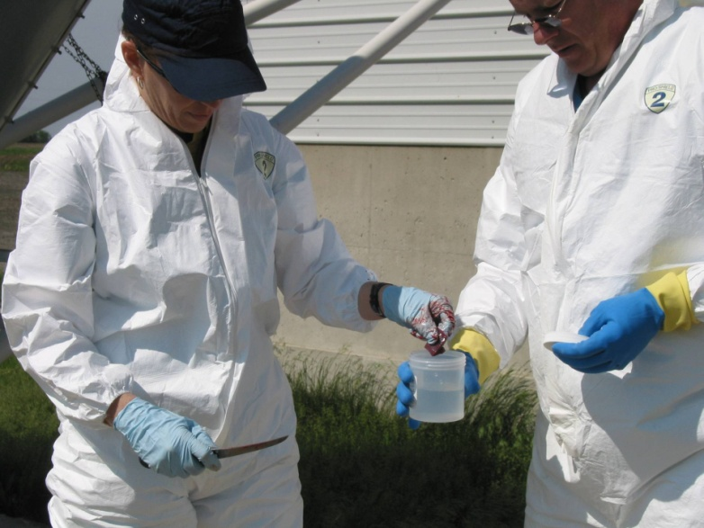
Sample Collection & Handling
Prevent contamination
  PPE
    Disposable gloves
  Disposable equipment
    Needles, syringes, blades
  Biosecurity
    Disinfection
Notes:
Handling of tissues and fluids from a suspected premises or animal will require strict adherence to biosecurity and infection control procedures. Wear disposable gloves and change them frequently. Use disposable equipment, such as needles, syringes, and blades, whenever possible, and change equipment between each animal. These practices serve not only to prevent sample contamination, but to prevent the accidental spread of disease between animals. When non-disposable equipment must be used, such as necropsy tools or surgical instruments, clean and disinfect equipment between each tissue and each animal. All equipment used to collect and transport samples while on the premises should be cleaned and disinfected in the designated area prior to leaving the farm. Care should be taken not to contaminate diagnostic samples with disinfectant, thereby inactivating it and providing false negative results.

Slide 8
Sample Packaging
Notes:
After diagnostic samples are collected, they must be prepared for shipment to the appropriate diagnostic laboratory. The necessary sample packaging will be dependent on the agent suspected and the type of sample being sent. We will review basic points to remember when packaging samples, however additional measures may be required depending on the situation.

Slide 9
Prior to Shipping
Samples must be packaged to withstand:
  Shocks and vibrations
  Pressure changes
  Other conditions encountered during transport
    Weather
    Temperature
    Rough handling
Notes:
It is essential to assess and ensure that packages will be able to withstand, shocks and vibrations during shipping, pressure changes, and other conditions encountered during transport, such as weather, temperature, and rough handling.

Slide 10
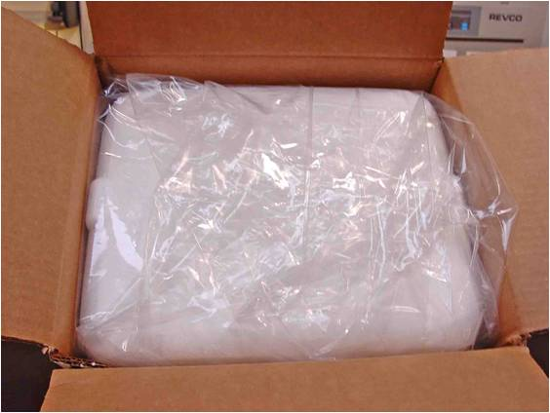
Packaging Basics
Prevent breakage
  Pad and protect from rough handling
Prevent spills/leaks
  Double waterproof barriers
  Absorbent material
Temperature
Labeling
  Potentially hazardous materials
Notes:
Therefore, when packaging the diagnostic samples, it is important to do this in a manner that will prevent breakage as well as spills and leaks, maintain the appropriate temperature requirements and have the necessary shipping labeling. Fragile primary sample packaging (e.g., tubes, slides, vials) must be wrapped and separated to prevent breakage. In the event the sample does break during shipment, care must be taken to prevent samples from spilling or leaking outside the container. This is accomplished by the use of two waterproof layers, with absorbent material such as paper towel between them. Preventing spills or leaks is particularly important given the potential infectious nature of some samples during an animal disease emergency. In order to be of diagnostic value, samples must also be protected from extreme heat or cold, and some samples require refrigeration or freezing. Finally, the package must be labeled appropriately to alert shippers to the nature of the contents, and to provide contact information for the diagnostic laboratory.

Slide 11
Preventing Breakage and Spills
Plastic versus glass containers
Pad primary sample container(s)
Primary watertight barrier
Absorbent material
Secondary watertight material
Rigid outer material (box)
Do not pack formalin in same box with non-formalin samples
Notes:
When possible, use plastic screwcap containers and avoid glass containers. In order to prevent breakage and spilling of samples during shipment, it is important to pad them well and include spill barriers and absorbent materials in the packaging. Primary sample containers, such as blood tubes, should be well padded with material such as bubble wrap, particularly if multiple containers will be shipped together. This should be placed within a primary waterproof barrier, such as a canister or plastic bag, which contains material such as paper towel sufficient to absorb the sample should it spill. This should be placed within a second watertight barrier, and finally into a rigid outer shipping container, such as a cardboard box. Formalin-fixed samples should not be packaged in the same box as non-formalin-fixed samples.

Slide 12
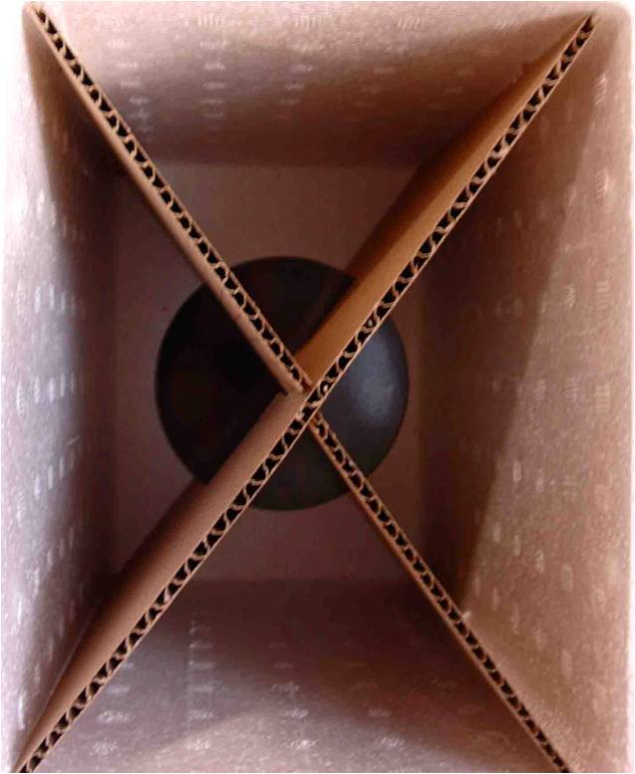
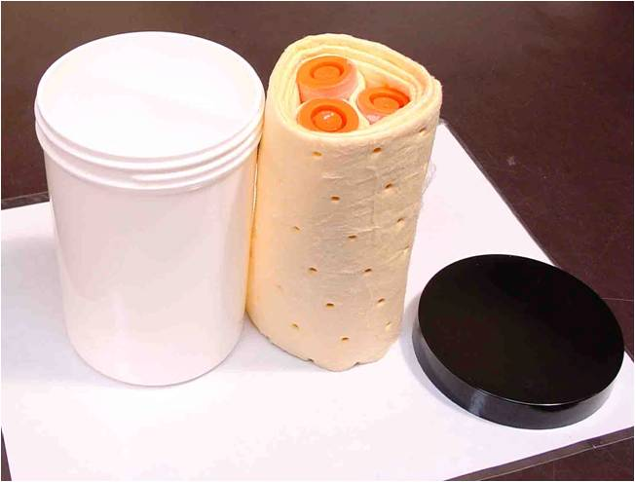
Packaging
Notes:
The left photo shows several sample tubes packed in absorbent padding material to prevent breakage and spillage during shipment. These will then be placed in the white plastic container on the left for leak prevention. The right photo shows a shipping box with dividers to keep samples secure during shipping. Photos courtesy of Dr. Dennis Senne, U.S. Department of Agriculture.

Slide 13
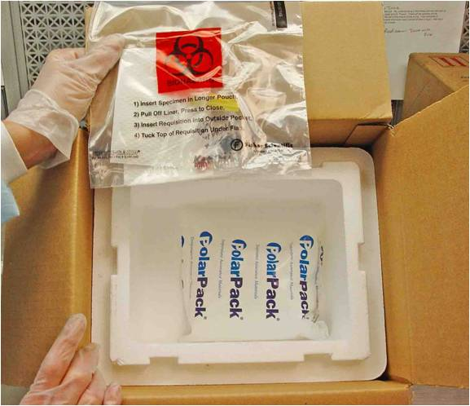
Temperature Requirements
Whole blood: on ice
Serum: ice or dry ice
Swabs
  Culture: ice
  PCR: ambient
Tissue samples
  Fresh: ice or dry ice
  Formalin fixed: ambient
Maintain the cold chain
Notes:
In order for samples to arrive at their destination with diagnostic value, they must be maintained within the temperature range appropriate for the sample type. Samples shipped on ice should have a layer such as bubble wrap between the sample and the ice packs to prevent freezing of the sample. Follow any requirements specified by the diagnostic laboratory. Swabs for PCR and tissues preserved in formalin can be shipped at ambient temperatures unless stated otherwise, but should still be protected from excessively hot or cold conditions.
For samples that require shipment on ice or dry ice, it is crucial to maintain the necessary temperature (referred to as the “cold chain” ) from the time of collection until arrival at the diagnostic lab, otherwise, such samples may lose their diagnostic value. [This photo shows a sample for submission in a sealed plastic bag to prevent leakage. An cold pack has been placed with the sample to keep it chilled during shipment. Photo courtesy of Dr. Dennis Senne, U.S. Department of Agriculture. ]

Slide 14
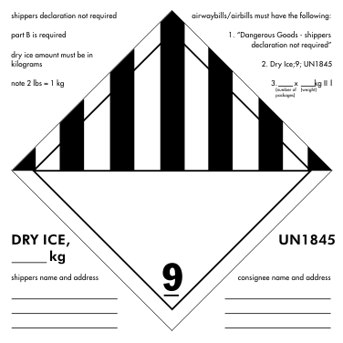
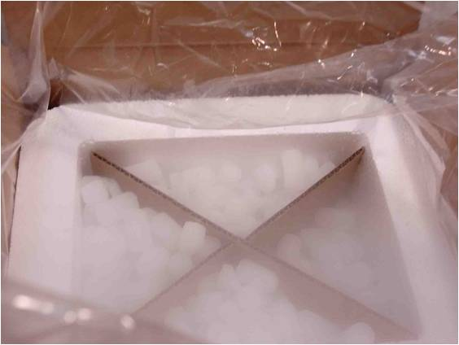
Ice, Dry Ice, and Formalin
Ice
  Arrival within 24 hours
  Ice packs only
  Protect samples from
  direct contact
Dry ice
  “Dry ice” label on box
  Category A shipments
Submission form in
separate plastic bag
Notes:
When packaging samples that require ice for shipment, use only ice packs, picnic packs, or sealed ice containers. Never ship with cubed or crushed ice, even if it is sealed in a plastic bag. Samples should be protected from direct contact with ice packs, to avoid being damaged by freezing temperatures. Samples shipped on ice should arrive at the diagnostic lab within 24 hours. Packages shipped with dry ice are considered dangerous goods, and may not be accepted by some carriers. It is essential to take measures to prevent leakage during shipment. Line the box with a plastic bag in which to further enclose the sample contents A “dry ice” label must be affixed to the outside of the shipping container, and such shipments are considered Category A shipments, which will be explained later. Dry ice may inactivate some viral samples, so be sure to seal sample vials or tubes tightly if shipping with dry ice. The sample submission form should be sealed in a separate plastic bag, and non-formalin samples should be shipped in a separate box. [Photo shows sample Class 9 label including UN1845 dry ice shipment label]

Slide 15
Sample Shipping
Notes:
Samples collected during an animal disease emergency will need to be sent to the USDA National Veterinary Services Laboratory for diagnostics. Special shipping requirements exist for infectious disease samples. The packaging and labeling of biological substances for shipment requires familiarity and training with current rules and regulations, which frequently change. Shippers are responsible for proper packaging, marking, labeling, documentation, classification, and identification of each shipment.

Slide 16
Diagnostic Sample Shipping
DOT hazardous material definition:
  Any material that is capable of causing risk to health, safety, and property during transportation
Includes infectious substances
Regulated by DOT Hazardous Materials Regulations (HMR)
  Section 49 Code of Federal Regulations
Notes:
The transport of biological materials is regulated by the Department of Transportation Hazardous Materials Regulation (Section 49 of the Code of Federal Regulations). These regulations impact the packaging and labeling parameters of the sample(s) being shipped to a diagnostic laboratory. The Department of Transportation defines a hazardous material as any material that is capable of causing risk to health, safety, and property during transportation. This definition includes infectious substances and animal diagnostic samples.

Slide 17
Sample Shipping
Shipping category
  Category A: Infectious substances,
    Affecting animals only: UN 2900
      African swine fever virus, Foot and mouth disease virus
    Affecting humans: UN 2814
      Bacillus anthracis, Brucella melitensis
    Declaration of dangerous goods
  Category B: Biological Material
    UN 3373
Notes:
Samples collected during an animal disease emergency are considered infectious substances, as they are know to contain (or reasonably expected to contain) pathogens. The United Nations (UN) and the United States Department of Transportation (DOT) specify how these potentially biohazardous materials should be classified and labeled for shipment. Category A Infectious substances are those considered capable of causing permanent disability, life-threatening or fatal disease in humans or animals when exposure to them occurs. Category A substances are further divided into those that affect animals only, which must be labeled with the code UN2900, and those that can affect humans, which should be labeled UN2814. Pathogens of concern in an animal health emergency can be of either type. Category A infectious substances require specially rated triple packing measures and must include a “declaration of dangerous goods” form on the outside of the box. Category B materials are those not in a form that can cause permanent disability or life-threatening disease in otherwise healthy humans or animals on exposure. Category B materials include specimens for general diagnostic or investigational purposes, must have leak-proof triple packaging, and should be labeled on the outside of the box with the code UN3373. These designations impact the packaging, labeling and shipping parameters of the sample which must comply with federal regulations.

Slide 18
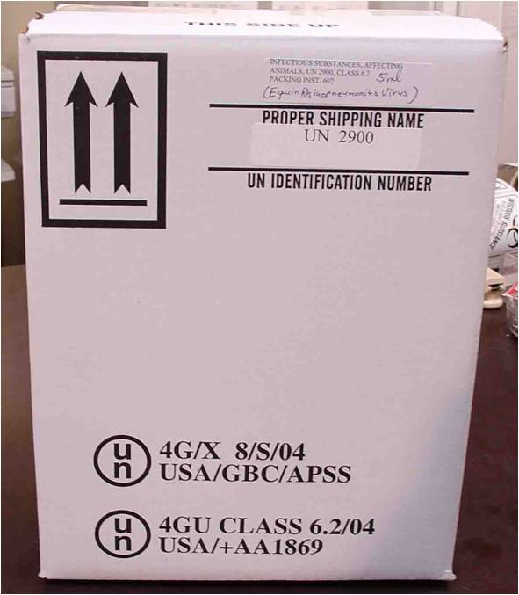
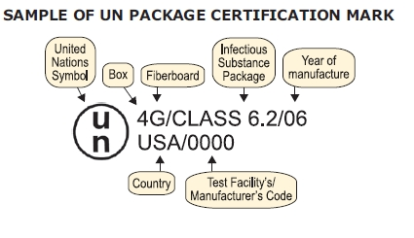
UN Package Certification Mark
Notes:
Photos show UN package certification markings required for shipping all infectious substances [CLASS 6.2]. The UN identification number (upper right hand corner of right photo) is required to properly identify the type of sample included in the box. This box is labeled UN2900, containing a Category A, infectious substance, animal only).

Slide 19
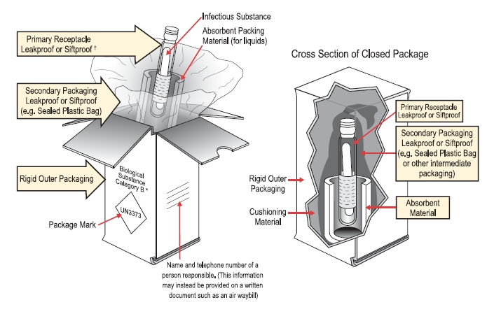
Packaging:
Category B Infectious Substances
Notes:
Place solid or liquid specimen in leak-proof primary container. Label content.
Place primary containers inside flexible secondary container (e.g., sealable plastic bag). Place absorbing material inside of the secondary container.
Place secondary container in approved insulated waterproof flexible or rigid shipping container. Place ice packs inside shipping container.
Place case history and submission forms in sealed plastic envelope inside of shipping container. Seal shipping container. Ensure appropriate package marks on the shipping container. Ship.

Slide 20
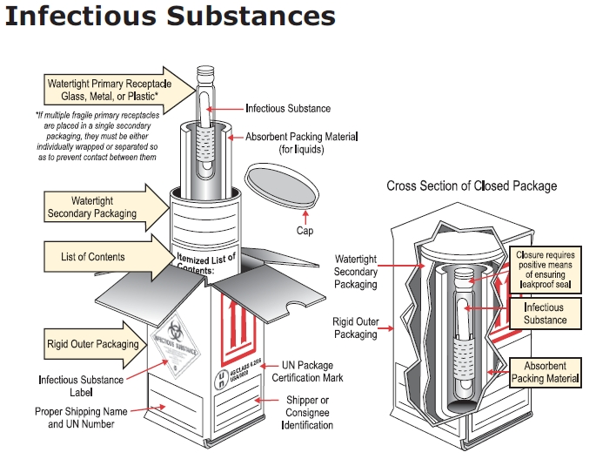
Packaging:
Category A Infectious Substances
Notes:
Packaging for Category A Infectious Substances will require additional precautions and labeling, including an itemized list of contents inside the package, and an infectious substance label and proper UN number on the outside of the shipping package. Where primary and secondary packaging for Category B includes leak proof receptacles, Category A requires watertight packaging.

Slide 21
Quantity Limitations
 | Passenger aircraft/rail | Cargo aircraft
Category A Infectious substances, affecting humans (UN 2814) or animals (UN 2900) | 50 ml or 50 g | 4 L or 4 kg
Category B | 4 L or 4 kg | 4 L or 4 kg
Notes:
The Category designation also determines the quantity of sample that can be shipped with a single container. This will also be dependent on the mode of transportation. Materials that are infectious to humans (UN2814) or animals (UN2900) cannot exceed 50mL or 50mg when being shipped via passenger aircraft or rail. However, up to 4L or 4kg can be shipped on a cargo aircraft. For Category B biological substances (UN3373), up to 4L or 4kg of biological substances can be shipped in passenger and cargo aircraft and by rail.

Slide 22
USDA-APHIS NVSL
NVSL-Ames
USDA-APHIS-NVSL
1920 Dayton Avenue
Ames, IA 50010
515-337-7266
NVSL-FADDL-NY
Plum Island
USDA-APHIS-FADDL
40550 Route 25
Orient, NY 11957
631-323-3256
www.aphis.usda.gov/animal_health_lab_info_services/
National Animal Health Laboratory Network (NAHLN) and USDA-APHIS approved laboratories http://www.aphis.usda.gov/animal_health/nahln/labs.shtml
Notes:
When shipping to federal laboratories, the type of agent will determine where the samples are to be sent to. The addresses to both Plum Island and NVSL are listed. The specific routing instructions for a foreign animal disease diagnostic samples to NVSL, including which lab submissions should go to, can be found on the USDA APHIS website (www.aphis.usda.gov/animal_health_lab_info_services/collection_submission.shtml). Testing for some high consequence diseases may be allowed at select APHIS-approved laboratories in the National Animal Health Laboratory Network (NAHLN). A current roster of NAHLN laboratories and the testing that they are approved to perform can also be found on the USDA APHIS website (www.aphis.usda.gov/animal_health/nahln/labs.shtml).

Slide 23
USDA-APHIS NVSL
Diagnostic Sample Prioritization
Priority 1: High Suspicion
  Highly likely a FAD or EDI
  Call before submitting
Priority 2: Intermediate Suspicion
  Possible
Priority 3: Low Suspicion
  Unlikely
Priority A:Animals in commerce being held pending results
  Call before submitting
Notes:
Samples being sent to the USDA National Veterinary Services Laboratories will require a diagnostic sample prioritization for processing, based on the disease suspected. Priority 1 is used when prompt laboratory diagnostic information is required and the sample is highly likely a foreign animal disease or emerging disease incident specimen. Once received these samples will be unpacked and examined immediately upon arrival. The NVSL must be contacted by phone prior to shipping Priority 1 submissions. Priority 2 samples are of intermediate suspicion and obtained from situations where a FAD/EDI is possible; samples will be processed the day they are received. Priority 3 samples are those that are unlikely to be a FAD/EDI and cannot be distinguished from an enzootic disease or condition. These samples will be processed in accession number order, unless otherwise directed by the Laboratory Director. Priority A designation involves situations where animals in commerce are being held pending the results of the diagnostic tests for an FAD/EDI or other situations where rapid laboratory tests are needed. These submissions will be processed immediately upon arrival and require contact with NVSL before submission.

Slide 24
Carriers
Not all carriers will ship biological materials
  Carriers must have security plan when shipping certain agents
    Subpart I of Part 172 of the HMR
  Chose carrier that allows tracking
  Ensure proper equipment/vehicles
Prompt and reliable delivery is key
  Security
  Sample viability
Notes:
When choosing a carrier to ship biologic substances, there are a few important aspects to consider. First, choose a carrier that will transport potential hazardous infectious substances. In accordance with the Department of Transportations, Hazardous Materials Regulations (Subpart I of Part 172), carriers must have security plans when shipping certain agents. Some carriers may not have extensive experience with transporting potential dangerous biological samples so a full assessment of safety features is needed. Next, choose a carrier that allows tracking so that progress and location can be monitored. Prompt and reliable delivery is key for reasons of security and sample viability.

Slide 25
Resources
USDA-APHIS
  USDA-APHIS National Veterinary Services Laboratories
    http://www.aphis.usda.gov/animal_health/lab_info_services/
  USDA-APHIS VS Memorandum No. 580.4: Procedures for the Investigation of Potential Foreign Animal Disease/Emerging Disease Incidents(FAD/EDI)
    http://www.aphis.usda.gov/animal_health/lab_info_services/downloads/VS_Memo580_4.pdf
Department of Transportation
  49 CFR 172: Pipeline and Hazardous Materials Safety Administration, Department of Transportation – Hazardous Materials Regulations.
    http://ecfr.gpoaccess.gov/cgi/t/text/text-idx?c=ecfr&tpl=/ecfrbrowse/Title49/49cfr172_main_02.tpl
  Transporting Infectious Substances Safely
    http://www.phmsa.dot.gov/staticfiles/PHMSA/DownloadableFiles/Files/Transporting_Infectious_Substances_brochure.pdf
Notes:
This presentation provided a brief overview of sample collection, packaging and shipping information. Additional details on this topic can be found on the USDA APHIS National Veterinary Services Laboratories and the Department of Transportation Hazardous Materials Regulations websites.

Slide 26
Acknowledgments
Development of this presentation was by the Center for Food Security and Public Health at Iowa State University through funding from the Multi-State Partnership for Security in Agriculture
Authors: Amber Stumbaugh, MS; Dan Taylor, DVM, MPH
Reviewers: Glenda Dvorak, DVM, MPH, DACVPM
Notes:
Information provided in this presentation was developed by the Center for Food Security and Public Health at Iowa State University College of Veterinary Medicine, through funding from the Multi-State Partnership for Security in Agriculture.

