Slide 1
Cleaning and Disinfection
Vehicles
Notes:
June 2011
Cleaning and disinfection (C&D) procedures are a crucial part of any animal health emergency response. The cleaning and disinfection of vehicles used during an animal health response will be necessary to prevent the spread of pathogens to other animals or locations. This Just-In-Time training presentation will discuss the steps needed to conduct C&D on vehicles used during an animal disease emergency response.

Slide 2
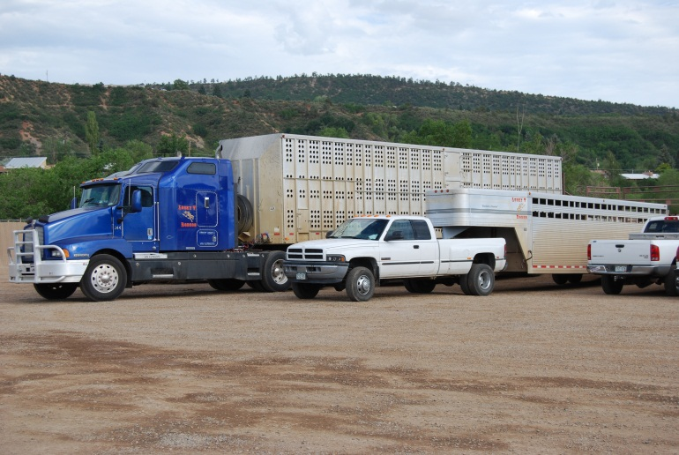
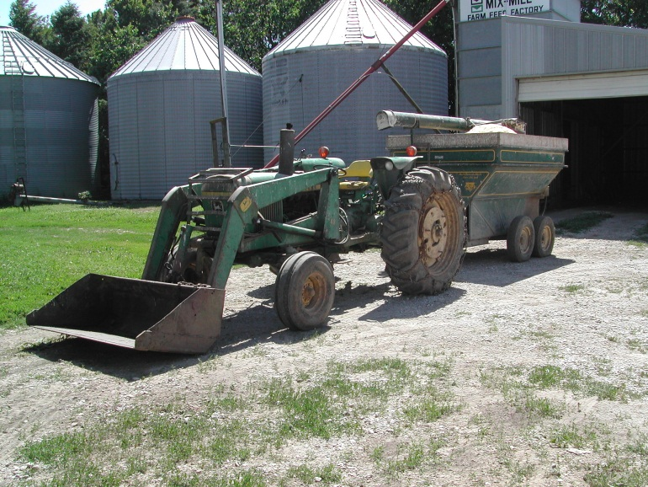
Overview
Any vehicle used on infected premises or with infected animals
  Trailers, feed trucks, milk trucks, carcass transporters
  Heavy machinery used during response
Can be difficult
Notes:
Vehicles used for an animal disease response can serve to transfer microorganisms to other locations and to susceptible animals. Any vehicle used on infected premises or to haul infected animals can potentially transport pathogens from one site to another. These may include personal vehicles, livestock carriers, feed trucks, milk trucks, or carcass transporters. These vehicles must be cleaned and disinfected before leaving the area. Additionally, heavy machinery used on a contaminated site (e.g., tractors, skid steers, backhoes, bulldozers) will also be grossly contaminated and require C&D procedures prior to leaving the premises. Vehicle disinfection should include disinfection of both external and internal surfaces. This can be difficult however due to vehicle design and the presence of uneven surfaces on vehicles. Inclement weather conditions (e.g., cold, rain) may also make these procedures difficult.

Slide 3
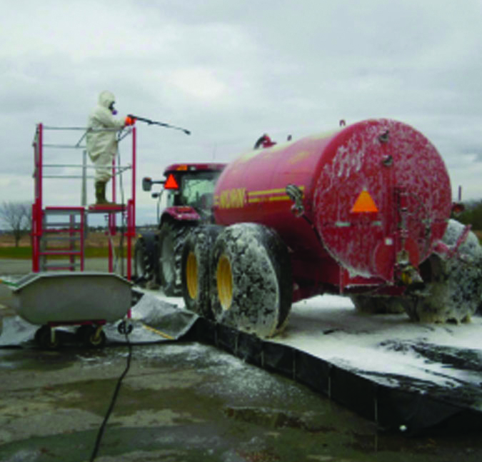
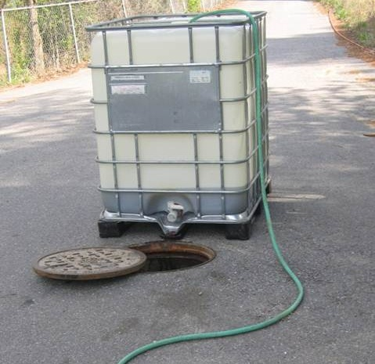
Site Selection
Adjacent to entrance
Flat terrain
Impermeable surface
House components
  C&D equipment
  Water supply
  Waste water containment
Notes:
A large-scale disinfection station should be set up adjacent to or at the entrance/exit points to the infected premises. The location should be on flat terrain with an impermeable surface to help prevent fluid infiltration into the soil while allowing containment of fluids and easier cleanup of the area following procedures. The area should be large enough to house the necessary C&D components such as a disinfection station, water supply, and waste water containment. The station should contain equipment (e.g., tubs, scrub brushes, power sprayers) to aid in the removal of gross debris and application of disinfection products. A running water supply, preferably warm (110ºF), should be included. [Photo from Buddy Gaither, North Carolina Biosecurity Committee]

Slide 4
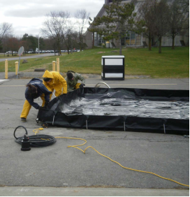
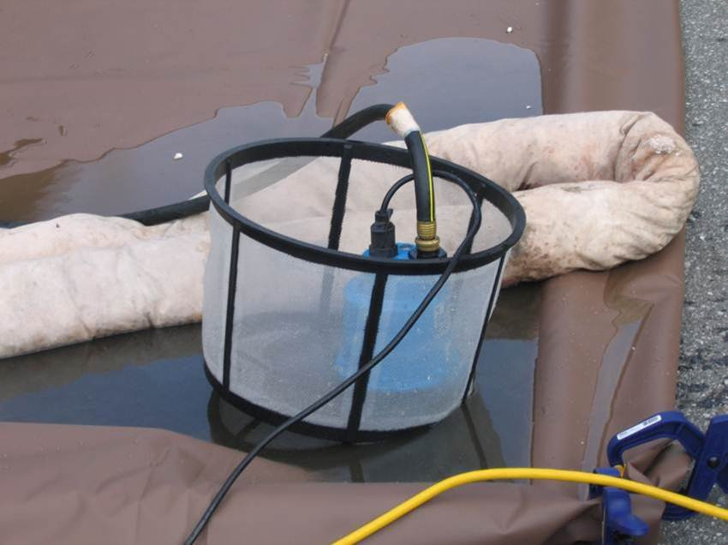
Preparation
Area two times the largest vehicle
Holding area for disinfectant contact time
Berming materials to contain fluid
Drain area by sump pump into holding tank for disposal
Notes:
The vehicle disinfection station area should be constructed to withstand the weight of the vehicles and heavy equipment and should be twice as big as the largest vehicle anticipated to enter. This will allow adequate working space for personnel to conduct C&D measures. A holding area should also be established. This is an area where disinfected vehicles can remain during the necessary disinfectant contact time, allowing for more efficient progress of vehicles through the station. Berming materials (e.g., sandbags, straw bales) should be setup around the station to aid in containing spent fluids and debris from the vehicles. Plywood sheeting or the ramps should be placed to protect the berm materials at the entrance and exits. Identify an area and drainage procedure using a sump pump to collect spent fluids into a holding tank. For highly contagious pathogens, a framing wall, covered with plastic sheeting, around the containment base may be needed to contain the spray drift and splash. The frame should be at least as high as the tallest vehicle to be disinfected. [Photo source: Top: Canadian Food Inspection Service; Bottom: Buddy Gaither, North Carolina Biosecurity Committee]

Slide 5
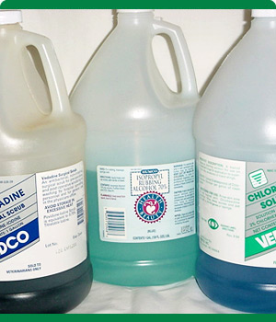
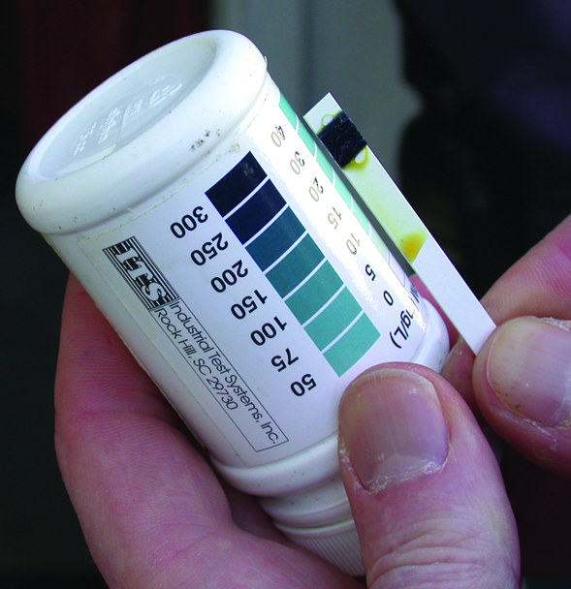
Disinfectant Preparation
Use according to product label
Only EPA-registered or approved products
Prepare fresh solutions
  Old solutions may have reduced efficacy
Test kits can help check concentration
Notes:
The preparation and application of disinfectant solutions must be in accordance with product label directions. Only EPA-registered or approved products should be used. Fresh solutions should be prepared prior to use; some disinfectant solutions may only be active for the same day of preparation. Failure to make fresh solutions may result in using a product that has reduced efficacy. The use of test kits can help to determine whether any chemical degradation of the disinfectant’s active ingredients has occurred and that diluted solutions contain the necessary amount of active ingredient. As a rough estimate, 1 gallon of solution will cover approximately 100-150 square feet. [Photo source: Top: Carla Huston, Mississippi State University; Top: Teresa Robinson, USDA]

Slide 6
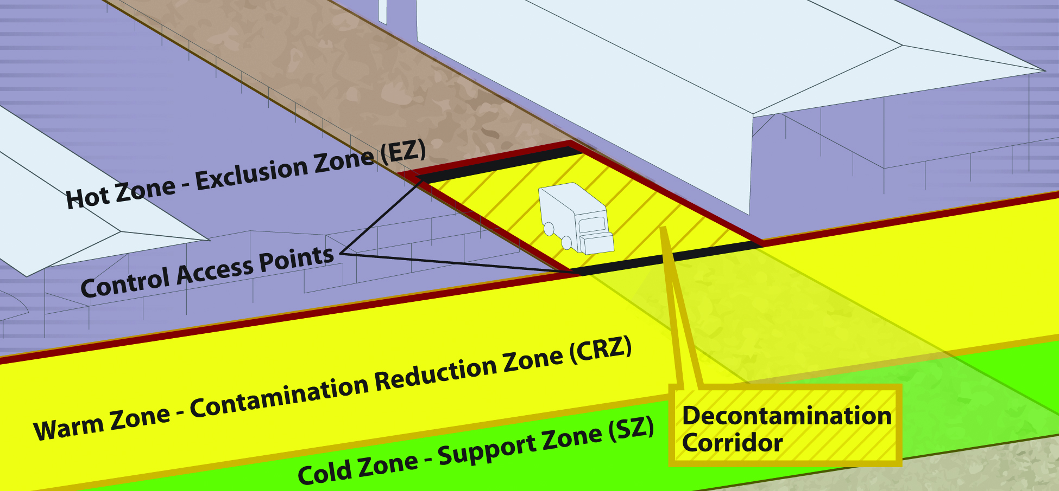
Biosecurity Work Zones
Notes:
During C&D procedures, biosecurity work zones must be maintained to prevent the spread of microorganisms. As a review, the 3 work zones of a response are the Hot Zone (Exclusion Zone), the Warm Zone (Contamination Reduction Zone), and the Cold Zone (Support Zone).
The Hot Zone - Exclusion Zone (EZ) is the high-risk area where infected animals were housed and is potentially contaminated and considered unsafe. PPE must be worn. Initial decontamination and disinfection of vehicles begins here prior to exiting.
The Warm Zone - Contamination Reduction Zone (CRZ) is also a high risk area due to the potential of exposure to pathogens and chemical disinfectants. All personnel are required to wear full PPE. Final decontamination and disinfection as well as final doffing of PPE occur in the Decontamination Corridor of the Warm Zone-Contamination Reduction Zone (CRZ).
Cold Zone - Support Zone (SZ): This is the “cleanest” work zone with the lowest relative risk of exposure to pathogens and other hazards such as decontamination chemicals. Contaminated articles and equipment are prohibited in this area. Decontamination activities are also prohibited.
A Decon (Decontamination) Corridor runs between the Hot Zone-Exclusion Zone and the Warm Zone-Contamination Reduction Zone. Decontamination of vehicles occurs along this corridor with the goal of decreasing the level of contamination as vehicles move toward the Cold Zone.
The size (i.e., width) of these zones will vary with the scale of activities required. The use of plastic tape can help in differentiating the various zones. [Graphic illustration: Andrew Kingsbury, Iowa State University]

Slide 7
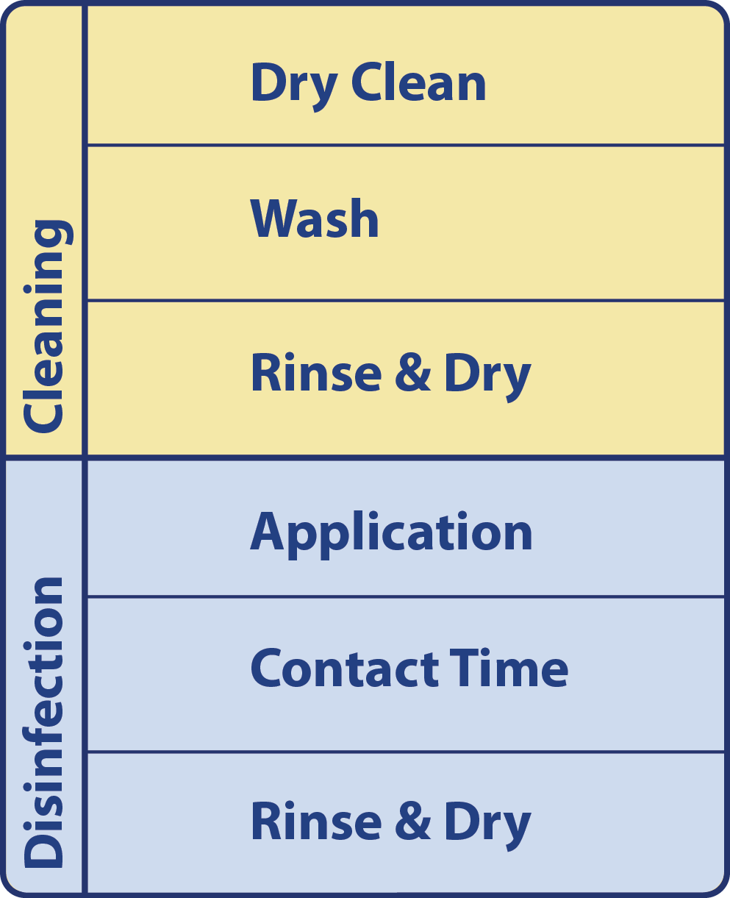
Basic Protocol
Systematic manner
Cleaning
  Dry clean
  Wash
  Rinse and Dry
Disinfection
  Application
  Contact time
  Rinse and Dry
Notes:
The cleaning and disinfection of vehicles should be carried out in a systematic manner to ensure proper disinfection. All exterior and interior surfaces must be addressed. The basic C&D protocol, regardless of item involves a cleaning step, which includes dry cleaning followed by a thorough wash and rinse. This is followed by a disinfection step, which includes disinfectant application, appropriate contact time, followed by rinsing and drying. When possible, drying of the vehicle between the cleaning and disinfection steps should occur. Disinfectant should be reapplied as necessary to keep the surfaces wet for the required contact time. Spent fluids and debris should be contained and removed from the area, which can be difficult. [Graphic Illustration: Andrew Kingsbury, Iowa State University]

Slide 8
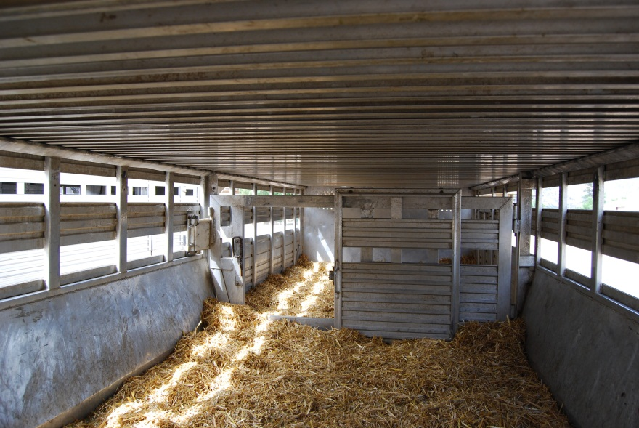
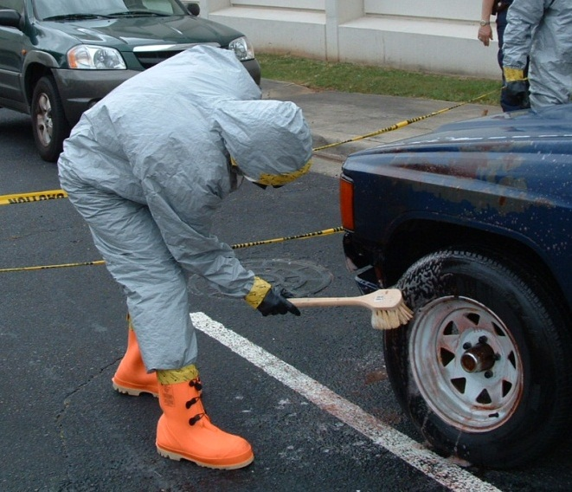
Vehicle Exterior: Dry Clean
Remove visible
organic material
  Use brooms, shovels, brushes
  Don’t forget
  wheel wells
Dispose in biosecure manner
Remove items
from interior
Notes:
Begin the C&D procedure by dry cleaning the vehicle. Use brooms, shovels, manure forks, brushes, or mechanical scrapers, to remove all visible organic material from the vehicle’s exterior. Remove any deposits of mud and straw from the wheels, wheel wells, tires, mudguards, and exposed chassis of the vehicle. Dispose of the gross debris in an appropriate, biosecure manner. Take any removable items out of the vehicle interior for subsequent C&D. [Photo source: Top: Renee Dewell, Iowa State University; Bottom: Tegwin Taylor, Iowa State University]

Slide 9
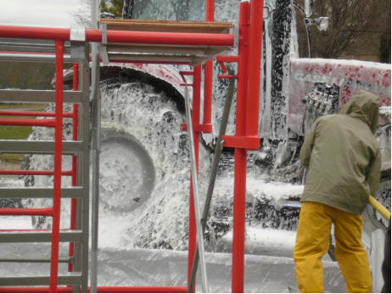
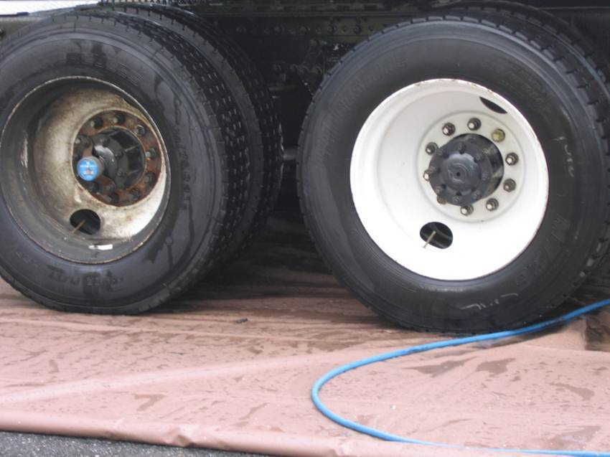
Vehicle Exterior: Wash and Rinse
Wash with detergent and warm water
Presoaking or degreaser for accumulations of urine/feces
Use high pressure sprayer with caution
Rinse with clean,
warm water
Allow to sit 5-10 min to drip off residual water
Notes:
Wash the vehicle and items removed from the vehicle with detergent and warm water (110 ºF). Areas with debris that is difficult to remove with simple washing may need presoaking with detergent and water. A degreaser may also be needed to remove any oils or exudates. High pressure water and detergent can be very effective for removing heavy accumulations of urine and feces. However, in cases of highly infectious or zoonotic pathogens, high pressure systems should be avoided or used with caution to avoid dispersal of the pathogen or risk to the applicator. Rinse the vehicle in clean, warm water and allow the vehicle to sit for 5–10 minutes to allow the residual rinse water to drip off. [Photo source: Top: Canadian Food Inspection Agency; Bottom: Buddy Gaither, North Carolina Biosecurity Committee]

Slide 10
Vehicle Exterior: Disinfect
Apply disinfectant
  Low pressure spray, scrub brushes
  EPA-registered product
  Non-corrosive product
  Allow necessary contact time
  Reapply as needed
  Rinse with clean, warm water
Allow vehicle to dry thoroughly
Notes:
Use low pressure sprayers and scrub brushes to apply an EPA-registered disinfectant solution to all areas of the vehicle or trailer, including the bodywork, undercarriage, wheels and wheel wells. Ensure a non-corrosive disinfectant product is selected. Allow the necessary contact time for the disinfectant to work. Areas must remain “wet” with the solution throughout the needed contact time. Reapplication may be necessary. Thoroughly rinse the vehicle with clean, warm water. If possible, allow the vehicle to dry thoroughly.

Slide 11
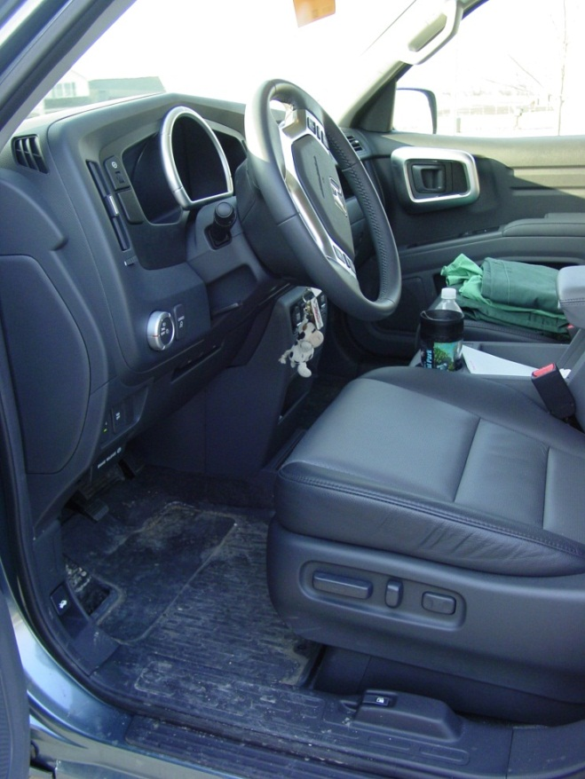
Vehicle Interior
Remove non-fixed items
Sweep away gross debris
Wash, rinse and dry
Wipe EPA-registered disinfectant
  Keep surfaces “wet”
  during contact time
Allow interior to dry
Notes:
The interior of the vehicle will also need to be disinfected, especially if the driver has left the cab while on the infected premises. Remove any non-fixed items from the vehicle (e.g., floor mats). Sweep and brush away any gross debris from the cab’s interior. Wash any vehicle components that have had contact with the driver or any passengers (e.g., dashboard, steering wheel, handbrake, gear shift, seats) with warm water and a mild detergent or cleaner. Rinse the areas and items with clean, warm water. Wipe down the dashboard, steering wheel, handbrake, gear shifter, and seats with an EPA-registered disinfectant soaked cloth, keeping surfaces “wet” for the necessary contact time. Move the vehicle from the disinfection area to the holding area. Wash the concrete surface with detergent. Allow the interior of the vehicle to dry. [Photo source: Danelle Bickett-Weddle, Iowa State University]

Slide 12

C&D Equipment
Equipment used
for C&D tasks
must also be
  Cleaned and disinfected
  before reuse
  OR
  Properly disposed of
Notes:
Following all C&D procedures on the infected premises, equipment used for C&D processes (e.g., brooms, rakes, shovels, brushes, hoses, sprayers) must be cleaned and disinfected before reuse or disposed of.

Slide 13
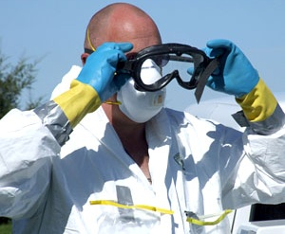
Safety
Chemical Hazards
  Skin, eye, respiratory
  irritation
Physical Hazards
  Slips, trips, falls
  High pressure sprayer
Personal Protective
Equipment (PPE)
  Gloves, masks, eyes
Notes:
Safety concerns during C&D of vehicles include personnel exposure to chemical disinfectant products which can cause irritation to the skin, eyes or respiratory tract. Personnel cleaning vehicles should wear protective, waterproof clothing and appropriate personal protective equipment, (e.g., rubber gloves, eye protection) when handling, mixing and applying disinfectant solutions. Physical hazards, such as slips, trips or falls from slippery surfaces can also occur, as can injury from high pressure sprayers. [Photo source: Travis Engelhaupt, Iowa State University]

Slide 14
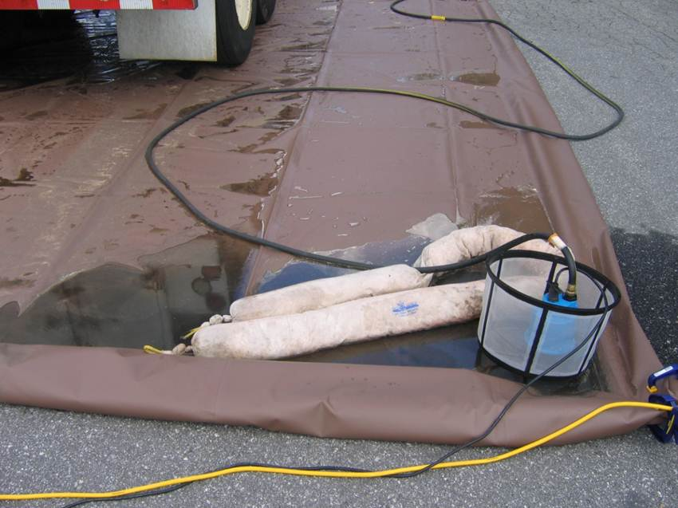
Environmental Hazards
Runoff must be avoided
  Infectious material
  Chemical solution
Toxic to aquatic organisms
Further spread of pathogens
Notes:
During vehicle C&D procedures, runoff of infectious material or chemical solutions must be avoided. This is necessary to prohibit environmental impacts, since many chemical disinfectants are toxic to aquatic organisms, as well as the further spread of pathogens into the environment. [Photo source: Buddy Gaither, North Carolina Biosecurity Committee]

Slide 15
References
https://fadprep.lmi.org
USDA APHIS. FAD PReP NAHEMS
  Highly Pathogenic Avian Influenza Standard Operating Procedures: Cleaning and Disinfection. February 2010.
  Foot-And-Mouth Disease. Standard Operating Procedures: Cleaning and Disinfection. February 2010.
  NAHEMS Guidelines: Cleaning and Disinfection. June 2011.
Notes:
Cleaning and disinfection of vehicles exiting or used on an infected premises will be essential during animal disease emergency situations. Attention to proper C&D procedures will help to minimize the further spread of pathogens and protect personnel from exposure. Information in this presentation was taken from the following USDA APHIS Foreign Animal Disease Preparedness and Response Plan documents. The full version of these documents can be obtained at the FAD PReP website.

Slide 16
Acknowledgments
Development of this presentation was by the Center for Food Security and Public Health at Iowa State University through funding from the Multi-State Partnership for Security in Agriculture
Author: Glenda Dvorak, DVM, MPH, DACVPM
Notes:
Information provided in this presentation was developed by the Center for Food Security and Public Health at Iowa State University College of Veterinary Medicine, through funding from the Multi-State Partnership for Security in Agriculture.

