Slide 1
Cleaning and Disinfection
Premises
Notes:
June 2011
Cleaning and disinfection (C&D) procedures are a crucial part of any animal health emergency response. The cleaning and disinfection of infected premises during an animal health response will be necessary to eliminate the targeted disease from the location and must be done before animals can be reintroduced to the facility. This Just-In-Time training presentation will discuss the steps for conducting C&D of farm premises during an animal disease emergency response. Special considerations based on the type of animal production facility (e.g., broiler house, milking parlor, feedlot) exist and will also be discussed later in this presentation.

Slide 2
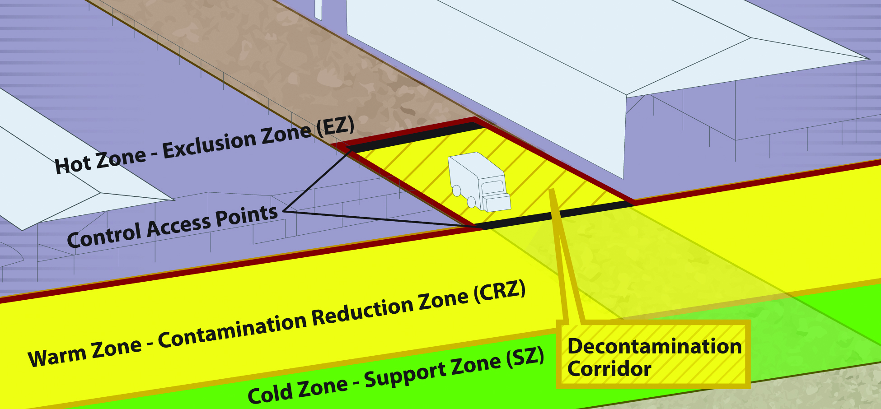
Biosecurity Work Zones
Notes:
Biosecurity work zones must be maintained during C&D procedures. Premises are located in the Hot Zone – Exclusion Zone. This high-risk area is where infected animals were housed and is potentially contaminated and considered unsafe. PPE must be worn in this area. Entry onto the premises for C&D procedures occurs through the Decontamination Corridor, after appropriate PPE is donned in the Cold Zone. The Decontamination Corridor is an area between the Hot Zone-Exclusion Zone and the Warm Zone-Contamination Reduction Zone. [Graphic illustration by Andrew Kingsbury, Iowa State University]

Slide 3
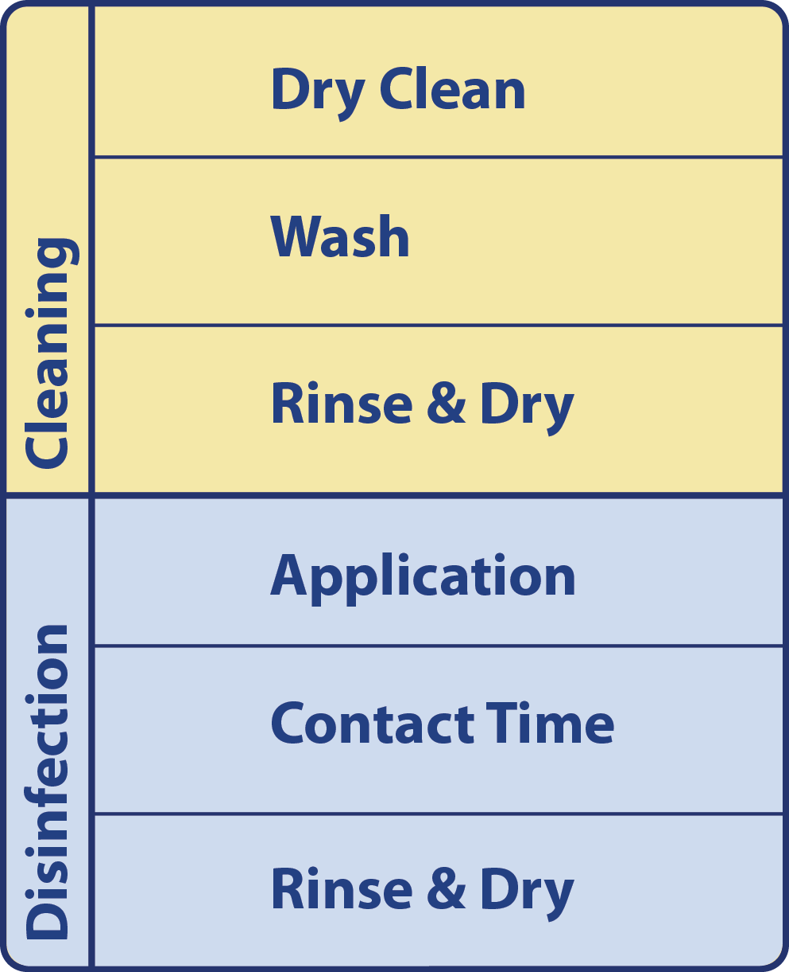
Basic C&D Protocol
Cleaning
  Dry Cleaning
  Washing
  Rinse and dry
Disinfection
  Application
  Contact Time
  Rinse and dry
Downtime
Notes:
The cleaning and disinfection of premises should be carried out in a systematic manner to ensure disinfection efforts are effective. The basic C&D protocol, regardless of item involves a cleaning step, which includes dry cleaning and a thorough wash and rinse. This is followed by the disinfection step, which includes disinfectant application, appropriate contact time, followed by rinsing and drying. When possible, drying between the cleaning and disinfection steps should occur. [Graphic illustration by Andrew Kingsbury, Iowa State University]

Slide 4
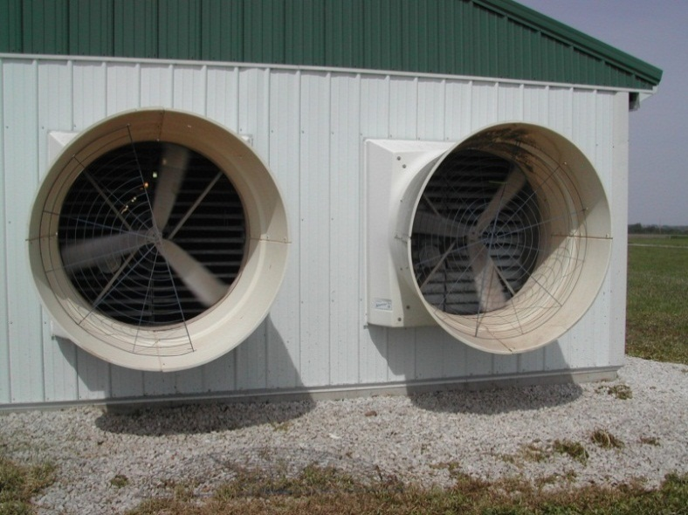
Preparation
Turn fans off
Disconnect electricity
Remove sensitive equipment
Alternative electrical supply for C&D equipment and lighting
Notes:
Before initiating the C&D process, all fans should be turned off to prevent dissemination of the infectious agent. The electricity supply to the building should also be disconnected to allow the removal of sensitive equipment and prevent electrical accidents during cleaning. An alternative electrical supply should be acquired to power any cleaning equipment. Good lighting is essential to ensure that surfaces are visibly clean after the washing step. [Photo source: Iowa State University Veterinary Diagnostics and Production Animal Medicine (VDPAM)]

Slide 5
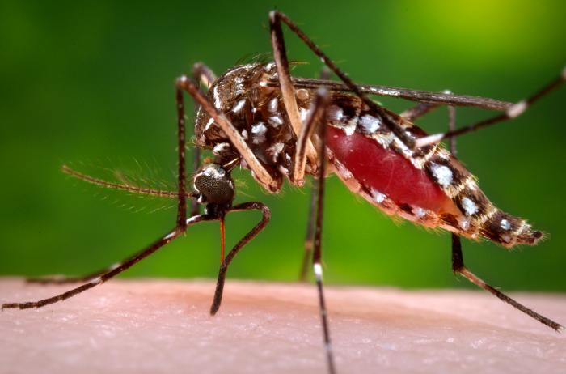
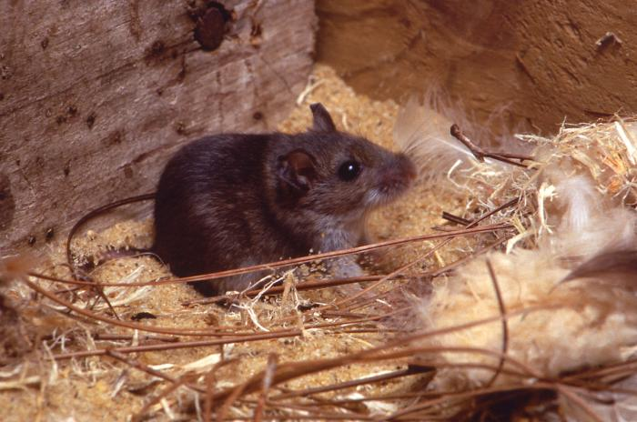
Vectors
To avoid transfer of pathogens
  Detect and remove disease vectors
  Seal rodent entrances
  Remove and prohibit wild bird nesting areas
  Eliminate insect breeding areas
Notes:
To avoid the potential transfer of pathogens to additional areas, animal vectors, such as rodents, birds, or other wildlife must be detected and dealt with appropriately. Areas of potential rodent entrances should be sealed. Roof areas and eaves with holes or nesting areas for wild birds must be addressed. Insect vector control procedures, such as eliminating insect breeding areas, will also be needed to prevent further dissemination of the disease agent. Feral animals must be trapped and removed or destroyed. [Photo source: Centers for Disease Control and Prevention]

Slide 6
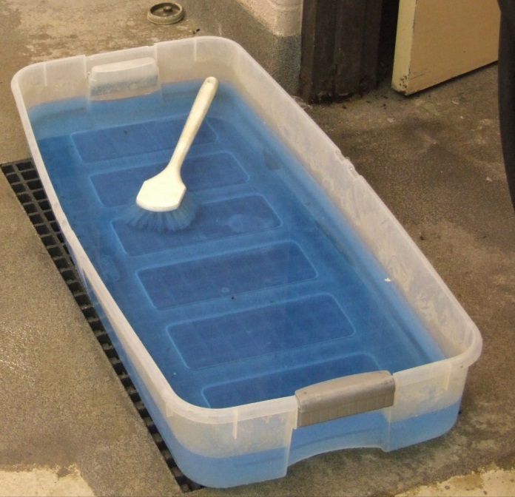
Preparation
Footbaths
  Set up at entrance/exits
  Ineffective if used incorrectly
    False sense of security
    Should not be sole process of disinfection
  Use fresh solution
  Allow contact time
Notes:
Set up footbaths at all entrances and exits to the building. NOTE: While disinfectant footbaths may be used upon entering and exiting the premises, these “stations” may give a false sense of security to responders and should not be used as a sole process of disinfection. However, the process will serve to raise awareness about the need for biosecurity and disinfection for the disease situation present. A freshly prepared, appropriate disinfectant solution should always be used and adequate contact time allowed on footwear for optimum efficacy. [Photo source: Alex Ramirez, Iowa State University]

Slide 7
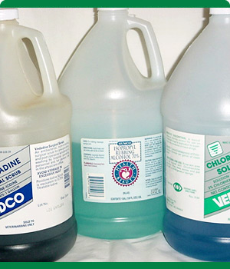
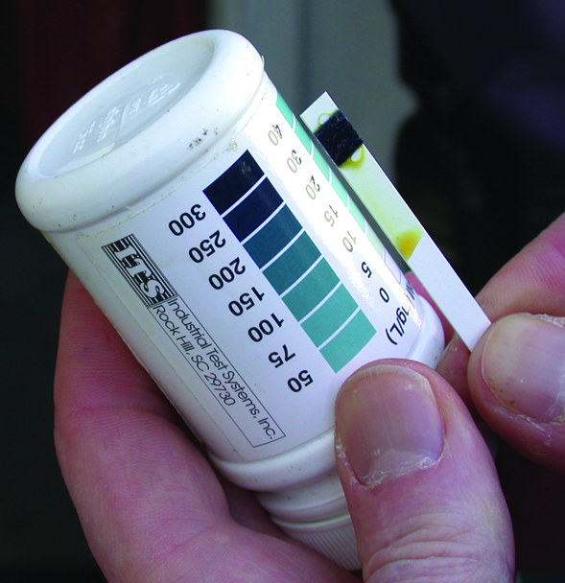
Disinfectant Preparation
Use according to product label
Only EPA-registered or approved products
Prepare fresh solutions
  Old solutions may have reduced efficacy
Test kits can help check concentration
Notes:
The preparation and application of disinfectant solutions must be in accordance with product label directions. Only EPA-registered or approved products should be used. Fresh solutions should be prepared prior to use; some disinfectant solutions may only be active for the same day of preparation. Failure to make fresh solutions may result in using a product that has reduced efficacy. The use of test kits can help to determine whether any chemical degradation of the disinfectant’s active ingredients has occurred and that diluted solutions contain the necessary amount of active ingredient. As a rough estimate, 1 gallon of solution will cover approximately 100-150 square feet. [Photo source: Top: Carla Huston, Mississippi State University; Top: Teresa Robinson, USDA]

Slide 8
Basic Protocol
Systematic manner
  Start at back and work toward front
  Start at ceiling and work down walls
  Small sections at a time
  Work toward the drain
Use marking tape to indicate completed areas
Notes:
Premises C&D should follow the basic C&D protocol previously described. Use a systematic procedure for cleaning and disinfection. Start at the back of the facility and proceed to the front. Begin all procedures on the ceilings, moving down the walls to the floor, then across the drain. Work in small sections at a time to ensure thorough coverage of each area. Use marking tape to clearly indicate where disinfection has and has not taken place.

Slide 9
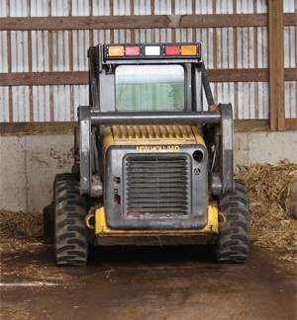
Dry Clean
Use brooms, shovels,
brushes, scrapers
Moisten to control dust
Remove
  Visible organic material
  Washable items
  Rotten wood fixtures
Scrape windowsills, floors
Dispose of debris in biosecure manner
Notes:
Begin the premises C&D procedure by dry cleaning the area to remove any gross contamination and organic material (e.g., soil, manure, bedding, feed). Shovels, manure forks, brooms and brushes should be used to sweep, scrape and remove organic material from surfaces and areas. Heavy equipment may be needed to remove large quantities of bedding or manure. Air blowers should not be used for dry cleaning due to the risk of spreading pathogens. Move any washable and removable equipment (hand feeders, mangers) to the outside for cleaning and disinfection. Remove rotten wood fixtures, posts and flooring for burial or burning. Scrape windowsills and floors and other permanently attached equipment to remove any adherent organic material. Disposal of all organic material and gross debris should be in a manner that minimizes further spread of microorganisms and that is compliant with federal, state and local requirements and policies.
In the case of a highly contagious disease, a disinfectant solution should be applied using a low-pressure sprayer to damp down dust in the building. This is not a disinfection step, but helps to minimize dust generation and further spread of the pathogen from the building interior while cleaning. [Photo Danelle Bickett-Weddle, Iowa State University]

Slide 10
Wash and Rinse
Wash area with detergent using
sprayer, scrub brush
  Avoid high pressure if highly contagious
May need pre-soaked
Scrubbing may be necessary
Steam
  Effective for cracks, crevices, pipework
Rinse with clean, warm water
Allow to dry overnight
Notes:
The second step in the cleaning process is washing. The washing process helps to reduce the number of microorganisms as well as remove any oil, grease, or exudates that may inhibit disinfection. This is one of the most overlooked steps in the C&D process. Areas and items with organic material adhered to the surfaces should be pre-soaked for several hours. Mechanical scrubbing and scraping may be necessary to remove oils, grease or exudates from rough surfaces, deep cracks, or other surface irregularities. High pressure water and detergent is very effective in removing the heavy accumulation of urine and feces and for cleaning porous surfaces, but should be avoided in cases of highly infectious or zoonotic pathogens to avoid further spread. Whenever possible, warm to hot water (110°F) should be used to increase efficacy. Hot water and steam can be effective for cleaning cracks, crevices and the inside of pipework where pathogens are likely to linger. Whenever possible, surfaces should be allowed to dry completely (if possible overnight) before the application of a disinfectant. Fans can be helpful to the drying process but should not be used if dealing with a highly infectious or zoonotic pathogens.

Slide 11
Disinfection
Apply EPA-registered disinfectant
  Allow appropriate contact time
  Must remain “wet”
  Reapply if needed
Rinse with clean, warm water
Allow to air-dry
Notes:
After thorough rinsing and if possible drying of the facility, apply an EPA-registered disinfectant. This can be done by low pressure spraying or wiping. Ensure all areas are covered thoroughly with the solution. Don’t forget areas such as the ceilings, rafters, light fixtures, fan blades, louvers and other structural components. Areas must remain “wet” with the solution for the necessary contact time. Apply disinfectant a second time if necessary. Rinse areas thoroughly with clean, warm water. Thorough rinsing is very important as some disinfectants may cause deterioration of rubber or corrosion of metal parts if not completely rinsed away. Allow the area and items to air-dry.

Slide 12
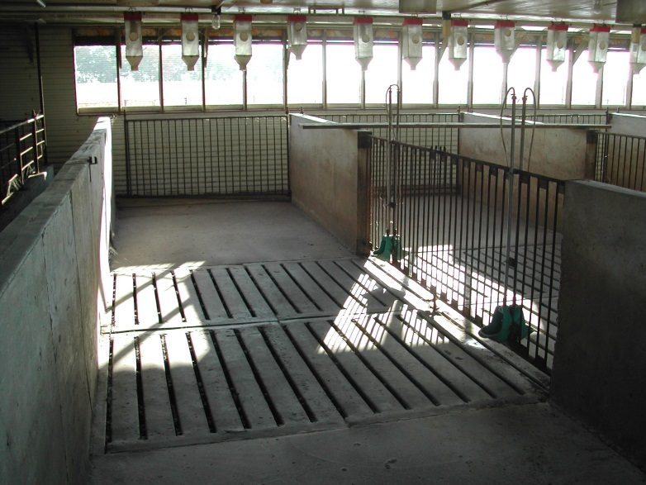
Building Interior
Ensure C&D of
interior components
  Water dispensers,
  troughs, augers, fans
Electrical equipment
  Turned off first
  Wipe clean, sanitize
Notes:
Special care should be taken to ensure components of any watering systems (e.g., water lines, dispensers, nipple drinkers, troughs), feeding equipment (e.g., feed lines, augers, hoppers), and other mechanical structures (e.g., fans, casings, motors, belts, curtains, ventilation pads, louvers) within the building are thoroughly cleaned and disinfected. Equipment such as thermostats, scales, time clocks, electrical panels, switches, and light bulbs may need to be individually wiped, cleaned, sanitized, and protected from the more severe effects of cleaning--such as high-pressure sprayers and disinfectant chemicals--and protected from recontamination during the cleaning process. Fumigation can only be performed where it is possible to seal or tent the building completely and requires considerable care to be performed safely and correctly. [Photo source: Alex Ramirez, Iowa State University]

Slide 13
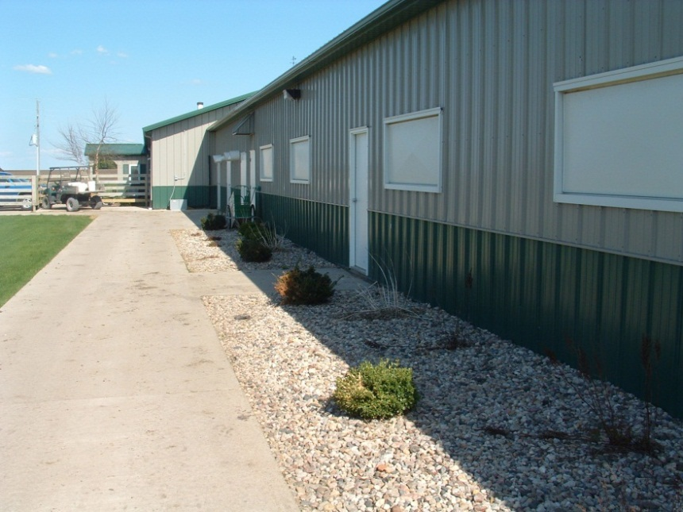
Building Exterior
Width will vary
with pathogen
  May be as wide
  as 10 feet
Flame gun
  Wet surfaces
  prior to distinguished areas treated
Fan inlets
  EPA-registered disinfectant
  with low pressure sprayer
Notes:
The immediate area around the exterior of the building must also be cleaned and disinfected. The width of the perimeter will vary depending on the pathogen involved, but may be as wide as 10 feet around the exterior. In some situations, a flame gun may be used on outdoor concrete, brick, or metal surfaces after disinfection. Surfaces should be wet before starting so that flamed and unflamed areas can be easily distinguished. A flame gun should only be used in areas where no combustible materials are present. Attention should be given to fan inlets on the exterior of the building. A low-pressure sprayer should be used for disinfecting of these areas. [Photo source: Danelle Bickett-Weddle, Iowa State University]

Slide 14
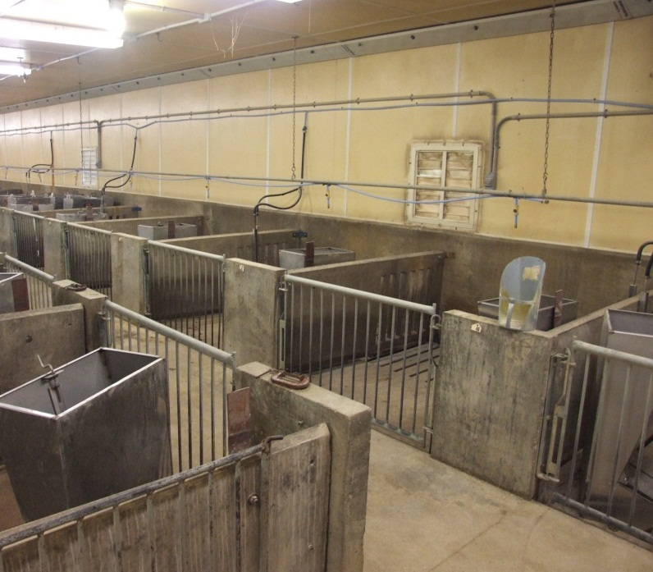
Material Composition
Concrete = porous
  Difficult to clean
  Registered product,
  flame gun
Metal = easier to clean
  Some products
  corrosive
  Flame gun
Wood = very porous
  Discard if possible
Soil, sand, clay
  No environmentally safe product
Notes:
The material composition of items and areas on animal production facilities can be quite diverse. This can impact the ability to adequately C&D these items or areas. Raw concrete surfaces are porous and therefore difficult to clean. A disinfectant product registered for concrete surfaces should be applied to all surfaces once gross organic debris has been removed and the area has been washed, rinsed, and thoroughly dried. High pressure washing with a disinfectant solution can be helpful for improving adequate contact of these surfaces, but may cause damage to some concrete surfaces. Some disinfectants can be corrosive to concrete surfaces. Flame guns may be an alternative disinfection method. Metal surfaces are generally easy to clean and disinfect, especially when surfaces are smooth. However, some chemical disinfectant are incompatible or corrosive to metal surfaces. A flame gun may be a useful alternative for metal surfaces. Wood is extremely porous and therefore difficult to disinfect. Any decaying wood surface that cannot be disinfected should be appraised, removed, and disposed of appropriately (e.g., burn or burial). Wood surfaces should not be rinsed, soaked, or sprayed with plain water prior to washing or disinfectant application as this can cause unintended dilution. A disinfectant solution of a product registered for wood surfaces should be applied once gross organic debris has been removed. If a registered product is not available, then an EPA-exempted product should be used. No environmentally safe procedures exist for “disinfecting” soil surfaces (e.g, dirt, sand, packed clay). [Photo source: Alex Ramirez, Iowa State University]

Slide 15
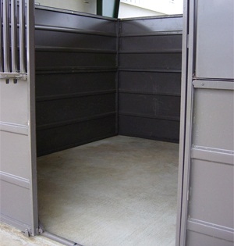
Downtime
Free of any animals
or activity
Reduces pathogens
by drying
Time varies based on pathogen
  Three times expected incubation period
Block of area
Notes:
Premises that have been cleaned and disinfected should have a period of downtime following the procedures. This involves the area being free of any animals or activity for a period of time to allow it to completely dry. The application of disinfectant solutions uniformly over large areas (e.g., ceilings, walls, floors) can be very difficult. Adequate downtime serves to further reduce or eliminate any remaining microorganisms on the premises through desiccation. Downtime can begin as soon as the premises is certified as clean and disinfected and should be at least three times the longest expected incubation time of the targeted pathogen. Areas should be cordoned off with marking tape to designate these areas. [Photo source: Carla Huston, Mississippi State University]

Slide 16
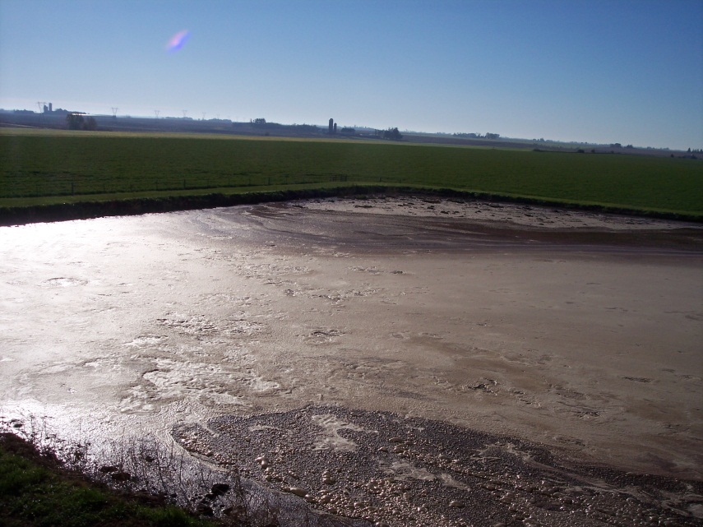
Slurry Pits
Decontaminate by
chemical process
that alters the pH
  Vigorous stirring
  Maintain pH
  for several days
Precautionary measures
  Minimum of 2 personnel
  Wear respirators, safety harnesses, lifeline
  Area well ventilated due to toxic gases
  produced with agitation
Notes:
Slurry pits contain liquid manure, which are a combination of feces, urine, fresh rainwater and runoff, cleaning materials, and bedding materials. Different methods of rendering a slurry pit inactive of pathogens exist, however, the most practical in the event of an animal disease emergency is the use of chemical processes that alter the pH for determined periods of time. The goal is to maintain the required pH for the necessary time period. Vigorous stirring will be required once a chemical is added to ensure adequate distribution of the disinfectant. This should occur for a minimum of 6 hours after application and on a daily basis for a minimum of 2 hours per day. The required pH must be maintained for the necessary time period to ensure the needed destruction of pathogens. Note that the agitation of slurry can release toxic gases such as carbon monoxide, carbon dioxide, hydrogen sulfide, ammonia, and methane. Therefore, safety precautions for responders must be implemented. These include having a minimum of two personnel engaged in mixing or preparing the tanks, as well as ensuring the area is well ventilated. Responders should wear respirators, safety harnesses and a lifeline. [Photo source: Danelle Bickett-Weddle, Iowa State University]

Slide 17
Specific Production Situations
Notes:
Next lets look at some of the special premise features of various animal production facilities that will require C&D processes during an animal disease emergency situation.

Slide 18
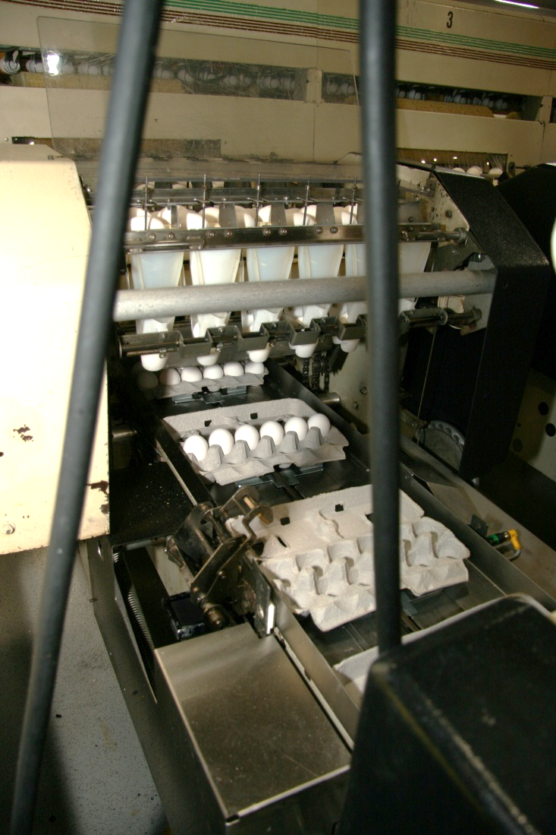
Poultry Premises
Egg processing equipment
  Egg belts, flats, buggies, packing machines
Nesting boxes
Egg storage rooms
Open floor areas
Curtains
Notes:
Poultry production premises, depending on the type of facility, can have a number of areas or equipment requiring C&D procedures. These may include egg processing equipment such as egg belts, flats, buggies, packing machines, nesting boxes and egg storage rooms. Production facilities may also consist of open floor areas which require removal of litter and manure prior to disinfection efforts. Curtains set up within the facility will need to be completely extended to ensure thorough cleaning and disinfection.

Slide 19
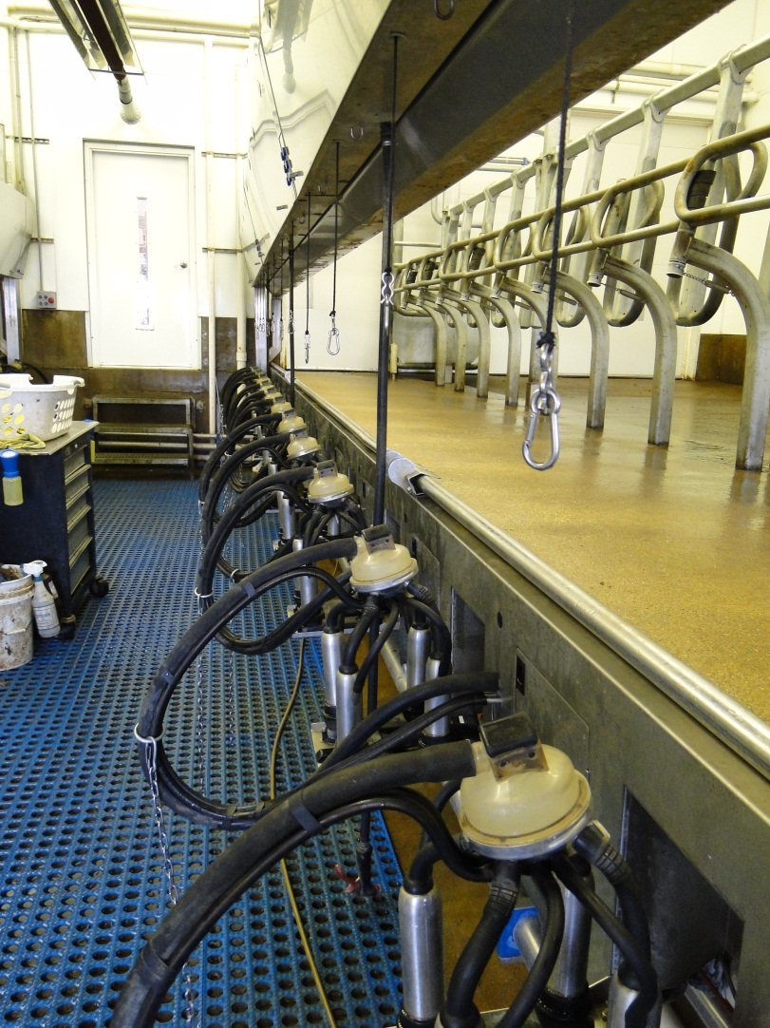
Dairy Facilities
Milking equipment
  Milking units, strainers, coolers, bulk tank
  Removal of milk-film
  or deposits
Input from manager,
personnel may be useful
Products must
specifically list
milking equipment
Notes:
Unique challenges for C&D of dairy operations include milking equipment such as milking units, strainers, coolers, the bulk tank and pipelines. Milk film or deposits on equipment can impact disinfection efficacy. Since the daily operation of dairies involves strict sanitation and disinfection protocols for milking equipment, input and assistance from the dairy manager or personnel may be useful to determine effective disinfection methods that will not cause damage to milking machines and tanks. Disinfection products used on milking equipment must specifically list this equipment on its label since they are considered food-contact surfaces. [Photo source: Danelle Bickett-Weddle, Iowa State University]

Slide 20
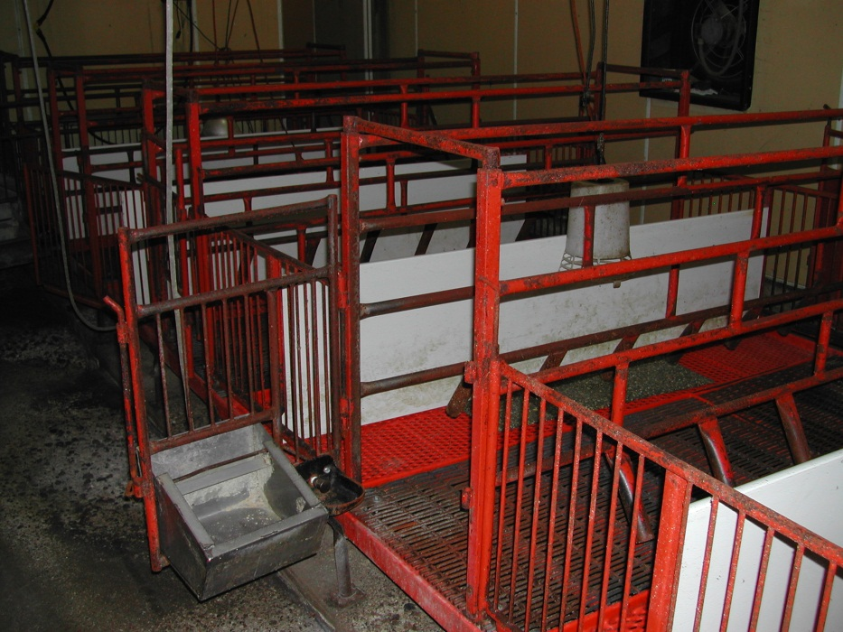
Swine Facilities
Special items
  Farrowing pens, slats,
  slurry alleys, pits
  Electrical equipment
  Bars, crates, gates
Clean and disinfect
without leaving
residual chemicals
Phenolic disinfectants
should be avoided
Notes:
Special situations in swine facilities include farrowing pens, slats, slurry alleys, and pits. Farrowing areas can present particular problems for C&D processes due to any number of complex structures (e.g., bars, crates, gates) that can be difficult to clean, as well as electrical equipment that may be sensitive and easily damaged. A further consideration is that after C&D measures, the building will need to house parturient and neo-natal animals; therefore, it is necessary to clean and disinfect without leaving residual chemicals. Phenolic disinfectants should be avoided as they can be toxic to swine. [Photo source: Alex Ramirez, Iowa State University]

Slide 21
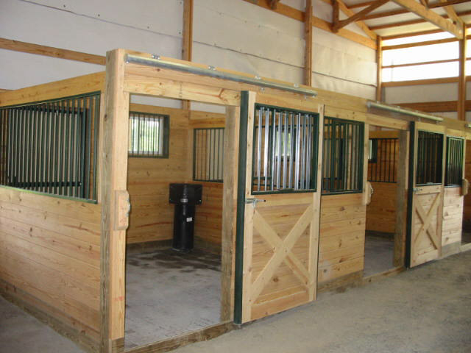
Equine Facilities
Equine facilities
highly variable
  Products labeled
  for wood, concrete
  should be applied
  once organic
  debris removed
  Special attention to metal bars on stalls
  Flame gun for non-flammable surfaces
Notes:
Equine facility environments are highly variable since they often contain pastures and paddocks as well as extensive porous materials like wood and cement block and variable stall flooring like dirt, clay, sand, rubber, and concrete. Disinfection products labeled for wood and concrete surfaces should be applied once organic debris is removed. Non-flammable surfaces may be treated with a flame gun. Special attention should be paid to metal bars on stalls. [Photo source: Danelle Bickett-Weddle, Iowa State University]

Slide 22
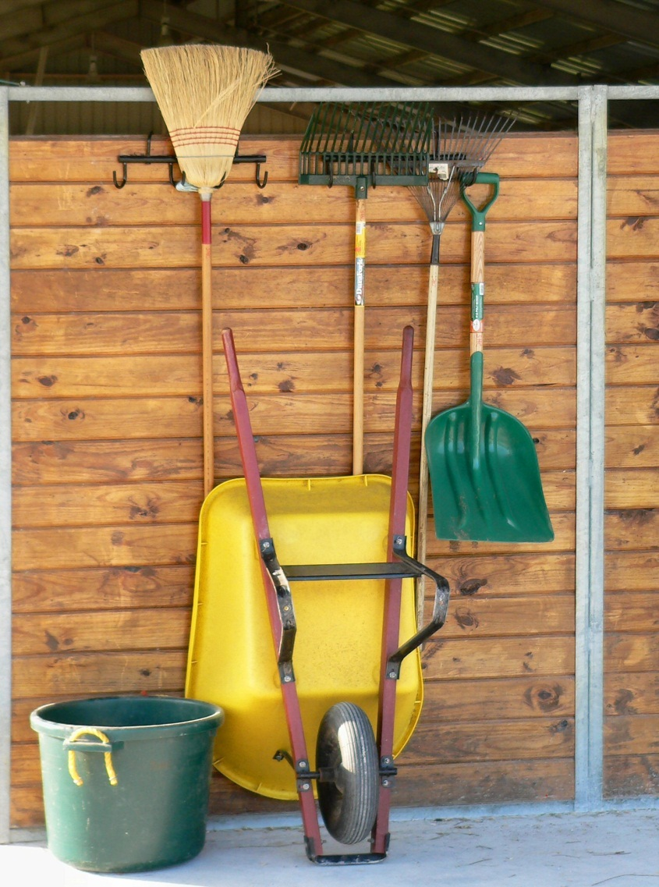
C&D Equipment
Equipment used for C&D procedures must also be either cleaned and disinfected before reuse or properly disposed of
Notes:
Following all C&D procedures on the infected premises, equipment used for C&D processes (e.g., brooms, rakes, shovels, brushes, hoses, sprayers) must be cleaned and disinfected before reuse or disposed of. [Photo source: Shutterstock]

Slide 23
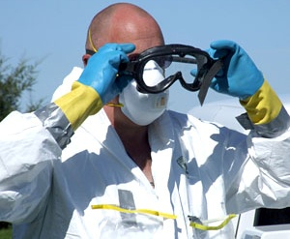
Safety
Chemical Hazards
  Skin, eye,
  respiratory
  irritation
Physical Hazards
  Slips, trips, falls
  High pressure sprayer
Notes:
Most chemical disinfectant products have health hazards or risks, such as irritation to the skin, eyes or respiratory tract. All disinfectants must be used with care to avoid injury or health issues. Personnel preparing and applying chemicals should follow all label safety precautions and wear appropriate PPE (e.g., gloves, goggles), as required. Additionally, physical hazards, such as slips, trips or falls from slippery surfaces can also occur, as can injury from high pressure sprayers. [Photo source: Travis Engelhaupt, Iowa State University]

Slide 24
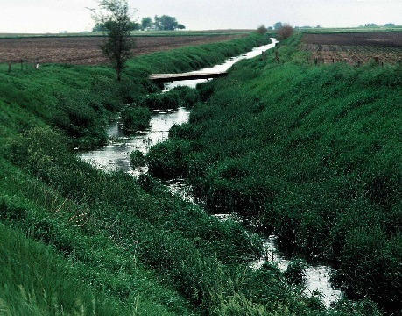
Environmental Hazards
Runoff must be avoided
  Infectious material
  Chemical solution
Toxic to aquatic organisms
Further spread of pathogens
Notes:
During premises C&D procedures, runoff of infectious material or chemical solutions must be avoided. This is necessary to prohibit environmental impacts, since many chemical disinfectants are toxic to aquatic organisms, as well as prevent the further spread of pathogens into the environment. [Photo source: USDA Natural Resources Conservation Service]

Slide 25
Evaluation
Areas properly cleaned/disinfected
Personnel aware of/implementing C&D measures
Proper disinfectant selected
  Appropriate concentration
  Correct contact time achieved
C&D Waste
  Minimize or avoid environmental impact
Notes:
Inspection of a site following C&D procedures should ensure all tasks have been performed effectively. Factors to be checked should include:
All grossly contaminated, infected or suspected areas have been identified and properly cleaned and disinfected
All personnel are aware of and are implementing C&D measures for themselves and their equipment
One or more appropriate disinfectants have been selected and used at the appropriate concentration and the correct contact time was achieved
Effluent from the C&D procedures has been handled in a manner to minimize or avoid environmental impact
Final inspection of the premises should be conducted by experienced personnel. If there is any doubt or sign of inadequate procedures, the disinfection measures must be repeated. Once final inspection of the premises has occurred, any and all personnel present should proceed through the personnel C&D disinfection station before leaving the premises.

Slide 26
References
https://fadprep.lmi.org
USDA APHIS. FAD PReP NAHEMS.
  Highly Pathogenic Avian Influenza Standard Operating Procedures: Cleaning and Disinfection. February 2010.
  Foot-And-Mouth Disease. Standard Operating Procedures: Cleaning and Disinfection. February 2010.
  NAHEMS Guidelines: Cleaning and Disinfection. June 2011.
Notes:
The cleaning and disinfection of infected premises will be essential during animal disease emergency situations. The diversity of facility types and set up can produce a number of challenges. Attention to proper C&D procedures will help to minimize the further spread of pathogens and protect personnel from exposure. Information in this presentation was taken from the following USDA APHIS Foreign Animal Disease Preparedness and Response Plan documents. The full version of these documents can be obtained at the FAD PReP website.

Slide 27
Acknowledgments
Development of this presentation was by the Center for Food Security and Public Health at Iowa State University through funding from the Multi-State Partnership for Security in Agriculture
Author: Glenda Dvorak, DVM, MPH, DACVPM
Notes:
Information provided in this presentation was developed by the Center for Food Security and Public Health at Iowa State University College of Veterinary Medicine, through funding from the Multi-State Partnership for Security in Agriculture.

