Slide 1
Cleaning and Disinfection
Personnel
Notes:
June 2011
Cleaning and disinfection (C&D) procedures are a crucial part of any animal health emergency response. Responders working at sites of animal health emergencies will be exposed to disease-causing organisms. Measures must be taken to decontaminate individuals and to disinfect all personal protective equipment (PPE), prior to leaving the response area to prevent the spread of pathogens to additional animals, locations or response personnel. This Just-In-Time training presentation will overview measures for personnel decontamination and personal protective equipment disinfection.

Slide 2
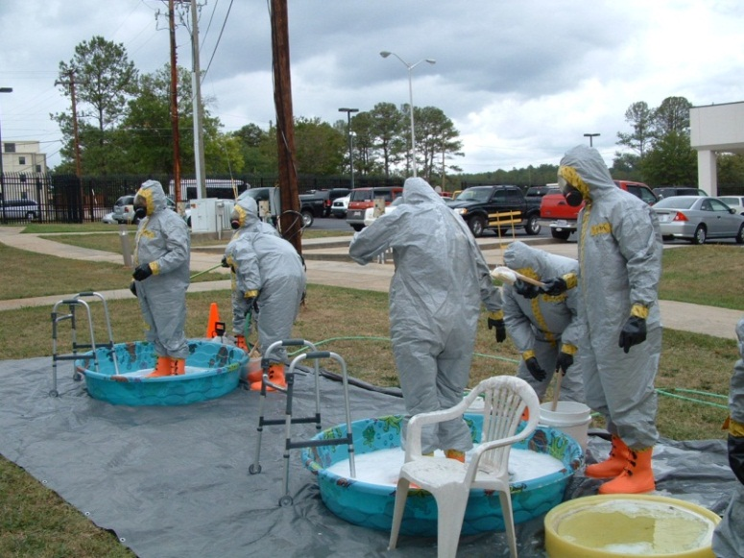
Personnel Disinfection Station
Adjacent to entrance
Flat terrain
Impermeable surface
House components
  C&D equipment
  Water supply
  Waste water containment
Notes:
Personnel disinfection stations should be set up adjacent to or at the entrance/exit points to the infected premises. The location should be on flat terrain with an impermeable surface (e.g., plastic sheeting) to prevent fluid infiltration into the soil, while allowing containment of fluids and easier cleanup of the area following procedures. The area should be large enough to house the necessary C&D components, including the disinfection station, water supply, and waste water containment. The station should contain equipment (e.g., tubs, scrub brushes, sprayers) to aid in the removal of gross debris and application of disinfection products. If possible, a building or shelter with a water supply and drainage should be included. Runoff water should be contained and not allowed to drain into “clean” uncontaminated areas. [Photo source: Tegwin Taylor, Iowa State University]

Slide 3
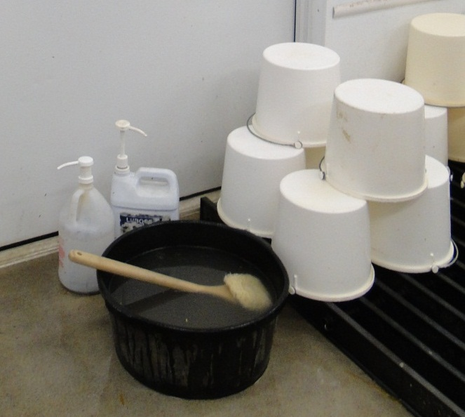
Preparation
Prepare (4) buckets of fresh warm water
  Add mild detergent/cleaner
  Rinse water
  Add EPA-registered disinfectant
  Rinse water
Water temperature
no greater than 110ºF
Running water is preferred
Notes:
To prepare for personnel and PPE C&D procedures, prepare (4) 2-gallon buckets of fresh warm water. Water temperatures for all buckets should not exceed a temperature greater than 110ºF. When possible, the use of running water is preferred. Add an appropriate mild detergent or cleaner to one of the buckets, an EPA-registered disinfectant to another. The remaining two buckets will be used for rinsing (or running water can be used for rinsing). [Photo source: Danelle Bickett-Weddle, Iowa State University]

Slide 4
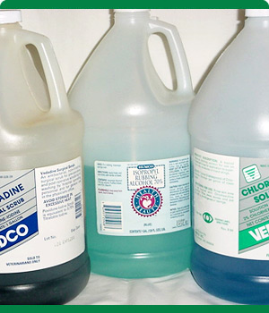
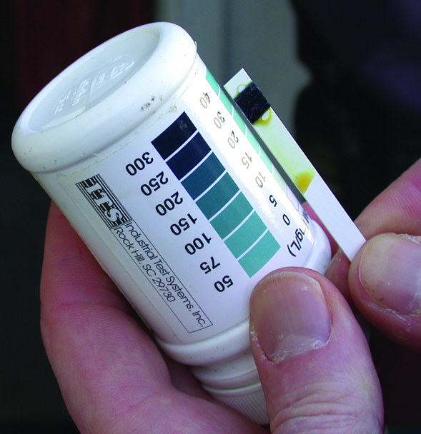
Disinfectant Solutions
Use according to product label
Only EPA-registered or approved products
Prepare fresh solutions
  Old solutions may have reduced efficacy
Test kits to help check concentration
Notes:
The preparation and application of disinfectant solutions must be in accordance with product label directions. Only EPA-registered or approved products should be used. Fresh solutions should be prepared prior to use since some disinfectant solutions may only be active for short durations. Failure to make fresh solutions may result in using a product that has reduced efficacy. The use of test kits can help to determine whether any chemical degradation of the disinfectant’s active ingredients has occurred and check that diluted solutions contain the necessary amount of active ingredient. [Photo source: Top: Carla Huston, Mississippi State University; Bottom: Teresa Robinson, USDA]

Slide 5
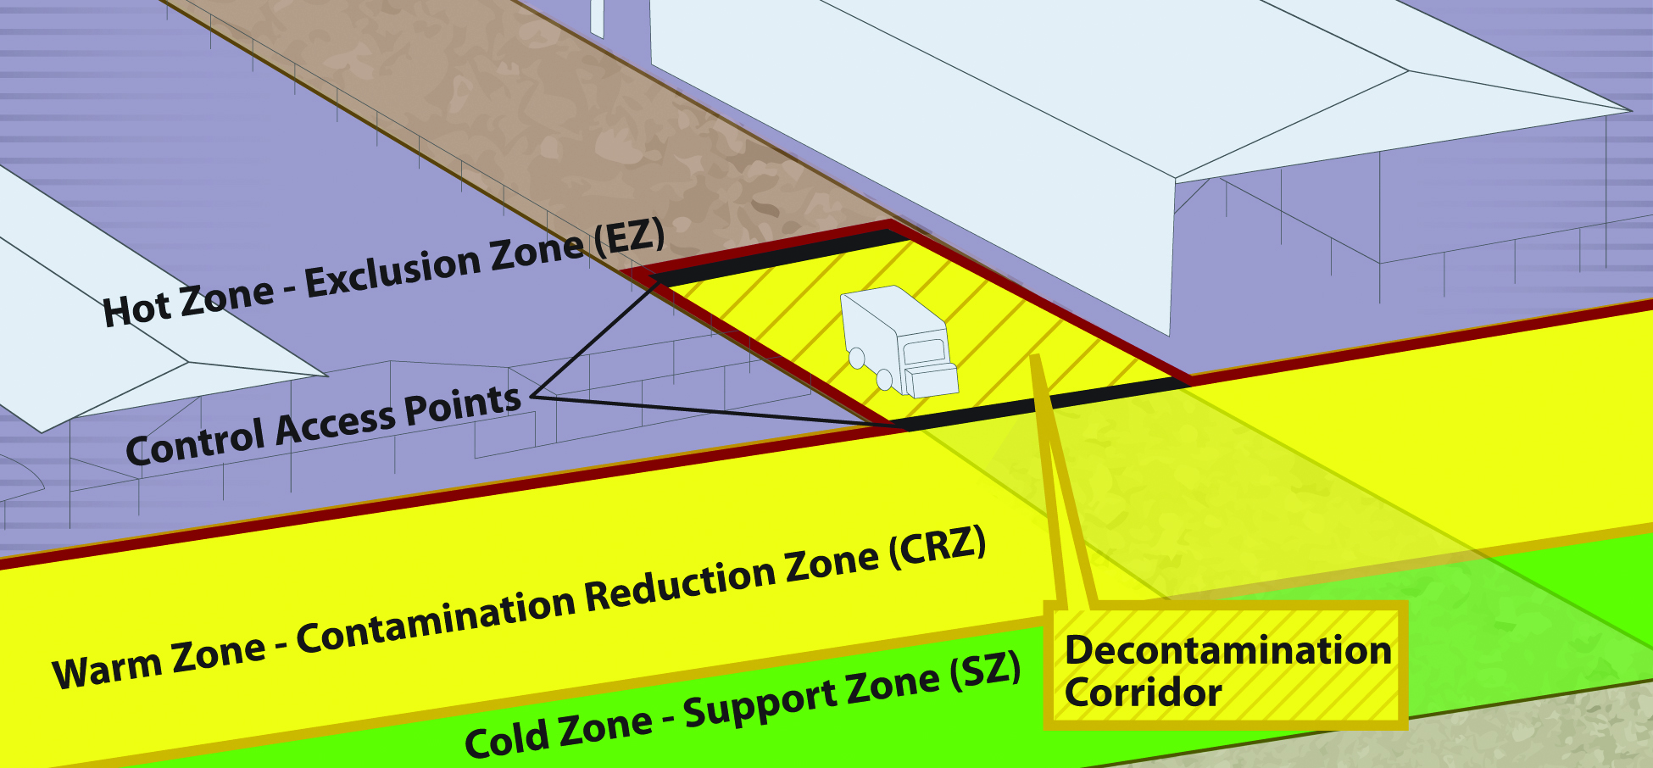
Biosecurity Work Zones
Notes:
During C&D procedures, biosecurity work zones must be maintained to prevent the spread of microorganisms. As a review, the 3 work zones of a response are the Hot Zone (Exclusion Zone), the Warm Zone (Contamination Reduction Zone), and the Cold Zone (Support Zone).
The Hot Zone - Exclusion Zone (EZ) is the high-risk area where infected animals were housed and is potentially contaminated and considered unsafe. PPE must be worn. Initial decontamination and disinfection of personnel begins here prior to exiting.
The Warm Zone - Contamination Reduction Zone (CRZ) is also a high risk area due to the potential of exposure to pathogens and chemical disinfectants. All personnel are required to wear full PPE. Final decontamination and disinfection as well as final doffing of PPE occur in the Decontamination Corridor of the Warm Zone-Contamination Reduction Zone (CRZ).
Cold Zone - Support Zone (SZ): This is the “cleanest” work zone with the lowest relative risk of exposure to pathogens and other hazards such as decontamination chemicals. Contaminated articles and equipment are prohibited in this area. Decontamination activities are also prohibited.
A Decon (Decontamination) Corridor runs between the Hot Zone-Exclusion Zone and the Warm Zone-Contamination Reduction Zone. Decontamination of personnel occurs along this corridor with the goal of decreasing the level of contamination as personnel move toward the Cold Zone. [Graphic illustration: Andrew Kingsbury, Iowa State University]

Slide 6
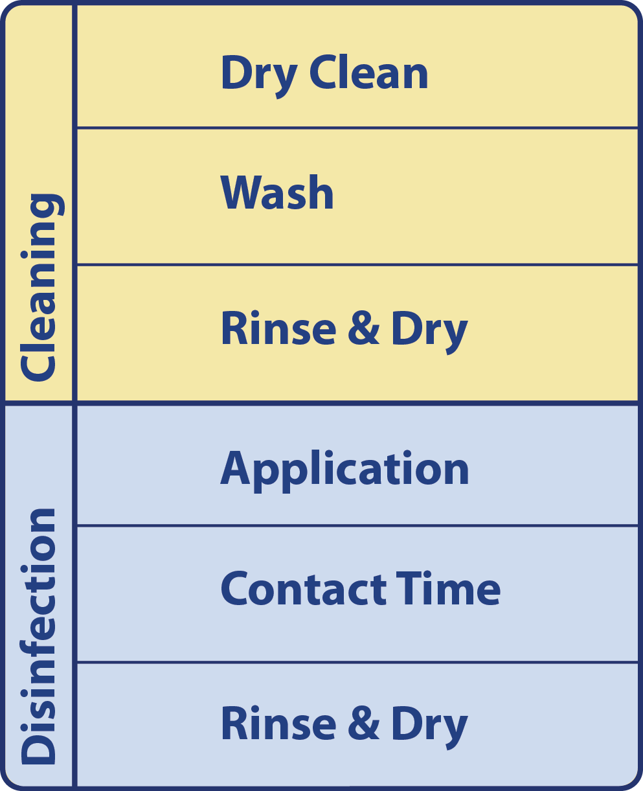
Basic Protocol
Systematic manner
Cleaning
  Dry clean
  Wash
  Rinse and Dry
Disinfection
  Application
  Contact time
  Rinse and Dry
Notes:
The cleaning and disinfection of personal protective equipment and personnel should be carried out in a systematic manner to ensure proper disinfection and decontamination. Following a basic C&D protocol will ensure efforts are effective. The basic C&D protocol, regardless of item involves a cleaning step, which includes dry cleaning and a thorough wash and rinse, followed by the disinfection step, which includes disinfectant application, appropriate contact time, followed by rinsing and drying. [Graphic illustration: Andrew Kingsbury, Iowa State University]

Slide 7
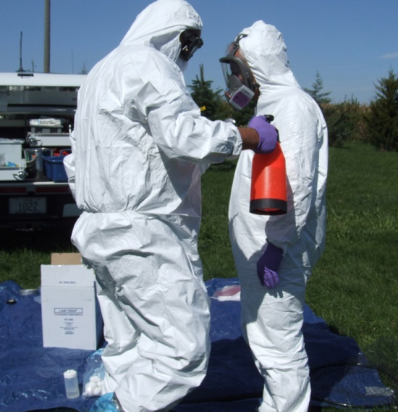
Procedure
In Hot Zone
  Dry brush exterior
  of PPE to remove gross contamination
  Spray PPE with disinfectant
  Enter Decon Corridor
Notes:
Begin the C&D/PPE doffing procedure in the Hot Zone, by dry brushing the exterior of PPE to remove any gross contamination. Be sure to scrub organic debris off the bottom of boots. Spray the exterior of PPE items with an appropriate disinfectant solution. Enter the Decontamination Corridor. [Photo source: Travis Engelhaupt, Iowa State University]

Slide 8
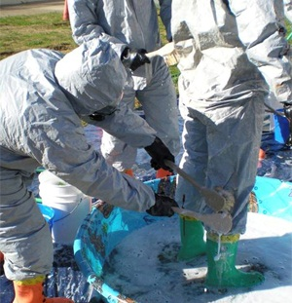
Wash and Rinse
Reusable Clothing
  Wash items with detergent using
  soft brush, cloth,
  or sponge
  Rinse components with clean, warm water
Notes:
Upon entering the Decontamination Corridor, a detergent solution should be applied (from head to toe) to any reusable clothing items, such as waterproof or nylon coveralls, using a scrub brush or low pressure spray to remove gross contamination. Pay particular attention to creases, zippers, and collars. Reusable footwear (e.g., rubber boots) should also be washed, ensuring the soles are cleaned well. Rinse the detergent from all items using clean warm water. [Photo source: Tegwin Taylor, CFSPH, Iowa State University]

Slide 9
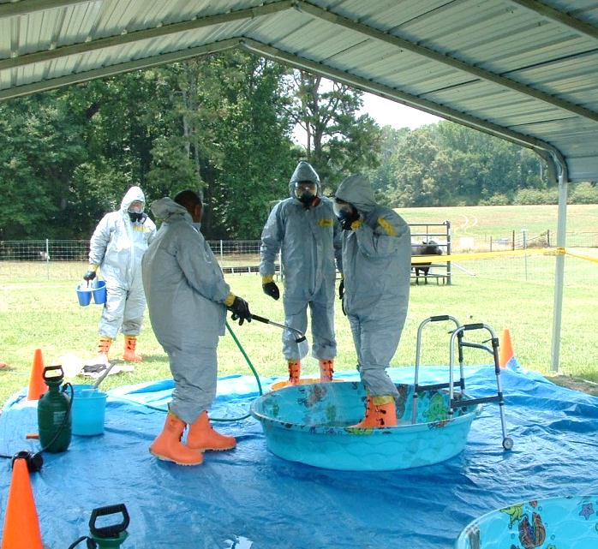
Disinfect
Apply EPA-registered disinfectant solution
to exterior
Allow solution to sit for appropriate contact time
Items must remain “wet” with solution
Notes:
Apply an EPA-registered disinfectant solution to the clothing and footwear items with a low pressure sprayer. Again pay close attention to creases, zippers and collars, as well as the soles of boots. Allow the disinfectant solution to remain on the items for the appropriate contact time. Items must remain “wet” with the solution throughout the necessary contact period. Reapplication may be necessary to achieve this. Then continue the PPE doffing procedure as described in the PPE Just-In-Time training presentation. [Photo source: Top: Tegwin Taylor, Iowa State University; Bottom: Jane Galyon and Travis Engelhaupt, Iowa State University]

Slide 10
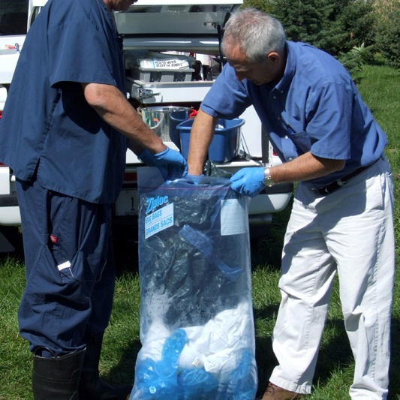
Disposable Clothing Items
Spray with
EPA-registered
disinfectant
Allow necessary
contact time
Doff PPE
Place in plastic garbage bags
  Spray outer surface with disinfectant
  Place at perimeter for removal
Notes:
If disposable PPE items (e.g., disposable booties, Tyvek coveralls, latex gloves) have been used, these items should be sprayed thoroughly with an appropriate EPA-registered disinfectant solution and allowed the necessary contact time. Items can then be removed in a biosecure manner according to PPE doffing procedures, and placed in plastic garbage bags. Once all disposable items are gathered into the bag, close and tie the bag. Spray the outer surface of the bag with disinfectant solution and place it at the outer edge of the premises for disposal according to the disposal plan. Alternatively, after cleaning, items may be removed and soaked in a container of disinfectant solution, ensuring complete contact of the solution with all surfaces and allowing for the adequate contact time prior to disposal. [Photo source: Dani Ausen, Iowa State University]

Slide 11
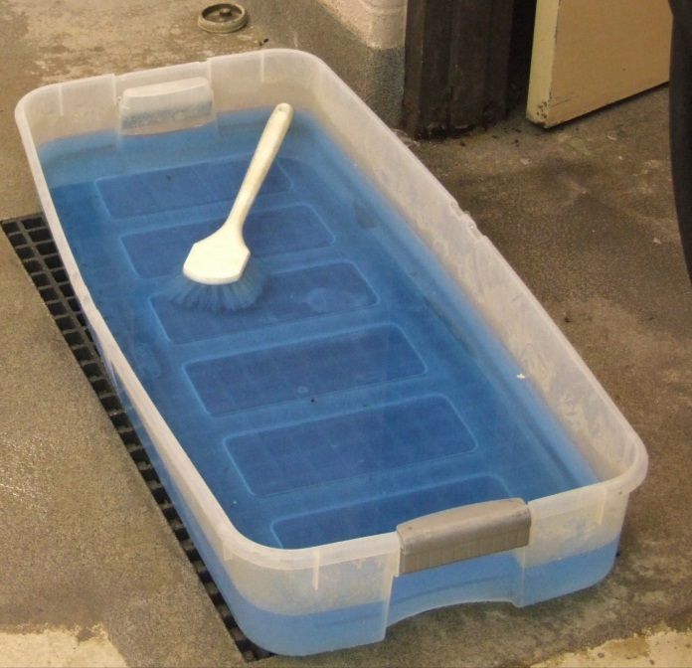
Footbaths
Ineffective if used incorrectly
  False sense of security
  Should not be sole process of disinfection
Use fresh solution
Allow contact time
Notes:
Note: While disinfectant footbaths may be in used upon exiting the premises, these “stations” may give a false sense of security to responders and should not be used as a sole process of disinfection. However, the process will serve to raise awareness about the need for biosecurity and disinfection for the disease situation present. A freshly prepared, appropriate disinfectant solution should always be used and adequate contact time allowed for optimum efficacy. [Photo source: Alex Ramirez, Iowa State University]

Slide 12
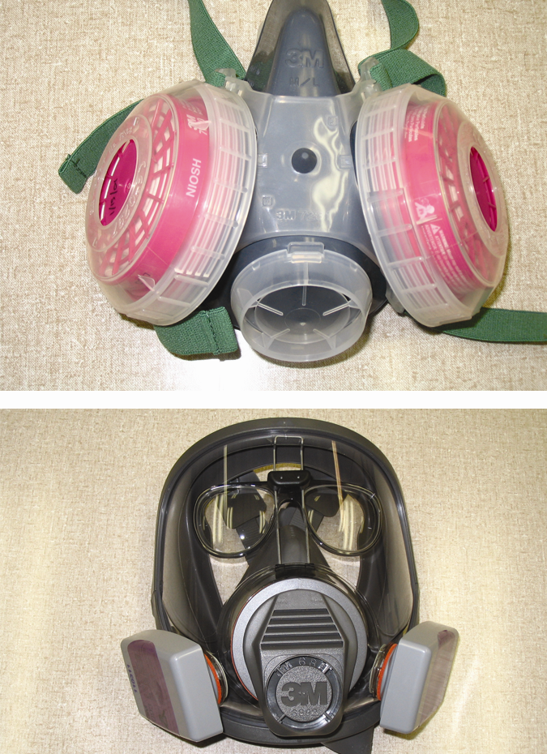
Respirators
C&D procedures available from OSHA
Proper cleaning to
  Reuse respirator
  Avoid damage to
  the respirator
  Avoid harm to user
  on reuse
Notes:
Some respirators, if properly cleaned and disinfected, may be used again. Suggested respirator cleaning and sanitation procedures are available from the Occupational Safety and Health Administration (OSHA) at http://www.osha.gov/pls/oshaweb/owadisp.show_document?p_table=STANDARDS&p_id=9782. Recommendations are highlighted here:
To avoid damage to the respirator, use a disinfectant/sanitizer recommended by the manufacturer that is efficacious for the targeted pathogen. Ensure that the respirator is properly cleaned and disinfected in a manner that prevents damage to the respirator components and does not cause harm to the user.
Specialized respirators such as PAPRs may require specialized C&D procedures to avoid damaging sensitive parts and components. [Photo source: Tru Twedt, Iowa State University]

Slide 13
Respirator C&D
Clean
  Remove filters, cartridges, canisters
  Disassemble components
  Wash with warm detergent water
  Rinse thoroughly
Disinfect
  Immerse in EPA-registered disinfectant
  Allow needed contact time
  Rinse thoroughly
Change solution after 20 respirators
Notes:
Remove any filters, cartridges, or canisters. Disassemble components, including the facepiece and hoses as recommended by the manufacturer. Wash components in warm water with a mild detergent or cleaner recommended by the manufacturer. Use a soft cloth or sponge to wipe all surfaces. Rinse components thoroughly in clean, warm water. Next, wipe the components with an EPA-registered disinfectant recommended by the respirator manufacturer for the necessary contact time; this may vary with the disinfectant product used. Some components may be immersible in disinfection solution. Rinse components thoroughly in clean, warm water. Allow components to air dry or hand-dry them with a clean, lint-free cloth. Respirator components should not be dried with heaters or in sunlight. Ideally , cleaning one respirator at a time is recommended. However, batches may be done in some cases. If doing this, it is best to group respirators together by manufacturer to avoid getting parts confused. Disinfection solutions should be changed after a maximum of 20 respirators are cleaned. Thorough rinsing of respirator components is very important as detergents or disinfectants that dry on facepieces may result in dermatitis on subsequent uses. Additionally, some disinfectants may cause deterioration of rubber or corrosion of metal parts if not completely rinsed away.

Slide 14
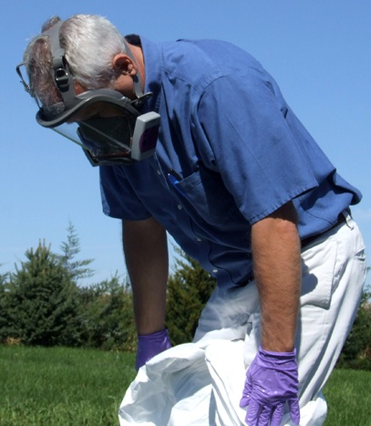
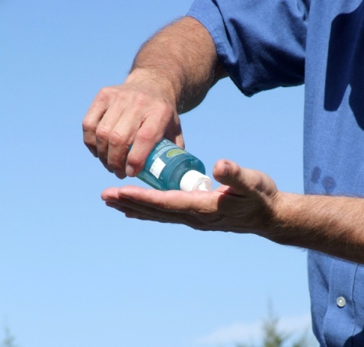
Personnel
Shelter for privacy
Warm water with antimicrobial soaps
Wash hands before leaving
Once home
(or if possible on-site)
  Complete shower
Notes:
After doffing all PPE items, clean clothing and shoes should be obtained in the Cold Zone. Privacy (e.g., tent, metal shed, trailer with shower) for changing needs should also be provided when possible. Warm water with antimicrobial soaps, scrubs, and hand cleaners should be available for personnel decontamination. Individuals must thoroughly wash their hands with antibacterial soap before leaving the premises. Once home, or when possible on-site, a complete shower should be taken. [Photo source: Travis Engelhaupt, Iowa State University]

Slide 15
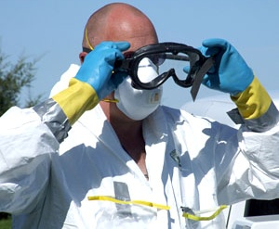
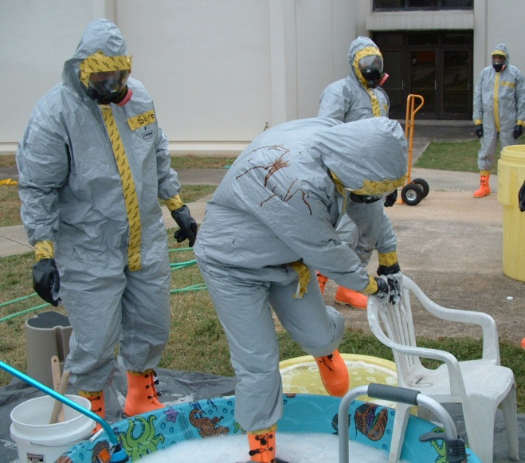
Safety
Chemical Hazards
  Skin, eye,
  respiratory
  irritation
Physical Hazards
  Slips, trips, falls
  Heat injury
  High pressure sprayer
Notes:
Safety concerns during C&D of personnel and PPE include exposure to chemical disinfectant products which can cause irritation to the skin, eyes or respiratory tract. Responders assigned to C&D areas should wear appropriate PPE (e.g., gloves, goggles). Physical hazards, such as slips, trips or falls from slippery surfaces can also occur, as can injury from high pressure sprayers. Providing stabilizing items (e.g., stool or other support) can help responders as they proceed through the decontamination corridor. [Photo source: Top: Travis Engelhaupt, Iowa State University; Bottom: Tegwin Taylor, Iowa State University]

Slide 16
References
https://fadprep.lmi.org
USDA APHIS. FAD PReP NAHEMS
  Highly Pathogenic Avian Influenza Standard Operating Procedures: Cleaning and Disinfection. February 2010.
  Foot-And-Mouth Disease. Standard Operating Procedures: Cleaning and Disinfection. February 2010.
  NAHEMS Guidelines: Cleaning and Disinfection. June 2011.
Notes:
The decontamination of personnel and disinfection of PPE will be essential during animal disease emergency situations. Attention to proper C&D procedures will help to minimize the further spread of pathogens and protect personnel from exposure. Information in this presentation was taken from the listed USDA APHIS Foreign Animal Disease Preparedness and Response Plan documents. The full version of these documents can be obtained a the FAD PReP website.

Slide 17
Acknowledgments
Development of this presentation was by the Center for Food Security and Public Health at Iowa State University through funding from the Multi-State Partnership for Security in Agriculture
Author: Glenda Dvorak, DVM, MPH, DACVPM
Notes:
Information provided in this presentation was developed by the Center for Food Security and Public Health at Iowa State University College of Veterinary Medicine, through funding from the Multi-State Partnership for Security in Agriculture.

