Slide 1
Cleaning and Disinfection
Overview
Notes:
October 2010
Cleaning and disinfection (C&D) procedures are a crucial part of any animal health emergency response. The cleaning and disinfection of premises, equipment, vehicles and personnel will be necessary to prevent the spread of animal pathogens to other animals, locations or response personnel. This Just-In-Time training presentation will overview basic C&D processes and procedures and the role of the C&D team.

Slide 2
Cleaning & Disinfection (C&D)
Stop the spread of pathogens
  Inactivate or destroy microorganisms
Vital for animal health emergency situations
Premises, equipment, vehicles, personnel
Personnel must be knowledgeable
  C&D methods, procedures, limitations
  Safety issues
Notes:
The potential spread or transfer of microorganisms, especially highly contagious pathogens, can occur from the direct or indirect contamination of premises, equipment, vehicles or personnel and the movement of animals or animal products. C&D procedures are used to inactivate or destroy microorganisms thereby inhibiting or eliminating their further spread. These efforts are vital for disease control and eradication measures. Response personnel must be knowledgeable about proper C&D methods and procedures as well as their limitations. Additionally, any number of safety issues must be considered and addressed.

Slide 3
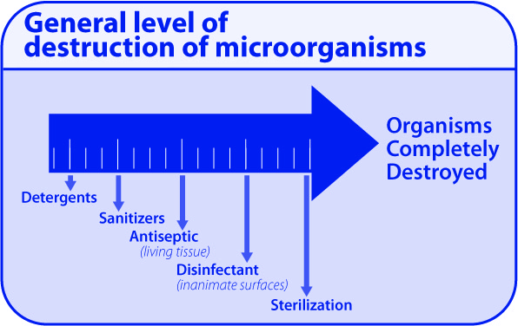
C&D Methods
Reduce, remove, inactivate, destroy
Methods vary in level of destruction
Physical
  Heat, UV light
Chemical
  Sanitizers
  Disinfectants
  Sterilants
Notes:
Cleaning and disinfection methods can involve the use of physical (e.g., heat or ultraviolet light) or chemical (e.g., sanitizers, disinfectants, sterilants) processes to reduce, remove, inactivate, or destroy pathogenic microorganisms. These processes vary in their level of destruction of microorganisms, which is an important consideration when selecting and conducting C&D processes. [Graphic illustration by: Clint May and Andrew Kingsbury, Iowa State University]

Slide 4

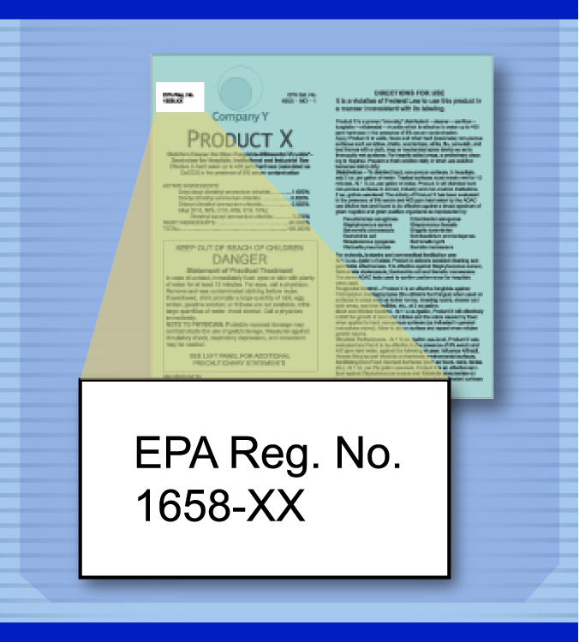
Disinfectant Regulation
Registered and regulated by EPA
  Federal Insecticide, Fungicide
  and Rodenticide Act (FIFRA)
  “Antimicrobial pesticides”
Use in manner inconsistent
with label
  Ineffective application
  “Misuse” of product
Notes:
Chemical disinfectants are registered and regulated as “antimicrobial pesticides” by the U.S. Environmental Protection Agency under the Federal Insecticide, Fungicide, and Rodenticide Act (FIFRA). Use of a registered disinfectant in a manner inconsistent with its labeling not only results in ineffective application but may be a “misuse” of the product and subject to potential enforcement action. In some situations, (e.g., highly contagious or foreign animal disease), EPA may grant Emergency exemptions for products to Federal or State agencies for a specified period of time.

Slide 5
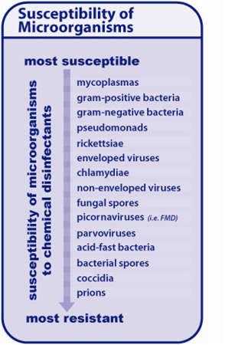
Efficacy Considerations
Microorganism
Considerations
  Vary in susceptibility
Environmental
Considerations
  Organic load
  Water hardness
  Temperature
  Surface type
  Other chemicals
Notes:
Microorganisms vary in their susceptibility to disinfection. Some, such as mycoplasmas and gram-positive bacteria, are generally susceptible to most disinfectants, while bacterial spores and prions are very resistant. Environmental factors can also affect disinfection efficacy the biggest factor is organic lad, as many disinfectants are inactivated in its presence. Other factors that can influence the disinfection process include water hardness and temperature. The type of surface being disinfected will also be important, as smoother surfaces will be easier than rough or porous surfaces. Interaction with other chemicals (e.g., soaps, detergents) or structural compositions (e.g., metals, rubber) can affect disinfectant efficacy. [Graphic illustration: Clint May, Iowa State University]

Slide 6
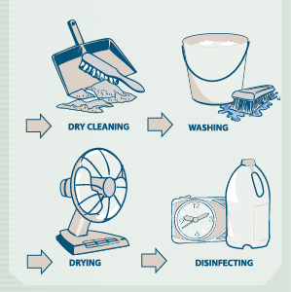
Basic C&D Protocol
Cleaning
  Dry Cleaning
  Washing
  Rinse and dry
Disinfection
  Application
  Contact Time
  Rinse and dry
Downtime
Notes:
Regardless of the situation, item, or area, effective C&D should always follow a basic C&D protocol. Cleaning – which includes dry cleaning, washing, rinsing and drying – and Disinfecting - which involves application, contact time, and rinsing and drying. After these measures are completed downtime is also important. Conducting C&D activities in this systematic manner help to ensure the C&D process is effective. Let’s look at these steps a bit closer. [Graphic illustration by: Andrew Kingsbury, Iowa State University]

Slide 7
Cleaning
Importance
  Can remove 90% of microorganisms
  Improves disinfection efficacy
  Prior to application of disinfectant
Three steps
  Dry clean
  Wash
  Rinse and Dry
Notes:
Cleaning is one of the most important steps in the C&D process and when done correctly, cleaning alone can remove over 90% of microorganisms. This step also helps to improve disinfection efficacy since most disinfectants have reduced effectiveness in the presence of organic material. The cleaning process should be conducted prior to the application of all EPA-registered disinfectants. The cleaning process involves three steps: dry cleaning, washing, and rinse and dry.

Slide 8
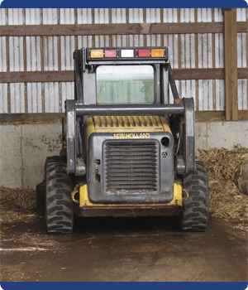
Cleaning: Dry Cleaning
Removal of gross contamination
  Organic material
    Soil, manure, bedding, feed
Moisten to control dust
Air blowers should not
be used
  Risk of pathogen spread
Disposal should minimize spread
  Burning, burial, composting
Notes:
Dry cleaning involves the removal of any gross contamination and organic material (e.g., soil, manure, bedding, feed). Shovels, manure forks, brooms and brushes should be used to sweep, scrape and remove organic material from surfaces and areas. Heavy equipment may be needed to remove large quantities of bedding or manure. This process may require considerable time and effort, depending on the size and type of facility, but it is essential as this material can harbor microorganisms, reduce disinfection efficacy, or even inactivate some disinfectant products. Disposal of all material should be in a manner that minimizes further spread of microorganisms and that is compliant with federal, state and local requirements and policies. In situations involving highly contagious foreign animal diseases, moistening the area or item with water first may be helpful for controlling dust and minimizing aerosolization of pathogens. Air blowers should not be used for dry cleaning due to the risk of spreading pathogens. [Photo Danelle Bickett-Weddle, Iowa State University]

Slide 9
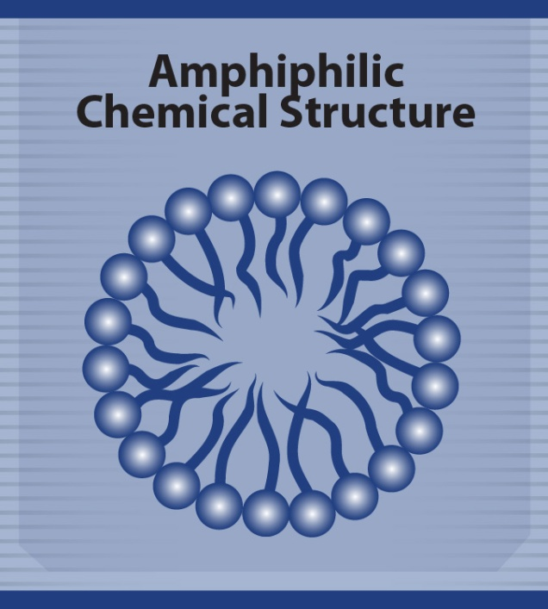
Cleaning: Washing
Most overlooked step
Detergent
  Reduces microorganisms
  Removes oil, grease,
  exudates
Shut off, remove or cover
electrical equipment
  Covered tightly with plastic
  Electrician may be helpful
May need pre-soaked
Notes:
The second step in the cleaning process is washing. The washing process helps to further reduce the number of microorganisms as well as remove any oil, grease, or exudates that may inhibit disinfection. This is one of the most overlooked steps in the C&D process. Soaps and detergents are surfactants – meaning their chemical structure has both water soluble and oil soluble properties. This characteristic serves to reduce surface tension and increase the penetrating ability of water to disperse and remove organic material and grease. Prior to washing, all electrical equipment should be turned off, removed or covered tightly with plastic sheeting. Areas and items with organic material adhered to the surfaces should be pre-soaked for several hours. [Photo Danelle Bickett-Weddle, Iowa State University]

Slide 10
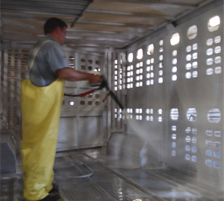
Cleaning: Washing
High pressure water
is very effective
  Avoid if highly
  infectious or zoonotic
Warm to hot water
should be used
Scrubbing may be necessary
Steam
  Effective for cracks, crevices, pipework
Notes:
Mechanical scrubbing and scraping may be necessary to remove oils, grease or exudates from rough surfaces, deep cracks, pits, pores or other surface irregularities. High pressure water and detergent is very effective in removing the heavy accumulation of urine and feces and for cleaning porous surfaces, but should be avoided in cases of highly infectious or zoonotic pathogens to avoid further spread. Whenever possible, warm to hot water (90-130°F) should be used to increase efficacy. Hot water and steam can be effective for cleaning cracks, crevices and the inside of pipework where pathogens are likely to linger. [Photo source: Danelle Bickett-Weddle, Iowa State University]

Slide 11
Rinse/Dry
Rinse with cold water at low pressure
Surfaces should be inspected
  No beading should occur
Surfaces should allow to dry completely
  Overnight if possible
Fans can be helpful in drying
Do not use with zoonotic pathogens
Notes:
After washing, all surfaces should be thoroughly rinsed at low pressure with cold water. Surfaces should then be carefully inspected to ensure they are visibly clean - moisture should spread evenly over surfaces and no “beading” should occur, as this would indicate the presence of oil or grease. Whenever possible, surfaces should be allowed to dry completely (if possible overnight) before the application of a disinfectant. Fans can be helpful to the drying process but should not be used if dealing with a highly infectious or zoonotic pathogens.

Slide 12
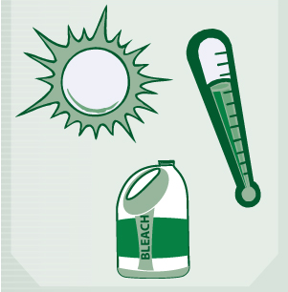
Disinfection
Application
  Physical
    Heat, UV light
  Chemical
    Disinfectant
Contact time
  Most important
  May need reapplication
Rinse after contact time
Notes:
The disinfection process also has three steps: application, contact time, and rinse and dry. As previously mentioned, disinfection can involve of physical (e.g., heat, ultraviolet light) or chemical (e.g., disinfectant) means, or a combination of methods may be needed. Application methods can vary and will depend on the disinfection method chosen. One of the most important steps of the disinfection procedure is to allow adequate contact time for the process to have its impact. In some cases, the chemical disinfectant may need to be reapplied to keep the surface wet for the required contact time. Following the application (and subsequent contact time) of chemical disinfectants, items and areas should be thoroughly rinsed as most of these products can be harmful to animals.

Slide 13
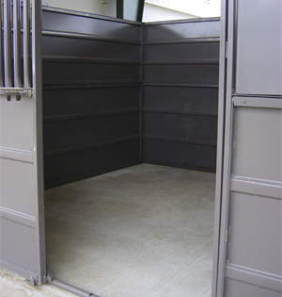
Downtime
Free of any animals
or activity
Reduces pathogens
by drying
Time varies based on pathogen
  Three times expected incubation period
Block of area
Notes:
Premises that have been cleaned and disinfected should also have a period of downtime following the procedures. This involves the area being free of any animals or activity for a period of time to allow it to completely dry. The application of disinfectant solutions uniformly over large areas (e.g., ceilings, walls, floors) can be very difficult. Adequate downtime serves to further reduce or eliminate any remaining microorganisms on the premises through desiccation. Downtime can begin as soon as the premises is certified as clean and disinfected and should be at least three times the longest expected incubation time of the targeted pathogen. Areas should be cordoned off with marking tape to designate these areas. [Photo source: Carla Huston, Mississippi State University]

Slide 14
Assessment and Planning
Identify pathogen
Determine areas & items
Select proper disinfection method
Identify & address hazards & safety issues
Determine personnel, equipment & supplies needed
Notes:
Cleaning and disinfection measures should begin as soon as possible to minimize the transfer of pathogens by contaminated vehicles, equipment and personnel or animals involved. However, assessment of the situation should be conducted and a site-specific plan developed before C&D procedures begin. This includes identifying the known or suspected pathogen to be controlled or eliminated, determining the areas and items in need of disinfection, selecting the proper disinfection method and identifying and addressing any potential safety or hazardous issues involved. The site-specific C&D plan should also address the details on how to dispose of material s (e.g., gross debris, chemical solutions) in a manner that minimizes the further spread of microorganisms and is compliant with federal, state, and local requirements and policies. Once the situation is thoroughly assessed, the personnel, equipment and supplies needed can be determined, and any regulatory permits or approvals can be obtained.

Slide 15
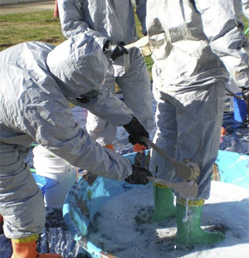
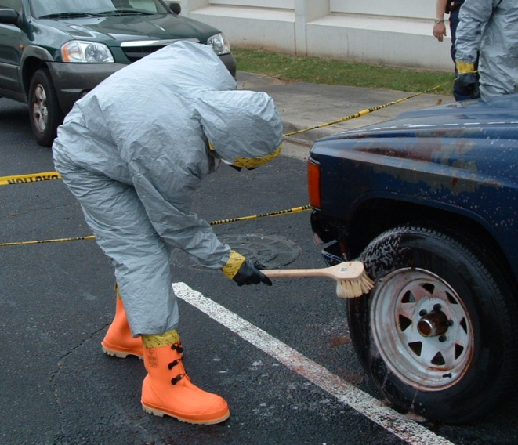
Site Selection
Adjacent to entrance points
Two scales
  Small scale for personnel/small equipment
  Large scale for vehicles, machinery
House C&D components
  Disinfection station
  Water supply/waste water containment
Notes:
The location used to establish C&D stations is critical and should be adjacent to or at the entrance points to the infected premises. Stations established for C&D efforts will involve two scales: small scale for personnel and small equipment, and large scale for vehicles and heavy machinery. Stations should be established at areas with flat terrain, large enough to house the necessary C&D components such as a disinfection station, water supply, and waste water containment.

Slide 16
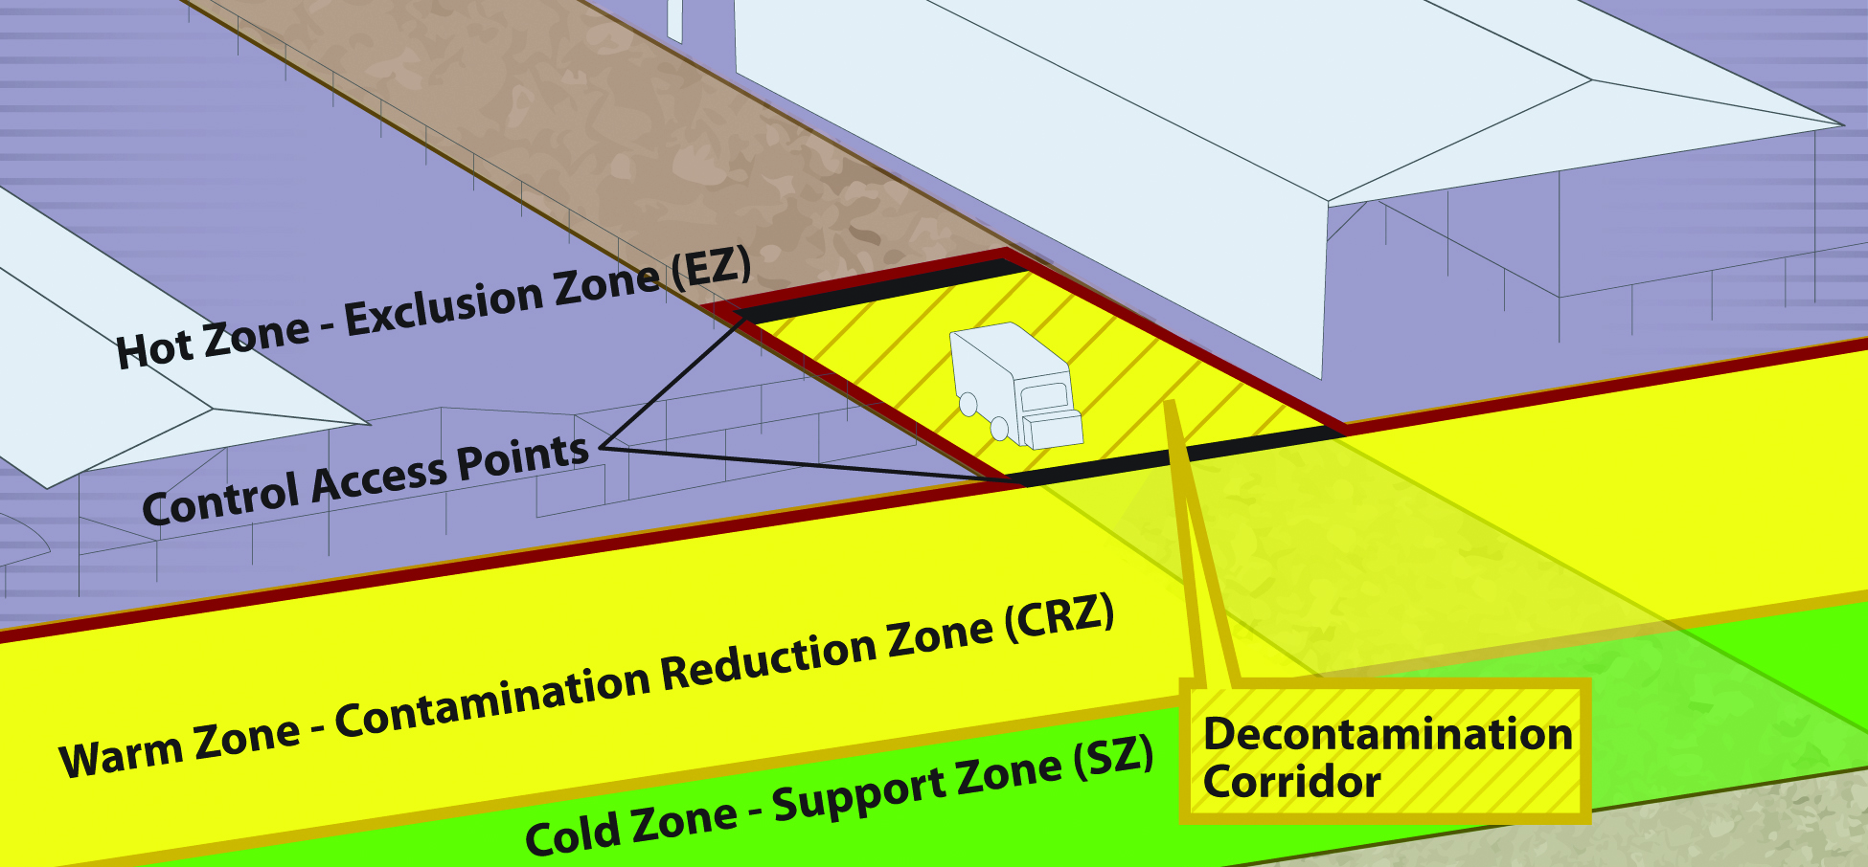
Biosecurity Work Zones
Notes:
Biosecurity work zones must also be maintained during C&D procedures. To learn more about these, see the Biosecurity Overview Just In Time presentation.

Slide 17
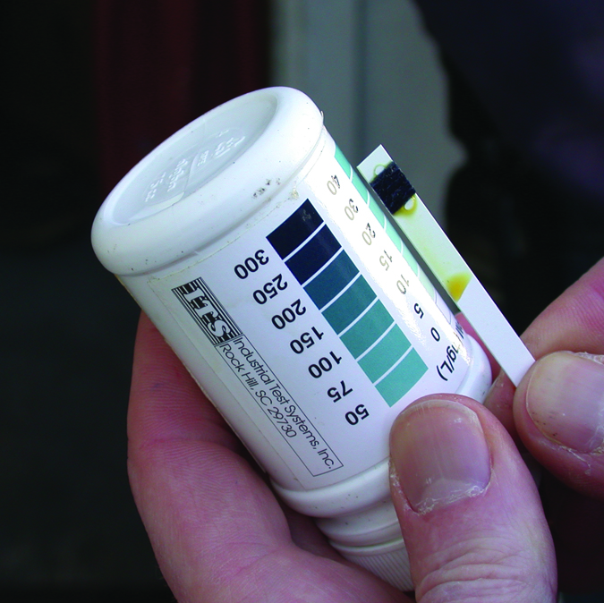
Disinfectant Preparation
Only EPA-registered products
Fresh solutions only
  Old solutions may
  have reduced efficacy
Test kits
  Determine chemical degradation of active ingredients
Notes:
The preparation and application of disinfectant solutions must be in accordance with product label directions. Only EPA-registered or approved products should be used. The quantity needed will be determined by the total surface area; a rough estimate is that 1 gallon will cover approximately 100-150 square feet. Fresh solutions should be prepared prior to use; some disinfectant solutions may only be active for the same day of preparation. Failure to make fresh solutions may result in using a product that has reduced efficacy. The use of test kits can help to determine whether any chemical degradation of the disinfectant’s active ingredients has occurred and that diluted solutions contain the necessary amount of active ingredient. [Photo source: Teresa Robinson, USDA]

Slide 18
Evaluation
Areas properly cleaned/disinfected
Personnel aware of/implementing C&D measures
Proper disinfectant selected
  Appropriate concentration
  Correct contact time achieved
C&D Waste
  Minimize or avoid environmental impact
Notes:
Inspection of a site following C&D procedures should ensure all tasks detailed on the premise assessment have been performed. Factors to be addressed should include:
All grossly contaminated, infected or suspected areas have been identified and properly cleaned and disinfected
All personnel are aware of and are implementing C&D measures for themselves and their equipment
One or more appropriate disinfectants have been selected and used at the appropriate concentration and the correct contact time was achieved
Effluent from the C&D procedures has been handled in a manner to minimize or avoid environmental impact
Final inspection of the premises should be conducted by experienced personnel. If there is any doubt or sign of inadequate procedures, the disinfection measures must be repeated. Once final inspection of the premises has occurred, any and all personnel present should proceed through the C&D site before leaving the premises.

Slide 19
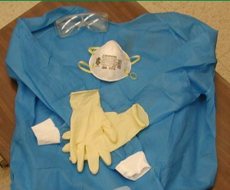
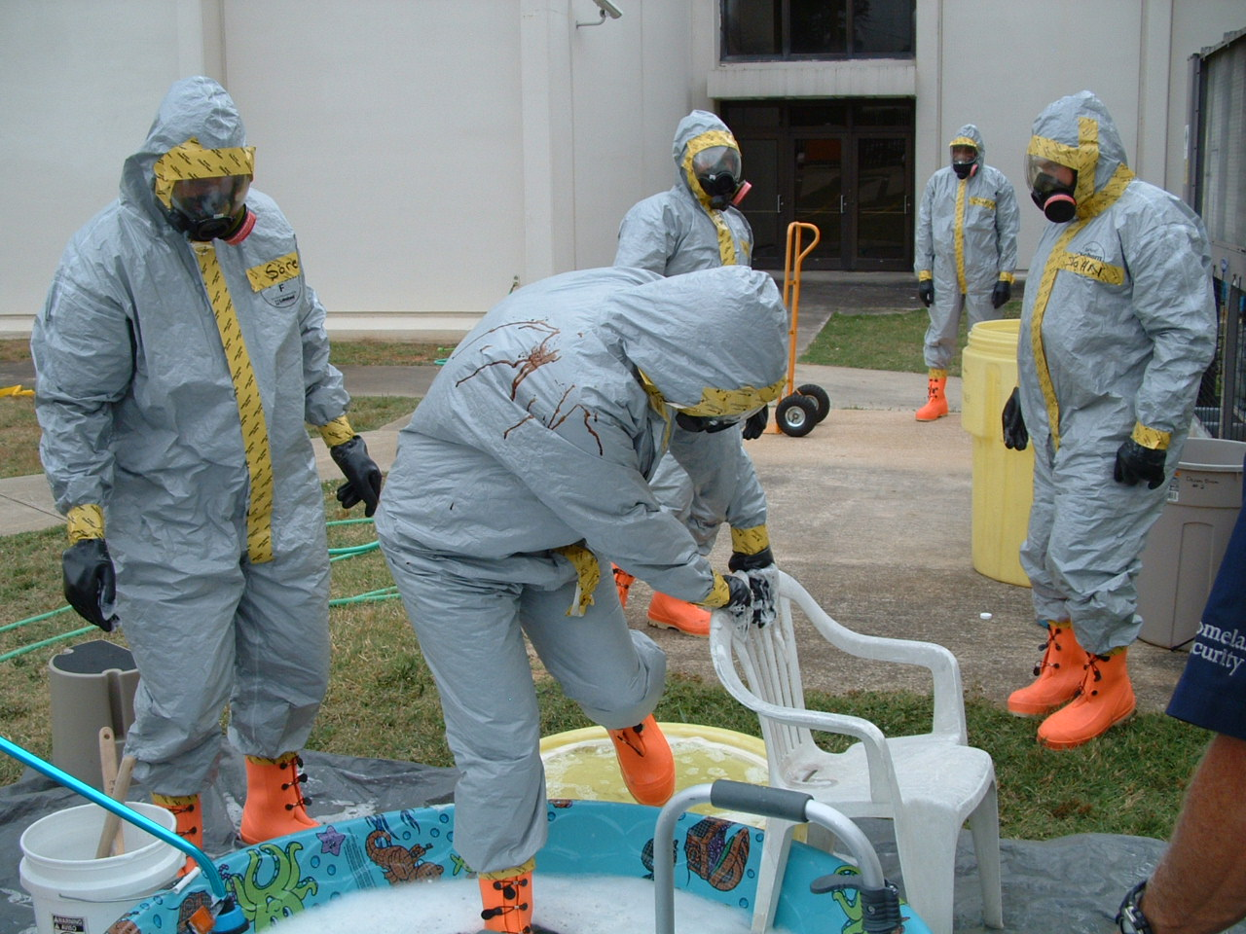
Safety
Chemical Hazards
  Skin, eye, respiratory
  irritation
  Ingestion (animals)
Physical Hazards
  Slips, trips, falls
  Heat injury
  High pressure sprayer
Personal Protective
Equipment (PPE)
  Gloves, masks, eyes
Notes:
Most disinfection methods have some level of hazard. This can range from irritation of the skin, eyes or respiratory tract to chemical burns; many are toxic to animals if ingested, or if allowed to runoff into environmental locations. A number of physical hazards are also possible while conducting C&D procedures. These may include slips, trips or falls from slippery surfaces; heat exposure or burns from hot water, or skin punctures from high pressure sprayers. To avoid many of these hazards, C&D personnel should wear personal protective equipment, such as gloves, masks, and eye protection when handling, mixing and applying disinfectant solutions.

Slide 20
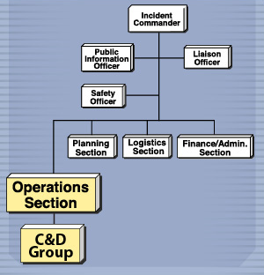
ICS: C&D Group
Part of Operations Section of ICS
  Establish C&D protocols
  Set up disinfection stations
    Vehicles
    Equipment
    Personnel
Notes:
The Cleaning and Disinfection Group functions as part of the Operation Section of the Incident Command System (ICS). The goals of the C&D team are to establish, coordinate and implement C&D procedures for infected or quarantined premises and disinfection stations for vehicles, equipment and personnel. [Graphic illustration by: LMI]

Slide 21
C&D Team
C&D Group Supervisor
  C&D implemented effectively
  Personnel know proper procedures
  Identifies team members with required expertise
C&D Team Leaders
  Supervises on site activities
C&D Team Members
  Implement C&D procedures
Notes:
The C&D Group is supervised by a Group Supervisor, and any Team Leaders assigned. The C&D Group Supervisor has the primary responsibility for ensuring that all C&D personnel are familiar with the proper C&D procedures and that they are implemented effectively. The Group Supervisor also works to identify team members with the required expertise. A C&D Team Leader supervises the on-site activities of the C&D Teams and is typically given responsibility for one of the specific C&D functions which have been identified, such as vehicle disinfection stations, equipment and supplies or premises C&D supervision. C&D Team members implement C&D procedures determined necessary for a specific incident.

Slide 22
Acknowledgments
Development of this presentation was by the Center for Food Security and Public Health at Iowa State University through funding from the Multi-State Partnership for Security in Agriculture
Authors: Glenda Dvorak, DVM, MPH, DACVPM; Ashley Osborn
Notes:
Information provided in this presentation was developed by the Center for Food Security and Public Health at Iowa State University College of Veterinary Medicine, through funding from the Multi-State Partnership for Security in Agriculture.

