Slide 1
Cleaning and Disinfection
Equipment
Notes:
June 2011
Cleaning and disinfection (C&D) procedures are a crucial part of any animal health emergency response. The cleaning and disinfection of equipment used during an animal health response will be necessary to prevent the spread of pathogens to other animals, locations or response personnel. This Just-In-Time training presentation will discuss the steps needed to conduct C&D of equipment used during an animal disease emergency response.

Slide 2
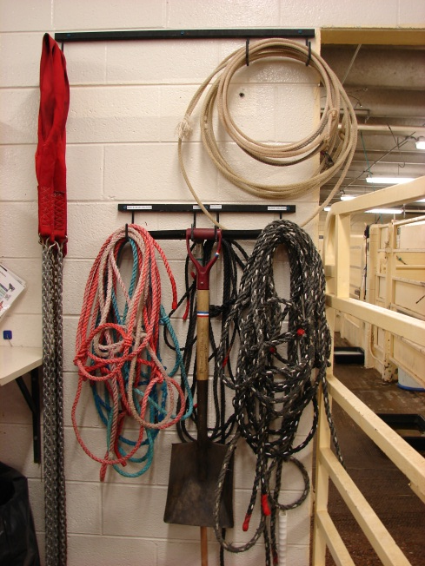
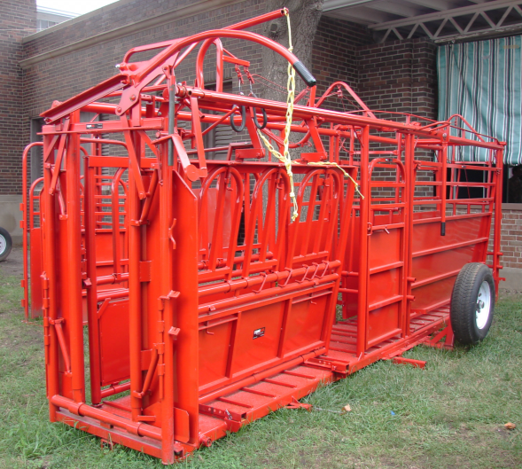
Equipment
Items for care, treatment, restraint, response activities
Anything in contact
with infected animals
Clean and disinfect
OR
appraise and dispose
Notes:
Equipment used for an animal disease response site can serve to transfer microorganisms to other locations and to susceptible animals. This may include any number of items used for the care, treatment, restraint or euthanasia of animals, any necropsy or sample collection equipment, or any other items that have had contact with infected animals. All of these items will require C&D before being removed from the infected premises. Many of these items will be difficult to clean. If items cannot be adequately cleaned and disinfected, they should be appraised and disposed of by appropriate means. [Photo source: Danelle Bickett-Weddle, Iowa State University]

Slide 3
Equipment
Necropsy
  Markers, cut-proof gloves, pencils or pens, cooler, clipboard, tweezers, hemostats
Restraining tools
  Rope, snares, halters
Clinical Supplies
  Thermometer, stethoscope, blood collection equipment
C&D Equipment
  Brushes, buckets, shovels, brooms
Notes:
This slide shows a sample of some of the equipment that may be used during an animal disease response – and that will require either C&D procedures prior to removal from the premises or appropriate disposal.

Slide 4
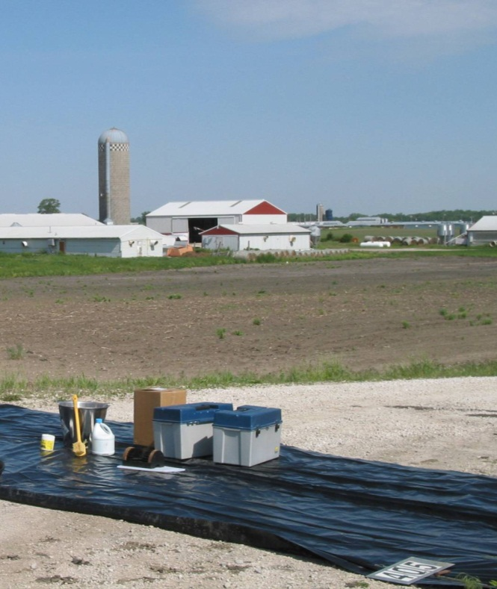
Site Selection
Adjacent to entrance
Flat terrain
Impermeable surface
House components
  C&D equipment
  Water supply
  Waste water containment
Notes:
A small-scale C&D station should be set up adjacent to or at the entrance/exit points to the infected premises. The location should be on flat terrain with an impermeable surface (e.g., plastic sheeting). This helps to prevent fluid infiltration into the soil while allowing containment of fluids and easier cleanup of the area following procedures. The area should be large enough to house the necessary C&D components such as a disinfection station, water supply, and waste water containment. The station should contain equipment (e.g., tubs, scrub brushes) to aid in the removal of gross debris and application of disinfection products. If possible, a running water supply should be included. Runoff water should be contained and not allowed to drain into “clean” uncontaminated areas. [Photo source: Tim Smith, Iowa Department of Agriculture and Land Stewardship]

Slide 5
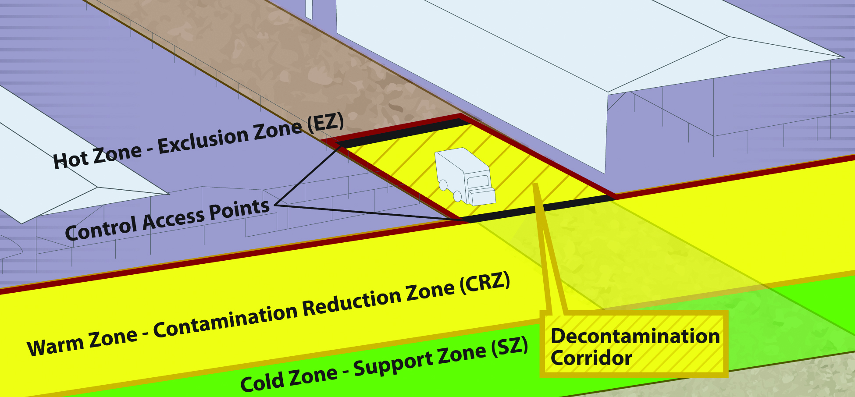
Biosecurity Work Zones
Notes:
During C&D procedures, biosecurity work zones must be maintained to prevent the spread of microorganisms. As a review, the 3 work zones of a response are the Hot Zone (Exclusion Zone), the Warm Zone (Contamination Reduction Zone), and the Cold Zone (Support Zone).
The Hot Zone - Exclusion Zone (EZ) is the high-risk area where infected animals were housed and is potentially contaminated and considered unsafe. PPE must be worn. Initial decontamination and disinfection of items begins here prior to exiting.
The Warm Zone - Contamination Reduction Zone (CRZ) is also a high risk area due to the potential of exposure to pathogens and chemical disinfectants. All personnel are required to wear full PPE. Final decontamination and disinfection occurs in the Decontamination Corridor of the Warm Zone-Contamination Reduction Zone (CRZ).
Cold Zone - Support Zone (SZ): This is the “cleanest” work zone with the lowest relative risk of exposure to pathogens and other hazards such as decontamination chemicals. Contaminated articles and equipment are prohibited in this area. Decontamination activities are also prohibited.
A Decon (Decontamination) Corridor runs between the Hot Zone-Exclusion Zone and the Warm Zone-Contamination Reduction Zone. Decontamination of items occurs along this corridor with the goal of decreasing the level of contamination as equipment is moved toward the Cold Zone. [Graphic illustration: Andrew Kingsbury, Iowa State University]

Slide 6
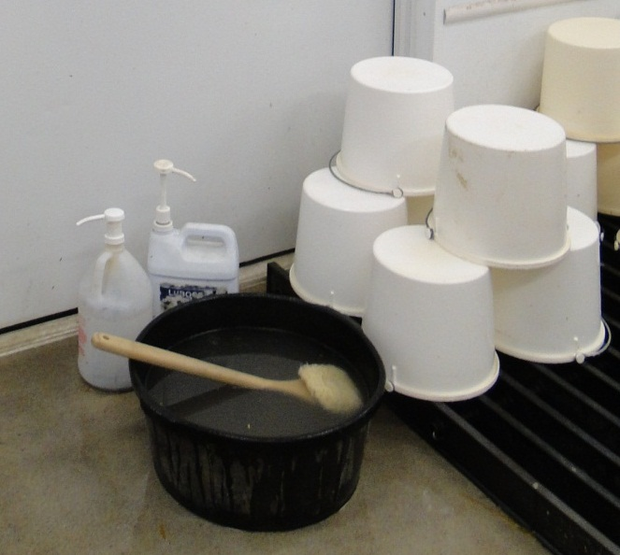
Preparation
Prepare (4) buckets of fresh warm water
  Add mild detergent/cleaner
  Rinse water
  Add EPA-registered disinfectant
  Rinse water
Water temperature
no greater than 110ºF
Running water is preferred
Notes:
Begin equipment C&D preparation by filling (4) 2-gallon buckets of fresh warm water. Water temperatures for all buckets should not exceed a temperature greater than 110ºF. When possible, the use of running water is preferred. Add an appropriate mild detergent or cleaner to one of the buckets, an EPA-registered disinfectant to another. The remaining two buckets will be used for rinsing (or running water can be used for rinsing). Ensure that the selected disinfectant will not damage or corrode the equipment. Special care should be used when cleaning and disinfecting rubber equipment because many disinfectants are corrosive to rubber. Strongly consider requesting an appraisal of these items and destroying them. Maintain an Operating Log noting temperature of wash and rinse waters, detergent and disinfectant concentrations. [Photo source: Danelle Bickett-Weddle, Iowa State University]

Slide 7
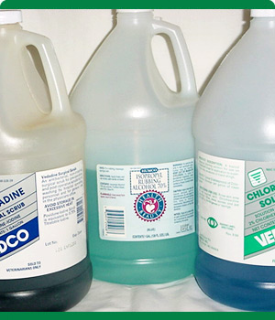
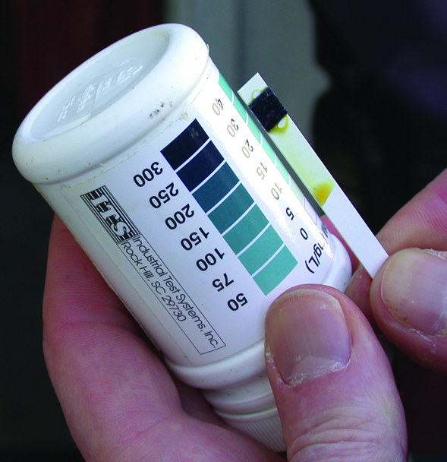
Disinfectant Preparation
Use according to product label
Only EPA-registered or approved products
Prepare fresh solutions
  Old solutions may have reduced efficacy
Test kits can help check concentration
Notes:
The preparation and application of disinfectant solutions must be in accordance with product label directions. Only EPA-registered or approved products should be used. Fresh solutions should be prepared prior to use; some disinfectant solutions may only be active for the same day of preparation. Failure to make fresh solutions may result in using a product that has reduced efficacy. The use of test kits can help to determine whether any chemical degradation of the disinfectant’s active ingredients has occurred and that diluted solutions contain the necessary amount of active ingredient. [Photo source: Top: Carla Huston, Mississippi State University; Bottom: Teresa Robinson, USDA]

Slide 8
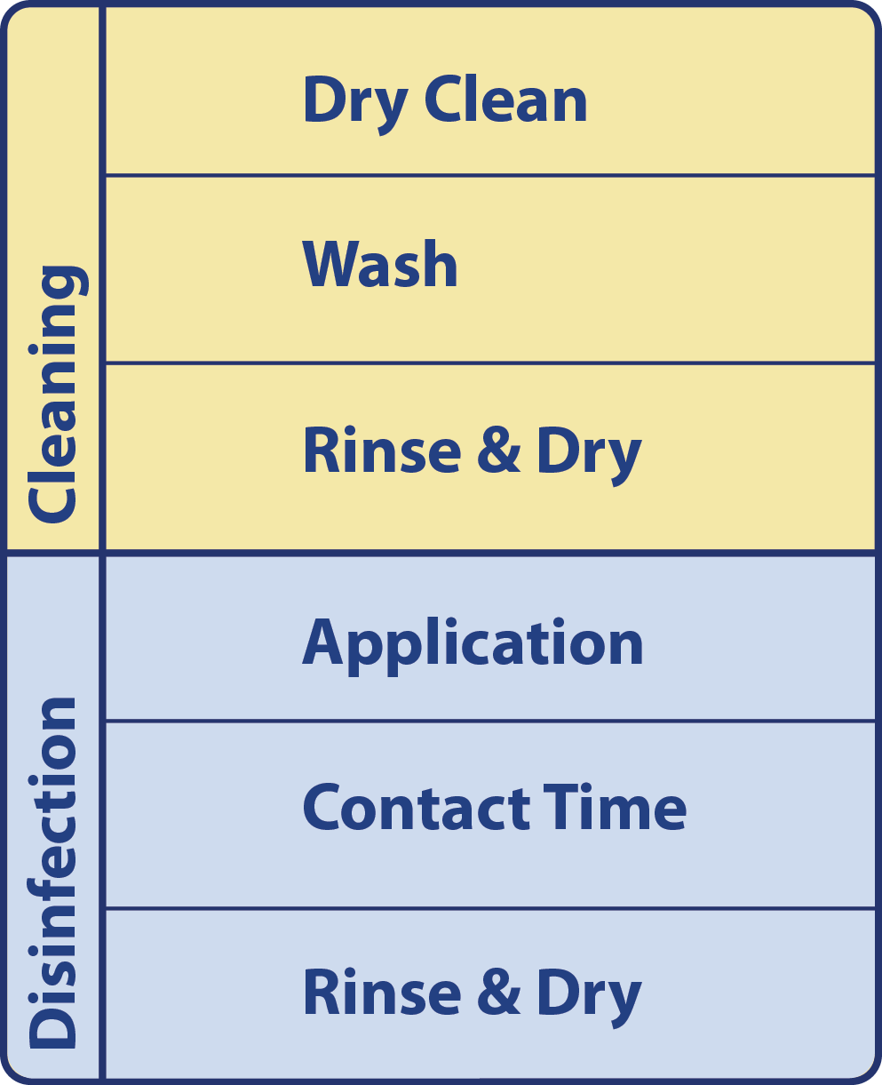
Basic C&D Protocol
Cleaning
  Dry Cleaning
  Washing
  Rinse and dry
Disinfection
  Application
  Contact Time
  Rinse and dry
Downtime
Notes:
The cleaning and disinfection of equipment should be carried out in a systematic manner to ensure proper disinfection. The basic C&D protocol, regardless of item involves a cleaning step, which includes dry cleaning and a thorough wash and rinse, and when possible, complete drying. This is followed by a disinfection step, which includes disinfectant application, appropriate contact time, followed by rinsing and drying. [Graphic illustration: Andrew Kingsbury, Iowa State University]

Slide 9
Wash and Rinse
In Hot Zone
  Dry brush to remove gross contamination
Enter Decon Corridor
  Wash items with detergent using
  soft brush, cloth, or sponge
  Rinse with clean, warm water
Notes:
Begin the equipment C&D procedure in the Hot Zone by dry brushing the equipment to remove the gross contamination. Enter the Decontamination Corridor. Wash items with a detergent solution to further remove organic debris. Rinse items thoroughly with clean, warm water.

Slide 10
Disinfect
Apply EPA-registered disinfectant
  Allow appropriate contact time
  Must remain “wet”
Rinse with clean, warm water
Allow to air-dry or place in sunlight
Place in clean plastic bag for removal
Notes:
Apply an EPA-registered disinfectant. This can be done by low pressure spraying, wiping or immersing items in solution. Ensure all areas are covered thoroughly with the solution and remain “wet” with the solution for the necessary contact time. Apply disinfectant a second time if necessary. Rinse equipment thoroughly with clean, warm water. Thorough rinsing is very important as some disinfectants may cause deterioration of rubber or corrosion of metal parts if not completely rinsed away. Allow items(s) to air-dry. Some items may be placed in the sunlight for drying and additional disinfection. Place equipment in a clean plastic bag for removal from the premises.

Slide 11
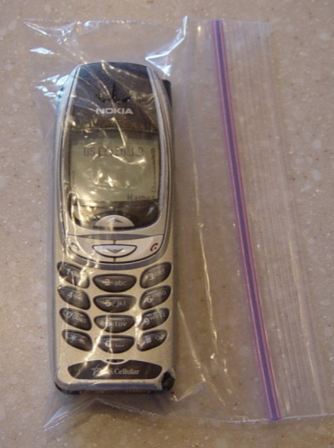
Electronics
Best done by fumigation
  Requires air-tight enclosure
If item is sealed,
  Disinfect by wiping or spraying
  Ultraviolet light exposure
Place in plastic bag before entry
  Wipe bag and item with disinfectant upon exit
Use waterproof cameras
Notes:
Disinfecting electrical or electronic equipment is best achieved by fumigation in an air tight enclosure. When possible, equipment should be dismantled so all parts can be fumigated. Some electrical items may be inherently airtight, in which case they can be safely disinfected by wiping or spraying the item with disinfectant solution. Exposure to ultraviolet light may be another option for disinfecting complex equipment. Some small hand-held equipment (e.g., radios, cell phones) may be useable while protected inside plastic bags and may be placed in bags prior to entry onto the infected premises. Upon removal from the infected premises, wipe the protective plastic bag with disinfectant, followed by the body of the item, and then discard the plastic bag. If cameras are needed to record response actions, inexpensive waterproof cameras which would allow for immersion into disinfection solutions should be considered. [Photo source: Tim Smith, Iowa Department of Agriculture and Land Stewardship]

Slide 12
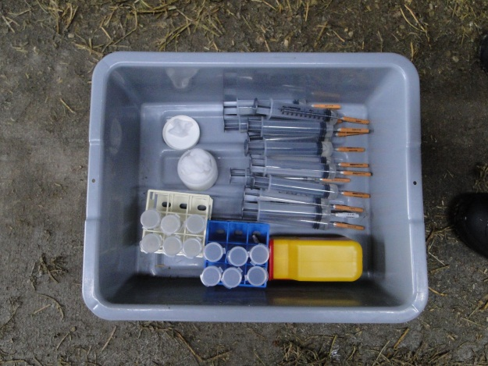
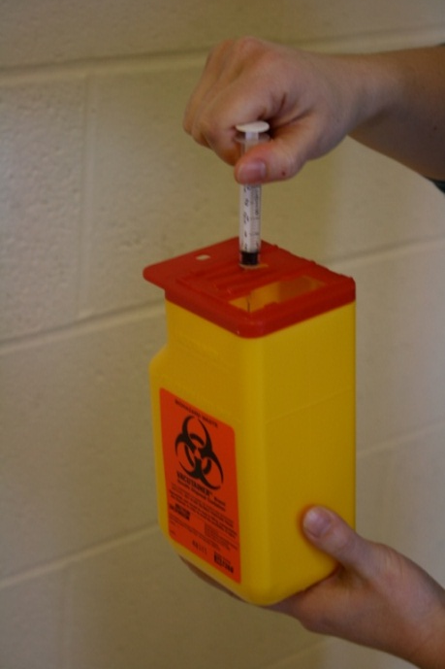
Other Equipment
Euthanizing Equipment
  Captive bolt guns
Biohazard Materials
  Scalpels for necropsy
  Needles
  Autoclave containers
C&D Equipment
  Brooms, shovels, brushes
Notes:
Equipment such as captive bolt guns and firearms should be considered grossly contaminated. Disinfection of these items can be difficult. Consult the euthanizing equipment manufacturer’s guidelines for cleaning and disinfecting. Some equipment (e.g., sharps, needles) used during an animal disease emergency may be considered biohazardous materials, and will need to be appropriately disinfected prior to disposal. Items should be sprayed with disinfectant, then placed in closed, leak proof containers to be autoclaved prior to disposal. Following all C&D procedures on the infected premises, equipment used for C&D processes (e.g., brooms, rakes, shovels, brushes, hoses, sprayers) must be cleaned and disinfected before reuse or disposed of. [Photo source: Danelle Bickett-Weddle, Iowa State University]

Slide 13
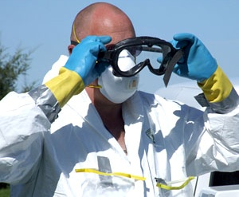
Safety
Chemical Hazards
  Skin, eye,
  respiratory
  irritation
Physical Hazards
  Slips, trips, falls
  High pressure sprayer
Notes:
Safety concerns during C&D of equipment items include exposure of personnel to chemical disinfectant products which can cause irritation to the skin, eyes or respiratory tract. Responders assigned to C&D areas should wear appropriate PPE (e.g., gloves, goggles). Physical hazards, such as slips, trips or falls from slippery surfaces can also occur, as can injury from high pressure sprayers. [Photo source: Travis Engelhaupt, Iowa State University]

Slide 14
References
https://fadprep.lmi.org
USDA APHIS. FAD PReP NAHEMS
  Highly Pathogenic Avian Influenza Standard Operating Procedures: Cleaning and Disinfection. February 2010.
  Foot-And-Mouth Disease. Standard Operating Procedures: Cleaning and Disinfection. February 2010.
  NAHEMS Guidelines: Cleaning and Disinfection. June 2011.
Notes:
The disinfection of equipment used during an animal disease emergency situation will be essential. Attention to proper C&D procedures will help to minimize the further spread of pathogens to additional locations, animals or personnel. Information in this presentation was taken from the following USDA APHIS Foreign Animal Disease Preparedness and Response Plan documents. The full version of these documents can be obtained at the FAD PReP website.

Slide 15
Acknowledgments
Development of this presentation was by the Center for Food Security and Public Health at Iowa State University through funding from the Multi-State Partnership for Security in Agriculture
Author: Glenda Dvorak, DVM, MPH, DACVPM
Notes:
Information provided in this presentation was developed by the Center for Food Security and Public Health at Iowa State University College of Veterinary Medicine, through funding from the Multi-State Partnership for Security in Agriculture.

