Slide 1
Personal Protective Equipment
Safety While Wearing PPE
Notes:
June 2012
During an animal health emergency, the use of personal protective equipment, or PPE, will be necessary to protect responders from exposure to infectious agents or chemical hazards, as well as to help prevent the further spread of pathogens to other animals, personnel or premises. However the use of PPE can raise various safety concerns for the personnel wearing it. This Just-In-Time training presentation will overview safety issues while wearing PPE, and steps to take to reduce your risk for injury.

Slide 2
Safety Concerns
Physical
Psychological
Environmental
Biological
Notes:
While the use of PPE is necessary during animal health emergencies, a number of physical, psychological, environmental and biological safety concerns can occur. Let’s look at these safety concerns more closely.

Slide 3
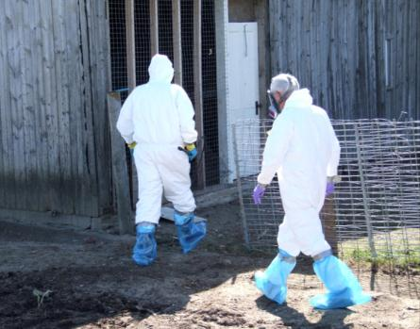
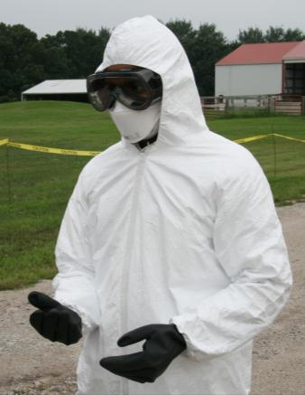
Physical Constraint
Restricts movement
Limits mobility
Increased energy/fatigue
Reduced dexterity
Reduced sensory perception
Vision
Hearing
Communication
Notes:
One of the first concerns posed by PPE is the restriction to movement. Protective outerwear, such as coveralls and boots, can add weight and bulk, and constrain movement. This not only limits responder mobility, but can also increase energy expenditure and lead to fatigue. Gloves, which are often worn during responses, can reduce a responder’s dexterity and the ability to grip objects. This can lead to difficulty in handling items or equipment as well as the potential for injury if items are dropped. Sensory perception can also be reduced while wearing personal protective equipment. Hoods limit the ability to hear. Vision may be reduced while wearing goggles or masks. These items can also become easily fogged or scratched, further decreasing visibility. While wearing respiratory protection, such as masks or respirators, communication with other responders can be difficult. All of these factors can impact a responder’s ability to work, and their risk for injury. [Top photo from Jane Galyon, CFSPH, Iowa State University; Bottom photo from Andrew Kingsbury, CFSPH, Iowa State University]

Slide 4
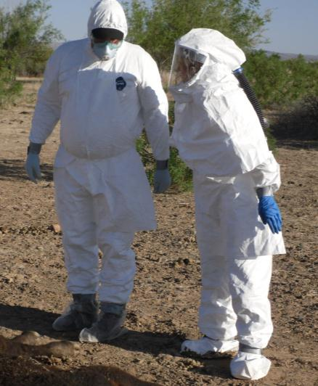
Other Physical Concerns
Physiological factors
Allergic reactions
Physical condition
Level of acclimation
Psychological stress
Confining
Claustrophobic
Notes:
Physiological factors can also contribute to responder safety while wearing PPE and may affect the responder’s ability to function. Some responders may have allergic reactions to certain PPE components – such as latex. The physical condition of the responder, as well as their level of acclimation to the use of PPE and response activities, can impact their health and safety while wearing PPE. In addition to the psychological stresses of the response itself, the confining nature of PPE can cause feelings of claustrophobia and psychological stress on responders. [Photo from John Wenzel, New Mexico State University]

Slide 5
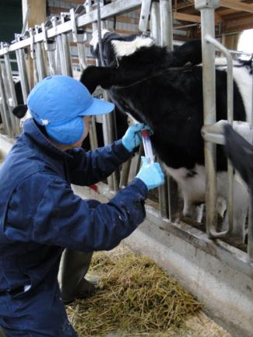
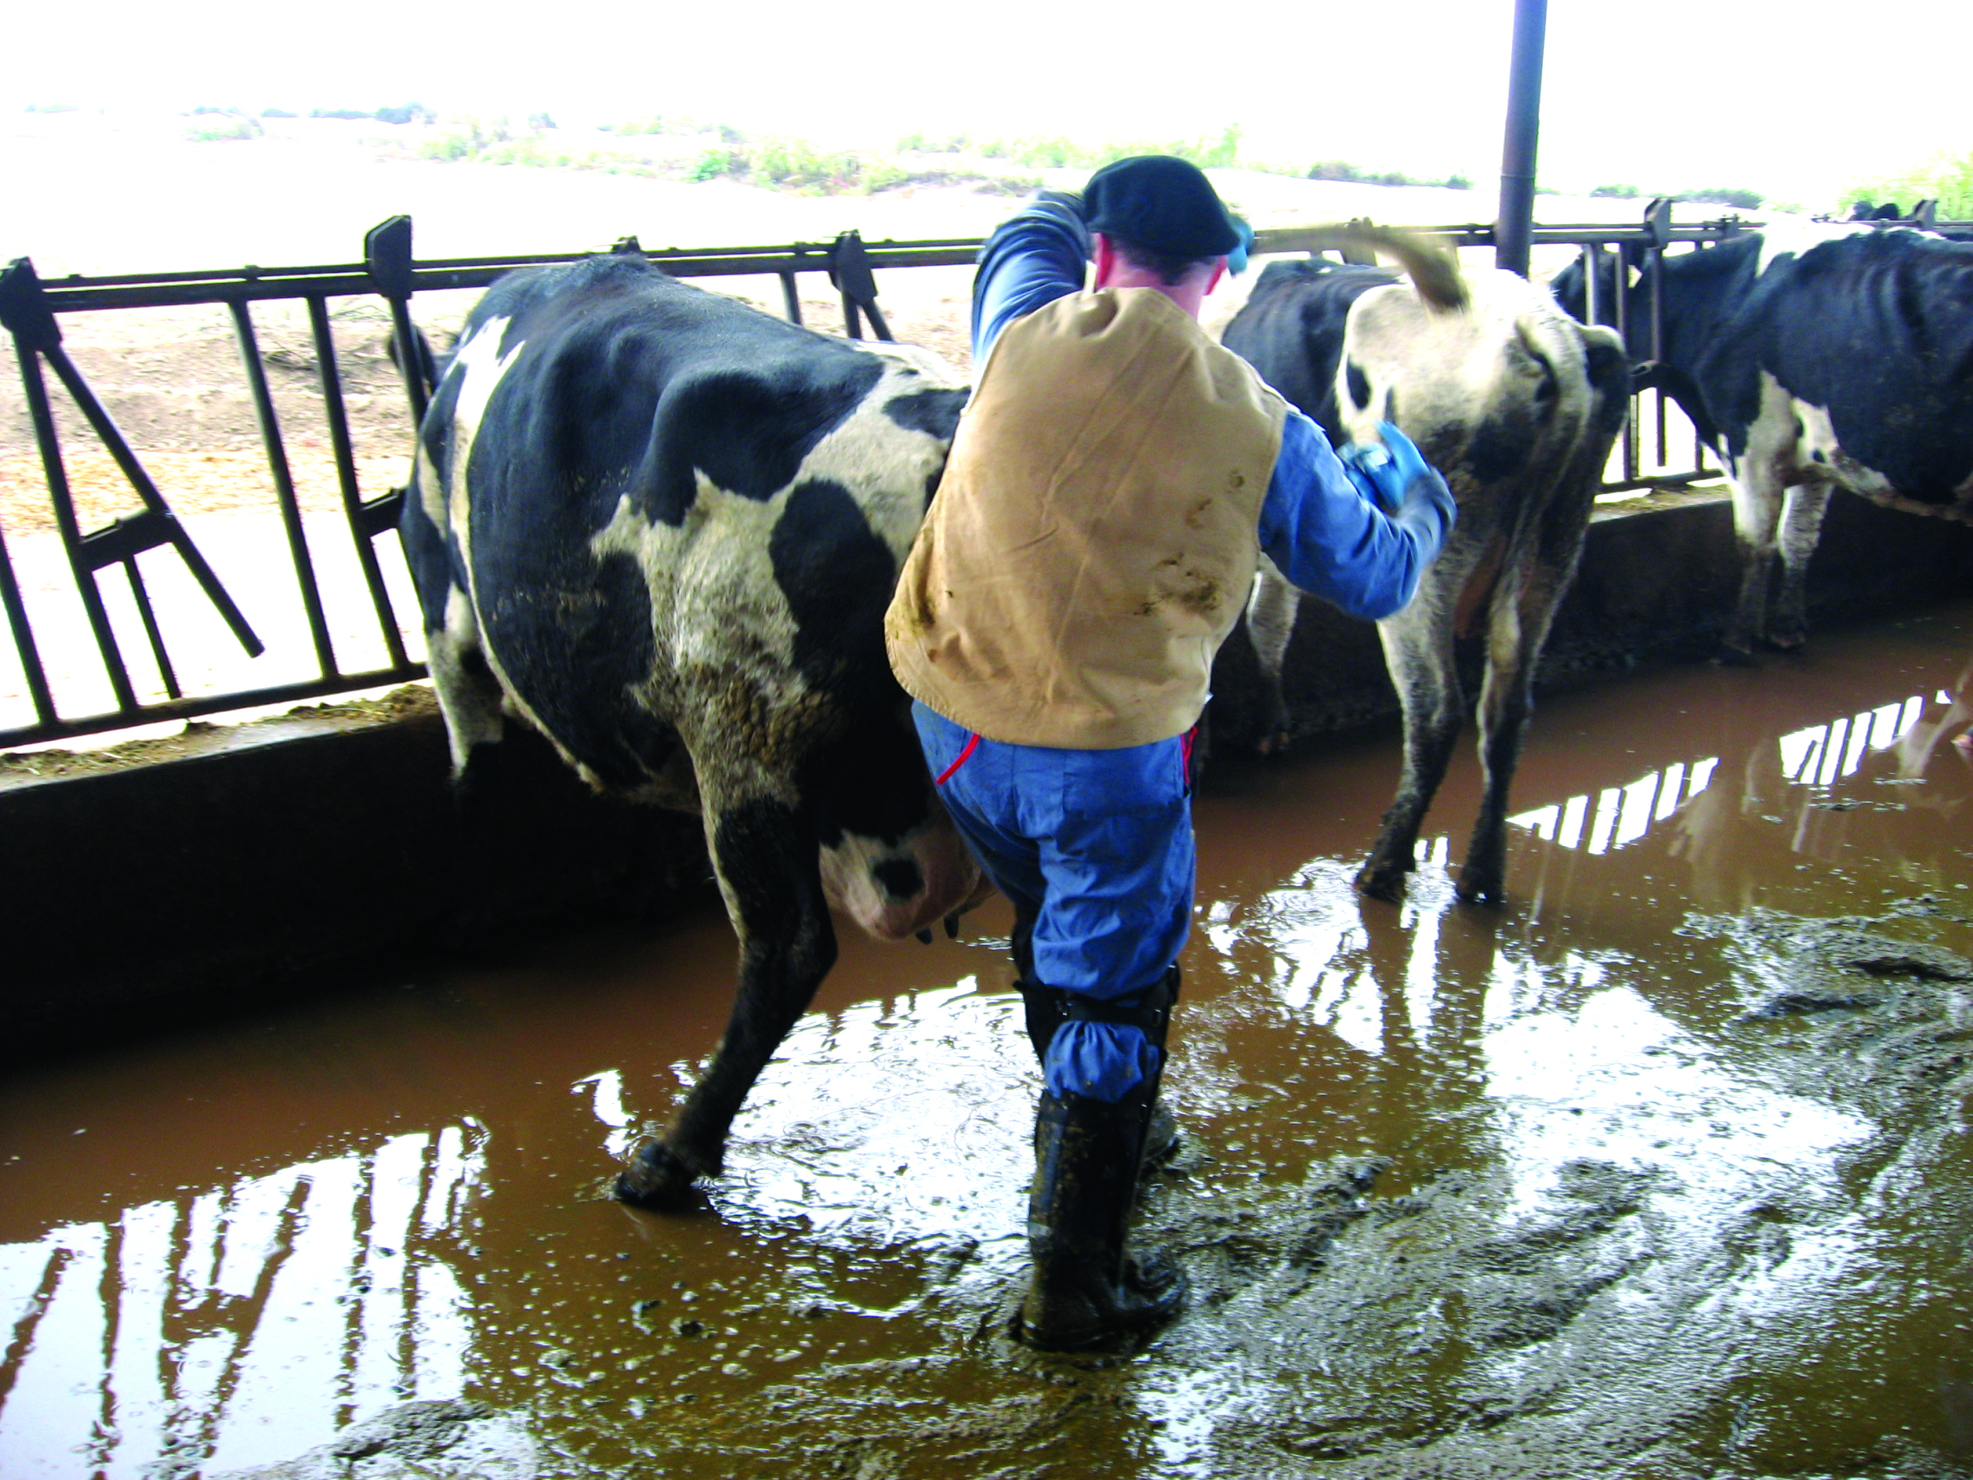
Environmental Concerns
Site conditions
Hot, cold
Rain and mud
Ice and snow
Uneven surfaces
Slips, trips, falls
Notes:
Environmental conditions of the response situation can also affect responder safety while wearing PPE. Depending on the response location or time of year, extreme hot or cold temperature conditions may occur. Additionally, weather conditions can impact the terrain of the response site. Rain and mud, or snow or ice, can make the ground slippery and uneven, making response efforts difficult and potentially unsafe. [Top photo from Pete Petch, USDA; Bottom photo from Danelle Bickett-Weddle, Iowa State University]

Slide 6
Heat Stress
Common
Contributing factors
High temperatures, humidity
Direct sun exposure
Limited air movement
Poor physical condition, low heat tolerance
Fatigue, exertion
Notes:
Heat-related illnesses can result when working in high temperatures and high humidity situations, as well as when working in direct sun exposure. Heat stress occurs when the body is unable to cool itself. Normally, when a person sweats, it evaporates, which cools the body. However, when wearing certain PPE clothing (e.g., Tyvek or Tychem) evaporation of sweat is limited. The longer this occurs, the higher your body temperature will rise, potentially resulting in various heat related illnesses, which can range from mild to fatal. Other factors that contribute to heat stress involve the degree of physical exertion required for a task, the physical health and condition of the responder, as well as their tolerance to heat.

Slide 7
Heat-Related Illness
Illness | Symptoms | First Aid/Treatment
Heat Cramps | Muscle spasms, pain in legs, arms, abdomen | Rest, drink clear juice/sports drink, seek medical attention if cramps persist >1 hour
Heat Stress | Thirst, fatigue, feeling “hot”, cramps, dizziness, headache, nausea, sweating, paleness, clammy skin | Treat immediately; rest in shade, rehydrate, seek medical attention if symptoms persist
Heat Exhaustion | Sweating, paleness, muscle cramps, fatigue, weakness, headache, dizziness, irritability, confusion, nausea, fast/weak pulse, shallow breathing | Move to cool area, rehydrate, take cool shower/bath/sponge bath, wear lightweight clothing, seek medical attention if symptoms are severe or last >1 hour
Heat Stroke | High body temp (104°F +), no sweating (hot, dry skin) confusion, loss of consciousness, seizures, convulsions, rapid pulse, hyperventilation | Life-threatening – call for medical assistance; begin cooling immediately (e.g., put in shade, immerse in water), monitor body temperature, give cool water if able to drink
Notes:
Heat-related illnesses range from heat cramps to more severe illnesses such as heat stress, heat exhaustion, and heat stroke (a life-threatening condition). It is essential to treat any heat-related illness promptly to prevent the risk of further injury. The table presented here describes the types of heat-related illnesses, some associated symptoms, and first aid/treatment that responders can provide.

Slide 8
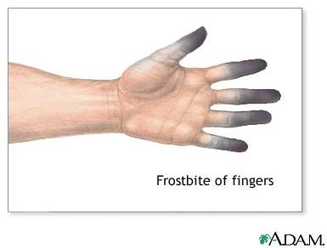
Cold-Related Illness
Extended exposure to cold, windy, wet conditions without adequate clothing or coverage
Hypothermia
Body loses more heat than produced
Frostbite
Skin/tissue freezes
Hands, feet, nose, ears most vulnerable
Notes:
At the opposite extreme, extended exposure to cold, windy, and wet conditions without adequate clothing can lead to hypothermia – a condition when the body loses more heat than it can produce. PPE is not generally designed for cold conditions. Frostbite can also occur when skin and tissue are exposed to cold conditions and freeze. The hands, feet, nose, and ears are most vulnerable to frostbite. [Photo from A.D.A.M. Health Solutions]

Slide 9
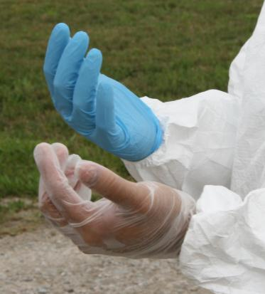
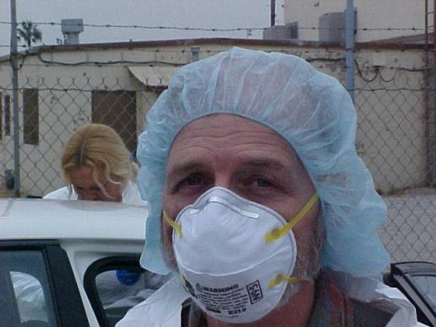
Biological Concerns
Zoonotic diseases
Integrity of PPE
Breakdown of materials
Breech of barriers
Pathogen exposure
Notes:
The potential for exposure to microorganisms during an animal health emergencies can be of responder concern – especially in situations involving zoonotic pathogens. Therefore any disruption in the integrity of PPE could result in potential biological exposure for responders. This may occur from a breakdown of material composition or as a breech (e.g., tear) in PPE barriers.

Slide 10
Safety Precautions
PPE Safety Training
Buddy System
Personal Behavior/Actions
Notes:
To enhance safety while wearing PPE, the following precautions should be taken.

Slide 11
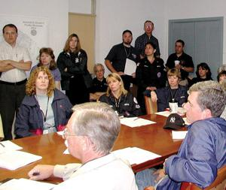
PPE Safety Training
Critical for ensuring appropriate use
What PPE is needed
Why it is needed
Limitations
Precautions
Consequences
Recognize damaged/improperly function
Decontamination, repair, replacement
Notes:
All personnel should receive appropriate training on the proper use of required PPE prior to engaging in any response activities. A comprehensive safety training program is critical to ensure responders understand what PPE is needed, why it is required, and how to use it appropriately for optimal protection. They must also be knowledgeable about the limitations and precautions of the selected PPE, as well as the consequences of PPE failure. Equally important is that responders know how to check the integrity of PPE items, recognize or detect damaged or improperly functioning equipment, as well as understand the importance of repairing or replacing damaged PPE, and ways of minimizing adverse consequences in the event of PPE failure (e.g., keeping backup PPE available or temporarily patching tears with extra tape). Techniques for safely decontaminating, storing, maintaining, disposing, and repairing PPE should also be included in PPE safety training. [Photo: Responders undergoing safety training. USDA]

Slide 12
Buddy System
Cooperative completion of tasks
Close visual contact
Assist as needed
Check PPE integrity
Observe partner for distress
Obtain emergency assistance if needed
Notes:
The use of the buddy system is another important part of maintaining responder safety while wearing PPE. This “partnering” method allows for cooperative completion of tasks, such as donning and doffing of PPE. Responders using the buddy system will remain in close visual contact with their partner, assist their partner as requested or needed, observe their partner for signs of distress (e.g., heat stress or other difficulties), and periodically check the integrity of their partner’s PPE. The use of the “buddy system also enables swift and effective actions to be taken for emergency situations, such as compromised PPE, personnel exposure, illness or injury. [Photo: Two responders in PPE working on collecting samples from a steer while utilizing the buddy system, FEMA Center for Domestic Preparedness]

Slide 13
Personal Preventive Actions
Remain alert
Watch for hoses, cables, ropes
Adequate lighting
Identify hazardous areas
Monitor yourself and others
Know physical limitations
Follow established guidelines
Stress-management techniques
Help stay calm, focused, analytical under adverse conditions
Notes:
Ensuring safety while wearing PPE also depends on personal preventive actions. Remain alert during all response activities. Watch for hoses, cables, ropes in the environment, as well as any slippery situations, that may lead to slips, trips or falls. Ensure adequate lighting for your tasks, especially at night or in darkened areas (e.g., barn interior). If hazardous areas are known, ensure they are identified clearly to warn others of the safety risk. Know the signs of heat- and cold-related illnesses. Monitor yourself and fellow responders for any signs of these conditions, as well as psychological stresses. Know your physical limitations. Do not overexert yourself. Follow the established guidelines for the response, which should address rest periods as well as emergency response procedures in the event of an accident of injury. Learn and practice stress-management techniques to help stay calm, focused, and analytical under high risk and/or emergency conditions.

Slide 14
Avoiding Heat Stress
Monitor yourself and team members
Be alert for signs of heat stress
Take quick action to avoid serious injury
Prevention
Keep hydrated
Fluids, replace electrolytes
Adjust work schedules
Perform work during cooler times of day
Limit or avoid strenuous activities mid-day
Take frequent rest breaks
Cooling devices
Notes:
To minimize heat-related illnesses, monitor yourself and your team members for signs of fatigue or heat stress. Adjust work schedules, so that most tasks are conducted during the cooler times of the day. Limit or avoid strenuous activities during the hottest part of the day. Drink plenty of fluids and replace electrolytes (e.g., salt and minerals). Take frequent rest breaks. Cooling devices, such as cooling jackets or vests, field showers, or hose down areas, can aid in reducing body temperature. Have a plan for summoning emergencies services in the event of a medical emergency. If heat stress is suspected, take prompt action to avoid serious injury.

Slide 15
Cold-Related Illnesses
Wear appropriate clothing
Dress in layers
Loose-fitting, lightweight clothing,
Water resistant/repellant outer layers
Cover hands, head, face, neck
Avoid overexertion
Stay dry
Notes:
To prevent hypothermia, wear appropriate clothing and dress in layers of loose-fitting lightweight clothing, with a water resistant or repellant outer layer. Keep hands, your head, face, and neck covered to prevent heat loss. Avoid overexertion, which can cause perspiration and lead to damp clothing. Stay dry if at all possible.

Slide 16
Psychological Stress
Recognize, understand symptoms
Monitor reactions of self, others
Take appropriate measures to reduce effects
Seek assistance or support
Physical, cognitive, emotional, behavioral signs/symptoms
Notes:
It is important to be able to recognize and understand the symptoms of emotional stress and to monitor one’s own reactions and those of others. Always take appropriate self-care measures to reduce the effects of emotional stress and seek assistance and support when needed. It is normal for most individuals to experience some reactions following a traumatic event. Individuals may experience a broad range of physical, cognitive, emotional, or behavioral signs or symptoms. For more information on psychological impacts of an animal health emergency listen to the Health and Safety: Psychosocial Impact Just-In-Time training presentation.

Slide 17
Resources
USDA Foreign Animal Disease Preparedness (FAD PReP) Guidelines:
Health and Safety
Personal Protective Equipment
http://www.aphis.usda.gov/animal_health/emergency_management/nahems_guidelines.shtml
Notes:
For more information on health and safety issues and personal protective equipment during an animal health emergency response, consult the USDA FAD PReP Health and Safety and Personal Protective Equipment Biosecurity Guidelines.

Slide 18
Acknowledgments
Development of this presentation was by the Center for Food Security and Public Health at Iowa State University through funding from the Multi-State Partnership for Security in Agriculture
Authors: Shaine DeVoe, BS
Reviewers: Glenda Dvorak, DVM, MPH, DACVPM
Notes:
Information provided in this presentation was developed by the Center for Food Security and Public Health at Iowa State University College of Veterinary Medicine, through funding from the Multi-State Partnership for Security in Agriculture.

