Slide 1
Personal Protective Equipment
Respirator Usage and Safety
Notes:
June 2014
During an animal health emergency, exposure to airborne hazards, such as zoonotic disease agents or chemicals, may occur. A number of different respirators are available and when used correctly can provide various levels of protection. This Just-In-Time training will overview the proper use of respirators as part of personal protective equipment during animal health emergencies. Safety concerns and considerations while wearing respirators are also addressed.

Slide 2
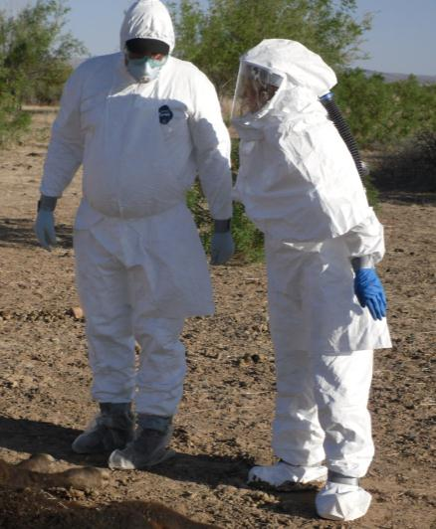
What is a respirator?
Worn on face
Covers nose and mouth
Forms a tight seal against skin
Filters out certain airborne particles
Notes:
A respirator is a personal protective device that is worn on the face. It covers the nose and mouth and is specifically designed to provide respiratory protection by forming a tight seal against the wearer’s skin. Respirators vary in their level of protection and efficiency to filter out airborne particles. The use of respirators may be needed for hazardous airborne particles, such as dust, pathogens, gases, or vapors, or chemical splash. [Photo: Two responders wearing different types of respirators. Source: John Wenzel, New Mexico State University]

Slide 3
Types of respirators
Notes:
Lets look at the various types of respirators available. Each type protects against different hazards at different levels. The appropriate respirator chosen for use will depend on the anticipated airborne risk for the responder. It is important to select the right respirator for a specific job.

Slide 4
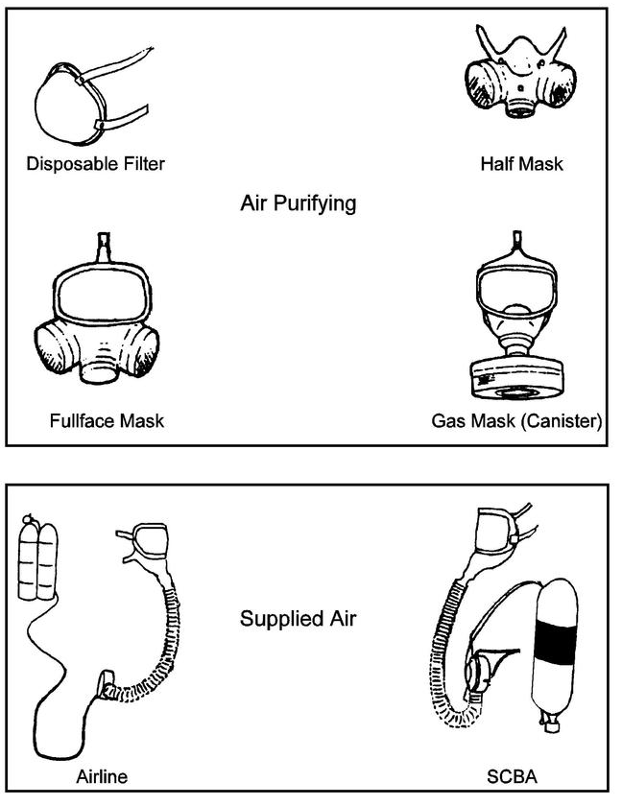
Classification of Respirators
Air-Purifying Respirators
  Removes contaminants
  from the air
    Particulate respirators
    “Gas mask” respirators
Air-Supplying Respirators
  Provides clean source
  of air
    Supplied air respirators (SAR)
    Self-contained breathing apparatus (SCBA)
Notes:
Respirators can be classified as one of two types based on how they protect the user; there are air-purifying respirators and air-supplying respirators.
The first class – air purifying respirators or APRs – filter and remove contaminants from the air. This group includes various particulate respirators, which filter out airborne particles, and “gas masks,” which remove gasses and vapors. Therefore, the proper cartridge, canister, or filter must be selected based on the hazardous threat. Since filter respirators only modify the ambient air, they cannot be used in oxygen deficient situations. Air-purifying particulate respirators can be further subdivided into three categories: particulate filtering facepiece respirators, elastomeric respirators, and powered air-purifying respirators, also known as PAPRs. The two types of respirators most commonly used for animal health emergencies are disposable or particulate filtering facepiece respirators and reusable or elastomeric respirators.
The other class of respirators – called air-supplying respirators (ASRs) – protect the user by supplying air from another source. Air-supplying respirators can use an airline hose attached to a remote source of air – which are called supplied air respirators or SARs, or they may come equipped with their own compressed air or oxygen supply, which are called self-contained breathing apparatuses (SCBAs). Both are used for high-risk environments. The SCBA offers the greatest respiratory protection from the outside environment compared to other respirators.
It is important to note that basic surgical masks are not considered respiratory protection. While a surgical mask can help block large particle droplets, splashes, sprays or splatter the may contain viruses and bacteria from reaching the nose and mouth, they do not form a tight seal against the skin or filter very small airborne pathogens. Unlike surgical masks, respirators provide a tight seal to the face when worn properly (fit-tested and seal checked).
[Photo: Diagram showing various types of respirators. Source: Texas State University. Respiratory Protection Program at http://www.fss.txstate.edu/ehsrm/safetymanual/ppe/resppro.html]

Slide 5
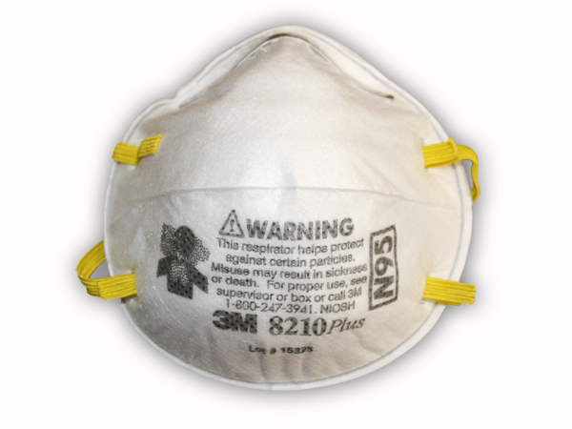
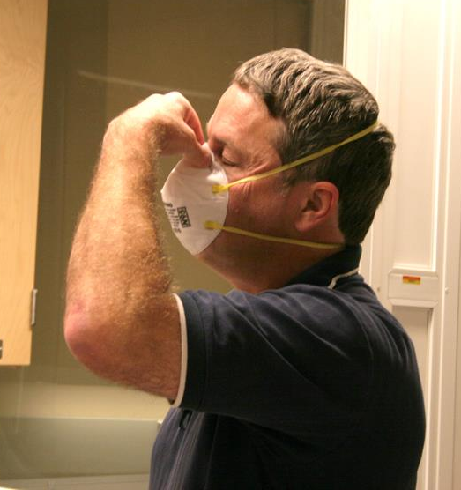
Particulate Filtering Facepiece
Air-Purifying Particulate Respirator (APR)
Disposable or single-use respirators
Some have exhalation valve
Goggle or eye protection needed
N95s
Notes:
Particulate filtering facepiece respirators are sometimes referred to as disposable or single-use respirators since the entire respirator is discarded when it becomes unsuitable for further use. This class of respirators offers protection against particulates only. They are made of cloth or paper and are primarily used for nuisance dusts or odors. The entire respirator facepiece is comprised of filter material. Some filtering facepiece respirators also have an exhalation valve which can reduce breathing resistance, reduce moisture buildup inside the respirator, and increase work tolerance and comfort for respirator users. Goggles or other eye protection would also need to be worn and should not interfere with the seal of the respirator.
These respirators are also commonly referred to as “N95s” and are one of the most commonly used respirators. N95 refers to the filtration capability of the respirator. The NIOSH respirator approval regulation defines N95 as a filter class that removes at least 95% of airborne particles during “worse case” testing using a “most-penetrating” sized particle. In most instances a NIOSH-approved N95 filtering facepiece respirator is used to protect wearers from airborne particles, including pathogens.
[Photo: (Top) 3M N95 particulate disposable respirator; (Bottom) A responder fit-testing a particulate filtering facepiece respirator. Source: Dani Ausen, Iowa State University]

Slide 6
NIOSH Particulate Filter
Approval Categories
Minimum Filter Efficiency | N series Not resistant to oil | R Series Somewhat resistant to oil | P Series Strongly resistant to oil
95% | N95 | R95 | P95
99% | N99 | R99 | P99
100% (99.97%) | N100 | R100 | P100 (~HEPA)
Notes:
Filtering facepiece respirators are available in three primary filtering efficiencies – 95%, 99% or 100% - and three levels of oil resistance, designated by N, R, or P. The N Series are not resistant to oil. N95, N99, N100 filter at least 95%, 99%, 99.97% of airborne particles, respectively. The R Series are somewhat resistant to oil. R95, R99, R100 filter at least 95%, 99%, 99.97% of airborne particles. The P Series are strongly resistant to oil. P95, P99, P100 filter at least 95%, 99%, 99.97% of airborne particles. 95% is the minimal level of filtration that will be approved by NIOSH.

Slide 7
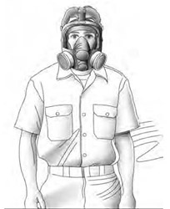
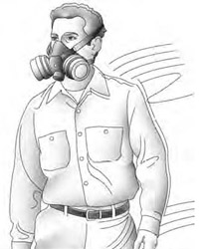
Elastomeric Respirators
Air-Purifying Particulate Respirators (APR)
Reusable facepiece with disposable filter cartridges
Half-face APRs
  Only covers nose and mouth
  Goggles or faceshield needed
Full-face APRs
  Covers entire face
Variety of filters
Notes:
Elastomeric respirators are often referred to as reusable respirators since the facepiece can be cleaned, decontaminated, and reused, however the filter cartridges are discarded and replaced when they become unsuitable for further use. The face piece can be half-face masks, which cover the face from above the nose to below the chin or full-face masks, covering the face from the hairline to below the chin. When half-face masks are used, goggles or other eye protection may also be need to be worn to protect the eyes from exposure, but should not interfere with the seal of the respirator. Full-face respirators offers higher level of protection as it can provide a more effective seal to the face as well as provide a level of ocular protection.
It allows for adjustable protection based on the filter used.
[Photo: (Top) A responder wearing a half mask elastomeric respiratory. (Bottom) A responder wearing a full-face elastomeric respirator. Source: U.S. Department of Labor, OSHA at https://www.osha.gov/Publications/3352-APF-respirators.html]

Slide 8
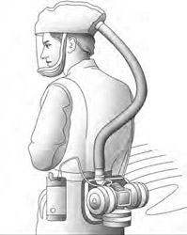
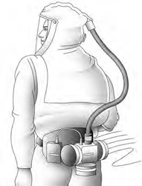
Powered Air-Purifying
Respirators (PAPRs)
Air-Purifying Particulate Respirators (APR)
Battery-powered blower pulls air through filters then moves filtered air towards facepiece
Can be cooling device
Not all require fit-testing and seal checks
Check batteries
Notes:
Powered air purifying respirators or (PAPRs) utilize a battery-powered blower to pull air through filters that trap particulates that may be present, and then moves the filtered air to the wearer’s facepiece. PAPRs decrease resistance to breathing and can act as a cooling device, but the battery and pump add extra weight to the equipment. Some hooded PAPRs do not require employees to be fit tested or perform a user seal check, but do require medical clearance and training in order to be used. The batteries used with PAPRs need to be used properly to be sure they last long enough to protect the wearer of the respirator. Several different types of batteries and chargers are available depending on the manufacturer of the PAPR and how long they will be used. Be sure to make sure the respirator worn is appropriate for the task at hand. Powered air- purifying respirators use filtered ambient air in a positive-pressure continuous flow mode. A PAPR utilizes a battery-powered blower that moves air through the filters that then trap particulates that may be present. This is generally the appropriate type of respiratory protection for high zoonotic risk levels of infectious agents.
[Photo: (Top) A responder wearing a loose-fitting powered air-purifying respirator (PAPR) with a battery pack and faceshield. (Bottom) A responder wearing a hood powered air-purifying respirator (PAPR) with a battery pack and faceshield. Source: U.S. Department of Labor, OSHA at https://www.osha.gov/Publications/3352-APF-respirators.html]

Slide 9
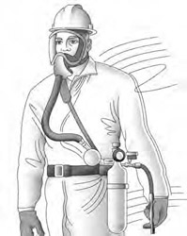
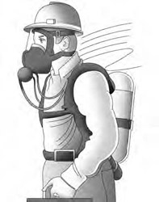
Self-Contained Breathing Apparatuses (SCBAs)
Air-Supplying Respirator
Supply uncontaminated air to full facepiece
Used in high risk environments
Minimum usage time
of 30 minutes
Follow-up medical examination required
Not commonly used
in veterinary medicine
Notes:
Self-contained breathing apparatus respirators are used for high-risk environments or when respiratory hazards are unknown. SCBAs come equipped with their own air supply to a full facepiece to allow for use in very high-risk environments. The SCBA offers the greatest protection from the outside environment compared to other respirators. SCBA respirators can’t be used in high risk environments for as long as PAPRs can since the air supply is limited to the size of the tank, but are required to have a minimum use of 30 minutes. Persons using SCBA respirators are required to have a follow-up medical examination in addition to the original medical examination for general respirator use. These are typically not needed for animal health emergencies.
[Photo: (Top) Responder wearing a full facepiece supplied-air respirator (SAR) with an axillary escape bottle. (Bottom) Responder wearing a full facepiece self contained breathing apparatus (SCBA). Source: U.S. Department of Labor, OSHA at https://www.osha.gov/Publications/3352-APF-respirators.html]

Slide 10
Respirator usage and Safety
Notes:
Next well look at specific respirator usage requirements and safety considerations.

Slide 11
Selecting a Respirator
Type of hazards
Identity and concentration of the contaminant
Degree of protection provided by each type of respirator
Activity of the person wearing the respirator
Time constraints
Notes:
When selecting a respirator, you must know the type of hazard involved, as well as the identity and concentration of the contaminant. Additionally, consideration must be given to the degree of protection provided by each type of respirators, as well as the anticipated activity of the person wearing the respirator. Time constraints may also be a factor. Respirators are available in different types and sizes. Ensure you have selected the correct type and size of respirator for which you have been fit tested. Never replace with a different size or type of respirator.

Slide 12

Standards and Regulations
OSHA
  Occupational Safety and Health Administration
  OSHA 1910.134
FDA
  Food and Drug
  Administration
NIOSH
  National Institute for Occupational Safety and Health
Notes:
Safety and health standards for respirator use are established by the Occupational Safety and Health Administration (OSHA), the Food and Drug Administration (FDA), and the National Institute for Occupational Safety and Health (NIOSH). Personnel must use respirators in conjunction with the OSHA 1910.134 comprehensive respiratory protection program standards which can be found on the OSHA website at http://www.osha.gov. A written respiratory protection program with procedures specific to the respond should be completed. Additionally, all respirators must be approved by NIOSH and are thoroughly evaluated and tested by NIOSH to meet strict federal safety requirements. The website, http://KnowIts.NIOSH.gov contains additional information regarding respirators, their use and other issues.

Slide 13
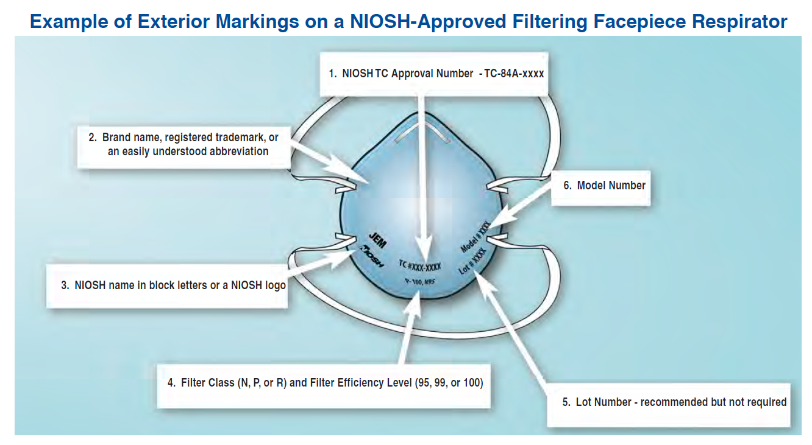
NIOSH-Approved
Notes:
This illustration shows an example of the exterior markings found on a NIOSH-approved filtering facepiece respirator. All NIOSH-approved filtering facepiece respirators are marked with the manufacturer’s name, the part number (P/N), the protection provided by the filter (e.g., N95, P100), and “NIOSH.” Some filtering facepiece respirators approved by NIOSH may have the NIOSH approval number (TC-84A-xxxx) [Note: TC stands for Testing and Certification] as an additional identification marking. This information is printed either on the face, exhalation valve (if one exists), or head straps. The lot number or date of manufacture may appear on the respirator or may be located on the packaging. Counterfeit or modified respirators (e.g. those covered with fabric or design) do exist and if worn can compromise safety. It is important to verify the approval of the NIOSH “TC” number before wearing any respirator. This can be done at the NIOSH website at http://www.cdc.gov/niosh/npptl/topics/respirators/disp_part.
[Image: Example of exterior markings on a NIOSH-approved filtering facepiece respirator. Source: CDC NIOSH (National Institute for Occupational Safety and Health) Respirator Awareness: Your Health May Depend On It. Personal Protective Equipment for Healthcare Workers at http://www.cdc.gov/niosh/docs/2013-138/pdfs/2013-138.pdf.

Slide 14
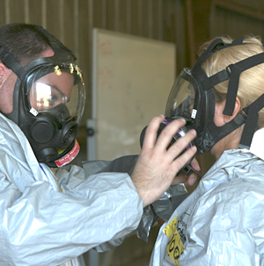
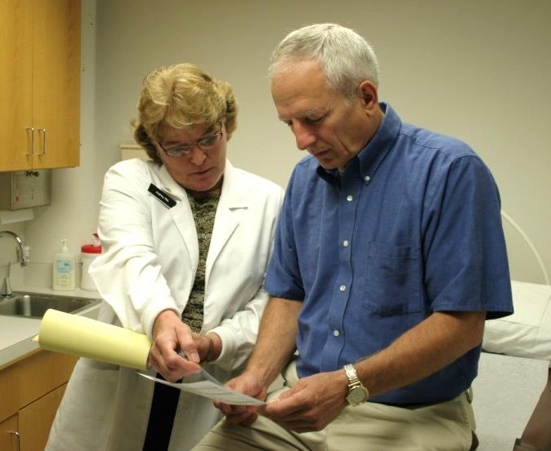
Proper Use of Respirators
Fit-tested
Seal checked
Training
Medical evaluation
  Personal health questions
  Medications
  Work conditions
Notes:
For a respirator to work properly, it needs to be fitted to the wearer using a fit-test and then it needs to be seal-checked against the face. Respirators come in various sizes and must be individually selected to fit the users face and provide a tight seal. A proper seal between the user’s face and the respirator forces inhaled air to be pulled through the respirator’s filter material and not through gaps between the face and respirator.
Fit-testing and seal checks are done to ensure there are minimal harmful particles, if any, getting through the respirator to harm the wearer. This will need to be done before the wearer is allowed into the contaminated area. All respirators that rely on a mask-to-face seal need to be annually checked with either qualitative or quantitative methods to determine whether the mask provides an acceptable fit to a wearer. A seal check is completed by the user to determine if the respirator is properly seated to the face ensuring inhalation occurs thorough the filter rather than around the edges of the respirator. This process may be performed differently depending on the type and model of respirator. The respirator wearer should be observed during a trial period to evaluate potential physiological problems
Tight-fitting air purifying respirators can impose a physiological burden on the user. For this reason a medical evaluation is also required prior to wearing a respirator. This involves answering a series of questions to assess your health, use of medications, and work conditions while wearing the respirator. Depending on the responses, a further work-up with a physician may be necessary to assess your pulmonary function or other concerns. A chest X-ray and or spirometry may be indicated.
Responders who will need to wear respirators will need to receive training on the proper procedures for donning and doffing the particular respirator before being released into a contaminated area.
[Photo: (Top) Two responders properly fitting APR facepieces. Source: Gordon Harman, Center for Domestic Preparedness; (Bottom) Medical evaluation of an employee for the use of a respirator. Source: Dani Ausen, Iowa State University]

Slide 15
Health Effects
When Wearing Respirators
Increased resistance to breathing
Reduced endurance
Reduced visual field
Increased risk for heat stress
Decreased voice clarity/loudness
Decreased hearing ability
Discomfort or irritation
Psychological stress
Notes:
There are a variety of health effects can be associated with wearing respirators. Pulmonary effects include added inspiratory and expiratory resistance and can lead to reduced endurance and exercise performance during the response. It also tends to increase ventilation. Respirators may reduce visual fields, decrease voice clarity and loudness, and decrease hearing ability. This may subsequently result in reduced productivity, and safety. Inspired air can increase the risk for heat stress since warm expired gases are rebreathed. Respirators can also cause discomfort to the user due pressure from the fit of the mask or allergic skin reaction. Eye irritation may occur from respirator air flow. For individuals that are claustrophobic, psychological stress may occur while wearing respirators.

Slide 16
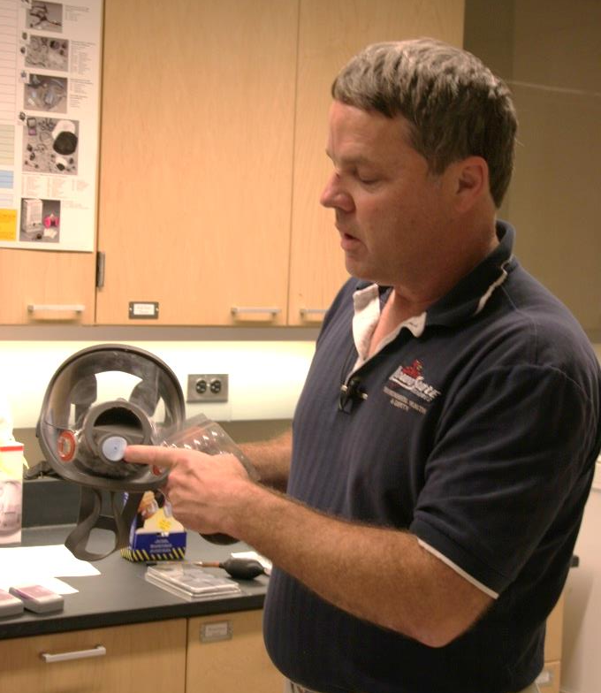
Before Usage
Inspect all parts of the respirator before use
Batteries charged
Proper air flow
Do NOT use the
respirator if it is not working properly
Notes:
All respirators must be inspected for basic function before each use. A respirator inspection must include a check of the respirator’s ability to work properly, the tightness of any connections, and the condition of the various parts, such as the facepiece, head straps, valves, tubes, hoses, and any cartridges, canisters or filters. In addition, elastomeric parts must be checked for pliability and sign of deterioration. If any parts are found to be damaged or compromised, do not use the respirator. For respirators with battery packs, be sure the battery has been charged and is ready for use. It is also important to test the air flow to make sure the respirator is working properly. If any part of the respirator is not working properly, do not use it.
[Photo: An employee checking the respirator before using it. Source: Dani Ausen, Iowa State University]

Slide 17
Safe Respirator Usage
Do not use a respirator unless
  Formally trained and
  Fit tested
Select the correct respirator for the job
  Particulate filter will not protect
  against gases or vapors
Inspect the respirator before each use
Ensure the face seal
  Remove facial hair
  Prevent hair or eyeglasses from interfering
Do not wear contact lenses with a respirator
Notes:
Follow these guidelines to ensure safe respirator usage:
Do not use a respirator unless you have been formally trained and have been fit tested for the respirator you are using
Be sure the correct respirator for the job is selected. Do not mistakenly use a particulate or HEPA filtered respirator for protection against gases or vapors. Inspect the respirator before each use.
Inspect the respirator before each use
To ensure a tight fit,
shave facial hair to ensure a good seal with the facemask
Do not allow your hair or eyeglass frames to interfere with the face mask seal
Contact lenses should not be worn while wearing a respirator

Slide 18
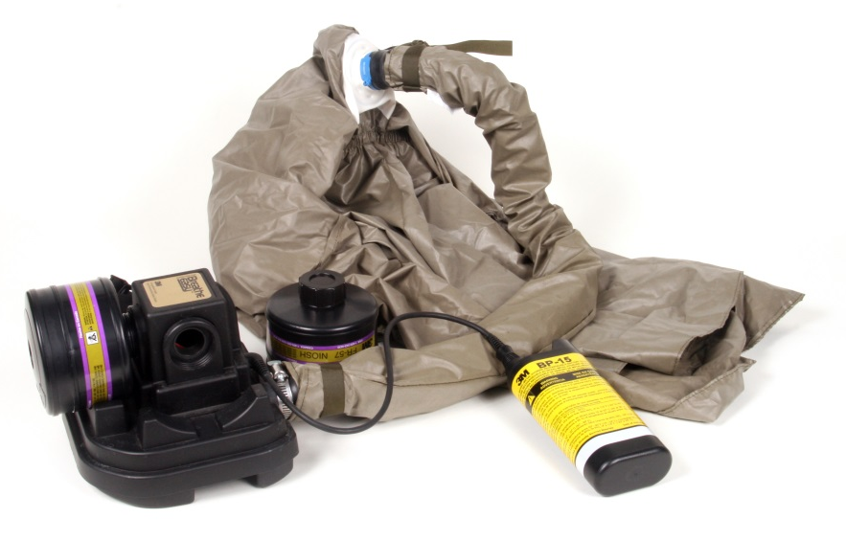
During Usage
Immediately leave contaminated area
if respirator
stops working
PAPR – make sure battery charge
is available
SCBA – make sure air
is available in tank
Notes:
While using a respirator in the field, be sure that it is working properly to filter harmful particulates and leave the contaminated area immediately if the respirator stops working or you think there may be a defect with it. If you feel nauseous, dizzy or ill, or have difficulty breathing, return to fresh air and remove the respirator. Never remove a respirator in a contaminated environment. Once in a safe area, check to see if the canister, cartridge, or filter needs to be replaced. Cartridges and canisters must be replaced if the user notices an odor, taste, or throat irritation. Wet, damaged, and grossly contaminated cartridges/canisters must also be replaced.
If using battery operated respirators (PAPRs), be sure you do not work in the contaminated conditions longer than the battery will last. Check the battery periodically to make sure enough power is left to finish the job. If not, stop and get a fully charged battery from a safe area. When using SCBA respirators, be sure you only work as long as the air supply will last and don’t try to test the limit. When you know the air supply is getting low, return to a safe area for a full tank.
[Photo: A PAPR battery charging with the unit attached before usage. Source: Dani Ausen, Iowa State University]

Slide 19
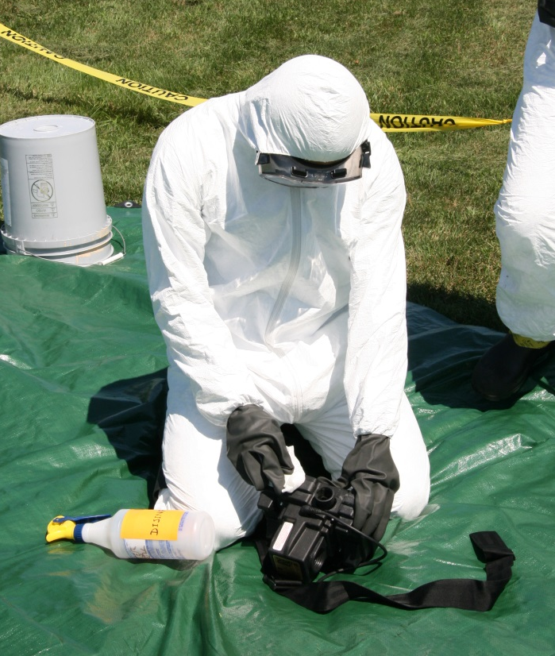
Cleaning
Follow manufacturer’s cleaning guidelines
Warm water/mild detergent
Disinfectant solution
Dry thoroughly
Never soak entire unit in detergent
Notes:
Cleaning reusable respirators is an important task to make sure the contaminants the respirator came in contact with do not spread. Follow manufacturer’s cleaning guidelines. Clean surfaces of the respirator with warm water and a mild detergent. Do not use organic solvents. Never soak the entire unit in cleaning solution as it can damage the respirator. If the response involved microorganisms, apply a disinfectant solution for the proper contact time. Rinse well and dry thoroughly with a lint free cloth.
[Photo: An employee cleaning the outside of a PAPR respirator with a detergent and warm water mixture. Source: Andrew Kingsbury, Iowa State University]

Slide 20
Respirator Storage
Store in accordance with manufacturer’s instructions
Check expiration dates
Never use and discard if:
  Color changes
  Shrinking
  Wearing/thinning of material
  Stretching
  Cuts/tears/holes
Notes:
Respirators need to be maintained and properly stored in accordance with the manufacturer’s instructions. Expiration dates need to be checked as quality and integrity of some materials degrades over time. Never use defective or damaged PPE and inspect and discard if color changes, shrinking, wearing/thinning of material, stretching, cuts, tears, or holes are found in respirators.

Slide 21
Resources
Occupational Safety and Health Administration (OSHA) – Respiratory Protection
  https://www.osha.gov/SLTC/respiratoryprotection/
National Institute for Occupational Safety and Health (NIOSH) – Respirators
  http://www.cdc.gov/niosh/topics/respirators/
U.S. Food and Drug Administration (FDA)
– Masks and N95 Respirators
  http://www.fda.gov/medicaldevices/productsandmedicalprocedures/generalhospitaldevicesandsupplies/personalprotectiveequipment/ucm055977.htm
U.S. Department of Agriculture – Foreign Animal Disease Preparedness and Response Plan (FAD PReP) NAHEMS Guidelines: Personal Protective Equipment
  http://www.aphis.usda.gov/animal_health/emergency_management/downloads/nahems_guidelines/fadprep_nahems_guidelines_ppe_final_april2011.pdf
Notes:
For more information on the usage and safety issues associated with respirators during animal health emergency response, consult the following resources.

Slide 22
Acknowledgments
Development of this presentation was by the Center for Food Security and Public Health at Iowa State University through funding from the Multi-State Partnership for Security in Agriculture
Authors: Abbey Smith; Glenda Dvorak, DVM, MPH, DACVPM
Notes:
Information provided in this presentation was developed by the Center for Food Security and Public Health at Iowa State University College of Veterinary Medicine, through funding from the Multi-State Partnership for Security in Agriculture.

