Slide 1
Biosecurity
Routes of Disease Transmission
Notes:
December 2015
During an animal disease emergency, efforts to contain and control the spread of disease will be essential. Responders need to have a basic understanding of how diseases can move from animal to animal, as well as location to location; these are called routes of transmission. This Just-In-Time training presentation will overview these routes of disease transmission as well as provide some specific preventive measures that can be used to break the transmission cycle.

Slide 2
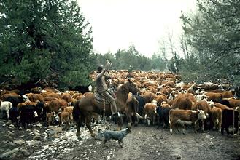
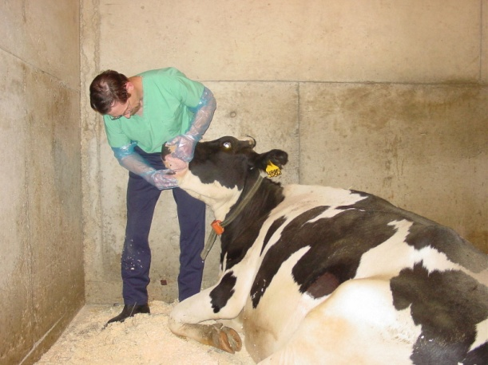
Disease Transmission
Sources
  Animal to animal
  Environment
    soil, water, feed
    vectors
  Animal to human
    Zoonotic
  Human to animal
Notes:
Animals can be exposed to diseases from a variety of sources. Most occur between animals, but transfer can also occur from the environment, such as soil, water, or feed. Some diseases can also be transferred between animals and people. Diseases of animals transferred to people are referred to as zoonotic diseases, while diseases of humans transferred to animals are referred to as reverse zoonoses. Zoonotic diseases of concern for responders during animal health emergencies are addressed further in the Health and Safety: Zoonoses Risks and Prevention Just-In-Time training presentation.
[Photos: (Top) Cattleman herding cattle through a ravine; (Bottom) oral examination of a dairy cow, Source: Danelle Bickett-Weddle, Iowa State University]

Slide 3
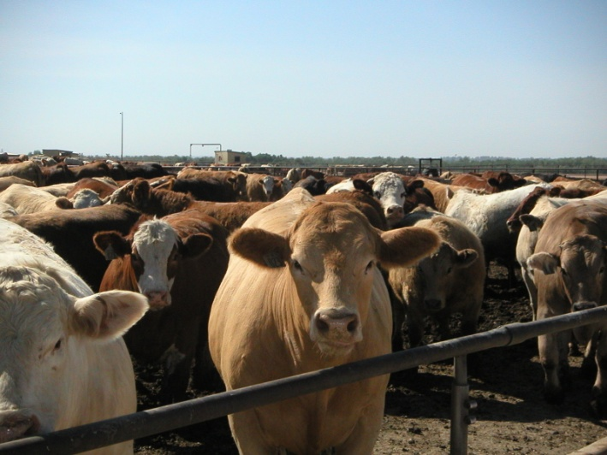
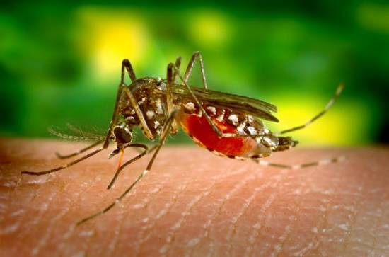
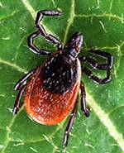
Routes of Transmission
Direct contact
Inhalation (Aerosol)
Oral/Ingestion
Fomites
  Inanimate objects
  Equipment, boots, vehicles
Vectors
  Mosquitoes, ticks,
  biting midges
  Rodents or birds
Notes:
Regardless of the source, animal diseases, much like human diseases, are then spread (or transmitted) through a variety of ways. These can vary with the disease of concern.
Animal diseases can be spread by 5 main routes of transmission: direct contact; inhalation of aerosols; ingestion; indirect transfer by fomites, such as equipment, footwear or vehicles; or vector transmission.
[Photos (Top): Feedlot cattle in close contact, Renee Dewell, Iowa State University; (Bottom) mosquito and tick, Centers for Disease Control and Prevention Public Health Image Library]

Slide 4
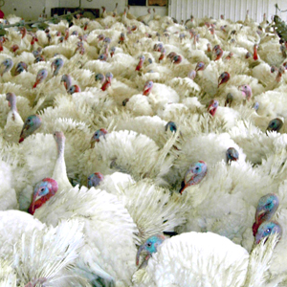
Direct Transmission
Susceptible animal
comes in contact with infected animal
Body fluids
  Urine, feces
  Saliva
  Blood, milk
Tissues
  Lesions
  Carcass
Breeding
Mother-to-offspring
Notes:
Direct contact is one of the main methods of disease spread between animals. It occurs when a susceptible animal comes in direct contact with an infected animal, its body fluids or tissues. Depending on the microorganism, it may be transferred directly by blood, saliva, urine, or feces. It may also be spread through contact with infected animal lesions or tissues. Entry into the susceptible animal generally occurs through contact with the mucous membranes, such as the eyes, nose, or mouth but can also enter through open wounds or breaks in the skin. So, possible exposures can occur from nose-to-nose contact, biting or rubbing against each other. Some diseases of animals can also be spread during breeding as well as from mother-to-offspring, during gestation or through milk when nursing.
[Photo: A flock of turkeys, USDA]

Slide 5
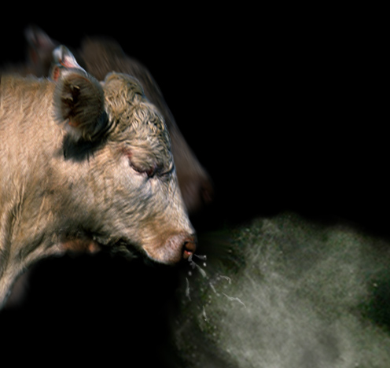
Aerosol Transmission
Disease agents contained
in droplets
  Pass through air
Most agents not stable
in droplets
Close proximity required
  Enclosed barns
  Coughing, sneezing
  Contaminated soil
    Birthing tissues
    Feces, urine
Notes:
Aerosol transmission is another means of disease spread. This involves the transfer of disease agents in droplets spread through the air, which are then inhaled by another animal. Most microorganisms are not able to survive for extended periods of time within the aerosol droplets, and as a result, close proximity of infected and susceptible animals is required for disease transmission. Aerosol transmission can also occur when infected droplets from urine, feces, or birthing material get stirred up from contaminated soil or dust and inhaled.
[Photo: Depiction of aerosol spread from a cow, Clint May, CFSPH, Iowa State University]

Slide 6
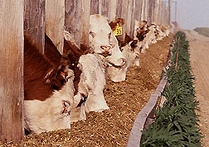
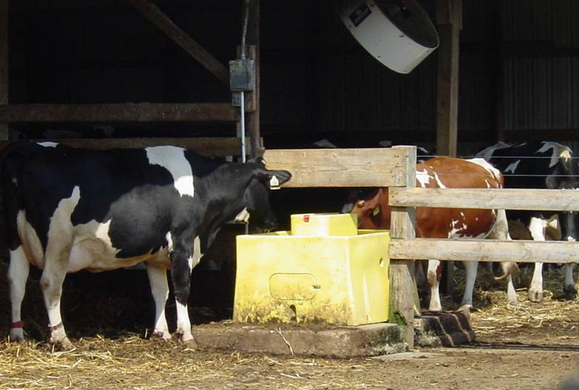
Oral Transmission
Ingestion of
contaminated
feed or water
  Feces, urine
  Saliva
  Milk
Licking/chewing
contaminated
environment
Shared feed or
water sources
Notes:
Oral transmission of disease causing organisms involves ingestion through the consumption of contaminated feed or water, or by licking/chewing on contaminated environmental objects. Feed and water contaminated with feces, urine or saliva are frequently the cause of oral transmission of disease agents. Fecal-oral transmission of diseases is a common means of infection in animals (and people). Shared feed and water sources can contribute to the spread of the disease.
[Photos: (top): Cattle eating at a feedbunk, Danelle Bickett-Weddle, CFSPH, Iowa State University; (bottom) cattle sharing a water tank, Danelle Bickett-Weddle, CFSPH, Iowa State University]

Slide 7
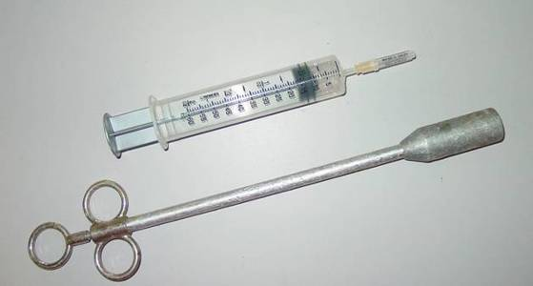
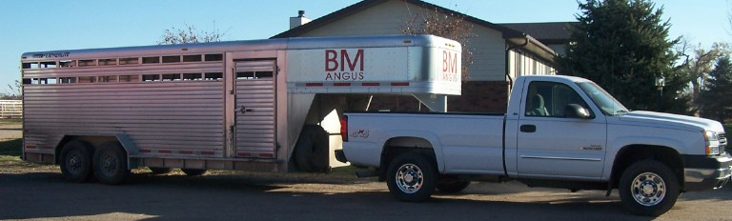
Fomite Transmission
Contaminated
inanimate object
Carries pathogens
to other animals
  Needles, balling guns
  Buckets
  Bedding, shovels
  Vehicles, trailers
  Humans, clothing
Notes:
Indirect transmission may occur by fomites. These are inanimate objects, such as equipment, clothing, footwear or vehicles, that can transfer microorganisms from an infected animal to another animal or person. Examples of fomites that may be present during a response include needles, balling guns (used to dispense medication to cattle), feed or water buckets, bedding and shovels. Even items such as clothing or vehicles may become contaminated and serve to spread pathogens.
[Photos: (top) Syringe and balling gun. Danelle Bickett-Weddle, CFSPH, Iowa State University; (bottom): pickup and trailer, Bryan Buss, CFSPH, Iowa State University]

Slide 8
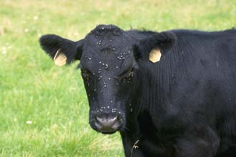
Vector Transmission
Living organism
transfers disease
between animals
  Mosquitoes
  Ticks
  Biting midges
  Flies
Acquires pathogen
from one animal
Transmits to
another animal
Notes:
Lastly, some diseases are spread by vectors – living organisms – able to transfer microorganisms from an infected animal to another. Mosquitoes, ticks, biting midges and flies are common disease carrying vectors, but sometimes rodents or birds can serve as disease vectors.
[Photos: (top): Calf with numerous face flies, USDA; (bottom): mosquito (left) and tick (right), CDC Public Health Image Library]

Slide 9
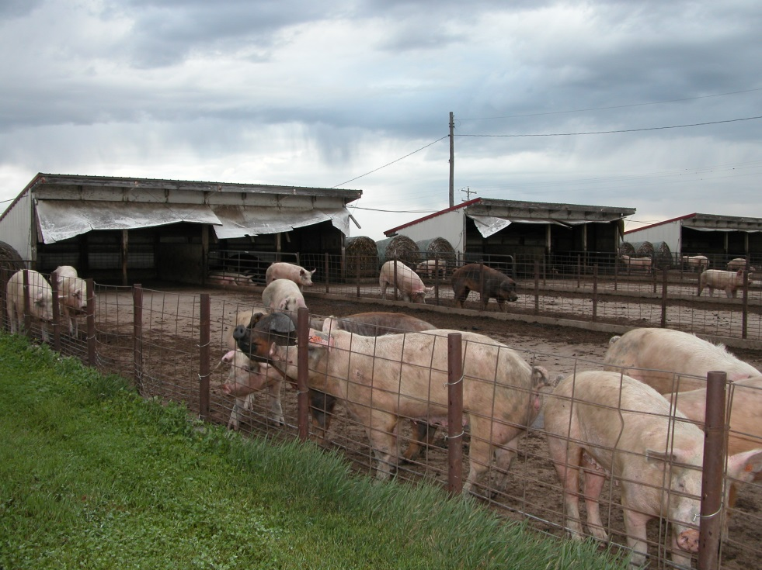
Points to Keep in Mind
Transmission routes vary with disease
  Multiple routes
  Single route
Animals may not show obvious
signs of disease
Persistence in environment
    Soil, manure, water
Notes:
It is important to remember that transmission varies with the disease of concern. Multiple routes of transmission may be possible for some diseases, while others may be limited to a single means of transfer. Equally important is knowing that transmission may occur without animals exhibiting obvious signs of disease. That is why awareness of the various routes of transmission becomes so essential when implementing a strategy to minimize disease spread during a response. Finally, remain aware that many disease agents can survive for extended periods of time in the environment or on objects; therefore, environmental contamination should not be ignored.
[Photo: Outdoor swine shed and pen, VDPAM, Iowa State University]

Slide 10
Biosecurity Measures for Transmission Routes
Route of Transmission | Possible Biosecurity Measures
Direct Contact | Isolation of infected animals; personal protective equipment
Fomites | Cleaning and disinfection procedures; personal protective equipment
Aerosol | Isolation of infected animals; personal protective equipment
Ingestion | Cleaning and disinfection procedures
Vectors (e.g., insects) | Pest management procedures
Notes:
This table shows some of the possible biosecurity measures that may be used to limit transmission of pathogenic agents based on their routes of transmission. For pathogens spread by direct contact and aerosols, the isolation of infected animals and use of personal protective equipment, such as gloves, can limit and prevent transmission by this route. For pathogens spread by fomites, such as equipment or vehicles, or ingestion, cleaning and disinfection measures can be effective in reducing contamination. Control of vector-borne diseases will involve the use of pest management procedures to limit transmission. Lets talk about these biosecurity measures a bit more.

Slide 11
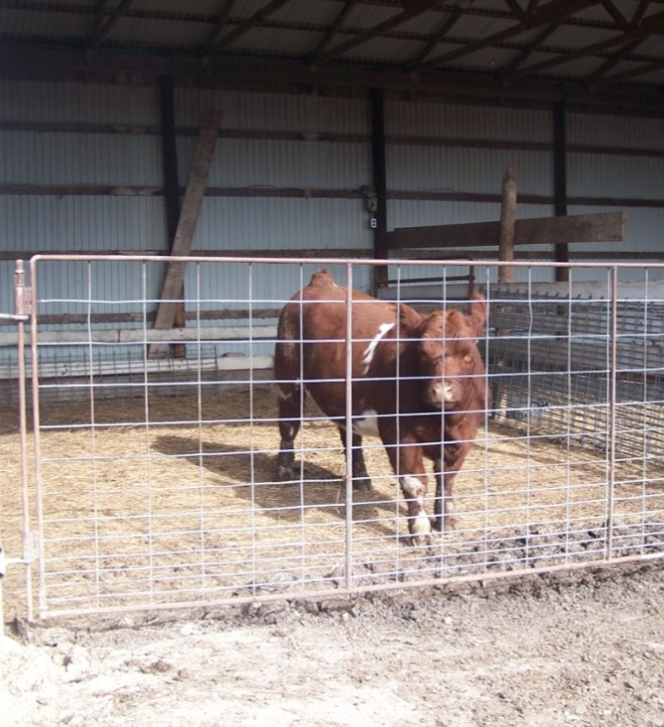
Prevention: Direct Contact
Isolation/quarantine
  Increase distance
  between sick and
  well animals
Dedicated equipment
to prevent spread from
isolation area
Cleaning and disinfection
Notes:
One of the first steps in preventing further spread of disease is minimizing contact between susceptible and infected animals. This is often accomplished by isolating the infected animal. In the case of animal disease emergencies, often more than one animal is involved, therefore the entire farm may be quarantined, in efforts to prevent the further spread of the disease. When working with animals in isolated or quarantined areas, dedicated equipment should be used to prevent pathogen spread outside of the area. Proper cleaning and disinfection procedures are also important for preventing the spread of pathogens by fomites, such as equipment, vehicles, or footwear. Keep the animal housing environment as clean and dry as possible to minimize risk of environmental exposure.
[Photos: (top) Bull in an isolation pen, Bryan Buss, CFSPH, Iowa State University; (bottom) cleaning and disinfecting boots, Sandy Amass, Purdue University]

Slide 12
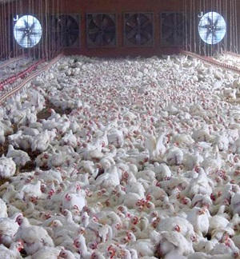
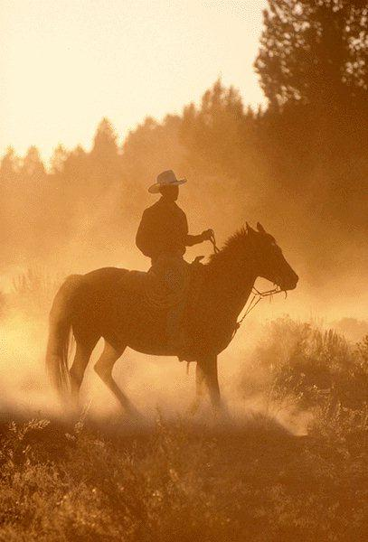
Prevention: Aerosol
Adequate ventilation
  Provide fresh air to
  all animals
  Decrease humidity
  and odor build up
Control dust
  Wear respiratory protection in
  certain situations
Notes:
To minimize aerosol transmission, maximize ventilation so that fresh air is provided to all animals and humidity and odors do not build up. Control the amount of dust generated in animal housing areas. This can damage the protective cells in the respiratory tract, as well as result in exposure to contaminated particles that can cause disease. Responders should wear respiratory protection, especially when there is a zoonotic disease concern.
[Photos: (top) Ventilation fans in a poultry facility, USDA; (bottom) stirred up dust, The Animal Photo Archive]

Slide 13
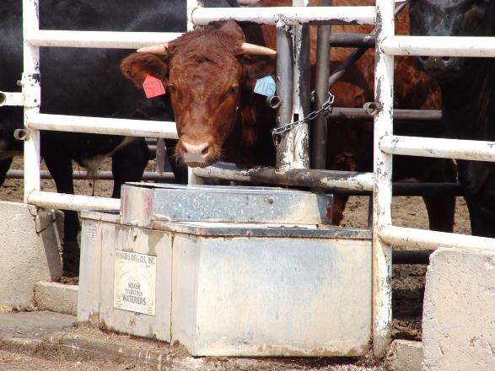
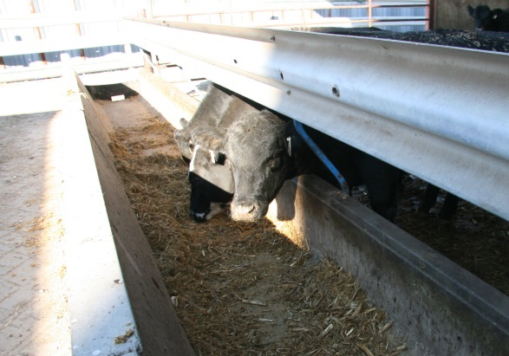
Prevention: Ingestion
Keep feed and water clean
Prevent rodent and
bird access
Proper waste management
  Keep environment clean and dry
Cleaning and disinfection
Notes:
Keeping feed and water clean by minimizing fecal and urine contamination is extremely important. Prevent rodent and bird access to feed and water to prevent contamination by these vectors. Proper waste management procedures can help to keep the environment clean and dry. Cleaning and disinfection procedures for feed bunks or waterer can help minimize transmission between animals.
[Photos: (top) Feedlot cow at a waterer, Renee Dewell, CFSPH, Iowa State University; (bottom) cows at a feedbunk, Mykel Weding, CFSPH Iowa State University]

Slide 14
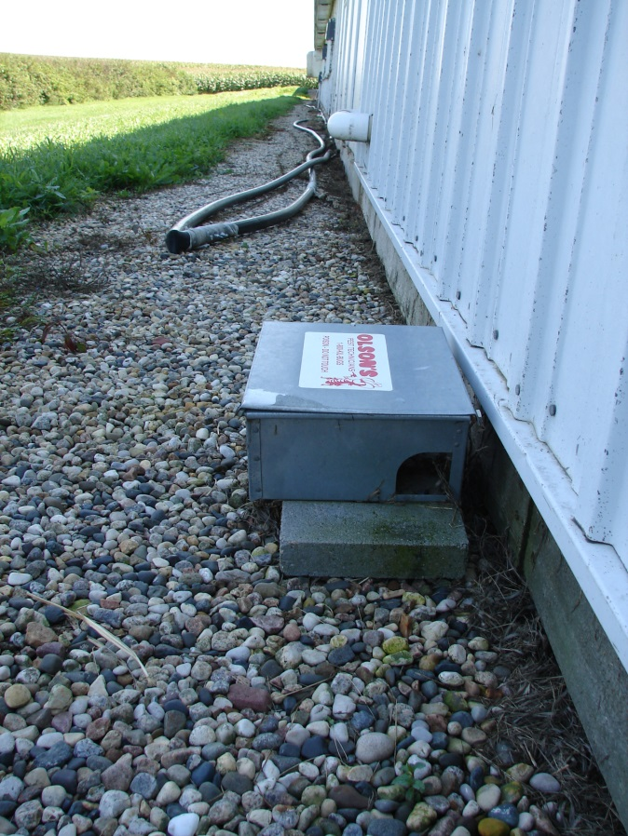
Prevention: Vector Control
Source reduction
  Habitat reduction/elimination
  Parasitic or predatory insects
Control adults
  Insecticides
    Knockdown and residual sprays
    Baits, fly traps
Minimize interaction
  Sheltering of animals
Notes:
Vector control begins with an understanding of the insect’s life cycle. Insect life stages vary and so do the specific, effective control measures. For instance, the egg laying grounds for flies are different than that of mosquitoes and midges, and one approach will not necessarily work for all. Source reduction consists of eliminating potential insect breeding areas and larval habitats. Generally this involves removing standing water sources, such as tree holes or old tires or agitating any water sources, such as stock tanks or water troughs. Some insects require manure or organic material for development, so cleaning animal feeding areas, yards and barns can minimize these vectors. Sometimes, parasitic or predatory insects may be used to control the larval stages of other insects. Controlling adult insects, often involves the use of insecticides, either as a knockdown or residual treatment. These methods are often less effective compared to habitat reduction methods. Baits and fly traps may aid efforts, but should not be used as the sole method of control. Sheltering animals indoors, can minimize the opportunities for insects to interact with animals. Additional information on vector control can be found in the corresponding Just-In-Time training presentation.
[Photo: A rodent bait trap, Danelle Bickett-Weddle, CFSPH, Iowa State University]

Slide 15
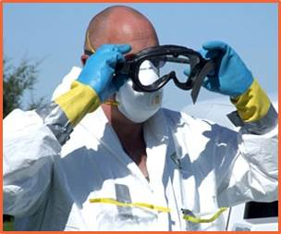
Personal Protective Equipment
Gloves
  Creates barrier between you and pathogen
  Especially hands with cuts, abrasions, chapped
  Wash hands after
  removing gloves
Coveralls, footwear
Respiratory and
eye protection
Notes:
The use of personal protective equipment, such as gloves, coveralls, and boots, can help reduce exposure and transfer of pathogens. Gloves should be worn when working with sick animals and those that you are unaware of their health status (remember that infected animals do not always appear sick). This is especially important if hands have cuts, abrasions or are severely chapped because areas of broken skin provide an entrance for disease agents. Wearing gloves does not replace good hand washing habits – wash hands in warm water and soap after removing gloves. Coveralls will help keep your clothes clean and cover your arms to minimize disease exposure when handling tissues or animals. Protective footwear (e.g., rubber boots) will protect your shoes from contamination and minimize spread to other areas of the farm. Wear masks in certain situations to prevent inhaling contaminated particles. Additional information on PPE can be found in the corresponding Just-In-Time training presentation.
[Photos: Responder in PPE, Travis Engelhaupt, CFSPH, Iowa State University]

Slide 16
Additional Resources
USDA Foreign Animal Disease Preparedness (FAD PReP) Guidelines: Biosecurity
  http://www.aphis.usda.gov/animal_health/emrs/nahems.shtm
Just-In-Time training presentations
  http://www.cfsph.iastate.edu/Emergency-Response/just-in-time-training.php
Notes:
For more information on biosecurity issues during an animal health emergency response, consult the USDA FAD PReP Biosecurity Guidelines. Additional training presentations, including a biosecurity overview, personal protective equipment, cleaning and disinfection, and wildlife and vector control, can be found on the Just-in-Time training website.

Slide 17
Acknowledgments
Development of this presentation was by the Center for Food Security and Public Health at Iowa State University through funding from the Multi-State Partnership for Security in Agriculture
Author: Glenda Dvorak, DVM, MPH, DACVPM
Notes:
Information provided in this presentation was developed by the Center for Food Security and Public Health at Iowa State University College of Veterinary Medicine, through funding from the Multi-State Partnership for Security in Agriculture.

