Slide 1
Biosecurity
Overview
Notes:
December 2015
During an animal health emergency, controlling the spread of disease to other animals, premises and responders will be necessary. This Just-In-Time training presentation will discuss the concept of biosecurity and procedures to use during infectious animal disease outbreaks.

Slide 2
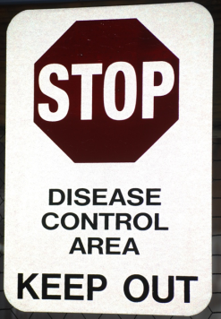
Biosecurity
Series of management practices
Bioexclusion
Preventing the introduction onto non-infected premises
Biocontainment
Preventing the spread from an infected premises
By animals, personnel, equipment
Notes:
Biosecurity involves a series of management practices designed to prevent the introduction and spread of disease causing organisms onto or off of an animal production or housing premises. There are two main goals of biosecurity. The first is bioexclusion, or preventing the introduction of disease onto a premises considered non-infected. Biocontainment involves preventing disease spread off a premises considered infected. The level of biosecurity and protocols implemented will vary with each situation and will be based on a site assessment and the potential routes of exposure for the disease of concern. Regardless, the use of various biosecurity measures, when properly implemented, will help reduce the risk of disease spread by the movement of animals, personnel, equipment and other materials during response activities.

Slide 3
ICS: Biosecurity Group
Biosecurity Officer
Experienced veterinarian
Develops site-specific biosecurity plan
Train personnel on protocols
Ensure biosecurity implemented
Biosecurity Team Members
Front line assistance
Biosecurity tasks to contain and control disease outbreak
Notes:
Biosecurity procedures for an animal health emergency are coordinated and managed by the Biosecurity Group of the Operations Section of ICS. A Biosecurity Officer should be appointed and should be an experienced veterinarian or consult with one. The Biosecurity Officer will be responsible for developing a site-specific biosecurity plan (in coordination with the Incident Commander and Safety Officer), training personnel on biosecurity protocols, and ensuring the appropriate biosecurity measures are implemented. Biosecurity Team Members will provide front-line assistance in containing and controlling the disease outbreak. All responders should receive a biosecurity briefing upon arrival to the incident site.

Slide 4
Basic Biosecurity Elements
Start biosecurity procedures quickly
Awareness of biosecurity measures
Understand disease transmission
Biosecurity measures aimed at preventing disease spread by
Movement of animals
Movement of personnel
Movement of equipment
Notes:
During an animal health emergency, it is important to start biosecurity procedures as quickly as possible. Basic elements of any biosecurity plan include an awareness and understanding of the importance of biosecurity measures and how disease agents can be transmitted. Biosecurity measures needed will be aimed at preventing disease spread from the movement of animals, personnel, and equipment.

Slide 5
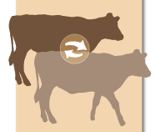
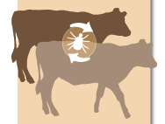
Disease Transmission
Direct
Contact
Ingestion
Inhalation (aerosol)
Indirect
Fomites
Inanimate objects
Vectors
Living organism (e.g., insects, rodents)
Notes:
Biosecurity measures help to break the disease transmission cycle; therefore, understanding the way animal disease can be transmitted can provide insight in the necessity of biosecurity protocols. The spread of disease can occur by direct and indirect transmission methods. Direct spread of a disease may occur through direct contact with an infected individual, ingestion of the organism, or through inhalation (or aerosol) exposure. Indirect methods involve fomites – or inanimate objects that can transfer pathogens, such as boots or equipment, or involves vectors – living organisms able to transmit pathogens – most commonly insects, but also rodents or birds.
Greater explanation on the routes of disease transmission for animal disease emergencies is provided in the Biosecurity: Routes of Transmission Just-In-Time training presentation and handout, which can be found on the Just-In-Time training website (www.cfsph.iastate.edu/Emergency-Response/just-in-time-training.php) or by searching “animal disease just in time training”).

Slide 6
Biosecurity measures
Movement control and restriction
Personal protective equipment
Cleaning and disinfection
Isolation
Vector control
Notes:
Let’s look at the various biosecurity measures that can be used to control and prevent the introduction of pathogens onto or off of a farm. These include movement control and restriction for animals, vehicles and personnel; the use of personal protective equipment; cleaning and disinfection, isolation of animals, and vector control measures.

Slide 7
Movement Control: Animals
Stop movements
Movement restrictions
Animals should not be moved if
Came from a confirmed or suspected premises
Had contact with infected or suspect animal
Are susceptible animal near infected or suspected premises
Found on transport vehicles that do not meet biosecurity standards
Notes:
Movement control and restriction efforts will be necessary to minimize the spread of pathogens by any number of items, including infected animals, vehicles on site, and even response personnel. Depending on the situation, this may involve complete movement restrictions (i.e., stop movement orders) or restrictive measures which may allow limited movement following biosecurity protocols (such as cleaning and disinfection). During highly contagious disease outbreaks, the movement of all affected or susceptible animals on the premises should be restricted until the scope of the outbreak can be determined. Movement restriction measures should include:
Any animals that came from a premises confirmed or suspected of the disease;
Any animals that have had contact with infected or suspected animals;
Any susceptible animals near an infected or suspected premises; or
Any animals found on transport vehicles that do not meet biosecurity standards (e.g., proper C&D measures).
Veterinary evaluation and any necessary biosecurity measures should occur for any of these situations before movement is allowed.

Slide 8
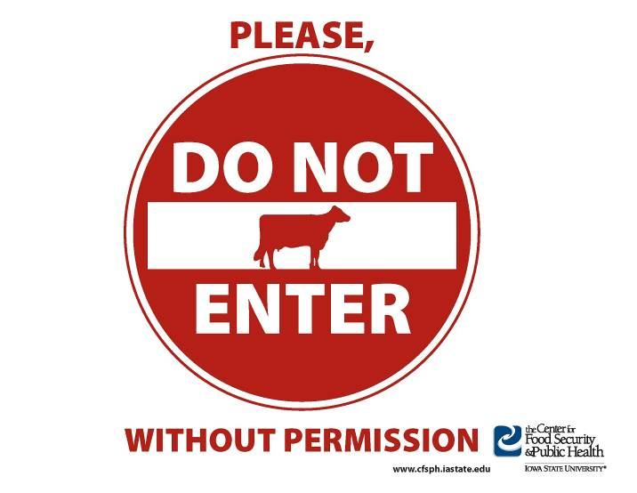
Movement Control: Personnel
Restrict access
Control movement on and off premises
Post highly visible signage
Describing biosecurity protocols
Designating PBA and LOS work zones
Log book for those allowed to access
Post signs at premises boundary
Notes:
Movement control and restrictions should also be applied to people entering and exiting the infected or suspected premises. This includes responders as well as employees, or any other visitors allowed on site, such as feed delivery personnel. Access to the premises should be restricted to only those necessary for farm functions or response procedures. Movement onto or off of the premise should be tightly controlled and biosecurity measures communicated and implemented prior to entry and upon exiting the premises. A log book should be maintained to record individuals and vehicles accessing the premises. The use of warning or restriction signs at the premises boundary can be helpful in informing visitors to stay away. [Graphic illustration by Clint May, Iowa State University]

Slide 9
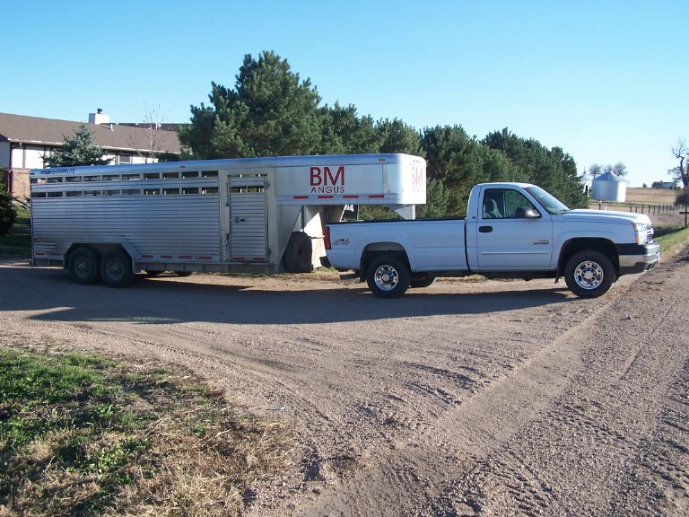
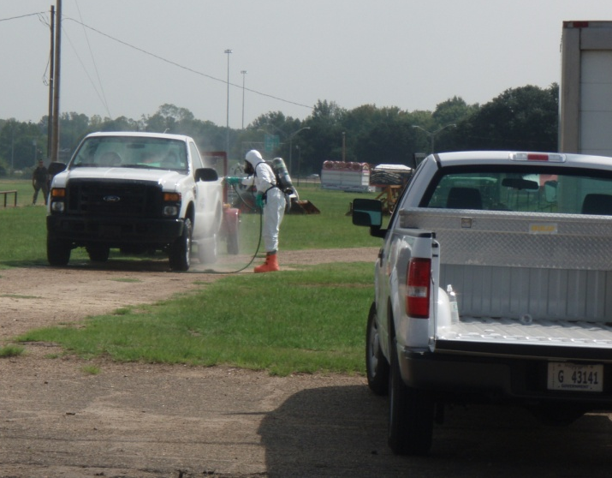
Movement Control: Vehicles
Potential fomite transfer
Park in designated areas away from animal locations
Clean and disinfect before entering and exiting premises
Notes:
Vehicles can serve as fomites and transfer pathogens to additional locations if proper biosecurity measures are not taken. Responders, employees, or visitors should park their vehicles in a designated area away from animal housing locations. This will help to prevent possible contamination of vehicles and fomite transmission of the disease. Any vehicles or equipment allowed on the premises must be cleaned and disinfected before entering and before exiting the premises to prevent potential spread to additional locations. This includes animal transport trailers or trucks, delivery trucks, personal vehicles or any other response vehicles entering the site. Individuals should put on clean and disinfected footwear, if leaving the vehicle is necessary. [Photo (top) from Bryan Buss, Iowa State University; (bottom) Carla Hueston, Mississippi State University]

Slide 10
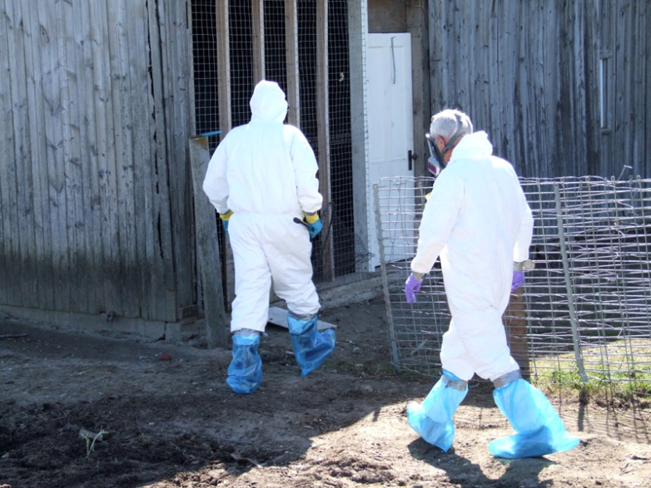
Personal Protective Equipment
Two functions
Prevent further spread
Protect responders
Don PPE prior to entry into area
Disposable Outerwear
Tyvek® coveralls, gloves, boot covers, masks
Reusable Outerwear
Cloth coveralls, rubber boots, goggles
Wear clean and disinfected footwear and outerwear
Notes:
The use of Personal Protective Equipment, or PPE, can also serve as a useful biosecurity measure to prevent the spread of disease agents. Personal protective equipment serves two functions during an animal health emergency response. First, it can help minimize the spread of pathogens off of a premises as well as between locations on a premises. PPE items are donned prior to entry to the site and doffed prior to exiting the site, thereby containing any contamination at the location. PPE also serves as a protective barrier to responders in situations involving zoonotic disease, thereby protecting the responder from potential exposure. The appropriate PPE required for a response will be determined by the pathogen involved and protective measures needed. [Photo from Jane Galyon, Iowa State University]

Slide 11
Personnel Biosecurity
Once on infected premises, do not exit until
PPE cleaned, disinfected
Disposable items left on premises or placed in designated area
Clean/disinfect reusable items on site
WASH HANDS!
Notes:
Once a worker has entered the infected premises, they should not exit the premises until all PPE has been properly cleaned and disinfected or disposed of prior to exiting the premises. All contaminated disposable items (e.g., Tyvek coveralls, boot covers, latex gloves) should be discarded in a plastic garbage bag to be left on the premises or in the designated area. Contaminated cloth coveralls and rubber boots should be scrubbed to remove dirt and debris and then sprayed with a disinfectant. The items should be placed into a clean plastic garbage bag or other container that is sealed until they can be washed further. Hands should always be washed after doffing all PPE.

Slide 12
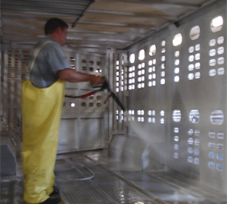
Cleaning and Disinfection Procedure
Cleaning
Remove all organic matter
Wash and rinse
Disinfection
Use proper concentration
Allow proper contact time
Read safety precautions
Wear appropriate PPE
All equipment or vehicles must be cleaned and disinfected
Notes:
Cleaning and disinfection procedures will be vital for controlling and containing any disease outbreak situation and minimizing the transmission between premises. C&D procedures should be established for animal housing areas, as well as any vehicles, equipment and PPE used on the site. The proper cleaning and disinfection procedure is a 2-step process. Cleaning involves the physical removal of any organic material such as manure, dirt, feed, or bedding, followed by a Wash step to clean surfaces and remove any adhered debris, residual oils or body fluids. The cleaning step is often overlooked, however, most disinfectants are inactivated by organic material, thereby making the cleaning step an essential part of the process. Once the area or item has been cleaned and rinsed, an appropriate (EPA-approved) disinfectant can be applied. There are various disinfectant products, application methods and use concentrations; therefore always read the label instructions for proper use. Another often overlooked step is not allowing for the proper contact time after application of the disinfection solution. The chemical disinfectant needs time to do its job, so it should remain on the surface being disinfected for the necessary time according to the product label. All chemical disinfectants have some degree of hazard with use, so always read the safety information on the label and wear the appropriate PPE when preparing and applying products. [Photo source: Danelle Bickett-Weddle, Iowa State University]

Slide 13
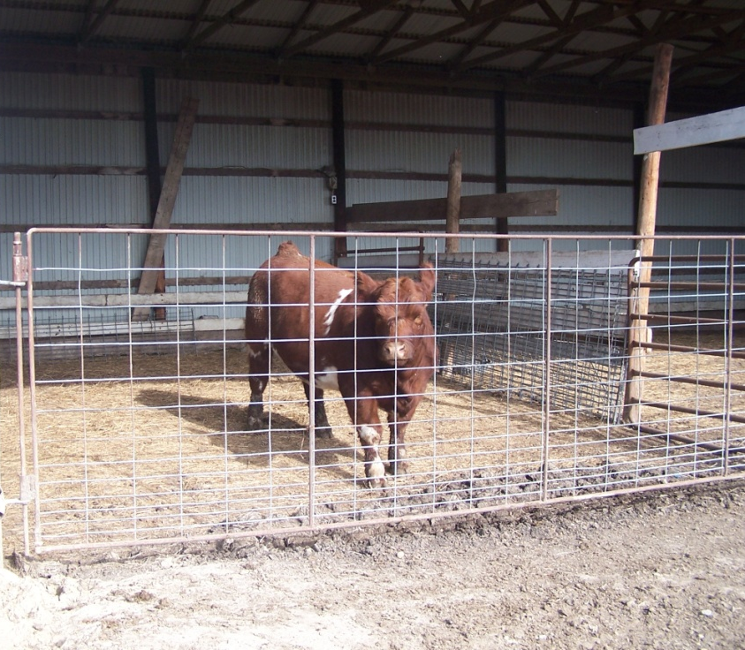
Isolation
Infected or exposed animals should be housed in separate areas
Proper carcass disposal of euthanized or dead animals
Notes:
Additional biosecurity measures necessary to minimize the spread of pathogens from the premises include isolation procedures and wildlife and vector control measures. The isolation of infected or exposed animals is necessary to minimize the transfer of pathogenic agents to other susceptible animals on the site or additional locations. Isolation areas should preferably be at a distance from susceptible animals if possible. Additionally, in the event of animal death or euthanasia, proper carcass disposal methods should be used to prevent animals or tissues from being carried off by wildlife. For additional information proper carcass disposal methods, see the Carcass Disposal During Animal Health Emergencies Just-In-Time training presentations. [Photo from Bryan Buss, Iowa State University]

Slide 14
Wildlife Control
Wildlife can carry diseases on and off the property
Keep animals isolated from wildlife contact
Ensure boundary measures are checked regularly and maintained
Store food in a way that does not attract wildlife
Notes:
For some diseases, wildlife may carry disease agents on and off of the property and infect additional susceptible animals. Wildlife can pose a difficult problem to biosecurity, especially on premises where livestock are not kept in an enclosed area. Keep infected, suspect or susceptible animals in areas that prevent wildlife contact. Boundary fences and barriers should be checked regularly and maintained. Ensure feed is stored in a manner that does not attract or allow access to wildlife (e.g., secure containers or building).

Slide 15
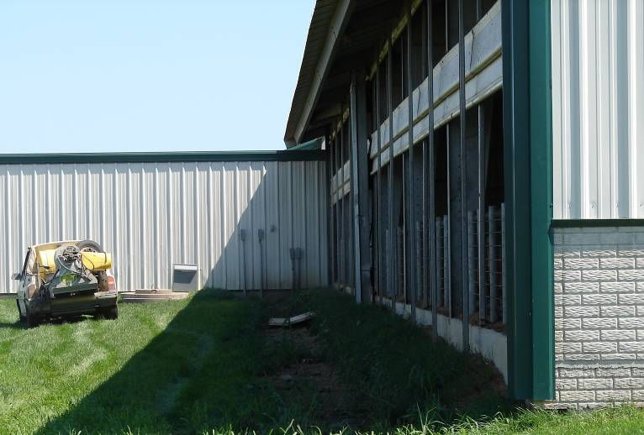
Vector Control
Source reduction
Prevent egg laying
Minimizing long vegetation (e.g., mowing)
Control adults
Insecticides
Spraying, fogging, baiting
Minimize animal interaction
Screens on buildings
Animal treatment
Notes:
Some animal health emergencies will involve insect vectors (e.g., mosquitoes, biting midges) capable of spreading disease agents. Control measures should be taken to limit the spread of disease by these insects. Vector control begins with an understanding of the insect’s life cycle, as these can vary among vectors, as will effective control measures. For instance, egg laying grounds for flies are different than those of mosquitoes or midges. Controlling adult insects often involves the use of insecticides; fogging and baiting may also work to a limited extent. Most effort should be focused on reducing the vector source (i.e., egg laying sites) and limiting the exposure of animals on the premises (e.g., through the use of screens on barns, animal treatment with approved chemicals, and minimizing tall vegetation or standing pools of water). Additional information on Wildlife Management and Vector Control during animal health emergencies can be found on the Just-In-Time training website. [Photo source: Danelle Bickett-Weddle, Iowa State University]

Slide 16
Biosecurity lines and Work Zones
Perimeter Buffer Area (PBA)
Line of Separation (LOS)
Biosecurity Work Zones
Notes:
Lastly, lets look at some of the terminology and biosecurity designations that will be used during an animal disease emergency response. These designations help establish various biosecurity areas and the protocols needed. These include the Perimeter Buffer Area, or PBA; the Line of Separation, or LOS; and Biosecurity Work Zones.

Slide 17
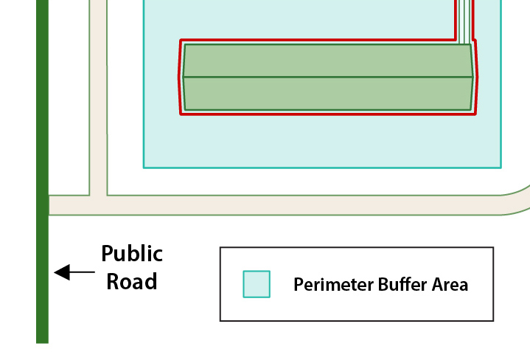
Biosecurity Lines
Perimeter Buffer Area (PBA)
Line of Separation (LOS)
Animal Housing Building
Notes:
On-site, biosecurity lines are established to act as a barrier to reduce the spread of disease on-site. These biosecurity lines consist of the Perimeter Buffer Area (PBA) and Line of Separation (LOS). This diagram shows an animal housing building in green with the PBA in light blue shading and the LOS as a red line around the production barn.

Slide 18
Perimeter Buffer Area (PBA)
First Line of Defense
Outer control boundary
Around premises or building perimeter
Designate PBA
Fencing, flags, ropes
Non-essential vehicles should not enter
Vehicles and equipment that are not cleaned and disinfected should not enter
Personnel training
Notes:
The Perimeter Buffer Area acts as an outer control boundary. It is set up around the perimeter of the premises or building to reduce the potential for contamination of the area around the buildings. It may be an actual barrier, such as a perimeter fence or it may be marked by flags, ropes or other markings. The PBA is the first line of defense to protect the animals housed on-site. Non-essential vehicles should not enter the PBA; those allowed to enter must be cleaned and disinfected before entering. Personnel (responders, employees, truck drivers) should understand the purpose and boundaries of the PBA and be trained on procedures to follow when entering and moving around the site.

Slide 19
Line of Separation (LOS)
Building walls separating animals from outside, AND
Clearly marked line at entry site of building
Cleaning and disinfection protocols must be completed prior to movement across the LOS (entry and exit)
Notes:
Once inside the Perimeter Buffer Area, the Line of Separation is established to isolate animals from potential disease sources. The LOS consists of the building walls separating the animals from the outside, plus a clearly marked line in the entry site of the production building. The LOS can be clearly marked with tape, paint, or signage. The LOS entry should include a bench or low physical barrier as an additional indicator. A site may have as many Lines of Separation as there are buildings. All equipment and supplies that cross the LOS must be cleaned and disinfected, or be from a known clean source, this includes personnel footwear and outer clothing.

Slide 20
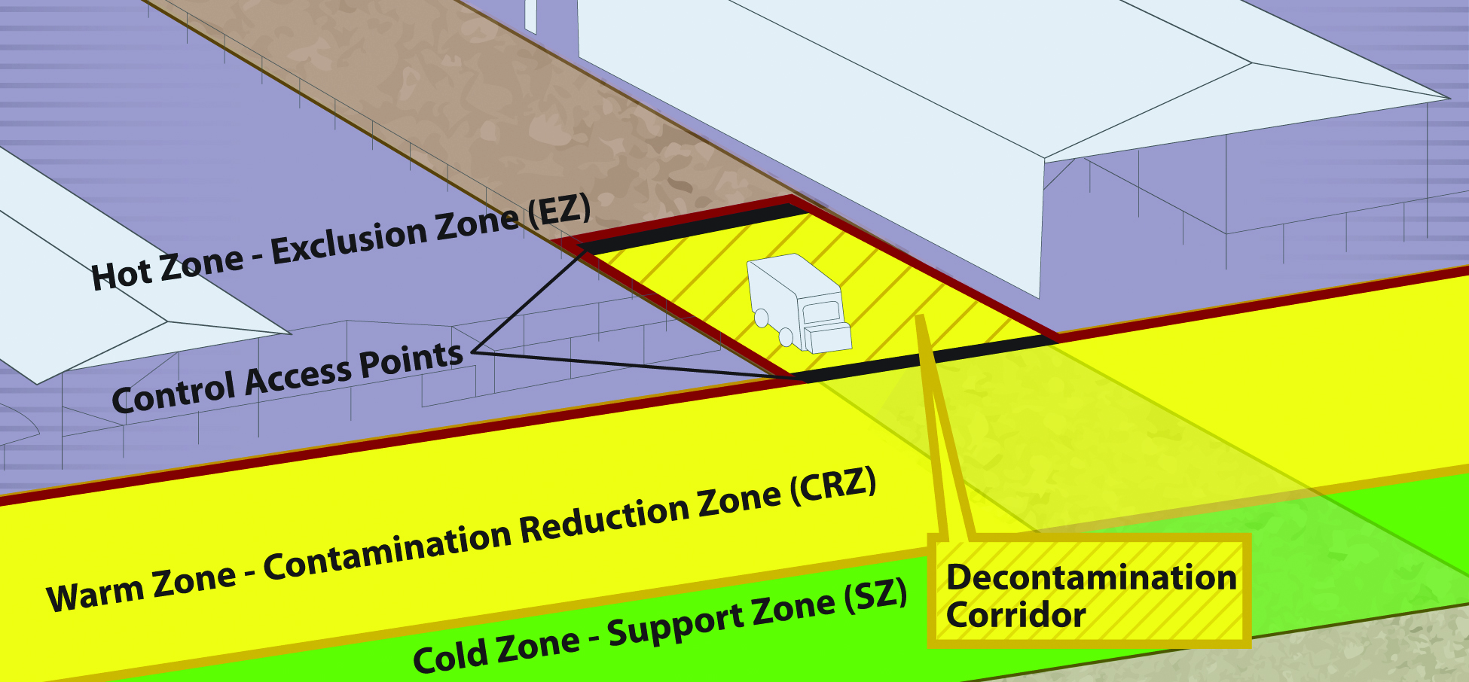
Biosecurity Work Zones
Notes:
Biosecurity Work Zones further enhance access control procedures (e.g., entry, exit) in efforts to minimize the spread of pathogen onto or off of an infected or suspected premises. Responders should understand the location and implications of each of the biosecurity work zones. These work zones apply to personnel and vehicle traffic onto the site as deemed necessary.
The Hot Zone or Exclusion Zone (EZ) is the potentially contaminated or unsafe area (e.g., infected animal premises). Appropriate PPE must be worn in this area.
The Warm Zone or Contamination Reduction Zone (CRZ) is also considered a high risk area due to the potential for exposure to pathogens and chemical disinfectants. All personnel are required to wear PPE.
The Decontamination or Decon Corridor is the area between the Hot Zone and the Warm Zone. Decontamination of personnel and disinfection of equipment occurs here. Teams exit and enter the site through this corridor. Once responders have doffed, disinfected, and decontaminated in the Warm Zone, they should move to the Cold Zone/Support Zone (SZ) through the designated Control Access Points.
The Cold Zone or Support Zone (SZ) is the clean/uncontaminated area of the site, where responders should not be exposed to hazardous conditions; support functions are based here. Donning of PPE prior to entry into the Hot Zone also occurs here. [Graphic Andrew Kingsbury, Iowa State University. Definitions from USDA FAD PReP Guidelines].

Slide 21
Resources
USDA Foreign Animal Disease Preparedness (FAD PReP) Guidelines: Biosecurity
http://www.aphis.usda.gov/animal_health/emrs/nahems.shtm
Poultry Biosecurity Officer Information Manual
http://www.poultrybiosecurity.org/
Additional Just-In-Time Training
http://www.cfsph.iastate.edu/Emergency-Response/just-in-time-training.php
Notes:
For more information on biosecurity issues during an animal health emergency response, consult the USDA FAD PReP Biosecurity Guidelines or the Poultry Biosecurity Officer Information Manual. Additional training presentations, including disease routes of disease transmission, animal carcass disposal, cleaning and disinfection, and wildlife and vector control, can be found on the Just-in-Time training website.

Slide 22
Acknowledgments
Development of this presentation was by the Center for Food Security and Public Health at Iowa State University through funding from the Multi-State Partnership for Security in Agriculture
Authors: Glenda Dvorak, DVM, MPH, DACVPM; Logan Kilburn, Sarah Viera, MPH
Notes:
Information provided in this presentation was developed by the Center for Food Security and Public Health at Iowa State University College of Veterinary Medicine, through funding from the Multi-State Partnership for Security in Agriculture.

