Slide 1
Health and Safety
Zoonoses: Risks and Prevention
Notes:
December 2011
During an animal disease emergency, the animal disease being controlled may also be of concern to human health. This Just-In-Time training presentation will highlight preventive measures for responders to take to protect themselves from zoonotic disease exposure and possible illness.

Slide 2
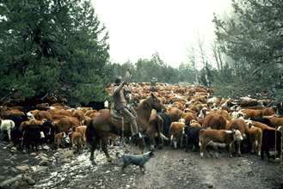
Zoonotic Disease
Zoonosis
  Disease of animals
  Transmitted to humans
  Under natural conditions
Awareness of routes of transmission
  Develop strategy to minimize risk
Dorland’s Illustrated Medical Dictionary, 28th Edition
Notes:
Animals may carry disease organisms that can cause illness in humans. Zoonotic diseases or zoonoses, are diseases of animals that can be transmitted – or transferred- to humans. Awareness of these diseases, and their means for spread is important so strategies can be developed to minimize the risk of exposure for responders. [Photo from Doug Wilson, USDA, image # 95cs0779].

Slide 3
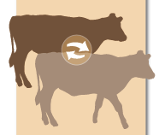
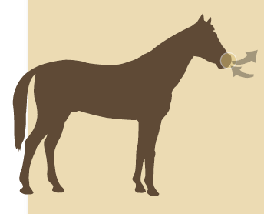

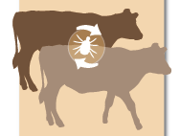
Disease Transmission
Direct
  Contact
  Ingestion
  Aerosol
Indirect
  Fomites
    Inanimate objects
  Vectors
    Living organism (e.g., insects)
Notes:
The spread of disease can occur by direct and indirect transmission methods. Direct spread of a disease may occur through contact with an infected animal, ingestion of the pathogen, or through inhalation (or aerosol) exposure. Indirect methods involve fomites – or inanimate objects that can transfer pathogens – and vectors – living organisms able to transmit pathogens – most commonly insects. Let’s look at these routes a bit closer.

Slide 4
Direct Transmission
Direct contact
  Body fluids
    Urine, feces
    Saliva, blood
    Milk
  Tissues
    Lesions
    Carcass
    Parturition
Aerosol
  Droplets spread through the air
  Close proximity
    Enclosed barns
    Coughing, sneezing
    Contaminated soil
Ingestion
  Contaminated
  food or water
  Contaminated meat from infected animal
Notes:
Direct transmission of pathogens can occur from exposure to infected animals, its body fluids – such as urine, feces, saliva, blood or possibly milk – as well as its tissues – either through lesions, carcasses, or during parturition. Entry of the organism occurs following contact with the mucous membranes, such as the eyes, nose, or mouth but can also enter through open wounds or breaks in the skin. Aerosol transmission, involves the transfer of infectious diseases in droplets spread through the air, which are then inhaled. Most microorganisms are not able to survive for extended periods of time within aerosol droplets, and as a result, close proximity to the infected animal is generally required for disease transmission. Aerosol transmission can also occur when infected droplets from urine, feces, or birthing material or when these fluids get stirred up from contaminated soil or dust and inhaled. Another route of transmission occurs through ingestion of the organism, either through food or water which has been contaminated by infected fecal material or by eating undercooked contaminated meat.

Slide 5
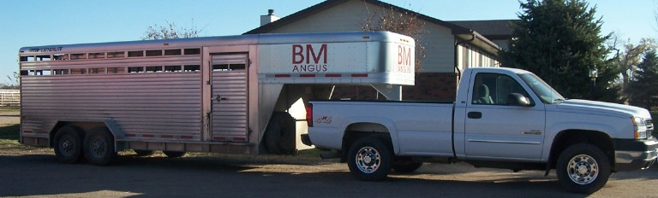
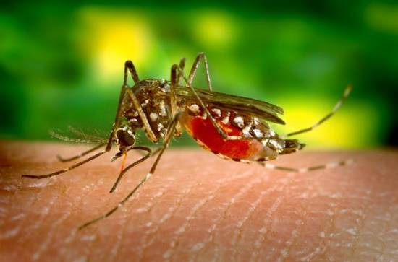
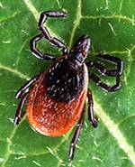
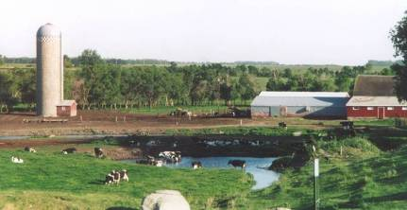
Indirect Transmission
Fomites
  Contaminated
  inanimate object
  Buckets, shovels
  Vehicles, clothing
Vector
  Living organism
  transfers disease
  between animals
  Mosquitoes, ticks,
  biting midges, flies
Environment
  Soil
  Organic material
Notes:
Some zoonotic diseases can be transmitted indirectly. Fomite transmission involves inanimate objects that become contaminated from an infected animal, which can then serve as a means of transfer for the microorganism. Contacting these items, followed by exposure to your body (eyes, nose, mouth), can increase the risk for disease. Examples of fomites during a response include needles, feed or water buckets, bedding or shovels. Even items such as clothing or vehicles may become contaminated and serve as potential means for exposure. Some diseases are spread by vectors. This involves living organisms – most commonly insects - able to transfer microorganisms from an infected animal to another, including responders. Mosquitoes, ticks, midges and flies are common disease carrying vectors. Lastly, many disease agents can survive for extended periods of time in soil or other organic material like bedding or manure, animals or humans can then acquire the disease agent from the environment through inhalation or aerosol, oral consumption, direct contact, or via fomites as discussed in previous slides. Therefore, environmental contamination should not be ignored but recognized as a potential means of infection that needs to be controlled. [Top photo from Bryan Buss, CFSPH, Iowa State University; Middle photos from CDC; Bottom photo from DB Weddle, CFSPH, Iowa State University].

Slide 6
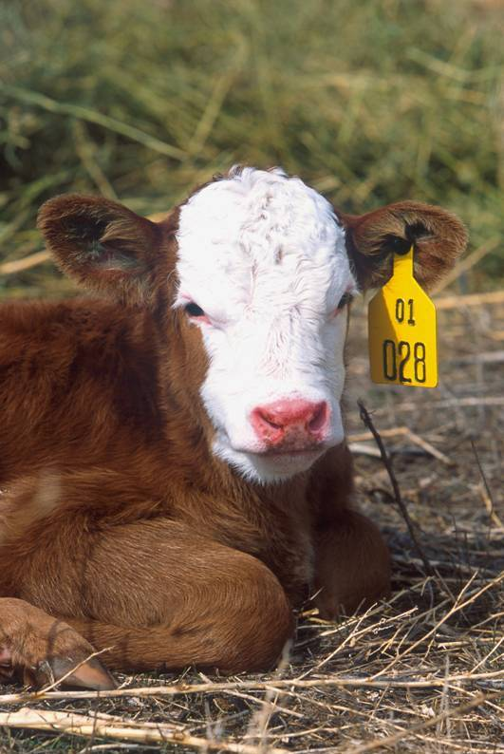
Points to Remember
Animals may not exhibit
obvious signs of disease
  Reservoir
    Harbors pathogen
    without illness
    Can be source of
    infection for others
Not all pathogens spread
by all routes of transmission
Notes:
It is important to remember that disease transmission can occur without animals exhibiting obvious clinical signs of disease. These animals may be referred to as a reservoir and may harbor pathogenic organisms, without injury to itself, but serve as a source of infection to others, including humans. Equally important is knowing that not all pathogens are spread by all routes of transmission. Understanding which disease causing organism you are up against, will help in determining which routes of transmission will be of concern during your activities. [Photo from USDA].

Slide 7
Example Zoonoses
Anthrax
Avian influenza
Brucellosis
Cryptosporidiosis
E. coli
Leptospirosis
Q Fever
Rabies
Ringworm
Salmonellosis
Tuberculosis
Vesicular stomatitis
Notes:
This list shows a few zoonotic disease examples, some of which you may be familiar with.

Slide 8
Preventing exposure
Notes:
While response activities will involve interacting with animals – generally infected animals – avoiding exposure to zoonotic disease may not be feasible. It is important to protect yourself against these zoonotic diseases while working with animals, or in their environment to decrease the risk of becoming ill. Let’s review a number of preventive measures you can take to minimize your risk of exposure to zoonotic pathogens.

Slide 9
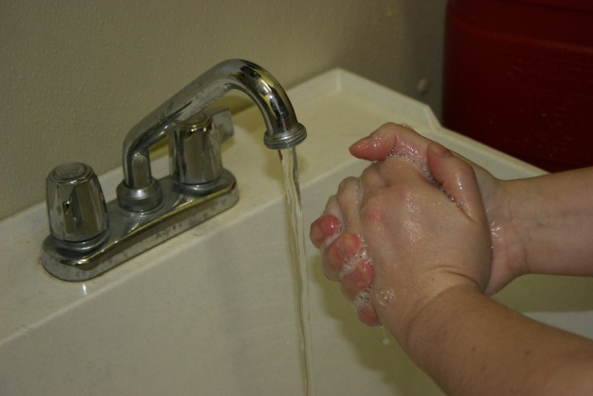
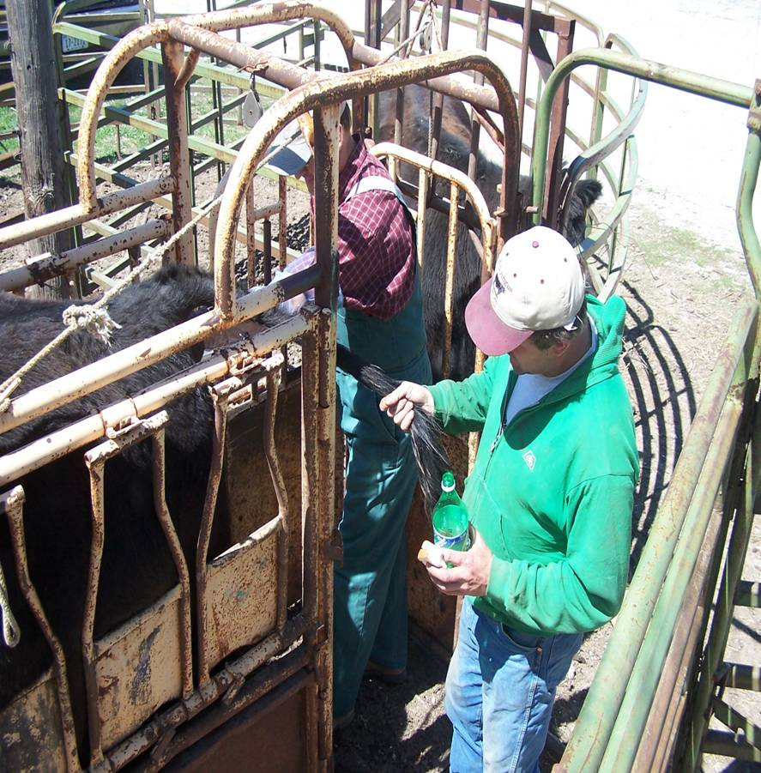
Zoonoses Prevention
Hand washing
  After animal contact
  Before eating, drinking
Limit contact
with animals
No food or drink in
animal areas
Notes:
One of the best protections against any disease is washing your hands. This simple task can greatly reduce the chance of transferring a pathogen from animals to yourself. Frequent hand washing, especially before eating or drinking can prevent harmful organisms from entering your body. Whenever possible limit your contact with infected animals. Minimizing contact with infected animals can reduce the risk of disease transmission. Since some pathogens can be transmitted from animals to humans through ingestion, do not eat or drink in animal areas. [Top photo from DB Weddle, CFSPH, Iowa State University; Bottom photo from Bryan Buss, CFSPH, Iowa State University]

Slide 10
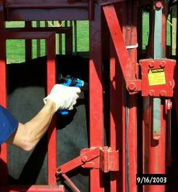
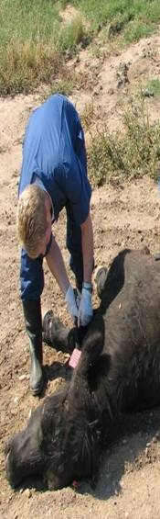
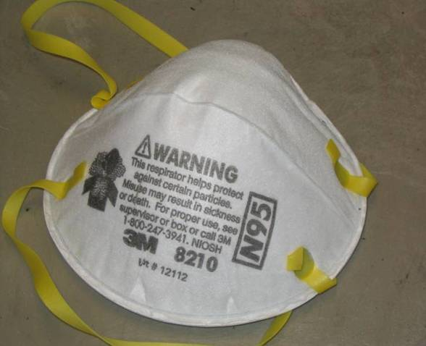
Personal Protective Equipment
Gloves
  Creates a barrier between
  you and the disease
  Especially for hands with
  cuts, abrasions, chapped
  Wash hands after
  removing gloves
Coveralls, boots
Mask, goggles
Notes:
If animal contact is necessary, the use of personal protective equipment, such as gloves, coveralls, and boots can help reduce exposure and transfer. Gloves should be worn when working with sick animals or those that you are unaware of their health status (remember that infected animals do not always appear sick). This is especially important if hands have cuts, abrasions or are severely chapped because areas of broken skin provide an entrance for disease agents. Wearing gloves does not replace good hand washing habits- wash hands in warm water and soap after removing gloves. Coveralls will help keep your clothes clean and cover your arms to minimize disease exposure when handling tissues or animals. Boots will protect your shoes from contamination and minimize spread to other areas of the farm. Wear masks in certain situations to prevent inhaling contaminated particles. [Top photo from Dr. Phil Prater, Morehead State University, KY; Left photo from Tru Twedt, Iowa State University, Right photo from Dan Thomson, Kansas State University]

Slide 11
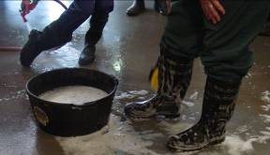
Cleaning and Disinfection
Manure properly handled
and removed
  Does not contaminate
  drinking water or equipment
Clean, disinfect soiled equipment
Clean and disinfect
(or dispose of)
PPE after
response activity
  Wash hands after removing any PPE
Notes:
To prevent oral transmission of disease, manure should be properly handled and stored so that it does not contaminate water sources. Keep equipment clean to prevent it from becoming a fomite that can transmit disease. If equipment becomes soiled, cleaning and disinfection procedures can aid in destroying pathogenic organisms, thereby minimizing your exposure. Personal protective equipment should be cleaned and disinfected (or disposed of properly) before leaving the farm. Always wash your hands after removing PPE.

Slide 12
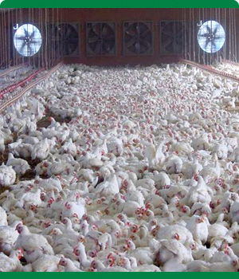

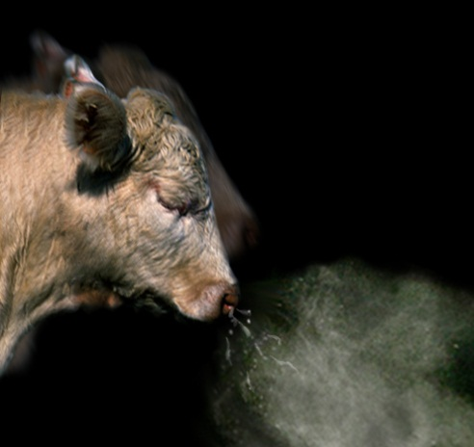
Aerosol
Adequate ventilation
Control dust
Wear masks in
certain situations
  Handling infectious
  animals or
  their tissues
  Assisting with calving
  Power washing
Notes:
Aerosol transmission occurs when infected droplets are passed through the air Prevention steps against aerosol transmission includes ensuring adequate ventilation, especially if entering enclosed production facilities. Additionally, control the amount of dust generated in animal housing areas. This can damage the protective cells in the respiratory tract and contribute to exposure of contaminated particles in that can cause disease. Wearing masks, such as an N-95 respirator – can help to prevent inhaling contaminated particles in certain situations such as when handling infectious animals or their tissues, assisting with calving, or using a power washer to clean animal areas. Top right photo from USDA, Left photo from The Animal Photo Archive, Bottom photo from Clint May, CFSPH, Iowa State University]

Slide 13
Vector Control
Source reduction
  Habitat reduction/elimination
  Parasitic or predatory insects
Control adults
  Insecticides
    Knockdown and residual sprays
    Baits, fly traps
Minimize interaction with insects
  Personal protection
Notes:
Vector control begins with an understanding of the insect’s life cycle. Insect life stages vary and so do the specific, effective control measures. For instance, the egg laying grounds for flies are different than that of mosquitoes and midges, and one approach will not necessarily work for all. Source reduction consists of eliminating potential insect breeding areas and larval habitats. Generally this involves removing standing water sources, such as tree holes or old tires or agitating any water sources, such as stock tanks or water troughs. Some insects require manure or organic material for development, so cleaning animal feeding areas, yards and barns can minimize these vectors. Sometimes, parasitic or predatory insects may be used to control the larval stages of other insects. Controlling adult insects, often involves the use of insecticides, either as a knockdown or residual treatment. These methods are often less effective compared to habitat reduction methods. Baits and fly traps may aid efforts, but should not be used as the sole method of control. Minimizing exposure to disease-carrying insects, such as mosquitoes or ticks, can be accomplished through personal protective measures, such as wearing insect repellents containing DEET, and wearing long sleeves and pants when working outside.

Slide 14
Biosecurity for Zoonotic Diseases
Route of Transmission | Possible Biosecurity Measures
Direct Contact | Limit contact with infected animals Hand washing Personal protective equipment
Fomites | Cleaning and disinfection procedures Hand washing Personal protective equipment
Aerosol | Personal protective equipment
Ingestion | Cleaning and disinfection procedures
Vectors (e.g., insects) | Pest management procedures
Notes:
This table reviews some of the possible biosecurity measures that may be used to limit transmission of zoonotic diseases. For pathogens spread by direct contact, limit contact with infected animals, and use frequent and through hand hygiene measures. The use of personal protective equipment, such as gloves, can limit and prevent transmission for all transmission routes. Cleaning and disinfection measures are essential to prevent fomite and ingestion transmission. Control of vector-borne diseases will involve the use of pest management procedures to limit transmission.

Slide 15
Acknowledgments
Development of this presentation was by the Center for Food Security and Public Health at Iowa State University through funding from the Multi-State Partnership for Security in Agriculture
Author: Glenda Dvorak, DVM, MPH, DACVPM
Notes:
Information provided in this presentation was developed by the Center for Food Security and Public Health at Iowa State University College of Veterinary Medicine, through funding from the Multi-State Partnership for Security in Agriculture.

