Slide 1
Health and Safety
Responder Security
Notes:
December 2011
Just as health and safety measures will be needed for responders during an animal health emergency, security procedures will also be essential to protect responders, the response site, as well as the public. This Just-In-Time training presentation will address security issues to be aware of and measures to take to ensure your personal security, as well as the security of the incident site during a response.

Slide 2
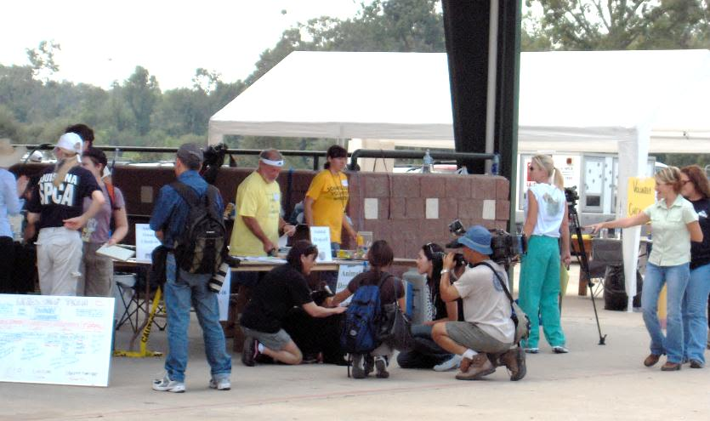
Security Threats
Intentional malevolent threats
  Angered owners
  Animal rights activists
  Unauthorized media
  Vandalism or theft
Unintentional threats
  Inadvertent intruders
  Curious visitors
  “Self-deployed” volunteers
Aggressive dogs
Notes:
Security threats during an animal health emergency can range from intentional malevolent threats, such as angered landowners, animal rights activist, or unauthorized media, to acts of vandalism or theft, as well as unintentional threats, such as inadvertent intruders, curious visitors, or “self-deployed” volunteers. Additionally, when entering unfamiliar premises, aggressive dogs may be encountered. [Photo source: Heather Case, American Veterinary Medical Association]

Slide 3

Site and Personal Security
Control access to the work site
  Limit unauthorized access
Prevent interference
with response
Account for personnel
Limit risk of disease,
hazards or injury
Notes:
The implementation of security measures serves various functions. First, it helps to control access to the work site and prevent unauthorized persons from entering or interfering with the response. It also helps to limit the risk of disease exposure or spread to areas beyond the control area, as well as prevent hazards or injury to personnel or the general public. Security measures also allow for close monitoring of personnel to maintain their safety and security. [Graphic: Center for Food Security and Public Health, Iowa State University, College of Veterinary Medicine]

Slide 4
Security Officer
Works with Operations Section Chief
  Assess any security threats
  Determine control measures
  Establish personnel identification system
  Establish communication system
  Implement use of temporary fencing

Slide 5
Site Control Plan
Site map and boundaries
Site work zones
Site communication
Safe work practices
  Use of “buddy system”
  Personal protective equipment
Medical assistance instructions
Notes:
All animal health emergency responses should have a site control plan. This plan should, at a minimum, include:
A map of the response site – designating the necessary boundaries
Site work zones – delineating where particular response activities will occur
Procedures for site communication, including an alerting method for emergencies
Standard operating procedures for safe work practices, such as the use of the “buddy system” and personal protective equipment
Identification of the nearest medical assistance
It is important for all responders to know the elements of the site control plan for the response.
(Source: 29 CFR 1910.120(d) Hazardous waste operations and emergency response)

Slide 6
Site Security
Control entry/exit
  Limit unauthorized access
Establish site boundaries
  Post signs at perimeter
Lighting
Log book for allowed personnel
Designated security personnel
  Law enforcement
Notes:
Site security is primarily established by controlling the entry and exit to the premises. This helps to limit access to the site to only those who are authorized and necessary for response procedures. Posting warning or restriction signs in obvious locations at the perimeter and entrance to the site can help designate response site boundaries and discourage unauthorized visitors. Response sites should maintain a log book to record vehicles and individuals entering and exiting the response site. It is also important to ensure response areas are well lit, especially for any evening activities. Some response situations may require personnel to guard perimeters and maintain site security. Law enforcement may also be needed to ensure the security of the response site.

Slide 7
Work Zones
Work zones
  Control access and movement in area
    Deters unauthorized personnel
  Reduce risk of spread of disease
Establishment of work zones
  Personnel are properly protected
  Work activities confined to certain areas
  Personnel can be located quickly
Notes:
Controlling access to the response site is best addressed through the use of designated work zones. Responders should understand the location and implications of each of the biosecurity work zones. The use of work zones ensures:
Personnel entering the worksite are properly protected against hazards while working
Work activities and contamination are confined to appropriate areas
Personnel can be located quickly and evacuated if necessary
The entrance of the response site is controlled

Slide 8
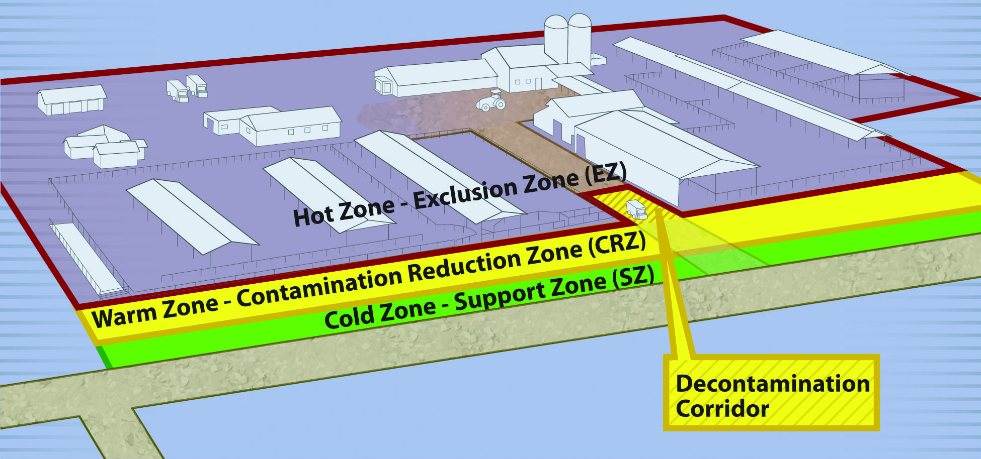
Biosecurity Work Zones
Notes:
Biosecurity work zones include:
The Hot Zone or Exclusion Zone (EZ) is the potentially contaminated or unsafe area (e.g, infected animal premises). Appropriate PPE must be worn in this area.
The Warm Zone or Contamination Reduction Zone (CRZ) is also considered a high risk area due to the potential for exposure to pathogens and chemical disinfectants. All personnel are required to wear PPE.
The Decontamination or Decon Corridor is the area between the Hot Zone and the Warm Zone. Decontamination of personnel and disinfection of equipment occurs here. Teams exit and enter the site through this corridor. Once responders have doffed, disinfected, and decontaminated in the Warm Zone, they should move to the Cold Zone/Support Zone (SZ) through the designated Control Access Points.
The Cold Zone or Support Zone (SZ) is the clean/uncontaminated area of the site, where responders should not be exposed to hazardous conditions; support functions are based here. Donning of PPE prior to entry into the Hot Zone also occurs here.
[Graphic Andrew Kingsbury, Iowa State University. Definitions from USDA FAD PReP Guidelines].
A full description and discussion of work zones can be found in the Biosecurity Overview Just-In-Time presentation.

Slide 9
Responder Responsibility
Follow established security measures
  Explained at initial briefing
Communication
  Established methods
  Cell phone, radio
Be aware of surroundings
  Unauthorized or suspicious persons
    If noticed, contact your supervisor
    Monitor the individual until assisted
Notes:
Responders have some level of responsibility for their own security. All personnel must adhere to the security procedures established for the incident. Personnel will receive information about on-site security procedures during their initial briefing. Communication during the response is essential; if a security or safety issue arises, prompt communication with supervisors will be necessary. Each field team should be equipped with a cell phone or radio for communication. When leaving the facility, responders should verbally notify their supervisor of their destination. During a response, be aware of your surroundings. If unauthorized or suspicious persons are noted on or around the response site, contact your supervisor or the Security Officer immediately. Monitor the individual until assistance can be obtained.

Slide 10
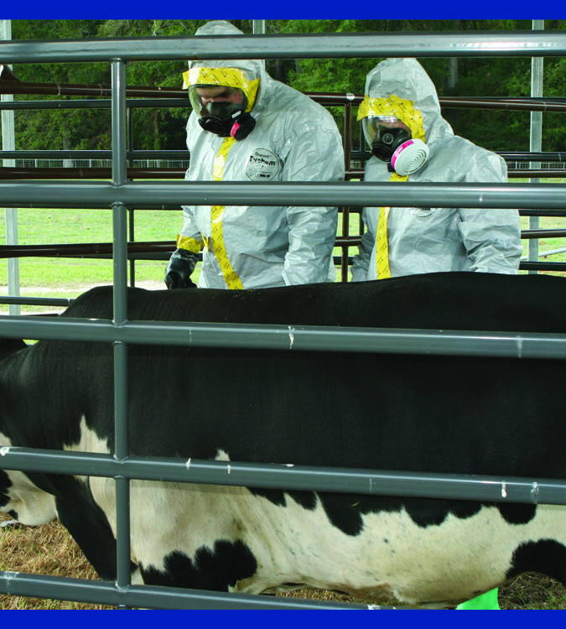
Buddy System
Accountability
  Accounted for at ALL times
    Site investigations,
    response control zone
  Enter/exit through
  designated points
Work in pairs
  Stay in close visual contact
  Assist partner as needed
  Observe for signs of distress
  Find emergency assistance if needed
Notes:
Response personnel must be accounted for at all times during a deployment. This includes personnel conducting site investigations as well as personnel working in a response control zones. Personnel must enter and exit the response site through designated points, and follow all check-in and check-out procedures. All response personnel should use the buddy system. This involves working in pairs and staying in close visual contact with each other. Due to the number of physical and psychological demands during an animal emergency response, the use of the buddy system allows for the observation of each other and ensures assistance in the event of an emergency, including safety for threating or security situations. Responders using the buddy system should:
Remain in close visual contact with their partner.
Assist their partner as requested or needed.
Observe their partner for signs of distress (e.g., heat stress or other difficulties.)
Notify the supervisor or other site personnel if emergency assistance is needed.
If the use of the buddy system is not feasible, a call-in schedule should be established for personnel working alone. This involves a schedule of when the responder is to call-in to a supervisor.

Slide 11
Non-Cooperative or
Threatening Persons
Guidelines
  Travel in teams or with buddy
  Carry cell phone at all times
  Remain calm; avoid confrontation
  Leave if safety concerns exist
    Call supervisor, team leader or police
  Document and report the incident
  Situations can escalate quickly
Interference is violation of US Code
Notes:
During some responses, situations may arise where the actions, behavior or language of an owner/occupant of a premises, or another member of the public, may cause concern for one’s personal safety. In these situations, personal safety is always a first priority. If threatened, avoid confrontation. Remain calm and leave the premises immediately. These types of situations can escalate without warning. Contact your team supervisor regarding the situation. For some situations, law enforcement may be needed.
When interacting with owners, use the following guidelines:
Travel in teams or at minimum with a buddy. No one should be in the field alone.
Carry a cell phone and phone number list for supervisory personnel with you at all times.
If a security or safety concern occurs, leave the area, and, depending on the urgency of the situation, call a supervisor or the police.
Document the incident and provide detailed information to the Security Officer.
Note that individuals interfering with a government employee doing his/her job, are in violation of Title 18 Section 111 of the U.S. Code and may be subject to fines or up to one year in prison, or both. (http://www4.law.cornell.edu/uscode/html/uscode18/usc_sec_18_00000111----000-.html)

Slide 12
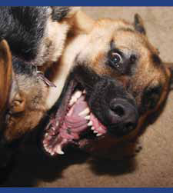
Aggressive Dogs
Be aware of surroundings
  Listen for barking and observe when entering
Do not enter when
  Unrestrained dogs
  Barking,
  but no dog seen
Notes:
When entering premises, aggressive dogs may also pose a threat. It is important to be aware of your surroundings when entering a premises or yard. Upon arrival to a location, look for any unrestrained dogs or listen for barking. If dogs are seen or heard, do not enter the premises until the animals can be restrained. If the owner is present, ask them to restrain the dogs.

Slide 13
Aggressive Dogs
When confronted by dog:
  Do not stare into eyes or run
  Stop, slowly back away, place barrier
  If you fall, curl into ball with hands over head/neck
  Get treatment and report if bitten
Notes:
If you are confronted by a dog or pack of dogs, do not turn and run. Instead, avoid eye contact and slowly back away while putting a barrier, such as a gate or fence, between you and the dog. If you are knocked to the ground, curl into a ball and place your hands over your head and neck to prevent serious injury to those areas. If you are bitten, get immediate medical attention and report the incident.

Slide 14
Resources
USDA Foreign Animal Disease Preparedness (FAD PReP) Guidelines: Health and Safety
  http://www.aphis.usda.gov/animal_health/emrs/nahems.shtml
USDA Health and Safety Plan
  http://www.aphis.usda.gov/emergency_response/hasp/health_safety_hs_training.shtml
Notes:
For more information on responder security issues during an animal health emergency response, consult the USDA FAD PReP Health and Safety Guidelines and the USDA Health and Safety Plan.

Slide 15
Acknowledgments
Development of this presentation was by the Center for Food Security and Public Health at Iowa State University through funding from the Multi-State Partnership for Security in Agriculture
Authors: Dan Taylor, DVM, MPH; Glenda Dvorak, DVM, MPH, DACVPM
Notes:
Information provided in this presentation was developed by the Center for Food Security and Public Health at Iowa State University College of Veterinary Medicine, through funding from the Multi-State Partnership for Security in Agriculture.

