Slide 1
Health and Safety
Psychosocial Impacts
Notes:
December 2011
In addition to the physical demands of an animal health emergency response, there will also be a number of psychological stresses. If ignored, they can lead to serious consequences. This Just-In-Time training presentation will overview some of the psychosocial impacts of being an emergency responder, as well as provide information to help recognize and respond to the signs of psychological distress.

Slide 2
Mental Health
“a state of psychological and emotional well-being that enables an individual to work, love, relate to others effectively, and resolve conflicts”
-Mental Health Education and Resource Center
Notes:
Maintaining the mental health of emergency responders is just as important as the care and well-being of their physical health. Mental health as defined by the Mental Health Education and Resource Center as “a state of psychological and emotional well-being, that enables an individual to work, love, relate to others effectively, and resolve conflicts.” During any animal health emergency, whether caused by a natural disaster or infectious disease situation, the mental health of all responders will be strained.

Slide 3
psychological stressors
Deployment
Working conditions
Assigned tasks
Notes:
While most psychological stressors cannot be avoided, it is important to be aware of aspects that can contribute to mental stress as well as ways to minimize their effects. Let’s looks at some of the psychological stressors that can occur during an animal emergency situation.

Slide 4
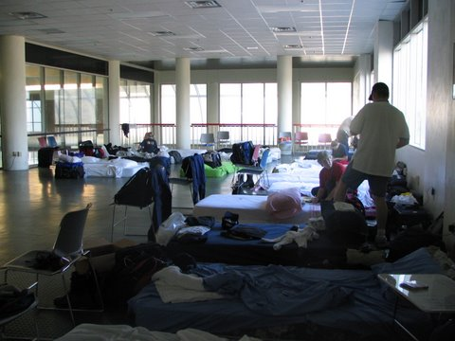
Deployment
Stressful for responder and their families
Disruption of regular schedule
Being away from home and family
Unfamiliar environment
New people
Notes:
The act of deployment itself can cause psychological stress. Disruption to your regular work and family schedules as well as being away from your home and family can cause strain for responders and their families. Additionally, you will be working in an unfamiliar environment and with new people. (Photo from Thomas Ratke)

Slide 5
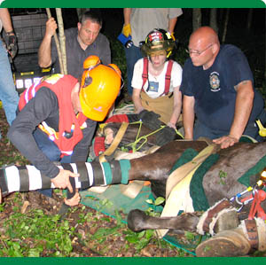
Working Conditions
Long work hours
Physically demanding work
Limited or lack of resources
Notes:
Working conditions during a response can be demanding. Responders will generally work long hours and perform physically demanding work. Initial phases of the response may be stressful due to limited or lack or resources, including personnel.

Slide 6
Assigned Tasks
Prolonged exposure to injury, death and destruction
Performing euthanasia and depopulation
Public perception/support
Lack of appreciation
Notes:
Tasks you are assigned during the response can also contribute to mental stress. Depending on the response circumstances, you may have prolonged exposure to injury, death and destruction. For example, during natural disaster situations, you may witness death and suffering of humans and animals. For animal disease emergencies, euthanasia and depopulation procedures may be needed. Both of these situations can be extremely powerful mental stresses. Additionally, the public’s perception or support can cause mental anguish, especially in situations where response activities are not appreciated.

Slide 7
Signs of Psychological Stress
Physical
Cognitive
Emotional
Behavioral
Notes:
The effects of psychological stress can manifest in a number of ways. These include physical, cognitive, emotional and behavioral manifestations.

Slide 8
Signs of Psychological Stress
Physical effects
Fatigue, body aches and pains
Nausea, headache
Rapid heart rate, sweats and chills
Muscle twitching
Cognitive (thinking)
Confusion, disorientation
Poor concentration or alertness
Memory problems
Sleep disturbances, nightmares
Notes:
Common physical symptoms of mental stress include fatigue, body aches and pains, nausea, headache, a rapid heart rate, sweats and chills, and possibly muscle twitching. Common cognitive symptoms of stress include confusion, disorientation, poor concentration or alertness, memory problems and sleep disturbances, including nightmares.

Slide 9
Signs of Psychological Stress
Emotional
Anxiety
Fear
Irritability, anger
Depression, sense of failure
Helplessness, feeling overwhelmed
Behavioral
Denial
Distrust
Blame
Withdrawal
Inability to relax
Excessive worry
Substance abuse
Notes:
Common emotional symptoms of psychological stress can include anxiety, fear, irritability or anger, depression, having a sense of failure, helplessness or feeling overwhelmed. Common behavioral symptoms of stress can include denial, distrust or blame, withdrawal, an inability to relax, excessive worry, and often substance abuse.

Slide 10
Psychological Disorders
Mild, transient distress
Acute Stress Disorder
2 to 28 days after event
Post-Traumatic Stress Disorder
Longer than 4 weeks after event
Depression
Persistence over 2 months after event
Notes:
It is important to understand and recognize the symptoms of psychological stress. If allowed to continue, these symptoms can manifest from mild distress into more severe psychiatric illnesses or disorders which may interfere with an individual’s normal response functions. Severe or chronic psychiatric illnesses or disorders – acute stress disorder, post-traumatic stress disorder and depression – require professional intervention and treatment. Seeking professional help for psychological issues promptly can aid in reducing their impact as well as speed the recovery process. It is important to remember that while development of these disorders can occur during a response event, they can also manifest weeks or months after an event. (Post-traumatic stress disorder graphic from SAMHSA – Substance Abuse and Mental Health Services Administration)

Slide 11
Reducing Psychological stress
Notes:
While avoiding psychological stressors during an animal health emergency response will not be possible, there are some steps you can take to minimize their impact.

Slide 12
Reducing Psychological Stress
Pace yourself
Take frequent rest breaks
Mental fatigue increases risk of injury
Take breaks away from work areas
Try to maintain a normal schedule
Regular eating and sleeping times
Drink plenty of water
Avoid the use of caffeine when possible
Eat a variety of foods
Increase intake of complex carbs
Notes:
During response activities, pace yourself. Most response efforts and deployments may continue for days, weeks or months. Take frequent rest breaks, as mental fatigue due to extended shifts can greatly impact your ability to respond and increase the risk of injury. If possible, take breaks away from the work area, to provide some mental relief. Try to maintain a regular eating and sleeping schedule. Drink plenty of fluids (water). Eat a variety of foods and increase your intake of complex carbohydrates (e.g., breads, and muffins made with whole grains, granola bars, etc.).

Slide 13
Reducing Psychological Stress
Communicate with loved ones
Choose your own comfort level
Avoid substance abuse
Practice stress/relaxation techniques
Accept what you cannot change
Formal mental health support
Notes:
Other steps you can take to reduce psychological stress include:
Communicating with loves ones when possible.
Choosing your own comfort level when talking about the event and your emotional response to it.
Avoiding substance abuse.
Practicing stress and relaxation techniques
Accepting the situation for what it is and what you cannot change
Taking advantage of any formal mental health support provided during the response

Slide 14
Prevention
Be aware of psychological stress
Monitor levels of stress
Yourself
Other responders
Seek assistance
Severe psychological disorder
Contact a health professional immediately
Notes:
Be aware of the signs of psychological stress on yourself, as well as other responders. Early recognition of signs of psychological stress can assure appropriate measures are taken to reduce the effects. Never hesitate to seek assistance and support when needed. If a severe psychological disorder is suspected, contact a mental health professional immediately. (Photo courtesy of Thomas J Ratke)

Slide 15
Resources
Substance Abuse & Mental Health Services Administration (SAMHSA)
Disaster Health Services
http://www.samhsa.gov/trauma/index.aspx#rhp
Notes:
For more information on psychosocial issues during an animal health emergency response, consult the Substance Abuse and Mental Health Services Administration (SAMHSA) website. The information in this presentation is NOT meant to take the place of professional psychological advice. If you or someone you know may be suffering from a severe psychological disorder, contact a health professional.

Slide 16
Acknowledgments
Development of this presentation was by the Center for Food Security and Public Health at Iowa State University through funding from the Multi-State Partnership for Security in Agriculture
Authors: Dan Taylor, DVM, MPH; Glenda Dvorak, DVM, MPH, DACVPM
Notes:
Information provided in this presentation was developed by the Center for Food Security and Public Health at Iowa State University College of Veterinary Medicine, through funding from the Multi-State Partnership for Security in Agriculture.

