Slide 1
Health and Safety
Responder Conduct
and Behavior
Notes:
December 2011
During an animal health emergency, the conduct and behavior of responders will not only be a reflection of their respective agency, but can also impact responder safety, as well as influence public perception of the response. This Just-In-Time training presentation will overview basic code of conduct practices and responder actions that should be followed during an animal emergency response.

Slide 2
Code of Conduct
Collection of rules, principles, behaviors, expectations
Significant and fundamental for successful response
Interaction of large number
of persons
Public perception
Notes:
A code of conduct is a collection of rules, principles, behaviors, and expectations considered significant and fundamental for a successful response. During any animal health emergency, a large number of personnel will be interacting and working together. Additionally, the public will be observing the activities of the response and actions of the responders. For this reason the behavior and conduct of responders can play a critical role in the success and public perception of an event.

Slide 3
Code of Conduct
Professional and courteous manner
  All team members, other responders, supervisors, general public
  “On” and “off” duty
Treat all with respect
  Without harassment, victimization
  or discrimination
  Avoid public criticism
  Avoid offensive or profane
  words/actions
Notes:
Responders should conduct themselves in a professional and courteous manner at all times. This includes when the responder is “on” or “off” duty. All persons, including team members, other responders, supervisors, as well as the general public, should be treated with respect, without harassment, victimization or discrimination. Avoid public criticism of team members or other responders. Avoid the use of offensive or profane language or gestures.

Slide 4
Code of Conduct
Honesty and with integrity
  Do not misrepresent yourself
  Illegal activities prohibited
    Do not work under the influence of alcohol,
    non-prescription medication
Do not jeopardize safety of others
Maintain confidentiality
Comply with regulations and policies
  Affected jurisdictions
  Response agencies
Notes:
Honesty and integrity are also expected. Do not misrepresent yourself or your training. Do not use your identification to gain unnecessary access, favors, special privileges, benefits, exemptions, or gifts from anyone. Responders are expected to perform to their level of training and within the limits of relevant laws and regulations. Do not engage in any illegal activities or work while under the influence of non-prescription drugs or alcohol. Be cognizant of your actions and do not take any actions that would jeopardize another team members’ safety. It is also important for responders to maintain confidentiality. Much of the information encountered during a response can be confidential and should be treated as such. Unless instructed otherwise, information provided during the response (e.g., briefings, situation reports) should be considered confidential and for official use only, until public notification is made. All actions during a response must comply with the affected jurisdiction (e.g. county, state, federal level) laws and policies. Additionally, any policies and procedures established by your respective response agency will also need to be followed.

Slide 5
Supervisors
Follow chain of command
Communication
  Progress, concerns, conflicts
  Promptly report
    All injuries and accidents
    Any unsafe conditions
Notes:
Responders should follow the chain of command at all times and follow instructions provided by their supervisor. Communication during a response will be essential. Keep your supervisor informed of any progress, concerns, conflicts, or other problems with tasks assigned. Promptly report all injuries, accidents and near misses. If any unsafe conditions are noticed, report them to your supervisor immediately. Seek medical attention as needed.

Slide 6
Communication
Test radios/phones prior to departure
  Check batteries often
  Replace as needed
Speak slowly and clearly
  Repeat unclear messages
Avoid using names over radio
Keep messages short, professional
Do not interrupt those
on same frequency
Notes:
To ensure optimum and secure communication, always test radios or phones prior to departure from the staging area. Check batteries often and replace as needed. When communicating information, speak slowly and clearly. If a message is unclear, or complicated, the receiver should repeat the message content to the transmitter. Avoid using names over the radio. Keep radio and cell messages short. Messages should be professional, concise and specific; never derogatory and should never address sensitive issues. Do not interrupt others using the same frequency.

Slide 7

Know Your Limits
Be aware of
current fitness level
Stay within
personal limits
Effects on health
  Activity level
  Extended shifts
  Reduced sleep
Notes:
For some responders, duty assignments on a deployment may involve a higher level of physical activity than their normal daily activities. Responders must be aware of their current fitness level and recognize that an increased activity level, working extended shifts, and reduced sleep may have an effect on their personal health and safety. Responders should know their limits and strive to work within their limits to avoid endangering themselves or their coworkers. [Graphic by Kate Harvey, Center for Food Security and Public Health]

Slide 8
Personal Safety
Personnel accountability
  Check in and check out
  Buddy system
Do not self-dispatch or act independent of response
Work within your physical capabilities and training
Avoid risks of injury to yourself
or others
Notes:
During response activities, it will be important for personnel to be accounted for at all times. Follow personnel accountability instructions, such as site check-in and check-out, or the use of the buddy system. Emergency response is a team effort. “Self-dispatching” or acting independently of the coordinated emergency response plan can be dangerous and is not permitted. Only undertake activities that are within your physical capabilities and within the scope of your training. Do not take risks that are likely to cause injury to yourself or others.

Slide 9
Responder Responsibilities
Comply with established work rules
Follow safety policies, procedures
Report unsafe conditions
Report all injuries to supervisor
Wear personal protection equipment
Refuse to perform any dangerous tasks
Constant awareness of surroundings
  Location of incident
Notes:
Each responder is expected to comply with all of the established health and safety policies and safe work procedures. Do not perform tasks until proper safety and health controls have been put into place. Any responder uncomfortable with a particular duty or situation due to safety concerns should relay the circumstances via the appropriate chain of command. Refuse to perform tasks that pose an imminent danger. Wear all personal protective equipment needed for the task. Maintain constant awareness of your surroundings.

Slide 10

Driving and Vehicle Use
Responders are responsible
Must have a valid drivers license
Response tasks or basic needs
  Meals, grocery store, hotel
Obey all traffic laws
  Seatbelts required
Do not use cell phones
Notes:
Responders using response vehicles are responsible for their safe operation and condition. Vehicles will be issued only to personnel with a valid driver’s license. Vehicles are to be used only for response tasks and basic personal needs (e.g., transportation to and from hotels, meals, grocery store, etc.) and may not be used for personal purposes. While driving, obey all traffic laws, including speed limits and seatbelt use. Be patient and courteous to other drivers. Drivers should never use cell phones while the vehicle is in motion – instead pull the vehicle over to safely talk on the phone. Do not text while driving. [Graphic from Center for Food Security and Public Health]

Slide 11
Vehicle Guidelines
Keep alert
Do not drive when drowsy
Set realistic goals for daily miles
Avoid taking depressant medications
Do not consume/carry alcohol
  Do not drive if impaired
Do not smoke in vehicles
Notes:
Long work hours are probable during a response. Keep alert when driving. Do not drive if you are drowsy. Set realistic goals for the number of miles driven in a day. Drivers should never operate a vehicle if impaired by alcohol or medications that induce drowsiness. Alcohol should never be consumed or carried in vehicles. Smoking in vehicles is not permitted.

Slide 12
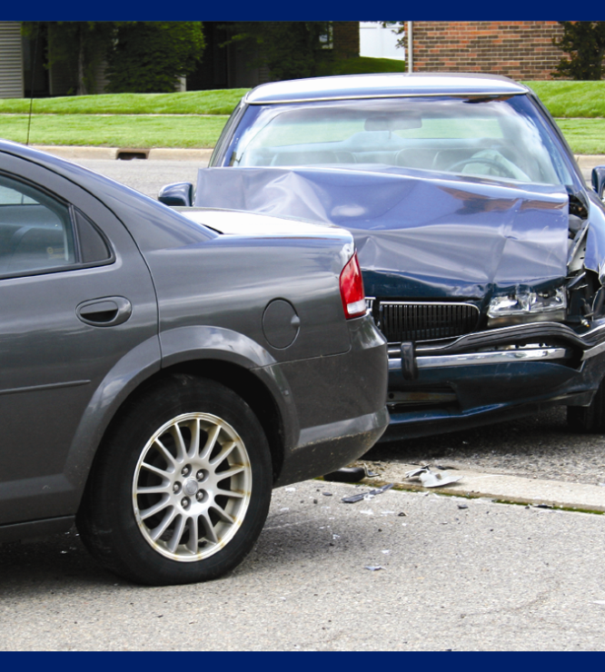
Vehicle Accidents
Report all accidents/damage
  No matter how minor
Damage not the result of accident
  Falling objects, fire, hailstones, etc.
Notes:
Vehicle damage may occur during response activities. Whether damage occurs by vehicle accident, vandalism, or environmental damage (e.g., hailstones), report it immediately to your supervisor.

Slide 13
Public Interaction
Respectful
No false or misleading information
Avoid conflicts of interest
  Bribes, gratuity
  Report to supervisor
Cognizant of public perception
  Be aware of actions at all times
  Publicly accessed sites and
  impact on business
    Live bird markets, custom slaughter plants
Notes:
Responders should handle all public interaction situations in a respectful fashion. Do not provide false or misleading information. Do not improperly use identification, information, status, power or authority to gain unnecessary access, favors, special privileges, benefits, exceptions or gifts. Avoid conflict of interest situations, including the offer of or acceptance of bribes, gratuity or favor. If these situations occur, report them to your supervisor. Be cognizant of the public’s perception and their impact on businesses, especially those involving publicly accessed establishments, such as live bird markets, or custom slaughter plants.

Slide 14
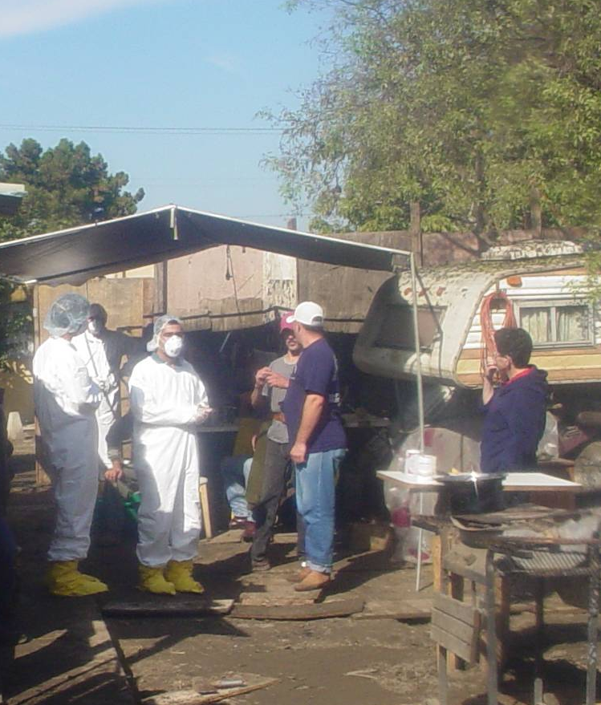
Public Communication
Misinformation and rumors
can cause panic
If approached by media, stakeholders or public
  Limit or avoid
  answering questions
  Refer them to the
  Public Information Officer
    Ensures consistent messages delivered
Notes:
Any animal health emergency situation will be of major interest and concern to individuals residing near the location, as well as in other parts of the country. Misinformation and rumors can cause panic among people who have little or no control over unfolding events. Be cognizant of your actions at all times. In today’s technological society and ease of internet access, the potential for rapid upload of photos or video to the internet can be damaging or beneficial to a response and depends greatly on responder behavior and actions. Limit or avoid communicating with news media during field operations. If you are approached by the media or the public, refer them to the on-site public information officer. This will ensure consistent messages are delivered regarding the response situation. [Photo from Clem Dussault, USDA]

Slide 15
Resources
USDA Foreign Animal Disease Preparedness (FAD PReP) Guidelines: Health and Safety
  http://www.aphis.usda.gov/animal_health/emrs/nahems.shtml
USDA NAHERC Deployment Guide, March 2010
  https://fadprep.lmi.org
Notes:
For more information on responder conduct and behavior during an animal health emergency response, consult the USDA FAD PReP Health and Safety Guidelines and the USDA NAHERC Deployment Guide.

Slide 16
Acknowledgments
Development of this presentation was by the Center for Food Security and Public Health at Iowa State University through funding from the Multi-State Partnership for Security in Agriculture
Authors: Dan Taylor, DVM, MPH; Glenda Dvorak, DVM, MPH, DACVPM
Notes:
Information provided in this presentation was developed by the Center for Food Security and Public Health at Iowa State University College of Veterinary Medicine, through funding from the Multi-State Partnership for Security in Agriculture.

