Slide 1
Health and Safety
Overview
Notes:
June 2010
During an animal health emergency response, any number of physical, environmental even psychological hazards can occur. The specific hazards that you will encounter during your deployment will depend on the nature of the response (e.g., natural disaster, vs. animal disease outbreak, vs. terrorism event) as well as the location, time of the year and weather conditions. This Just-In-Time training presentation will provide an overview of some of the potential health and safety issues you should be aware of as an emergency responder.

Slide 2
Physical Hazards
Animal Related Incidents
Musculoskeletal Injuries
Slips, Trips and Falls
Fatigue
Notes:
Some of the more common health and safety issues during a response are the various physical hazards that may occur while performing response activities. These can include animal related incidents, musculoskeletal injuries, slips, trips or falls, and fatigue.

Slide 3
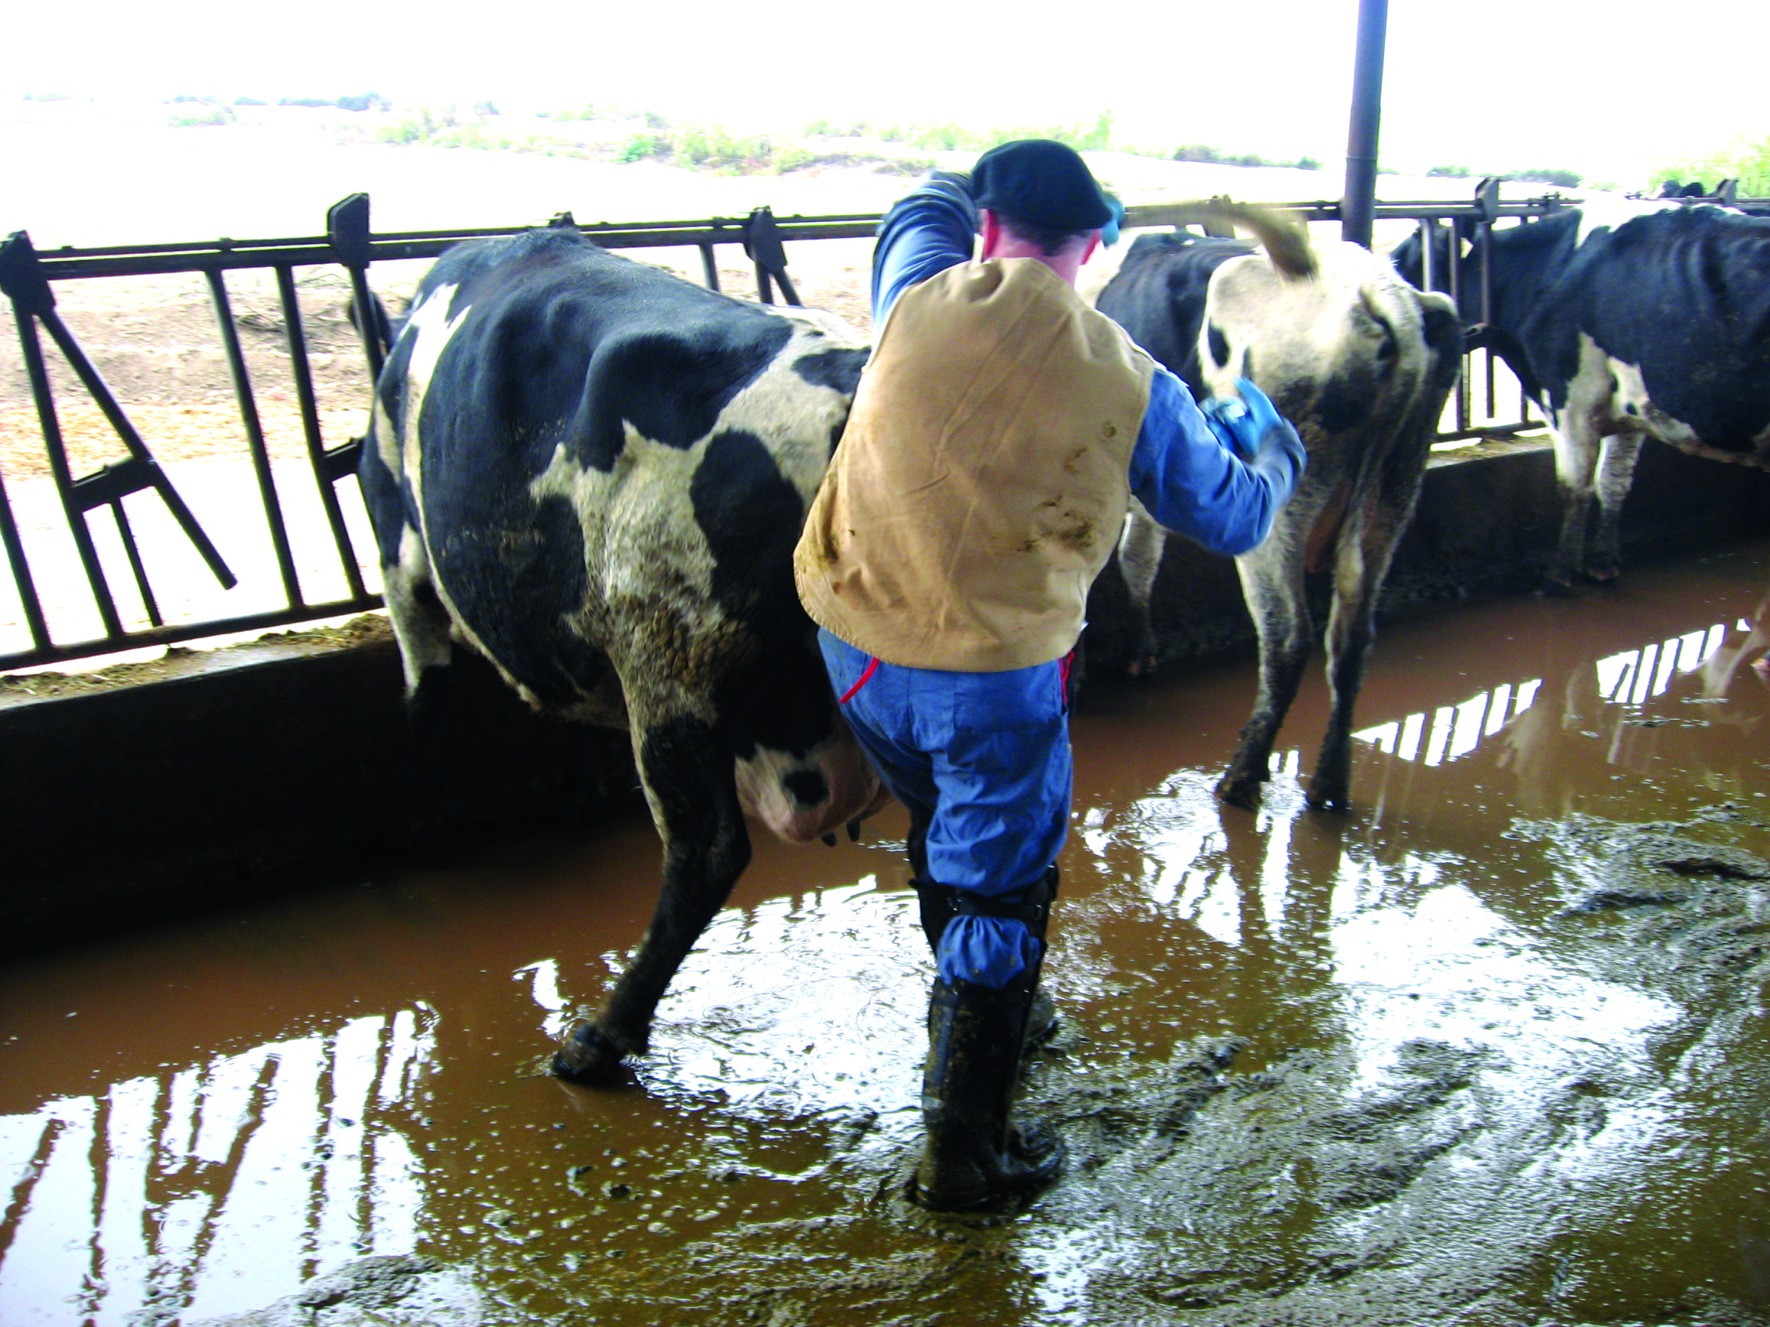
Animal Encounters
Injuries - Kick, crush, bite, scratch
Zoonoses
Aggressive dogs
Prevention
  Remain alert
  Proper restraint
  Avoidance
Notes:
Any animal health emergency, will involve interactions with animals. These encounters can lead to any number of injuries from kicks, crushing incidents, as well as bites or scratches. If a zoonotic disease (a pathogen of animals transmissible to humans) is involved, there can also be a potential threat to you or other responders. Other situations can include the presence of aggressive dogs when visiting premises, such as for surveillance activities. Preventative measures for animal encounter situations involve remaining alert, implementing proper restraint and handling procedures, and when possible avoiding the hazardous situation until additional assistance can be obtained. [Photo from Pete Petch, USDA]

Slide 4
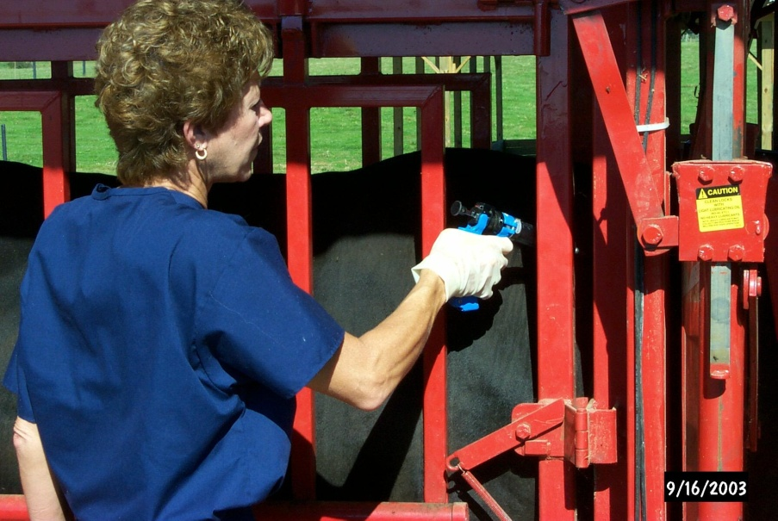
Musculoskeletal
Strains, sprains
Ergonomic injury
  Awkward postures
  Highly repetitive motions
  High hand force
  Heavy, frequent,
  or awkward lifting
Notes:
Musculoskeletal injuries, such as strains, sprains or ergonomic related injuries can also occur. These injuries may occur after repetitive incident tasks, such as maintaining awkward postures during the collection of large numbers of blood or tissue samples, conducting administration of multiple vaccinations, or using high hand force while restraining animals. [Photo shows an animal health responder administering an injection to a cow in a chute, Photo from Phil Prater, USDA]

Slide 5

Safe Lifting
Assess object
  Get assistance if needed
Lifting technique
  Bend at knees
  Grasp object firmly
  Lift using legs
    Keep back straight and upright position
    Keep object within your power zone
  Pivot, if turning – do not twist
Notes:
Additionally, musculoskeletal injuries may occur following heavy, frequent or awkward lifting procedures. To prevent such injuries, practice safe lifting techniques. First, evaluate the object to be moved for its size, weight, and stability; also note if there are any sharp edges. If the object is heavy or awkward, seek assistance from another person or obtain machinery (e.g., fork lift) to handle the task. Only attempt to lift the object if it is within your ability level. To properly lift an object, stand close to the object, squat down, bending at your knees. Firmly grasp the object and slowly lift with your legs, keeping yourself in an upright position. Once the object is lifted, keep it close to your body and within your power zone (the area between your knees and shoulders). Do not twist your knees, elbows or shoulders, instead pivot on your feet. [Graphic illustration by Oriana Hashemi-Toroghi, Iowa State University]

Slide 6
Slips, Trips and Falls
Common
  Uneven, wet, icy surfaces
  Personal Protective Equipment
    May limit motion and vision
Prevention
  Watch for hoses, cables, ropes
    Keep out of walkways
  Adequate lighting
  Identify hazardous areas
Notes:
Slips, trips and falls may occur when uneven, wet, or icy surfaces are present. Additionally, personal protective equipment (PPE) may limit your range of motion and vision predisposing you to a fall. Extra care should be taken when walking through the response site and while wearing PPE. Be cautious of hoses, cables, ropes, or anything else that may cause tripping. Be sure there is adequate lighting so that hazards can be clearly seen. If tripping hazards, such as holes or uneven surfaces, are identified, they should be fixed, clearly marked with signs, or roped off with caution tape.

Slide 7
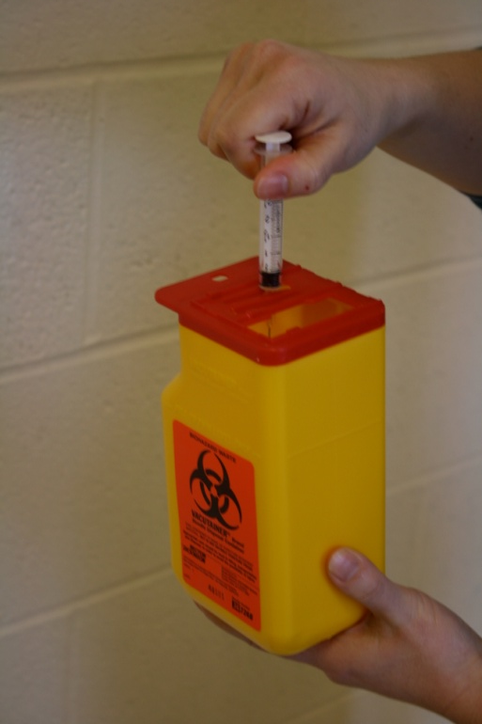
Sharps
Needles and other sharps
  Needle sticks very common
Handle and dispose
of properly
  Avoid recapping
  Direct disposal
  Use rigid disposal containers
  Account for sharps after use
Notes:
Needles and other sharps will be commonly used during animal health emergencies. Needle sticks and cuts can be easily prevented by handling and disposing of any sharps properly. Avoid recapping needles before disposal. Instead discard the entire needle directly into the sharps container. This eliminates the potential for punctures while recapping. Sharps should always be disposed of in a rigid container that cannot be penetrated by the sharp item. Lastly, account for all sharps after use and before cleanup in order to prevent injury. [Photo from Danelle Bickett-Weddle, Iowa State University]

Slide 8
Fatigue
Extended shifts
  Increased errors, accidents, injuries
Signs of fatigue
  Sleepiness, decreased alertness
  or motivation
  Irritability
  Giddiness
  Headaches, decreased appetite
Rest or time off
Notes:
During a response, extended or unusual work shifts can be expected and will inevitably cause physical and mental fatigue, increasing your risk for operational errors, accidents, and injuries as well as emotional stress. Be aware of the signs of fatigue, which can include sleepiness, decreased alertness and motivation, irritability, giddiness, headaches, or decreased appetite. When any of these signs are recognized by either you or your supervisor, it is indicative of the need for some rest or time away from the response effort.

Slide 9
Environmental Hazards
Weather Related Injury
Insects
Noise
Electrical Shock
Chemical Exposure
Notes:
Next, lets look at some of the potential hazards found from the response environment itself. This can include things such as weather related injury, or exposure to insect vectors, hazardous noise levels, electrical shock potentials and various chemicals.

Slide 10
Extreme Heat
Sunburn, dehydration
Heat cramps
  Muscle spasms
Heat exhaustion
  Paleness, dizziness, nausea, fainting
Heat stroke
  High body temperature,
  little or no sweating, confusion
  Seek medical attention immediately
Notes:
Extremes in weather and temperatures can occur during a response. Hazards from extreme heat situations involve the combination of temperature and humidity, individual tolerance to heat, level of exertion and the use of PPE. Sunburn and dehydration can easily occur in these situations, especially during outdoor response activities. Heat related illnesses are also possible and can range from relatively minor to life-threatening. Heat cramps, involve muscle spasms or contractions usually in the gastrocnemius (or hamstring) muscle. Heat exhaustion is usually due to dehydration, and manifest as paleness, dizziness, nausea, and fainting. Heat stroke is a more severe, life-threatening condition with symptoms of high body temperature, cessation of sweating, and confusion. If any of these signs occur, medical attention should be sought immediately.

Slide 11
Extreme Heat
Prevention
  Sunscreen
  Monitor yourself and others for signs
  Take breaks and seek shade
  Keep hydrated - water/sports drinks
  Avoid caffeine/alcohol
Notes:
The best way to prevent heat-related illness includes self-monitoring and monitoring of others for signs of heat illness. Wear sunscreen with an SPF of at least 15 and reapply frequently. Take breaks in the shade to allow your body to rest and recover. Keep hydrated by drinking water or electrolyte sports drinks; avoid caffeine or alcohol. If signs of heat illness are noticed, move to a shaded areas and contact the Safety Officer or other medical personnel.

Slide 12
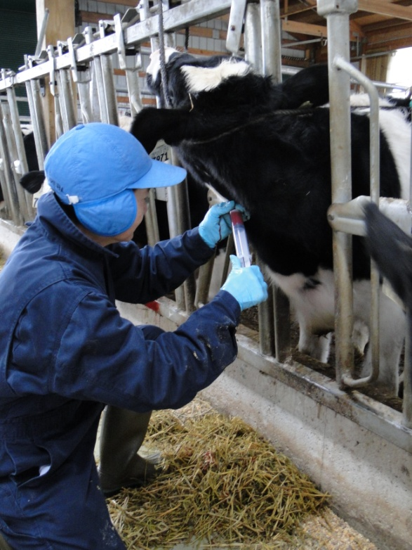
Extreme Cold
Frostbite
  Cold, numb, hard, pale
Hypothermia
  Numbness, lethargy,
  behavior
Prevention
  Appropriate clothing
    Cover ears, hands, and face
  Stay dry and avoid over-exertion
  Warm individual, seek medical attention
Notes:
Cold weather conditions may also occur during response situations. Cold temperatures combined with wet and windy conditions can contribute to both frostbite and hypothermia. Frostbite occurs when the skin and body tissue just underneath it freezes; the skin becomes very cold, numb, hard and pale. Mild forms can be treated with first-aid measures; severe cases will require medical attention. Hypothermia occurs if your body loses heat faster than it can be produced. Signs of hypothermia include shivering, lack of coordination, slurring of speech, numbness in extremities, lethargy, and confusion. A person with hypothermia usually isn't aware of his or her condition. If any of these situations occur, get the person to a warm location, and contact the site Safety Officer or other medical personnel immediately. To prevent cold-related problems, dress appropriately and in layers. Keep hands, ears, and face covered as these area are especially prone to frostbite. Stay as dry as possible and avoid over-exertion (i.e., sweating). [Photo from Danelle Bickett-Weddle, Iowa State University]

Slide 13
Insects
Bites and stings
Vector-borne diseases
Prevention
  Repellants with DEET
  or Picaridin
  Wear long sleeves and long pants
  Tuck pants into boots
Notes:
Most animal emergency responses will occur in outdoor settings. Depending on the season (e.g., spring, summer), bites and stings from insects (e.g, flies, mosquitoes, or ticks) can occur. In addition to the physical trauma caused by these encounters, some insects may also transmit vector-borne diseases such as West Nile virus or Lyme disease. Preventive measures include applying repellant products containing DEET (N,N-diethylmetatoluamide) or Picaridin. Additionally, wearing long sleeves and long pants which are tucked into boots, can minimize exposure areas to these vectors. Graphic illustration by Dani Ausen, Iowa State University]

Slide 14
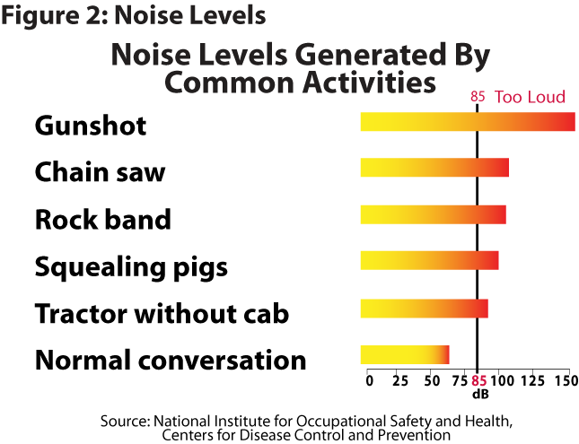
Noise
Can lead to permanent damage
Hazardous at 85 dBA for 8 hours
  Conversation difficult at 3 feet
Notes:
Noise is another common environmental hazard at a response site and can come from any number of sources, including heavy equipment, power tools, or animal vocalization. Exposure to loud or prolonged noise can cause permanent hearing damage. Noise is measured by decibels adjusted or dBA. The figure shows the various noise levels generated by common activities. Eighty-five (85) dBA for 8 hours is considered hazardous. To roughly gauge noise levels of particular situations, hazardous levels are probable when holding a conversation or hearing another responder is difficult at 3 feet or arm’s length. If entering “loud” situations, ensure some type of hearing protection is used. [Graphic illustration by Oriana Hashemi-Toroghi, Iowa State University]

Slide 15
Electrical Shock
Power equipment, cords, downed power lines
Prevention of shock and electrocution
  Inspect cords/ cables for damage
  Do not use damaged cords/cables
  Use caution when working in wet areas
  Observe area for downed power lines
  Assume all power lines are active
Notes:
Another potential hazard at the response site is electrical shock. Power equipment, cords or possibly downed power lines may be present at a response site and can result in serious injury or death from shock or electrocution. Prevention measures include inspecting all cords and cables prior to use; do not use damaged cords or cables. Use caution when using power tools or equipment in wet conditions. If downed power lines are noted, assume they are “live” and avoid them until they can be removed.

Slide 16
Chemical Hazards
Examples
  Animal facilities
  Carbon monoxide
  Disinfectant products
Prevention
  Awareness
  Do not use in confined spaces
  Personal Protective Equipment
Notes:
Any number of chemical exposure hazards may also be present. Exposure to animal waste gases can be encountered when entering enclosed animal facilities. Carbon monoxide released from gas-powered tools can build to hazardous levels when used in confined spaces. Some disinfectants when aerosolized, such as during preparation or application, can cause mucous membrane and respiratory tract irritation. Remain vigilant of potential chemical exposures, especially when entering confined or enclosed places. Wearing respiratory protection can minimize some of the risk of exposure.

Slide 17
Psychological Hazards
Stress
Depression
Notes:
In addition to physical and environmental hazards, psychological impacts can also occur during an animal health emergency.

Slide 18
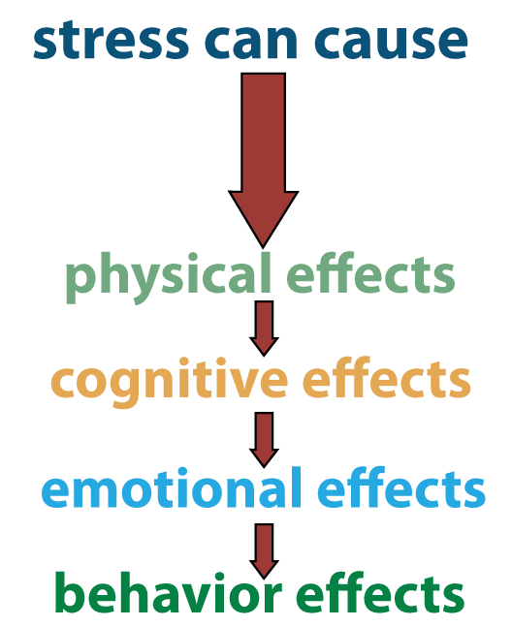
Stress
Recognize the signs
Physical
  Nausea, dizziness, headaches
Cognitive
  Disorientation, memory
Emotional
  Anxiety, guilt, grief, irritability
Behavioral
  Anger, withdrawal, depression, drug or alcohol abuse
Notes:
Responding to emergencies can be stressful. Long unusual hours, physical demands and emotional stress, can affect responder mental health. This can manifest in a variety of ways. Physical symptoms of stress include fatigue, nausea, dizziness, headaches, and a high heart rate. Cognitive symptoms include disorientation or confusion, memory problems, or nightmares. Emotional signs include anxiety, guilt, grief, denial, panic, fear, and irritability. Finally, stress may cause changes in behavior, such as anger, withdrawal, emotional outbursts, as well as drug and alcohol abuse and depression. [Graphic illustration by Oriana Hashemi-Toroghi, Iowa State University]

Slide 19
Dealing with Stress
Ways to reduce stress
  Monitor self and others for signs
  Take frequent rest breaks
  Accept what cannot change
  Maintain schedule as possible
  Communicate with loved ones
  Take advantage of support programs
Notes:
Stress will accompany any response effort, but to minimize the impact, it is important to take preventive steps. These include monitoring yourself and others for signs of fatigue and stress. Take occasional breaks away from the worksite. Recognize and accept things you cannot change, such as changes of command, equipment failures, or the event itself. Maintain a schedule that is as normal as possible when it comes to eating, drinking, and sleeping. Communicate frequently with loved ones or others on site to “destress” or take advantage of formal support programs.

Slide 20
Contingency Plans
Evacuation
Shelter-In-Place
Fire/Explosion
Hazardous Material Release
Severe Weather
Notes:
Even with the best planning, unforeseen situations, such as fire or severe weather, may arise. The Safety Officer is responsible for creating emergency and contingency plans specific for these incidents during the response.

Slide 21
Contingency Plans
Evacuation
  Pre-determined signal and site
  All are accounted for
Shelter-In-Place
  Pre-determined locations
  Remain until “all clear” is given
Notes:
If it is decided that evacuation is in order, you should go immediately to the pre-determined location where all personnel can be accounted for. Some situations will require “sheltering-in-place” in a pre-determined location until the “all clear” signal is given.

Slide 22
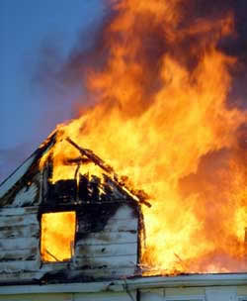
Fire/Explosion Response
Attempt to extinguish if deemed safe
  Extinguisher kept in every vehicle
If fire is out of control
  Sound warning alarm
  Evacuate to safe distance
  Account for team members
  Notify Command Staff
  and fire department
  Remove vehicles and
  equipment if possible
Notes:
Fire or explosions may be an unanticipated event during a response. If a fire occurs, attempt to extinguish it only if this can be done without injury to yourself or others. Fire extinguishers should be kept in all response vehicles and at all response sites. If the fire is out of control, first sound a warning alarm, then evacuate the area to a safe distance; account for all team members. Notify the fire department and the command staff of the incident. Finally, if possible and if it can be don safely, remove any vehicles or flammable field equipment from the area while waiting for the fire department. [Photo: California Environmental Protection Agency - http://www.calepa.ca.gov/Disaster/fire/]

Slide 23
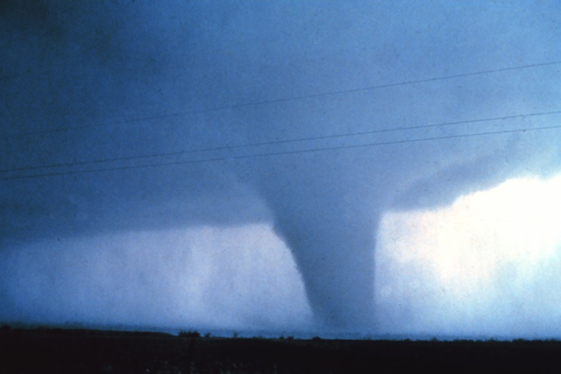
Severe Weather
Considerations for halting work:
  Heavy precipitation
  Extreme heat or cold
  Limited visibility
  Treacherous conditions
  (tornadoes)
  Lightning
  Flood potential
Notes:
Severe weather is another unanticipated event that may occur during a response situations. Command Staff will determine if weather conditions are severe enough to stop work. Considerations for halting work include: treacherous conditions, heavy precipitation, extreme heat or cold, lightning, or flooding potential. [Photo from NOAA National Weather Service Photo Library, D. Burgess - http://www.photolib.noaa.gov/htmls/nssl0066.htm]

Slide 24
Roles and Responsibility
Notes:
Let’s look at the roles and responsibilities for health and safety issues during a response.

Slide 25
ICS: Health and Safety
Safety Officer
  Assure safe working environment
  Identifies hazards and sets procedures
  Provides training
  Develops Health and Safety Plan
  Authority to issue stop work order
Other Sections also have a role
Everyone’s responsibility
Notes:
While protecting the health and safety of personnel assigned to an emergency response is everyone’s responsibility, management and monitoring of a safe working environment for all responders is done by the Safety Officer. Additionally, the Safety Officer will identify current and potential hazards, establish and train responders on safe work procedures (e.g., appropriate personal protective equipment), and prepare a Health and Safety Plan specific for the incident. If unsafe work conditions are noted, the Safety Officer does have the authority to issue an immediate stop work order. Other Sections of the ICS structure do play a role in health and safety procedures for the response. The Operation Section is responsible for creating safe work conditions, the Finance and Administration Section handles worker’s compensation claims and the Logistics Section includes the Unit that provides first aid to responders.

Slide 26
Responder Responsibility
Follow health and safety procedures
Report all injuries, accidents
Report unsafe conditions or
safety concerns
Adhere to the chain of command
Be aware of surroundings
Wear all PPE correctly
Notes:
As a responder, your responsibility involves following all established health and safety procedures. Report all injuries, accidents and near misses. Additionally, report any unsafe conditions or safety concerns to your immediate supervisor. Maintain constant awareness of your surroundings for hazards, monitor yourself and other responders for changes in health conditions, especially when wearing personal protective equipment.

Slide 27
Resources
USDA Foreign Animal Disease Preparedness (FAD PReP) Guidelines: Health and Safety
  http://www.aphis.usda.gov/animal_health/emrs/nahems.shtml
Notes:
For more information on health and safety issues during an animal health emergency response, consult the USDA FAD PReP Health and Safety Guidelines.

Slide 28
Acknowledgments
Development of this presentation was by the Center for Food Security and Public Health at Iowa State University through funding from the Multi-State Partnership for Security in Agriculture
Authors: Dan Taylor, DVM, MPH; Glenda Dvorak, DVM, MPH, DACVPM
Reviewers: Janice Mogan, DVM; Leslie Cole, DVM
Notes:
Information provided in this presentation was developed by the Center for Food Security and Public Health at Iowa State University College of Veterinary Medicine, through funding from the Multi-State Partnership for Security in Agriculture.

