Slide 1
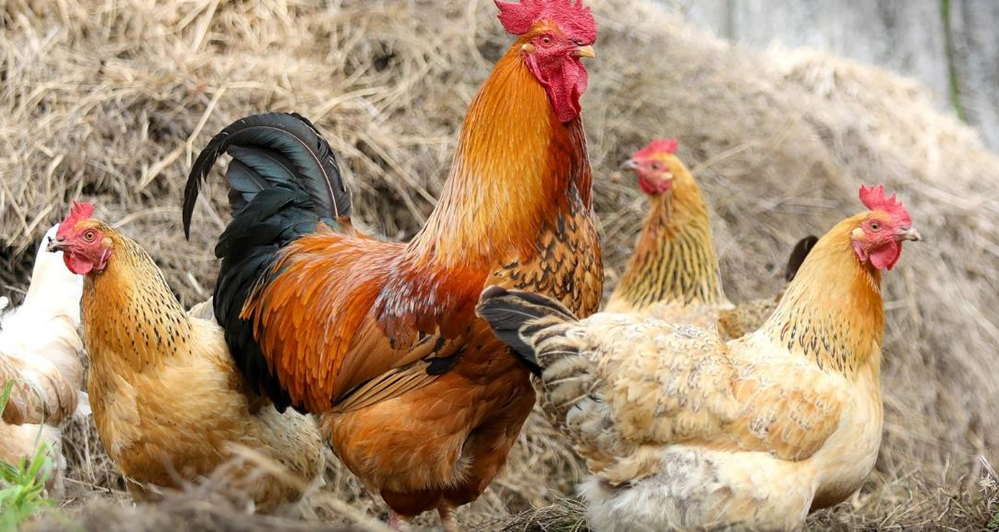

Zoonoses of Poultry
Notes:
Today I’m here to talk to you about some important diseases that affect poultry, and people working on or visiting your farm. These diseases are called zoonoses, and they can have a big impact on your health, and the health and productivity of your animals. Although zoonoses may be serious, they can often be prevented by simple steps you can take on your farm.
Photo: Pixabay/Klimkin at https://pixabay.com/photos/cock-farm-village-chicken-polygamy-2522623/

Slide 2
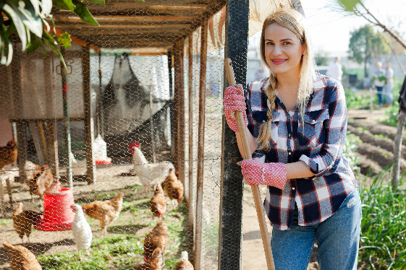
What are Zoonoses?
Diseases that spread between animals and people
Caused by germs: bacteria, viruses, parasites, and fungi
Notes:
So, let’s talk more about zoonoses. Zoonoses (also called zoonotic diseases) are diseases that spread between animals and people. Zoonoses are caused by many different germs, including bacteria, viruses, parasites, and fungi.
Photo: https://www.shutterstock.com/image-photo/smiling-young-female-proffesional-farmer-standing-1391145176

Slide 3
Effects of Zoonoses
Human Health
Animal Health
Financial
Public Health
Illness
Lost time
Long-term illness
Death
Illness
Death
Production losses
Lost income
Disease costs
Trade loss
Reputation
Food safety
Illness
Notes:
Why should we be concerned about zoonoses? Well, there are a lot of reasons. People who get sick can miss time at work. Zoonoses can also cause long term (chronic) conditions. Less commonly, some zoonoses cause death. In animals, zoonoses cause illness or death, leading to production losses with financial and economic impacts. Nationally, disease outbreaks can lead to trade restrictions and damage to the reputation of U.S. livestock producers. Zoonoses also impact public health. People can become ill after consuming contaminated animal products, like meat, milk, or eggs, or after visiting a farm.

Slide 4
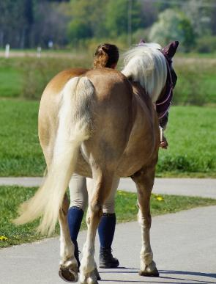
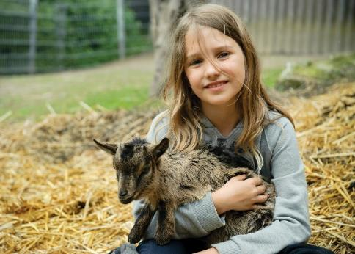
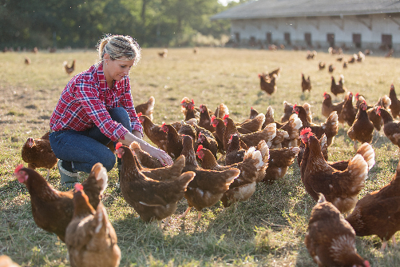
Who Can Get Sick?
People who live near, or work with,
animals or their environments
Notes:
Why are you, your family, and people working on your farm more likely to get sick? Because people who live near or work with animals, or their environments, spend a lot of time with animals. When you’re caring for animals, by feeding, cleaning up, or moving them, you have a greater chance of coming into contact with germs that cause zoonoses. But, you can take precautions to lessen your risk of getting sick.
Photos: Left: https://www.shutterstock.com/image-photo/agriculture-industry-farming-people-animal-husbandry-548279158; Middle: Marzena P. from Pixabay at https://pixabay.com/photos/human-horse-walk-spring-nature-5074978/; Right: https://www.shutterstock.com/image-photo/little-girl-holding-small-goat-83331634

Slide 5
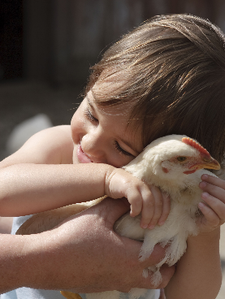
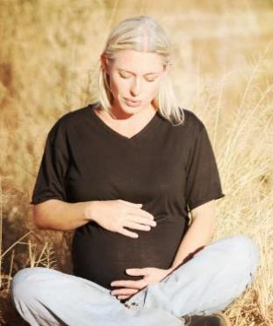
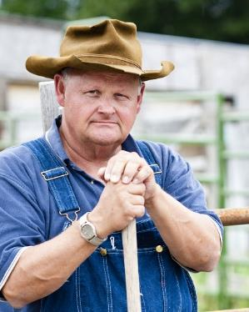

Who Can Get Sick?
Anyone with a weakened immune system
Children under age 5
Pregnant women
People over 65
People with long- term illness
Notes:
Zoonoses can cause anyone to get sick. But some people are more likely to get very sick compared to others, like people with a weakened ability to fight germs. This includes children (especially those under age 5), pregnant women, people over age 65, and people with long term illnesses like diabetes. People who are taking medicines that make their immune systems less effective are also more likely to get very sick, as are people receiving chemotherapy.
Photos: https://www.shutterstock.com/image-photo/little-girl-chicken-41153200; Middle left: Pregnant woman from Pixabay; Middle right: https://www.shutterstock.com/image-photo/rugged-old-farmer-portrait-144535121; Right: https://www.shutterstock.com/image-photo/white-round-pills-pouring-out-medicine-1304462122

Slide 6
How Do You Get Sick?
People or animals must
breathe in, touch, or swallow
germs that cause zoonoses
in order to get sick
Notes:
It’s important to remember that people or animals must breathe in, touch, or swallow germs that cause zoonoses in order to get sick. Let’s look at how germs get into the body in more detail.

Slide 7
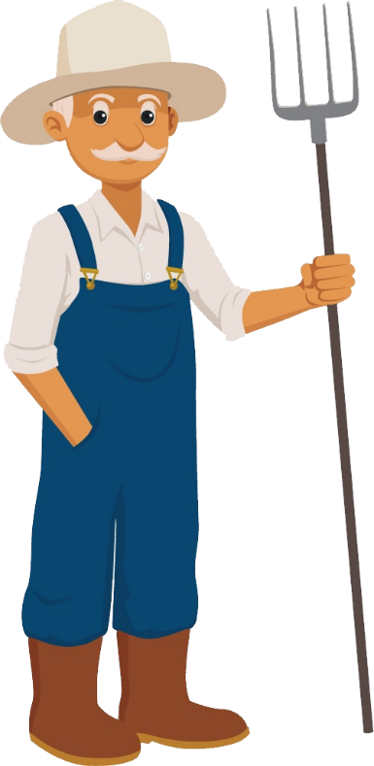

How Do Germs Get Into the Body?
Openings in skin
  Bite or scratch
  Needle stick
  Chapped, broken
Eyes, nose, mouth
Breathing in
Mucous membranes
Swallowing
Notes:
Germs can enter the body through the skin, or through the eyes, nose, or mouth.
Most germs can’t get through unbroken skin. There must be a bite or scratch, or you can get stuck with a dirty needle. Germs also enter the body through cuts, scrapes, and chapped or broken skin.
You can breathe in germs in the air. Also, the lining of the eyes, nose, and mouth (known as mucous membranes) are very thin and can have tiny tears in them. When people touch their mucous membranes with dirty hands, or dirty clothing like a handkerchief, germs can get through.
You can swallow germs if your hands are dirty, and germs get onto your food or water, or if the food or water is contaminated with manure. Raw or undercooked meat, raw eggs, and raw or unpasteurized dairy products from infected animals can also contain germs.

Slide 8
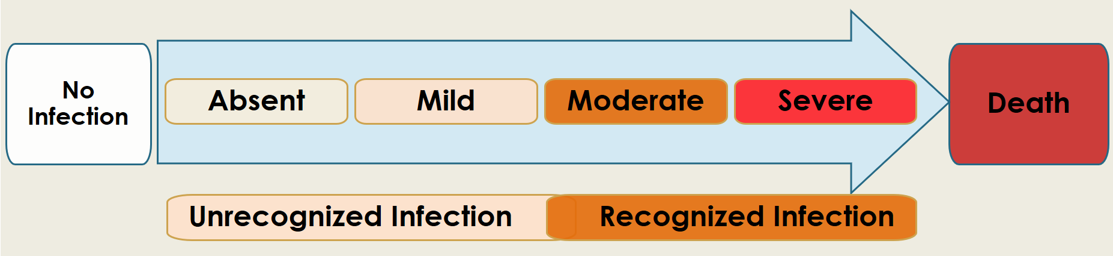
How Sick Can You Get?
Zoonoses can make you a little sick, or very sick
Reproductive problems
Long-term (chronic) illness
Disability
Notes:
In people, some zoonoses cause no signs of disease, while others are mild. For example, they may result in small skin lesions that heal on their own, or flu-like illness that we think of as a “seasonal bug.” But, some zoonoses cause serious respiratory or intestinal disease, and may require hospitalization. Others lead to illness or miscarriage in pregnant women. Zoonoses cause similar health impacts in poultry—they may get a little sick, very sick, or even die.

Slide 9
sources of germs that cause zoonoses
Notes:
Next, we’ll look more closely at some of the sources of germs that cause zoonoses.

Slide 10
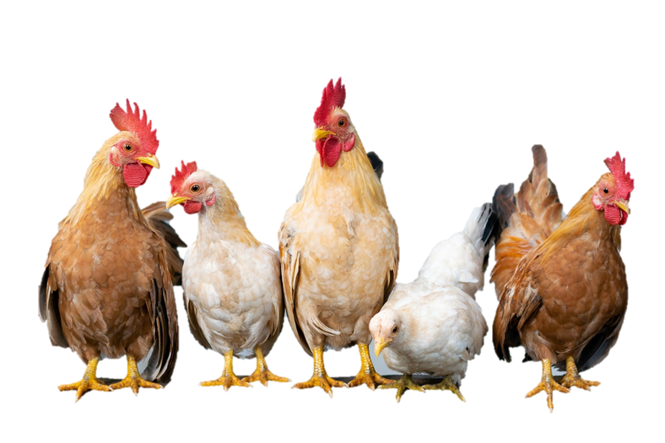
Zoonoses of poultry
Avian influenza
Campylobacteriosis
E. coli
EEE, WEE
Erysipelas
Histoplasmosis
Mange
Newcastle disease
Psittacosis
Salmonellosis
West Nile virus
Notes:
You might be familiar with common zoonoses of poultry. Some of them spread through the air, some you get by eating or drinking, and some are spread through touch. Zoonoses you should know about include:
Avian influenza
Campylobacteriosis
E. coli
EEE, WEE (Eastern and Western equine encephalitis)
Erysipelas
Histoplasmosis
Mange
Newcastle disease
Psittacosis
Salmonellosis
West Nile virus
Photo: Chickens by Xuân Tuấn Anh Đặng from Pixabay at https://pixabay.com/photos/chicken-rooster-hen-chicks-easter-4849979/.

Slide 11
What Happens When You Get Sick?
Source
Transmission
Entry
Where germs come from
How germs spread
How germs enter your body
Notes:
Now, let’s look at how germs get into your body. First you need a source—this is where the germs come from (we’ll talk more about sources in a minute). Then, when germs spread from an infected source to a person or animal, this is called transmission. Last, germs need a way to enter the new person (or animal). Remember that entry can happen through breaks in the skin (like cuts or scrapes), or through the lining of the eyes, nose or mouth (called the mucous membranes). You can also swallow germs or breathe them in.

Slide 12
Where Germs Come From
Animals
Animal Environment
Food and Water
Insects and Ticks
Body fluids, tissues,
Skin surface
Bites, scratches
Air
Surfaces
Equipment
Soil/manure
Wild animals
Meat
Milk
Eggs
Water
Mosquitoes
Flies
Ticks
Notes:
There are many potential sources of germs.
Infected animals can have germs in or on their bodies. Exposure can occur from contact with body tissues or fluids, skin surfaces, from bites or scratches
Where infected animals live, germs are often present in the environment. They may be found in the air, on building surfaces like flooring, or on equipment like feeders or buckets.
Meat, milk, eggs, and water can be a source of germs, either because they came into contact with manure or because they were from a sick animal.
Infected insects and ticks also carry germs, including many that are zoonotic. They can spread disease when they bite humans and animals.

Slide 13
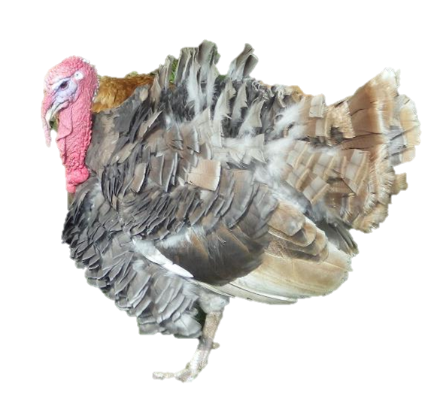
Animals
Skin sores
Feathers
Cough
Sneezes
Saliva
Mucus
Droppings
Urine
Eggs
Meat
Notes:
Germs can be found in or on many different parts of an animal’s body. These include:
Eggs or meat
Droppings or urine
Skin sores or feathers
Small drops of moisture from coughs or sneezes, saliva, or mucus from the nose
You can become sick if you touch any of these, or if you are bitten or scratched by a sick animal.
Photo: Turkey with chickens_ARG_Flickr_CC BY 2.0

Slide 14
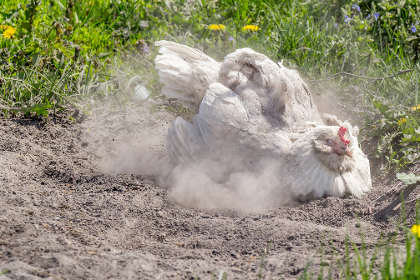
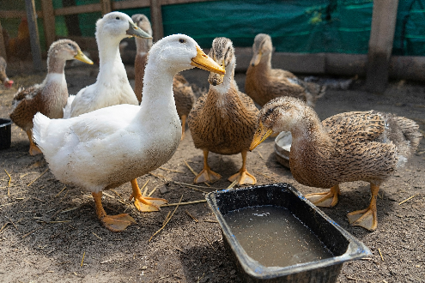
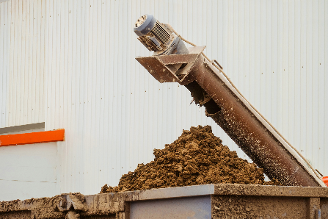
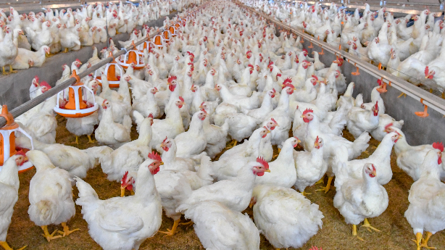
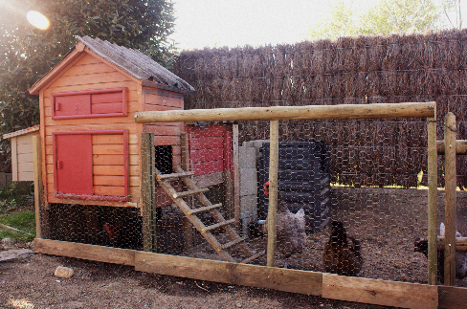
Animal Environment
Notes:
When animals are sick, the places they live can become contaminated with germs. Some germs travel through the air on small particles and can be breathed in by people and animals. This is called airborne transmission. Droppings and urine in poultry buildings can also harbor germs; they can get onto equipment, vehicles, and your clothing and boots. Any droppings in the environment are a potential source of dangerous germs.
Photos: Top left: https://www.shutterstock.com/image-photo/poultry-yard-geese-chickens-on-plot-1802738194; Bottom left: https://www.shutterstock.com/image-photo/poultry-broiler-farm-business-group-white-1242757759; Top middle: https://www.shutterstock.com/image-photo/chicken-cleans-feathers-ash-digs-ashes-420451735; Bottom middle: https://www.shutterstock.com/image-photo/wooden-poultry-house-chickens-1700807431; Right: https://www.shutterstock.com/image-photo/removal-poultry-manure-house-agro-industry-742546018

Slide 15
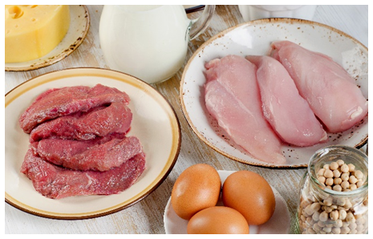
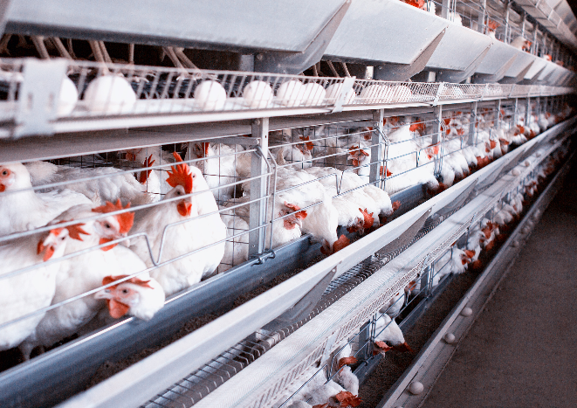
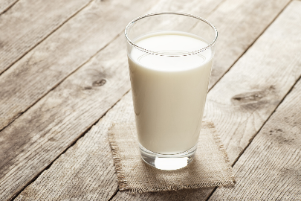
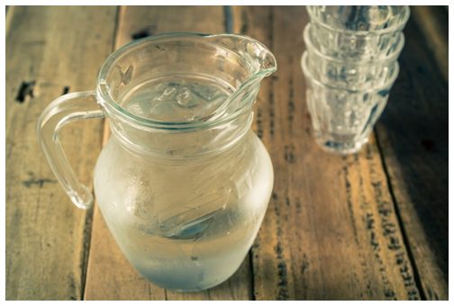

Food and Water
Notes:
Bacteria like Salmonella can be found inside eggs. Other germs, like those found in bird droppings, can get onto any type of prepared food, including cooked meat, especially if you eat in barns or other animal areas and don’t wash your hands. If manure gets into milk or water, germs can spread to people or animals when they drink.
Photos: Top left: https://www.shutterstock.com/image-photo/foods-high-protein-diet-eating-393314365l; Bottom left: https://www.shutterstock.com/image-photo/glass-pitcher-water-on-wooden-table-393786253l; Middle: https://www.shutterstock.com/image-photo/big-glass-milk-napkin-on-old-640957921; Top right: https://www.shutterstock.com/image-photo/poultry-farm-breeding-chickens-chicken-eggs-1180051501; Bottom right: https://www.shutterstock.com/image-photo/delicious-over-easy-egg-bread-on-689610223

Slide 16
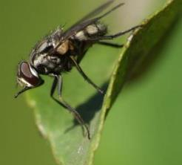
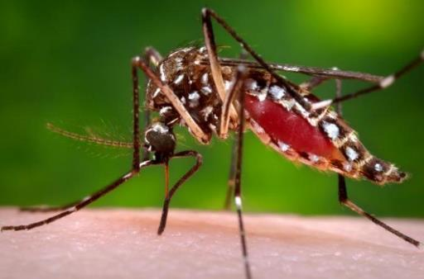
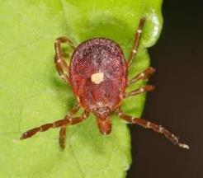
Insects and Ticks
Notes:
Insects and ticks are also known as vectors—living organisms that can spread disease-causing germs. Some vectors, like mosquitoes and ticks, bite people and animals, and spread germs that get into the blood. Others, like flies, gnats, and cockroaches, can carry germs on their bodies to other surfaces, animals, or people.
Photos: Left: Lone star tick, Judy Galllagher/Flickr, CC BY 2.0, at https://www.flickr.com/photos/52450054@N04/49692933603; Right: Mosquito (Culex pipiens), Janet Graham/Flickr, CC BY 2.0, at https://www.flickr.com/photos/130093583@N04/32400655674; Middle: Fly (Stomoxys calcitrans), Eran Finkle,/Flickr CC BY 2.0, at https://www.flickr.com/photos/finklez/3733608561

Slide 17
Protecting against zoonoses
Notes:
Next, let’s learn about how to keep you, your family, and your workers safe from zoonoses.

Slide 18
Don’t Get Sick: Stop Zoonoses!
How germs enter your body
How germs
spread
Where germs
come from
Entry
Transmission
Source
Personal Protection
Animal
Health
Biosecurity
Notes:
To prevent zoonoses, you have to block—or disrupt—one or more steps that take place when people become sick. Recall that germs come from a source, often an animal, then they are spread (or transmitted) to a person or animal. Germs enter the body through breaks in the skin or through the lining of the eyes, nose, and mouth. They can also be breathed in or swallowed.
To break this cycle, we need to think backwards. First, how can you prevent germs from entering the body? Next, how can you stop the spread of germs? And finally, how can you control germs at the source? By focusing on these steps—and breaking the chain of transmission—you can lessen your chances of getting sick.

Slide 19

Entry
Wash your hands
Wash hands after working with animals, for 20 seconds using soap and hot water
Wear protective clothing
Wear clean coveralls and boots
When needed: wear mask, goggles, and gloves
Personal Protection
Keep germs out of your body
Avoid exposure
Cover open wounds
Be extra careful around animals if you have a weak immune system
Notes:
Protect yourself against zoonoses by keeping germs out of your body. First, wash you hands frequently – especially after touching animals. Wash for 20 seconds (about the time it takes to sing Happy Birthday twice), using soap and hot water. Next, wear protective clothing. Always wear clean coveralls and boots. If you’re cleaning up dusty areas, consider protecting your eyes, nose, and mouth with a mask and goggles. Also wear gloves when needed. Cover cuts or scrapes with a bandage to keep germs out. Be extra careful around animals if you have a weakened immune system. Avoid young animals and pregnant animals, as well as animals that are sick.

Slide 20
Entry
Cook Food
Properly
Clean
Wash hand often when preparing food
Wash utensils, cutting boards, knives
2. Separate
Keep raw and cooked foods separate
Personal Protection
3. Cook
Cook foods to proper internal temperature; use a meat thermometer
4. Chill
Don’t thaw meat on the counter
Freeze or refrigerate food within 2 hours
Keep germs out of your body
Notes:
To prevent the spread of germs when eating or drinking, follow these steps:
CLEAN: Wash your hands often when preparing food. Also wash utensils, cutting boards, and countertops with hot, soapy water. Scrub and rinse fruits and vegetables under running water.
SEPARATE: Keep different types of food separate – like vegetables and raw meat. Don’t share knives or cutting boards.
COOK: Cook foods properly to kill germs in eggs or meat. Different temperatures are required for different types of meat. Be sure to use a meat thermometer.
CHILL: Keep meat frozen or refrigerated. Always thaw food in the refrigerator, in cold water, or in the microwave – not on the kitchen counter. Refrigerate any leftover food within 2 hours. Germs can grow quickly on food left at room temperature.

Slide 21
Transmission
Keep disease out
Limit farm access
Quarantine new animals
Isolate sick animals
Manage manure
Remove manure from pens
on a regular basis
Biosecurity
Control insects and ticks
Keep animals indoors
Don’t let water accumulate
Use insecticides
Stop germs from spreading
Notes:
You can also protect yourself against zoonoses by practicing good biosecurity – in other words, by stopping animal diseases from getting onto your farm and spreading. This means limiting farm access, allowing only essential people and vehicles on your property. When new animals come to your farm, keep them away from the herd for a few weeks. Also isolate sick birds. Remove manure/litter from small coops on a regular basis to keep them clean. Keep animals indoors, in screened areas, to limit contact with insects and ticks that can spread disease. Don’t let water accumulate in bins or tires, because mosquitoes like to breed there. You can also use chemicals (known as insecticides) to control insects.

Slide 22
Transmission
Clean and
Disinfect
Clean
  Remove dirt/debris
  Soak area with hot water, detergent
  Wipe or scrub area
  Rinse
  Dry
Biosecurity
2. Disinfect
  Choose a disinfectant
  Apply as directed
  Let disinfectant sit
  Rinse
  Dry
Stop germs from spreading
Notes:
Make sure to keep germs from spreading on equipment, especially if it’s used on sick animals or shared between farms. To remove germs, start by cleaning.
Remove dirt/debris by brushing, scraping, or sweeping
Soak the area with hot water and detergent
Wash (wipe, spray) area, starting with the dirtiest part
Rinse to remove detergent and dry
Next, follow these steps to disinfect.
Choose the right disinfectant (consider the germs you’re concerned about, temperature, and safety)
Follow instructions on the label and apply to surfaces/objects
Let the disinfectant sit on surfaces/objects for the right “contact time” (this is shown on the product label)
Rinse and dry

Slide 23
Source
Manage herd
Provide clean, dry housing
Make sure birds have enough food
Keep stress low
Vaccinate
Work with your veterinarian to find out which vaccines are appropriate for your birds
Animal
Health
Prevent parasites
Keep animals free from parasites using medicines and coop management practices
Stop animals from getting sick
Notes:
Finally, try to eliminate germs at the source – put a health program in place to stop animals from getting sick. Work with your veterinarian to determine the best ways to keep poultry healthy. Make sure you provide clean, dry housing, and that animals get enough quality food. Use low stress handling techniques. Vaccines are available for some zoonoses. Your veterinarian can help you develop a vaccination schedule. You should also develop a control program to keep animals free from worms and other parasites that cause disease. This can include medicines to kill parasites, like dewormers, as well as pasture management.

Slide 24

Take a STEP in the Right Direction
P
Talk with your veterinarian
about how to
protect your animals and yourself.
E
T
Prevent
S
Entry
Transmission
Source
Notes:
To prevent zoonoses, “Take a STEP in the right direction.”
Recognize possible sources of germs,
Be mindful of how germs can be transmitted to people,
Stop germs from entering your body, and
Prevent zoonoses by washing your hands often, practicing good biosecurity, and talking to your veterinarian about ways to keep your animals healthy.

Slide 25
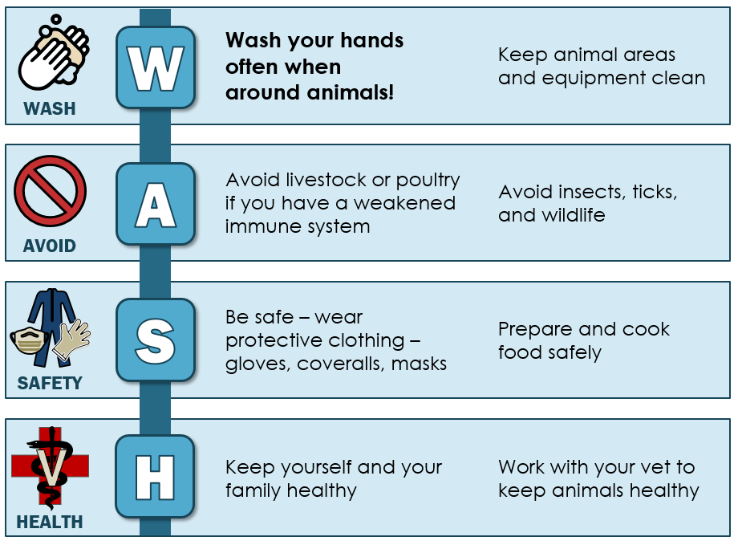

Prevent Zoonoses: W.A.S.H.
Notes:
You can also use the W.A.S.H. prevention strategy for zoonoses.
W: Wash your hands often, especially after you touch animals or body fluids like saliva, urine, or manure. Also keep animal areas clean. Pick up manure regularly.
A: Avoid livestock or poultry if you have a weakened immune system. Also avoid disease carrying insects and ticks.
S: Be safe – wear protective clothing like coveralls, boots, and gloves when you work with animals, touch their manure, or deliver calves. Prepare and cook food safely.
H: Stay healthy – work with your veterinarian to keep your animals healthy; also protect yourself and your family.

Slide 26

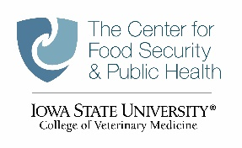

Be Aware of the Risk
Ask your veterinarian about zoonotic disease risks on your farm
Learn more about zoonoses at https://www.cfsph.iastate.edu/zoonoses
Notes:
So, remember that zoonoses can affect animals and people, including you, your family, and people that work on or visit your farm. Make sure your animals stay healthy, and take simple precautions to decrease your chance of getting sick.

