Slide 1
Vehicles and Equipment
Biosecurity Basics
Notes:
Biosecurity Basics: Vehicles and Equipment
Biosecurity on your operation is essential to keeping your animals healthy and starts with a few key steps. This presentation will address one of these biosecurity basics for small-scale producers – the handling of vehicles and equipment.

Slide 2
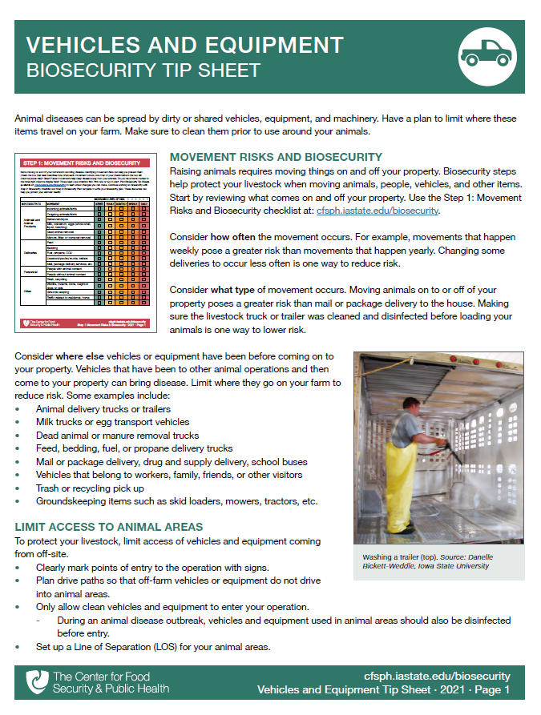

Vehicles and Equipment
Movement risks and biosecurity
Line of separation
Limit access to animal areas
Cleaning and disinfection
www.cfsph.iastate.edu/biosecurity/
Notes:
Animal diseases can be spread by contaminated vehicles, equipment, or machinery. To protect your animals, it is important to determine the movement risks for your operation, and establish biosecurity actions to minimize these risk. This includes actions such as limiting access to animal areas, establishing a line of separation, and cleaning and disinfection. A printable PDF containing the tips presented here is available for free download on the CFSPH website.

Slide 3
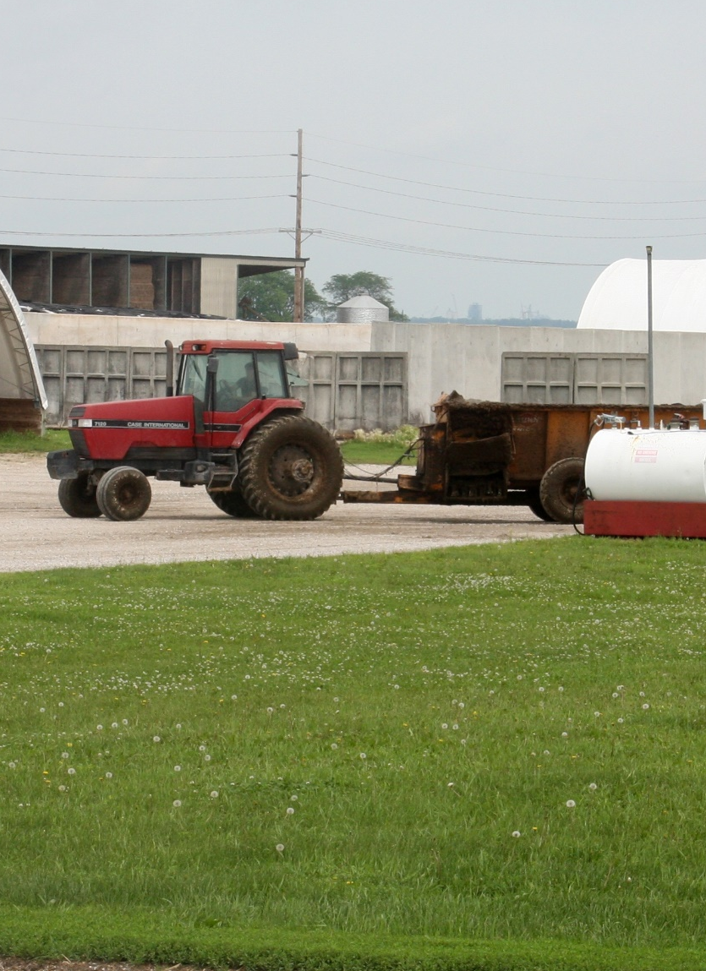
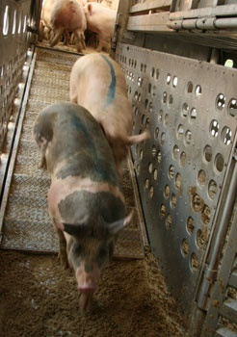
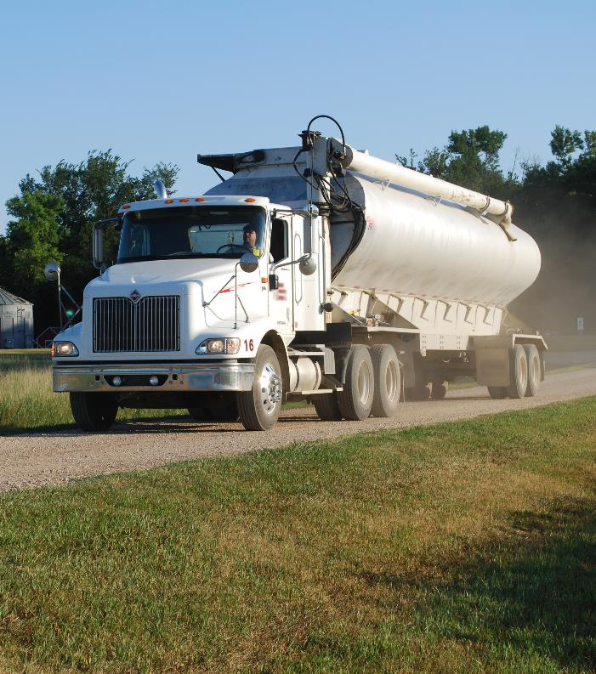
Movement Risks and Biosecurity
Notes:
Raising animals requires the movement of vehicles and equipment on and off your property. However, animal diseases can be spread by these actions when precautions are not taken.
Photos: manure spreader, Dani Ausen/Iowa State University; unloading swine, Alex Ramirez/Iowa State University; feed truck, National Pork Board

Slide 4
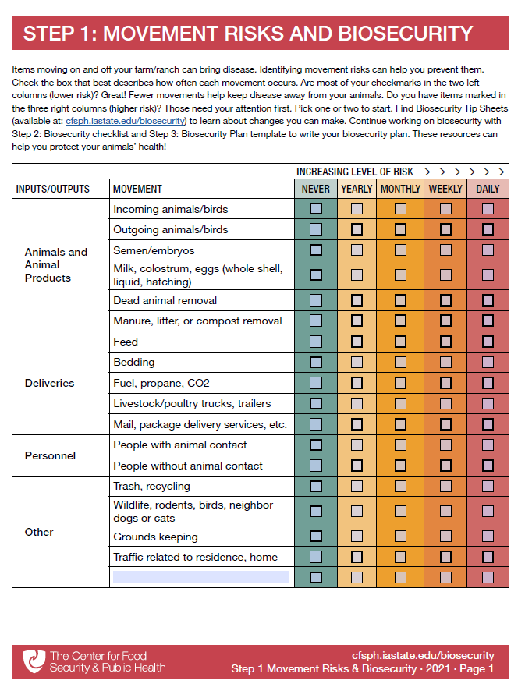
Find Movement Risks For Your Operation
Use the Step 1: Movement Risks and Biosecurity Checklist
www.cfsph.iastate.edu/biosecurity/
Notes:
One of the first steps to reduce the risk of disease entry or spread on your operation from vehicle and equipment movement, is to review the movement of vehicles and equipment onto, off of, or within your operation. To help you with your assessment of movement risks for your operation, a checklist is available at cfsph.iastate.edu/biosecurity.
It is important consider the vehicles transporting animals or animal products, including dead animal removal, as well as deliveries to the farm, people – including employees or visitors, and other movements such as trash pickup.
Identifying these movement risks can help you determine biosecurity measures needed.

Slide 5
How often?
Been At Other Locations?
Animal/Animal Product Transport | Non-Animal Transport
Animal trailers/trucks | Feed, bedding, fuel delivery
Milk or egg transport | Mail/package delivery
Carcass or manure removal | Drug or supply delivery
 | Trash/recycling pickup
 | Groundskeeping: skid loaders, mowers, tractors
 | Family, employee or visitor vehicles
Notes:
Consider not only the type of vehicle or movement, but also how often it occurs. For example, movements that happen daily or weekly pose a greater risk than movements that happen on a yearly basis. Changing movements, such as deliveries, so they occur less often is one way to reduce risk.
Also consider if vehicles or equipment have been at other locations before coming on to your property. Those that have been to other animal operations or elsewhere, can bring disease when they enter your property.
Some examples include:
Animal delivery trucks or trailers
Milk trucks or egg transport vehicles
Dead animal or manure removal trucks
Feed, bedding, fuel, or propane delivery trucks
Mail or package delivery, drug and supply delivery, school buses
Vehicles that belong to workers, family, friends, or other visitors
Trash or recycling pick up
Groundskeeping items such as skid loaders, mowers, tractors, etc.

Slide 6
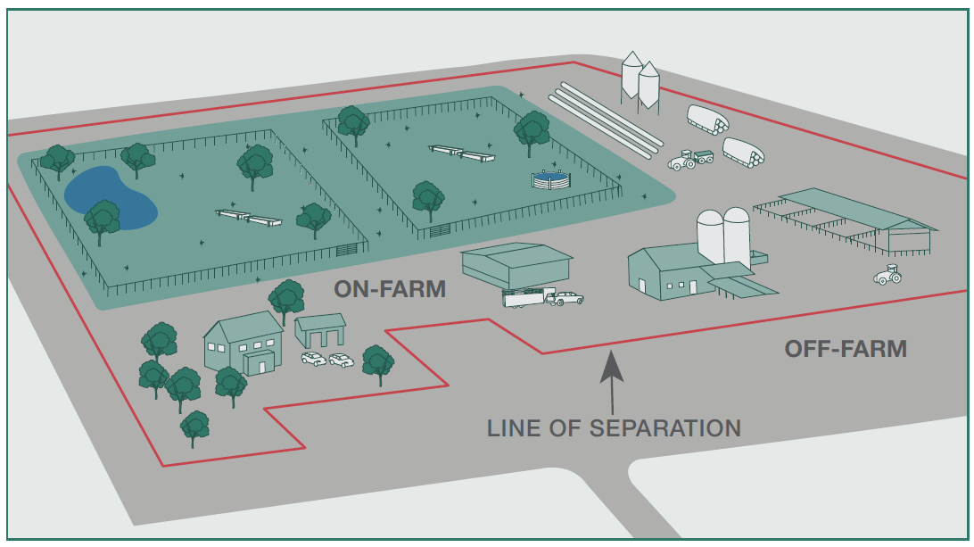
Line of Separation (LOS)
Notes:
A helpful biosecurity action to control and manage the movement of vehicles or equipment on your farm is by setting up a Line of Separation (LOS) – sometimes referred to as a clean-dirty line – as shown by the red line. This line helps to determine the on-farm area – those inside the LOS - from the off-farm risks.
The LOS might include the entire operation (as shown here), or it may just surround the animal housing areas, or it may be something in between. All equipment within the LOS should remain inside the LOS.
Items outside the LOS, such as off-farm vehicles or equipment, should be considered “dirty” or contaminated, and should either not be allowed to cross the LOS or is allowed, must be cleaned and disinfected before crossing the LOS.
You can learn more about setting up an LOS in the Protecting Your Herd or Flock Biosecurity Tip Sheet at cfsph.iastate.edu/biosecurity.

Slide 7
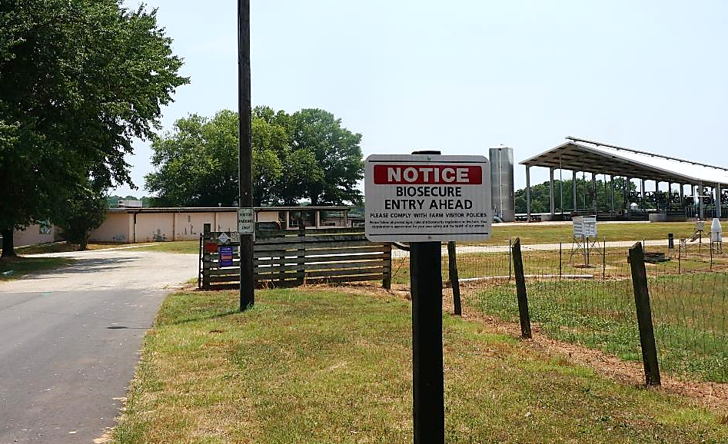
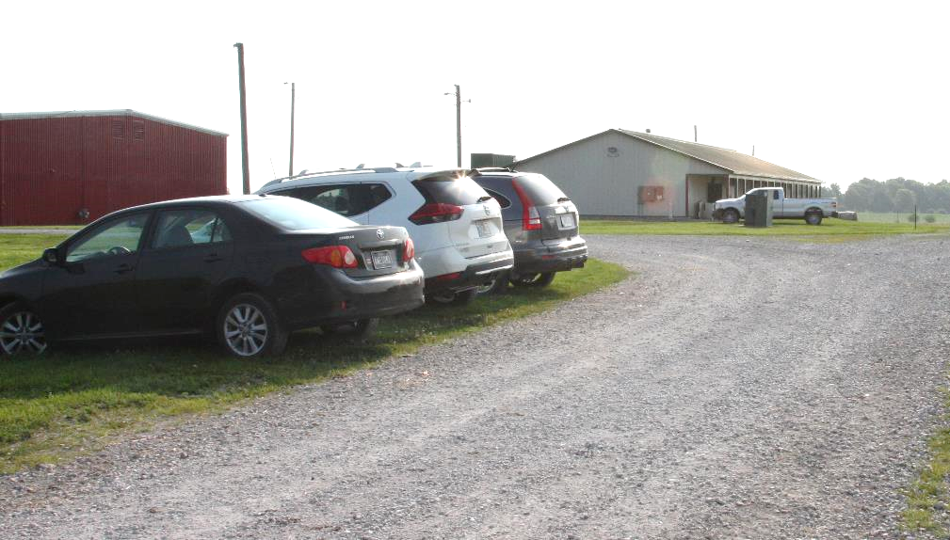
Prevent or Limit Access To Animal Areas
Parking area away from animal areas and outside the LOS
Clearly mark points of entry and drive paths
Notes:
To further protect your livestock from disease risks by vehicles or equipment,
Prevent or limit vehicle access, especially to animal areas, whenever possible.
Provide a designated parking area for personnel and visitors. The parking area should be located outside the LOS and away from animal areas.
Clearly mark allowed points of entry with signs
Plan drive paths so that off-farm vehicles or equipment do not enter into animal areas.
Photos: parking area, Dani Ausen/Iowa State University; entry sign, Danelle Bickett-Weddle/Iowa State University

Slide 8
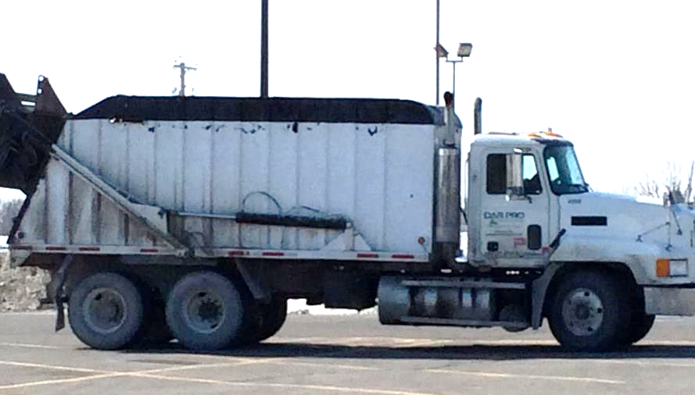
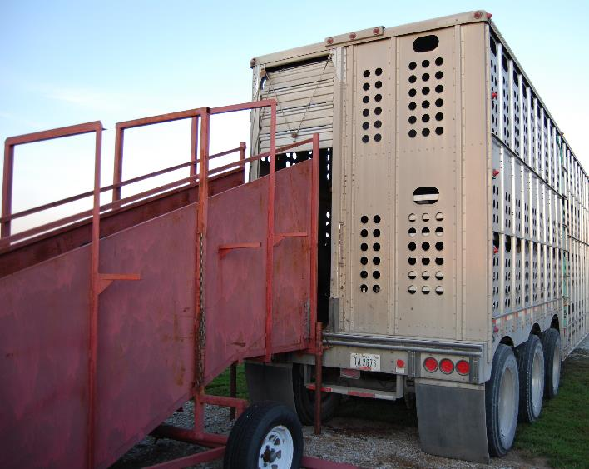
Keep High Risk Vehicles Out
Pick up should occur away from animal areas
When possible at the boundary of the LOS
Notes:
Limit the entry of vehicles used for the removal of dead animals , manure, litter, and compost. These vehicles likely visit other farms and could carry disease. Make every effort to use these services outside the LOS.
Pick up of animals – live or carcasses – should occur away from animal areas, and when possible at the LOS boundary, to provide easy to access, without crossing the LOS.
Photos: rendering truck, Pam Zaabel/Iowa State University; livestock trailer, Renee Dewell/Iowa State University

Slide 9
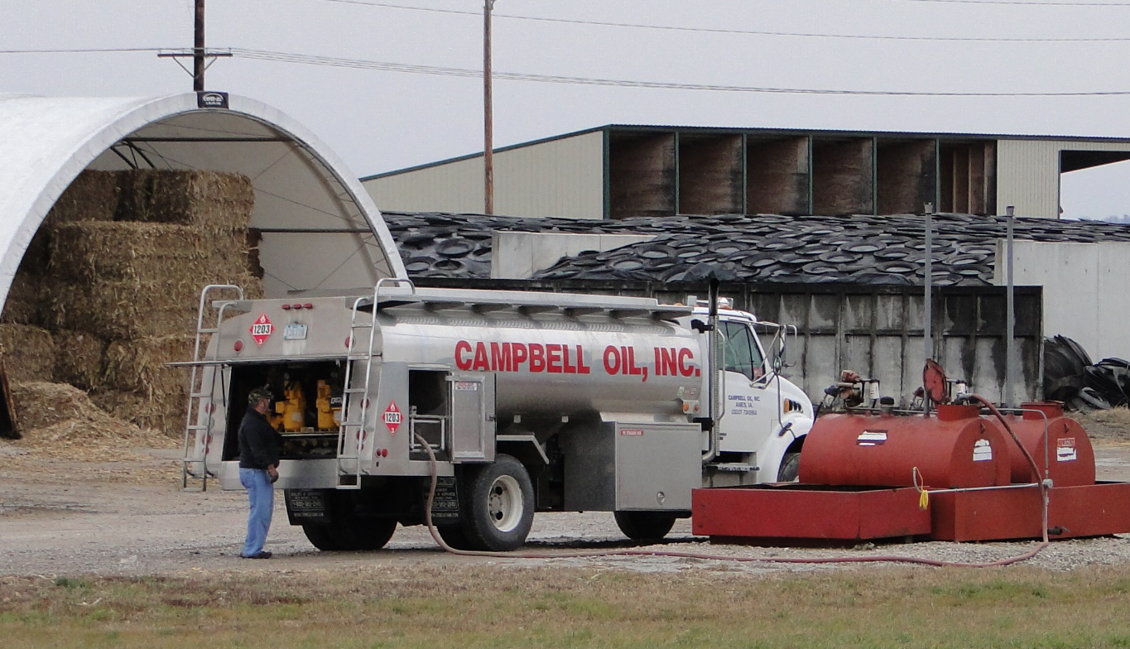
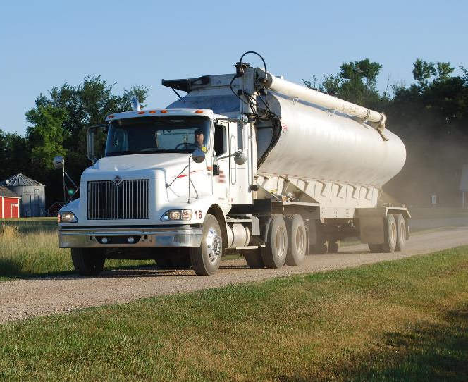
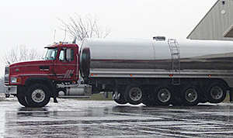
Limit access to only those that are essential
Limit areas where they are allowed to go on
your farm
Notes:
When access is necessary, such as feed or animal delivery, limit access to only those vehicles or equipment that are essential. Also limit areas where these vehicles or equipment are allowed to go on your farm.
Photos: feed truck, courtesy of National Pork Board; milk truck and fuel truck, Danelle Bickett-Weddle/Iowa State University

Slide 10
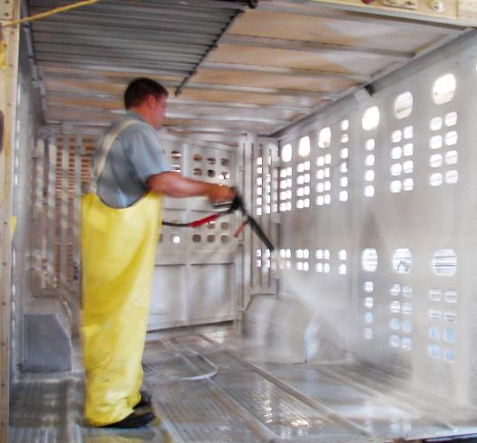
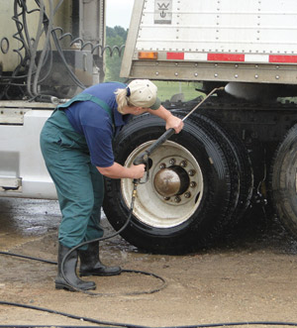
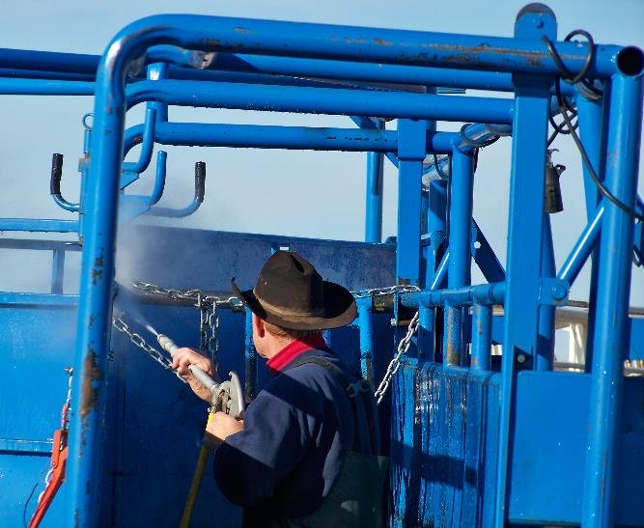
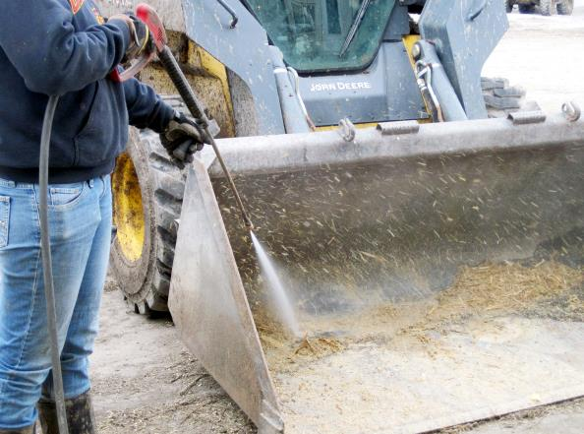
Clean any vehicles or equipment allowed to enter
Notes:
Any vehicles or equipment that have been on other operations before yours, should be cleaned and disinfect before allowing access your operation.
Photos: trailer cleaning, Danelle Bickett-Weddle/Iowa State University; cleaning skidloader, Megan Smith/Iowa State University; cleaning chute, Steve Goff/USDA

Slide 11
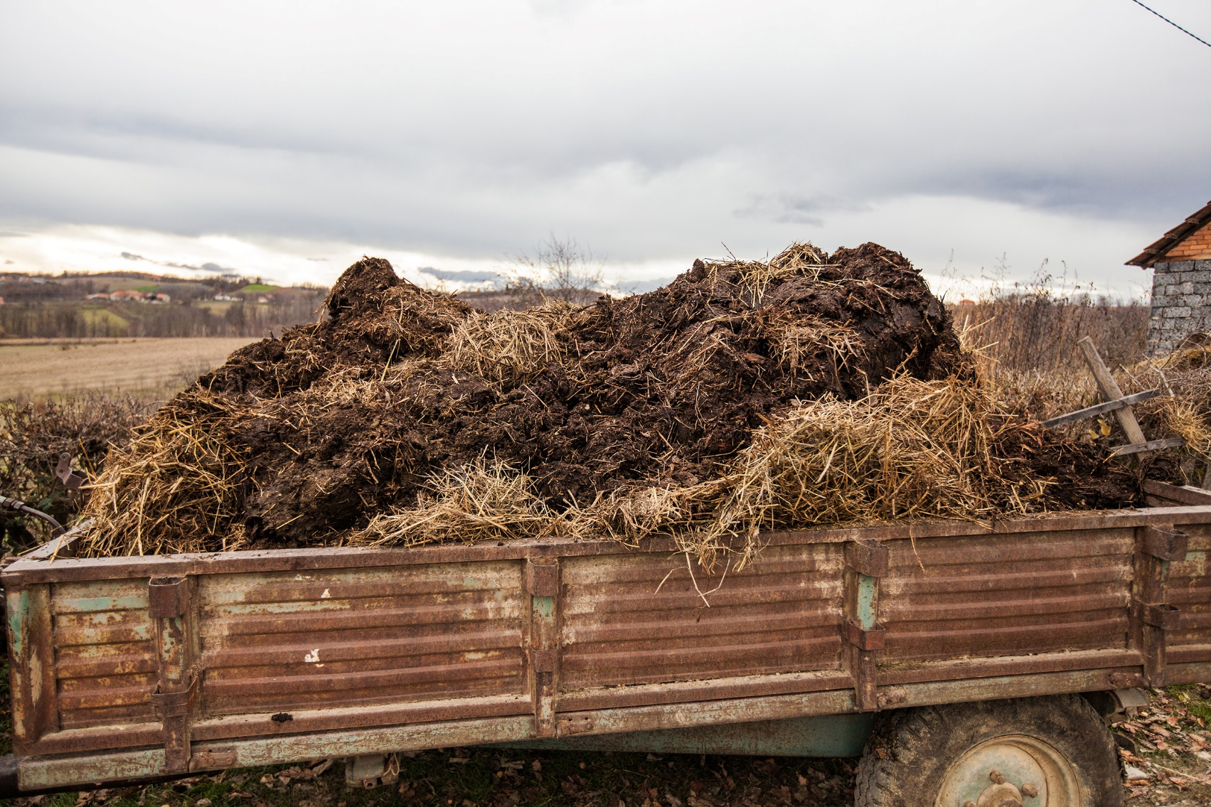
Manure/Litter Spreaders
Keep away from animal areas
Notes:
Manure or litter spreaders and other items kept on farm should be stored away from animal areas.
Photo: manure wagon, Shutterstock.

Slide 12
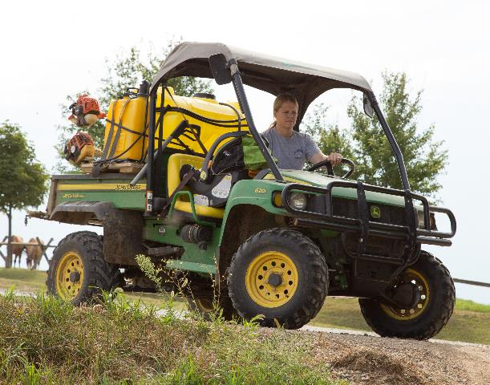
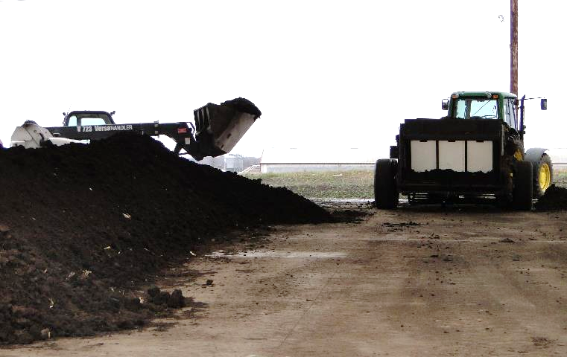
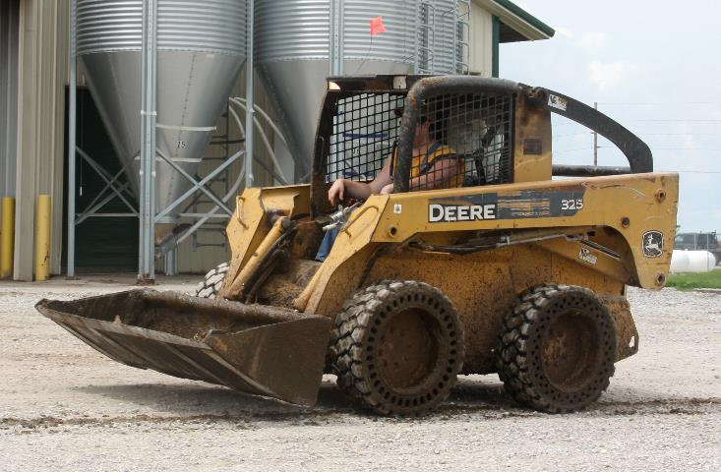
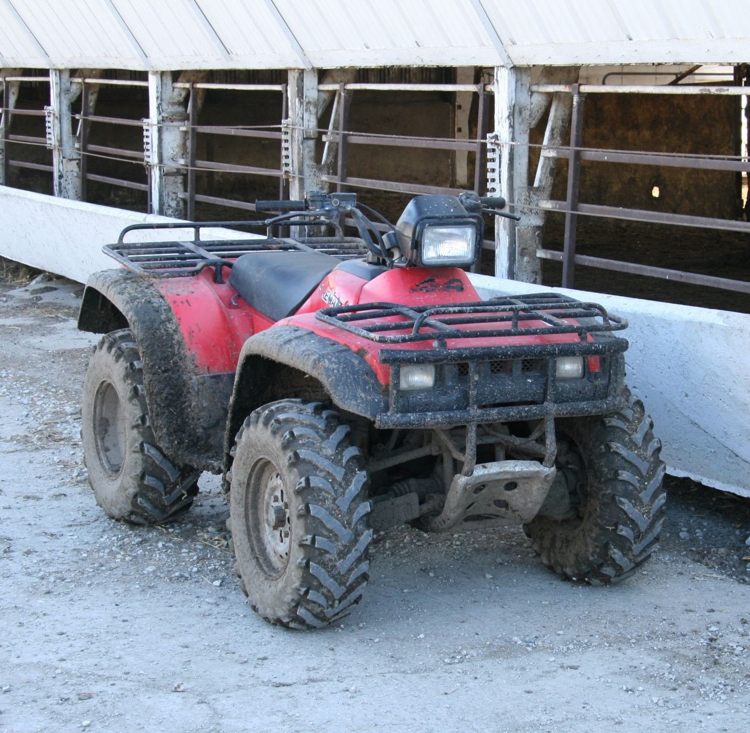
Use farm dedicated equipment
Clean and disinfect before moving to animal areas
Notes:
Farm-dedicated equipment and machinery is ideal. Limit the entry of items that are shared with other sites. Any shared items should be cleaned and disinfected before crossing the LOS.
Heavy machinery such as tractors or skid loaders used in animal areas get dirty. When moved, they can spread germs on farm and to other farms. Clean and disinfect before moving to other animal areas.
Photo: gator, Rexanne Brandie/Iowa State University Extension; equipment with compost pile, Danelle Bickett-Weddle;
4 wheeler, M Wedig/Danelle Bickett-Weddle/Iowa State University; skid steer, Dani Ausen/Iowa State University

Slide 13
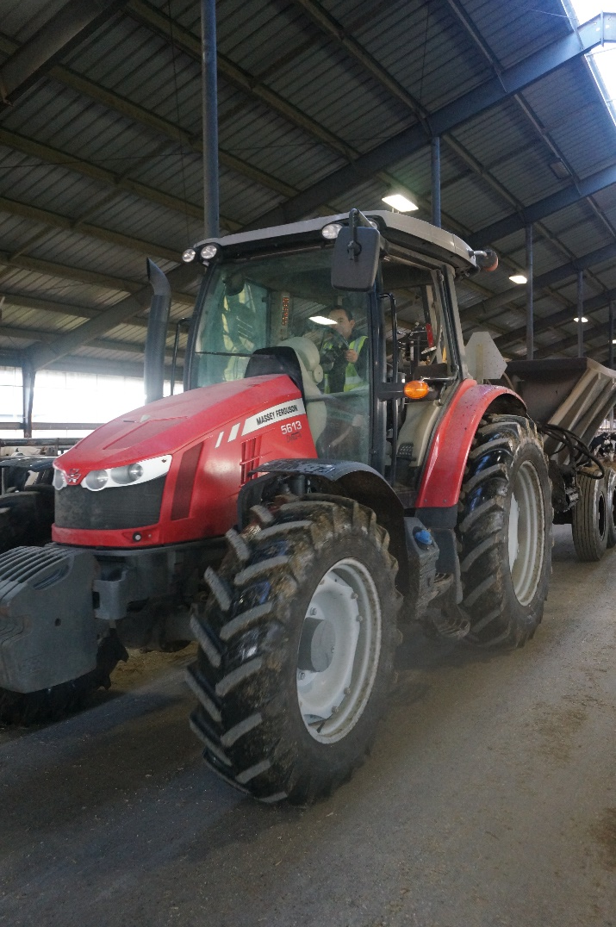
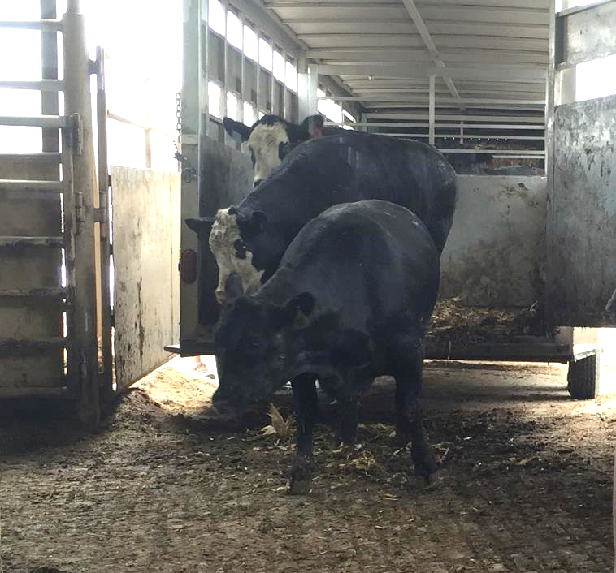
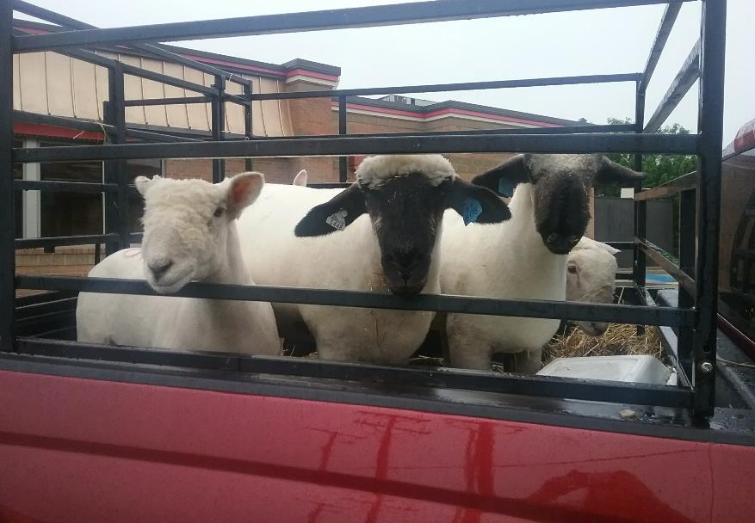
Shared Equipment
Avoid or limit sharing of animal transport vehicles and equipment
Notes:
Limit the sharing of animal transport vehicles (e.g., trailers) and other equipment. If shared, clean and disinfect them between uses.
Photo: tractor, Danelle Bickett-Weddle/Iowa State University; sheep in truck, Amy Powell/Iowa State University Extension; unloading cattle, Renee Dewell/Iowa State University

Slide 14
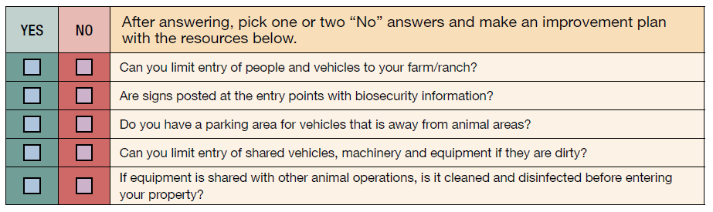
ASSESSMENT CHECKLIST
Notes:
Using the following checklist, determine areas where you are doing well and others that need to improve.
[Read the questions]
After answering, pick one or two “No” answers and make an improvement plan.

Slide 15


Acknowledgments
Development of this material was made possible through a grant provided to the Center for Food Security and Public Health at Iowa State University, College of Veterinary Medicine from the North Central Region Sustainable Agriculture Research and Education, or SARE program of the USDA National Institute of Food and Agriculture, under award number AWD-021794-00001 and project number ENC19-176. USDA is an equal opportunity employer and service provider. Any opinions, findings, conclusions, or recommendations expressed in this publication are those of the author(s) and do not necessarily reflect the view of the USDA. Iowa State University is an equal opportunity provider. For the full non-discrimination statement or accommodation inquiries, go to www.extension.iastate.edu/diversity/ext.
Content was developed and reviewed by veterinarians at CFSPH:
  Glenda Dvorak, DVM, MPH, DACVPM
  Renée Dewell, DVM, MS
  Brandy R. Sobczak, DVM, MPH
Notes:
Development of this material was made possible through a grant provided to the Center for Food Security and Public Health at Iowa State University, College of Veterinary Medicine from the North Central Region Sustainable Agriculture Research and Education, or SARE program of the USDA National Institute of Food and Agriculture, under award number AWD-021794-00001 and project number ENC19-176. USDA is an equal opportunity employer and service provider. Any opinions, findings, conclusions, or recommendations expressed in this publication are those of the author(s) and do not necessarily reflect the view of the USDA. Iowa State University is an equal opportunity provider. For the full non-discrimination statement or accommodation inquiries, go to www.extension.iastate.edu/diversity/ext.
Content was developed and reviewed by veterinarians and staff at CFSPH:
Glenda Dvorak, DVM, MPH, DACVPM
Renée Dewell, DVM, MS
Brandy R. Sobczak, DVM, MPH

