Slide 1
Animal Movements
Biosecurity Basics
Notes:
Biosecurity Basics: Animal Movement
Biosecurity on the farm is an essential step to keeping your animals healthy and starts with a few key actions. This presentation will address biosecurity tips for the movement of animals onto or off of your farm or ranch.

Slide 2
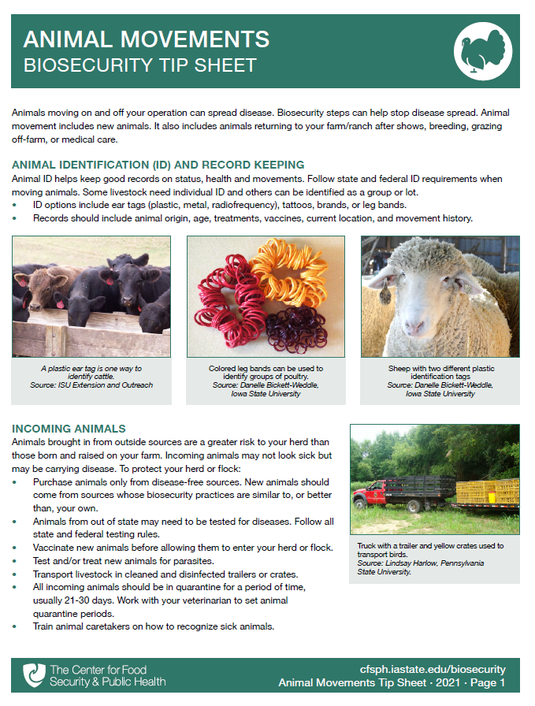

Animal
Movements
Animal identification and record keeping
Incoming animals
Returning animals
Emergency planning
Notes:
Animals moving on and off your operation can introduce disease onto your farm or ranch. Biosecurity steps can help stop disease spread and protect your animals. Key areas to address include animal identification and record keeping, the management of incoming and returning animals, as well as planning the movement of animals during emergency situations. A printable PDF containing the tips presented here is available for free download on the CFSPH website.

Slide 3
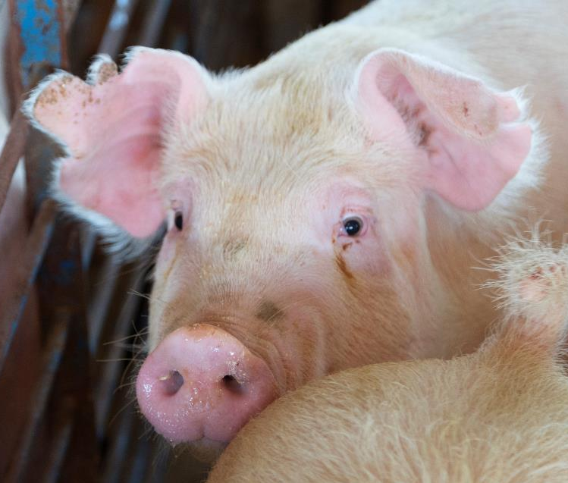
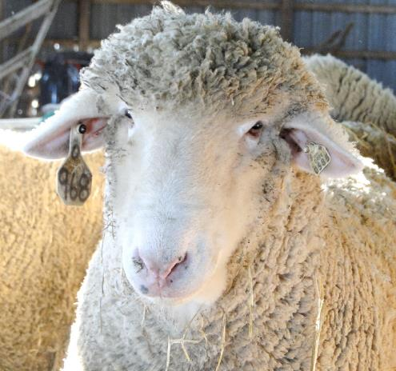
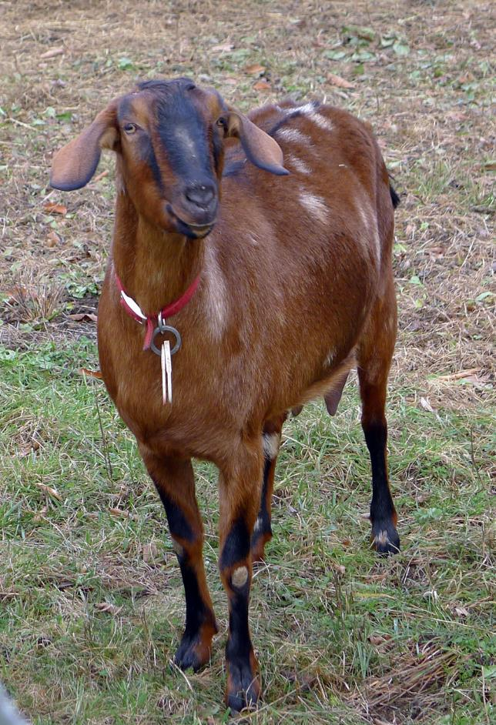
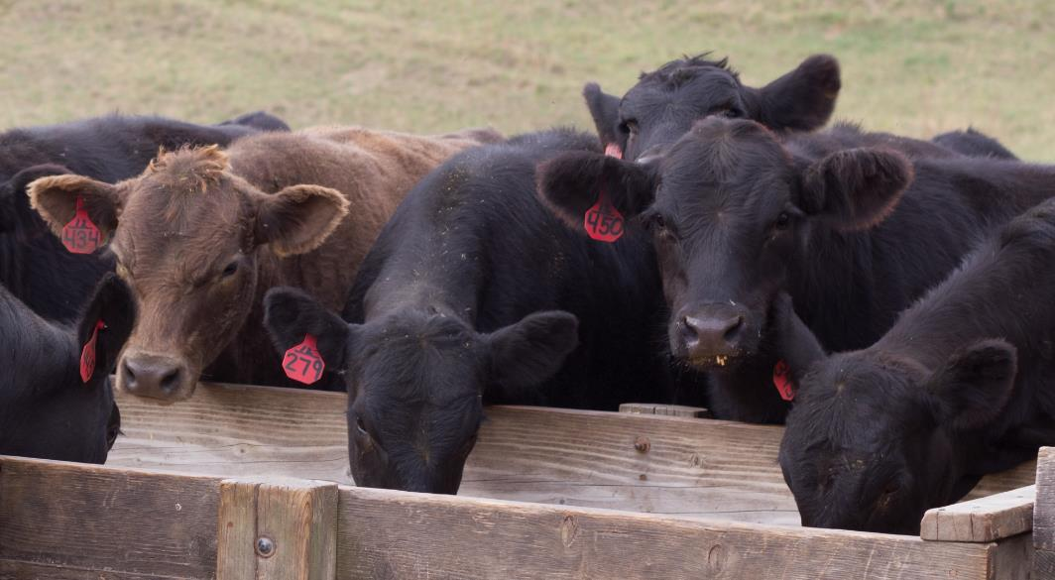
Ear tags
Tattoos
Brands
Neck collars
Leg bands
Animal Identification
Notes:
All livestock need some form of identification to help with record keeping on their status, health and movements. Some livestock need individual identification; others can be identified as a group or lot. Animal identification options may include plastic, metal, or radiofrequency ear tags, collars, tattoos, brands, or leg bands. Follow state and federal identification requirements when moving animals.
Photos: pigs, rawpixel/Flickr, CC BY 2.0; sheep, Danelle Bickett-Weddle/Iowa State University; goat, William Avery Hudson/Flickr, CC BY-NC-ND 2.0; cattle, Iowa State University Extension and Outreach

Slide 4
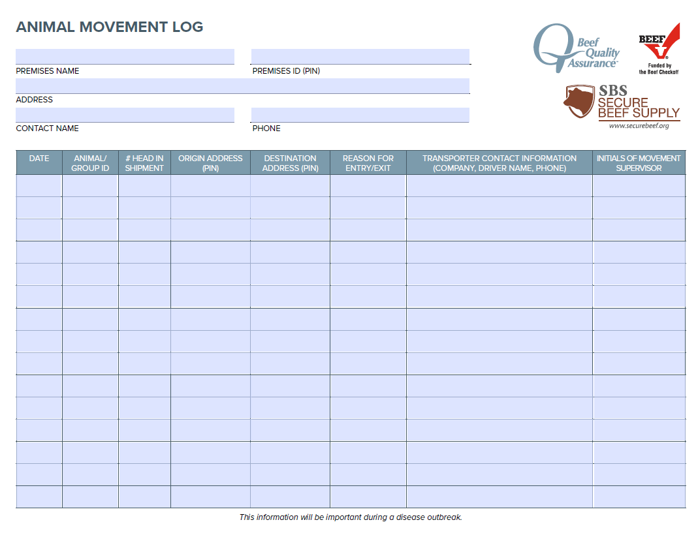
Record Keeping
Animal origin
Health history
Vaccinations
Current location
Movement/
travel history
Notes:
Maintaining good records of your animals helps to monitor animal production and health, and can help to detect disease problems quickly. Animal records should include the animal’s origin, age, health history, vaccination administration, and its current location. Request copies of vaccination and treatment records for all purchased animals. It is also important to document any animal movements and travel history in the event of a disease outbreak. Records can be electronic or on paper, whichever is easiest for you to maintain and keep current.
Photo: Example animal movement log. Secure Beef Supply resources. Center for Food Security and Public Health. https://securebeef.org/beef-producers/forms-and-sops/.

Slide 5
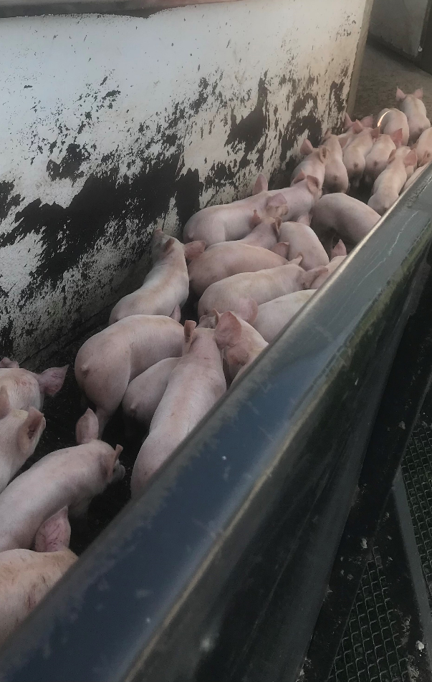
Incoming Animals
Animals brought onto the farm are a greater risk than those born and raised on your farm.
Incoming animals may not look sick but may be carrying disease.
Notes:
Animals brought onto your farm from outside sources are a greater risk to your herd than those born and raised on your farm. Incoming animals may not look sick but may be carrying disease.
Photo: unloading pigs, Renee Dewell/Iowa State University

Slide 6
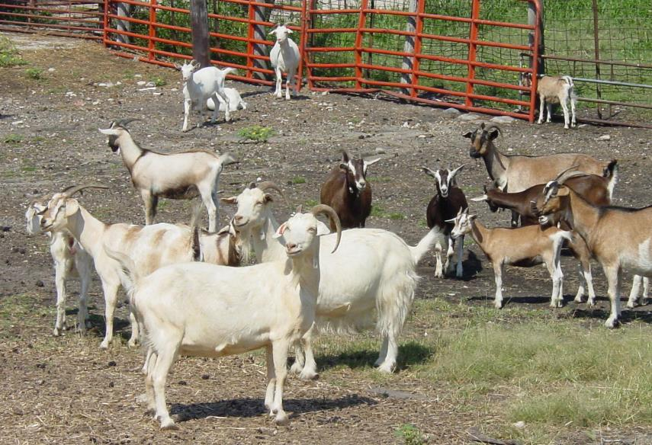
Protect Your Herd/Flock
Purchase from
disease-free sources
with biosecurity practices
Transport livestock
in clean and disinfected trailers or crates
Notes:
To protect your herd or flock:
Purchase animals only from disease-free sources. New animals should come from sources whose biosecurity practices are similar to, or better than, your own.
Transport livestock in clean and disinfected trailers or crates
Photo: goat herd, Danelle Bickett-Weddle/Iowa State University

Slide 7
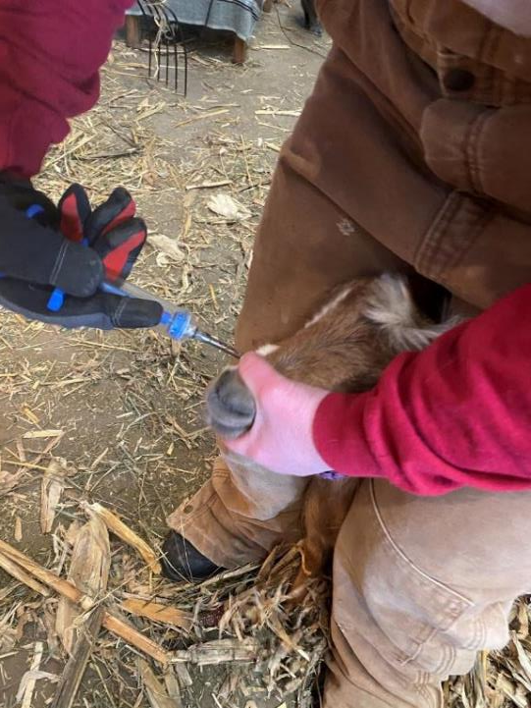
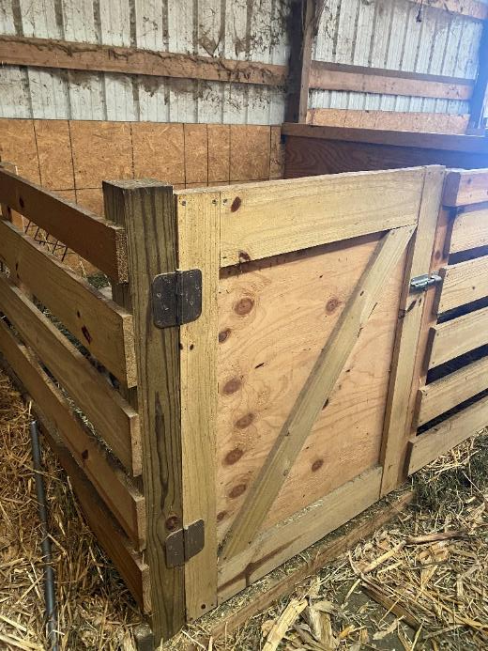
Test, vaccinate, parasite control
Quarantine before adding to herd
Notes:
Test and vaccinate new animals before allowing them to enter your herd or flock.
Animals from out of state may need to be tested for diseases before movement. Follow all state and federal testing rules.
Vaccinate or confirm vaccination status of new animals for key disease for the species. Test and/or treat new animals for parasites.
All incoming animals should be kept in quarantine for a period of time, usually 21-30 days.
Work with your veterinarian to determine vaccination and testing needs and to set animal quarantine periods.
Photos: Deworming a goat and quarantine stall. Renee Dewell/Iowa State University; isolation quarantine stall, Renee Dewell, Iowa State University

Slide 8
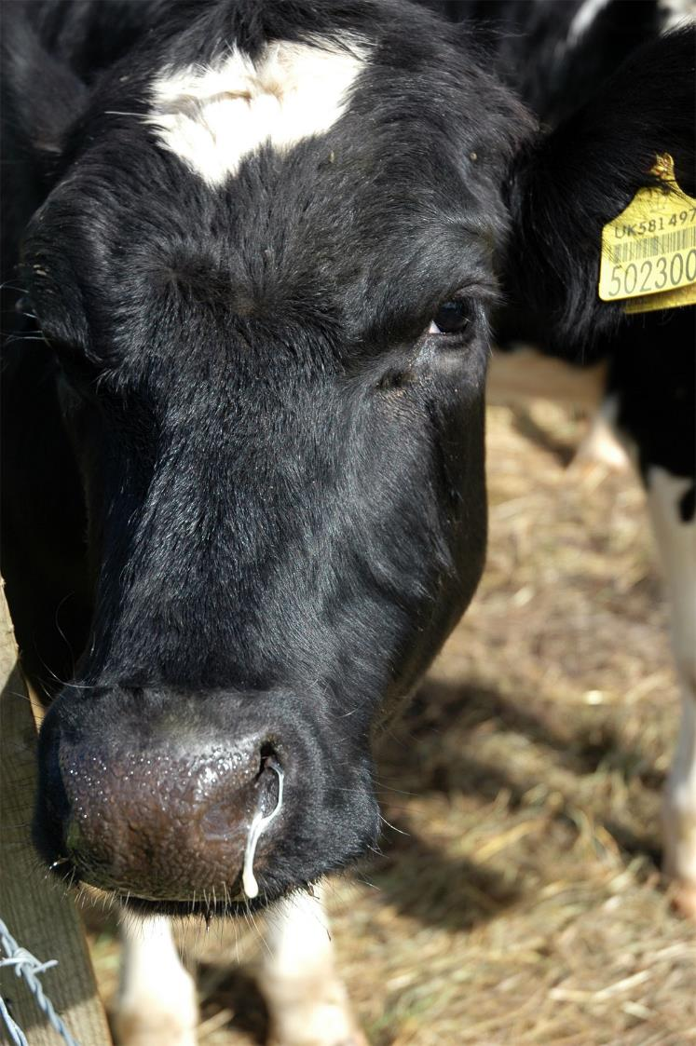
Signs to watch for
Watch for disease
  Reduced feed intake
  Weight loss
  Decreased activity
  Lameness
  Difficulty breathing
  Persistent coughing
  Eye or nasal discharge
  Diarrhea
  Depression
  Abortion
Notes:
Know signs of illness to watch for and train any animal caretakers on how to recognize sick animals. Some examples of signs to look for include reduced feed intake, weight loss, decreased activity, lameness, difficulty breathing, persistent coughing, eye or nasal discharge, diarrhea, depression, and abortion. If these signs are noticed, follow the diagnosis and treatment protocol you have developed with your herd/flock veterinarian or contact your veterinarian, extension or other animal health specialist with concerns.
Photo: Cattle with nasal discharge, Flickr. CC BY 2.0. https://www.flickr.com/photos/88728149@N00/8281964816

Slide 9
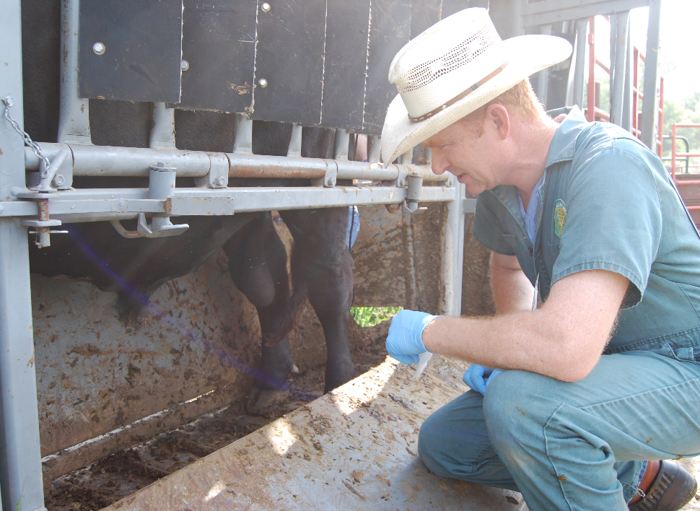
Breeding Animals
Examine and test
Quarantine
Clean and disinfect
shared equipment
Prevent unplanned
mating
Notes:
For breeding animals,
Examine and test breeding animals based on guidance from your veterinarian.
Animals brought in for breeding should also be quarantined for a period of time.
Breeding equipment shared with other farms should be cleaned and disinfected before use.
Prevent unplanned mating with animals from other herds/flocks.
Photo: Aleks/Wikipedia Commons, CC BY-SA 3.0

Slide 10
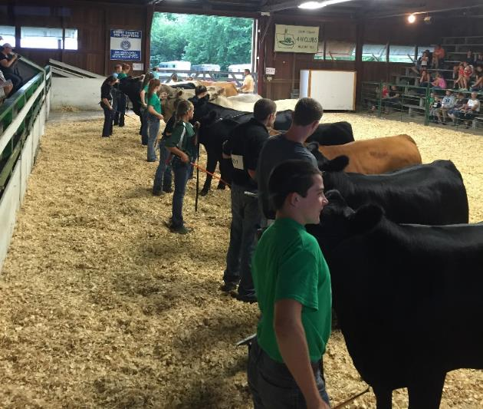
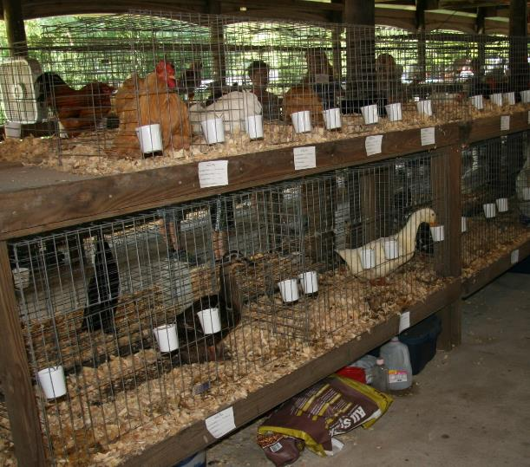
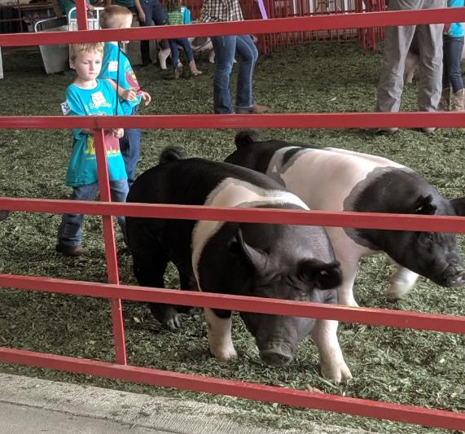
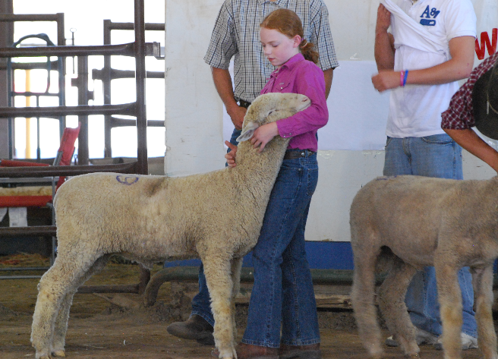
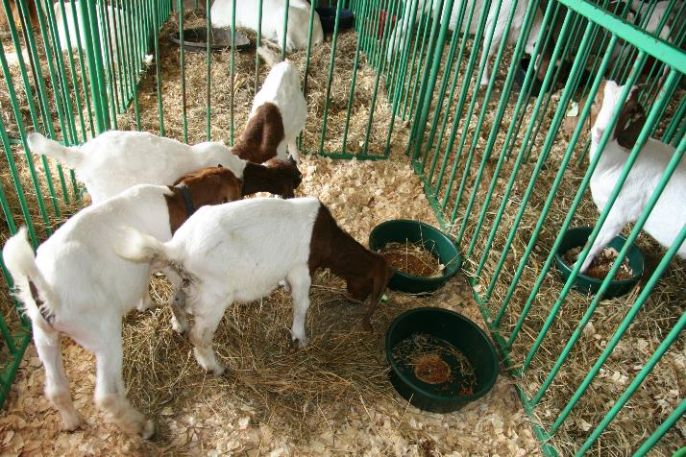
Show Animals
Notes:
Livestock that have left your operation and returned should be quarantined for a period of time, usually 21-30 days. Limit, as much as possible, interactions between animals while at shows. Avoid sharing equipment with animals from other operations. Equipment such as feed or water containers, grooming equipment, leads, or halters can easily spread germs. Make sure that animal housing areas at shows have been cleaned and disinfected before allowing animals to enter.
Photos: kids showing cows at fair, Renee Dewell/Iowa State University; poultry at fair, Brittany Nelson/Iowa State University; kids showing pigs, Abbey Cannon/Iowa State University; girl showing sheep, Renee Dewell/Iowa State University; goats at fair, Brittany Nelson/Iowa State University

Slide 11
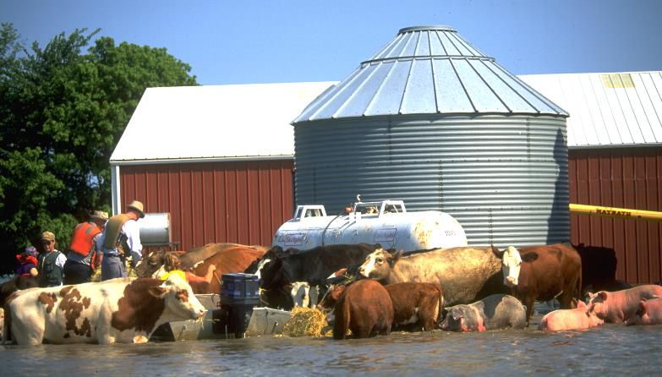
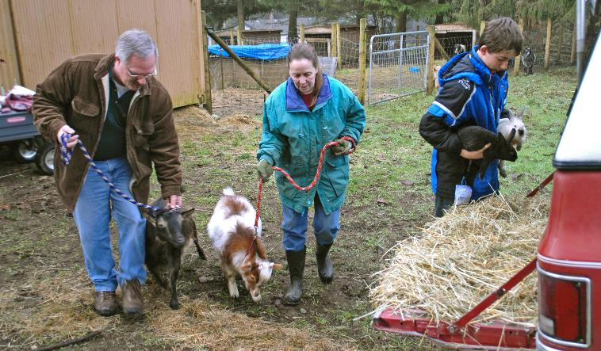
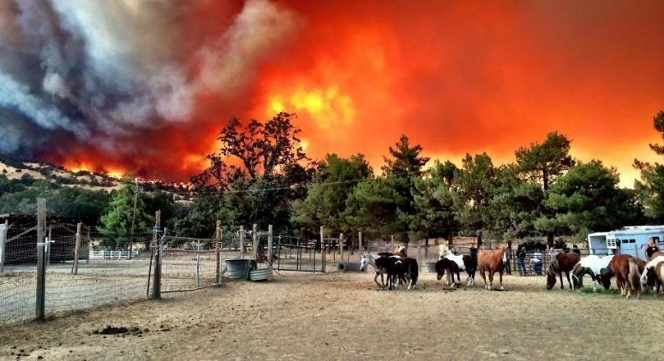
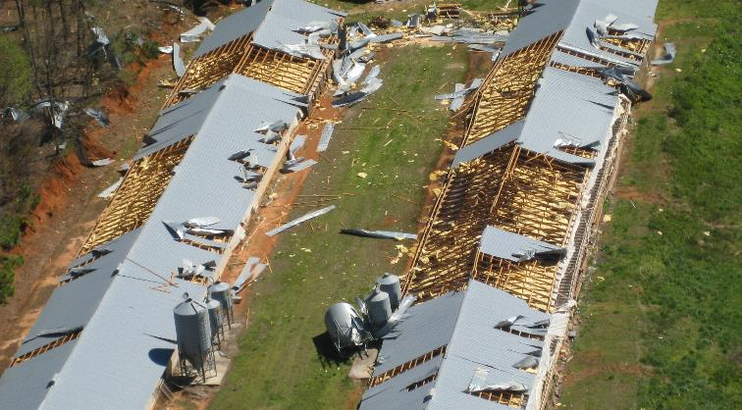
Disasters/Emergencies
Plan ahead for evacuation or disruptions in movement or feed supply
Notes:
Disasters can strike at any time. Emergency situations may require evacuation, or they may prevent the movement of animals or feed. Plan ahead. A written emergency plan can help decrease the impact and speed recovery. Include how you care for animals, move feed, personnel, and other needed items.
Photos: wildfire and horses, Kelly Campbell/SF Gate, with permission; livestock flood rescue, FEMA Photo Library-3408, public domain; tornado damage to poultry barns, NOAA, public domain; evacuating goats, FEMA Photo Library-28323, public domain.

Slide 12
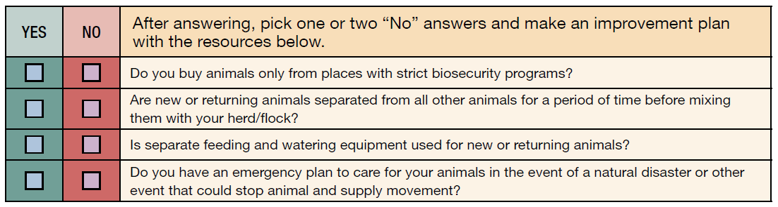
ASSESSMENT CHECKLIST
Notes:
Using the following checklist, determine areas where you are doing well and others that need to improve.
[Read the questions]
After answering, pick one or two “No” answers and make an improvement plan.

Slide 13
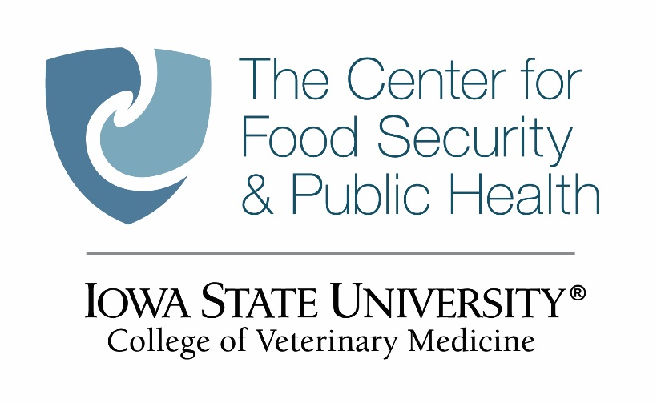

Acknowledgments
Development of this material was made possible through a grant provided to the Center for Food Security and Public Health at Iowa State University, College of Veterinary Medicine from the North Central Region Sustainable Agriculture Research and Education, or SARE program of the USDA National Institute of Food and Agriculture, under award number AWD-021794-00001 and project number ENC19-176. USDA is an equal opportunity employer and service provider. Any opinions, findings, conclusions, or recommendations expressed in this publication are those of the author(s) and do not necessarily reflect the view of the USDA. Iowa State University is an equal opportunity provider. For the full non-discrimination statement or accommodation inquiries, go to www.extension.iastate.edu/diversity/ext.
Content was developed and reviewed by veterinarians at CFSPH:
  Glenda Dvorak, DVM, MPH, DACVPM
  Renée Dewell, DVM, MS
  Brandy R. Sobczak, DVM, MPH
Notes:
Development of this material was made possible through a grant provided to the Center for Food Security and Public Health at Iowa State University, College of Veterinary Medicine from the from the North Central Region Sustainable Agriculture Research and Education, or SARE program of the USDA National Institute of Food and Agriculture, under award number AWD-021794-00001 and project number ENC19-176. USDA is an equal opportunity employer and service provider. Any opinions, findings, conclusions, or recommendations expressed in this publication are those of the author(s) and do not necessarily reflect the view of the USDA. Iowa State University is an equal opportunity provider. For the full non-discrimination statement or accommodation inquiries, go to www.extension.iastate.edu/diversity/ext.
Content was developed and reviewed by veterinarians and staff at CFSPH:
Glenda Dvorak, DVM, MPH, DACVPM
Renée Dewell, DVM, MS
Brandy R. Sobczak, DVM, MPH

