Slide 1
Animal Health and Disease Monitoring
Biosecurity Basics
Notes:
Biosecurity Basics: Animal Health and Disease Monitoring
Biosecurity on your operation is an essential step to keeping animals healthy and starts with a few key steps. This presentation will address one of these biosecurity basics for small-scale producers – animal health and disease monitoring.

Slide 2
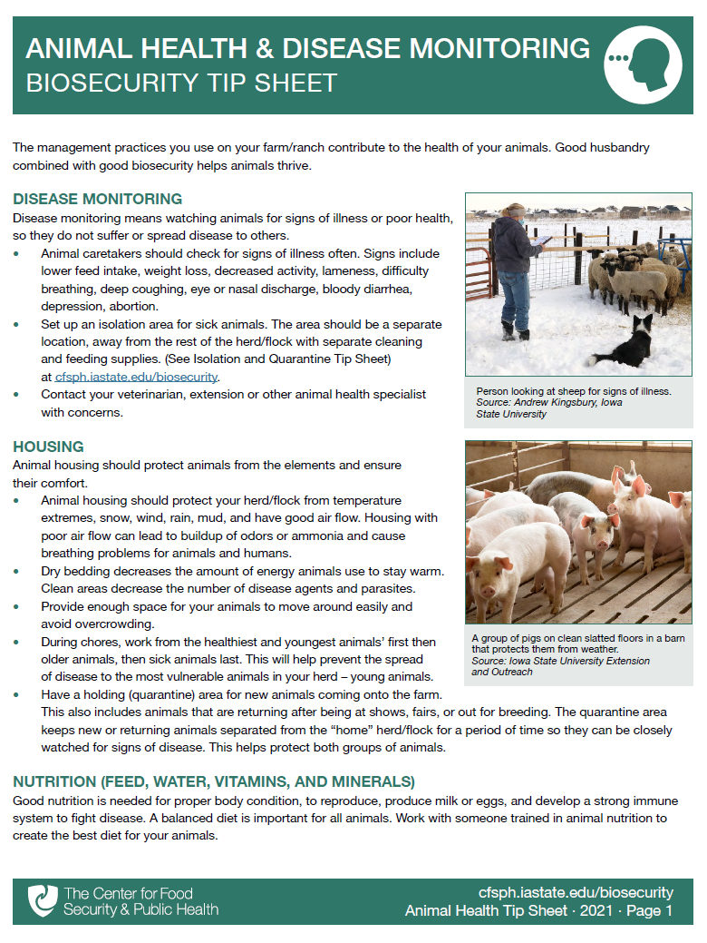

Animal Health and Disease Monitoring
Disease monitoring
Housing
Nutrition
Vaccines and
medical treatments
Parasite control
Prevent stress
in your herd or flock
Notes:
The management practices you use on your farm or ranch contribute to the health of your animals. Good husbandry combined with good biosecurity helps animals thrive.
In this presentation, we will overview important animal health and disease monitoring measures you should take on your farm to protect the health of your animals from disease. These key principles include disease monitoring, housing, nutrition, vaccines and medical treatments, parasite control, and preventing stress in your herd or flock. A printable PDF containing the tips presented here is available for free download on the CFSPH website.

Slide 3
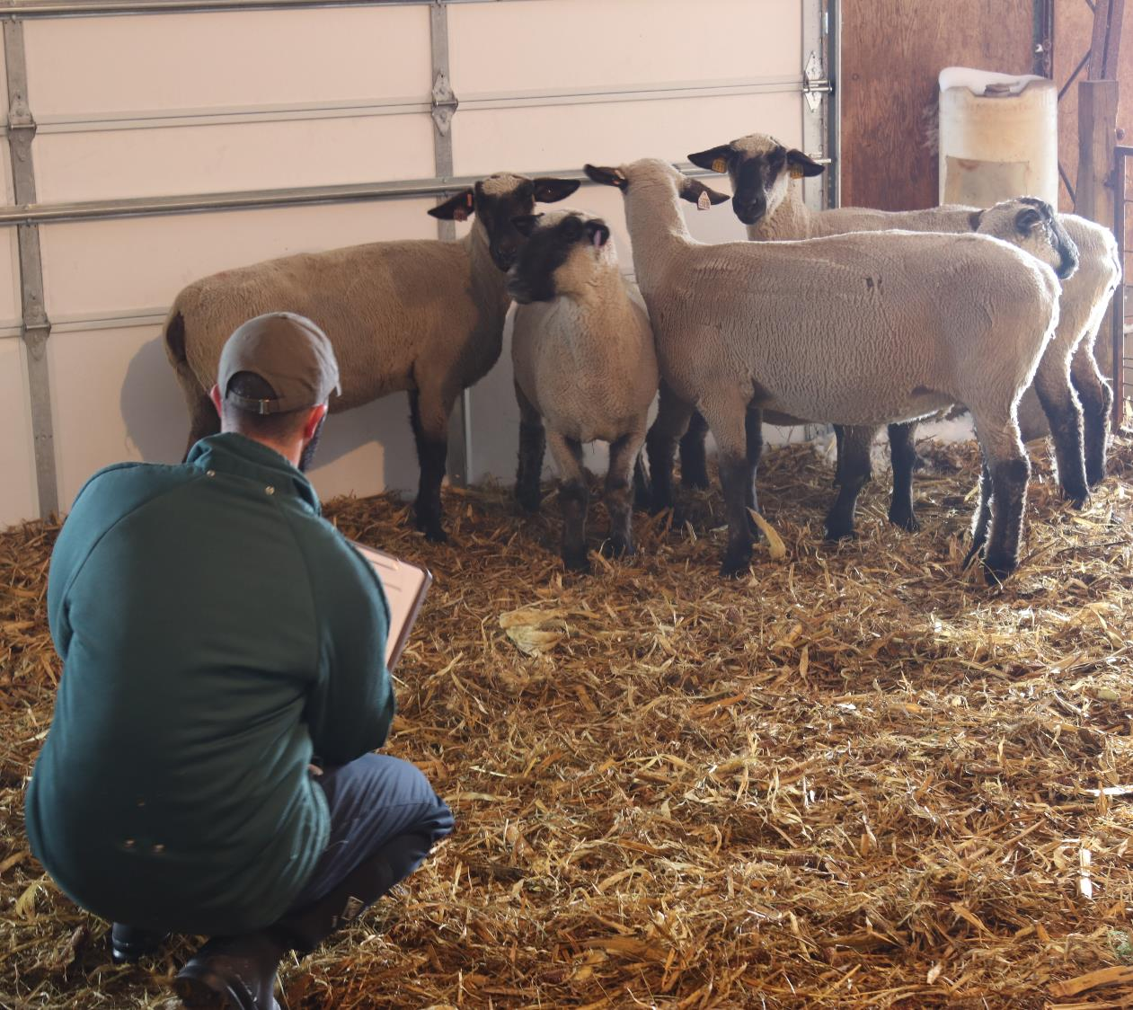
Observe animals for signs of illness or
poor health
Avoid suffering
Avoid spread
of disease
Notes:
Disease monitoring means carefully watching animals for signs of illness or poor health, so they do not suffer or spread disease to others. Animal caretakers should check for signs of illness at least once daily.
Photo: Observing sheep. Andrew Kingsbury/Iowa State University

Slide 4
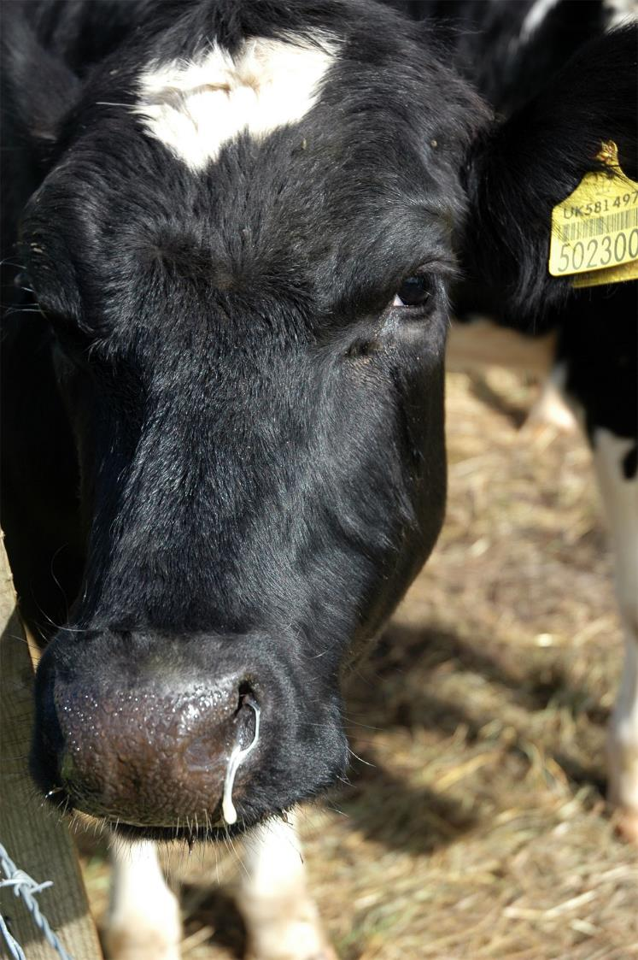
Signs to watch for
  Reduced feed intake
  Weight loss
  Decreased activity
  Lameness
  Difficulty breathing
  Persistent coughing
  Eye or nasal discharge
  Diarrhea
  Depression
  Abortion
If seen, contact your veterinarian
Notes:
Some examples of signs to look for include reduced feed intake, weight loss, decreased activity, lameness, difficulty breathing, persistent coughing, eye or nasal discharge, diarrhea, depression, and abortion. If these signs are noticed, follow the diagnosis and treatment protocol you have developed with your herd/flock veterinarian or contact your veterinarian, extension or other animal health specialist with concerns.
Photo: Cattle with nasal discharge, Flickr. CC BY 2.0. https://www.flickr.com/photos/88728149@N00/8281964816

Slide 5
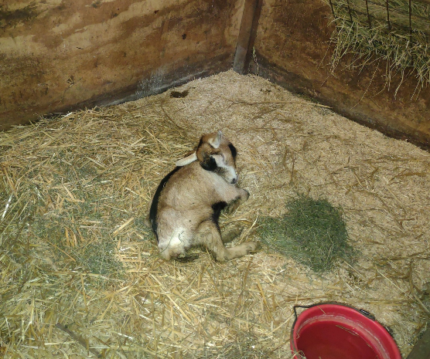
Isolation
House sick animals in an isolated location
Away from herd/flock
Use separate feeding and cleaning equipment
Notes:
Additionally, set up an isolation area for sick animals suspected of having an infectious disease while being treated or until they can be seen by your veterinarian. This will help to prevent disease spread to others in the herd or flock. The isolation area should be a separate location, away from the rest of the herd or flock. It is also important to use separate cleaning and feeding supplies with the isolated animals to avoid spreading any disease to other areas on the farm or to other animals in the herd or flock.
Photo: Goat in quarantine. Jessica Ross.

Slide 6
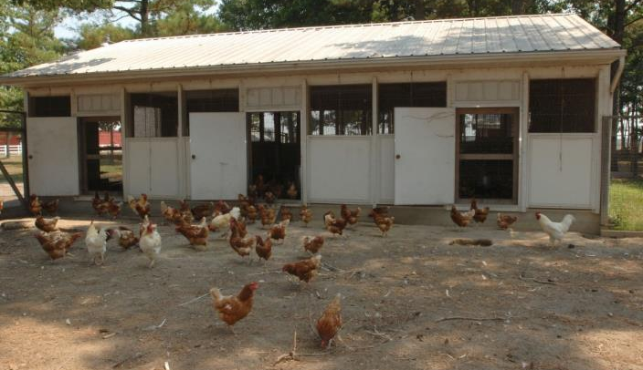
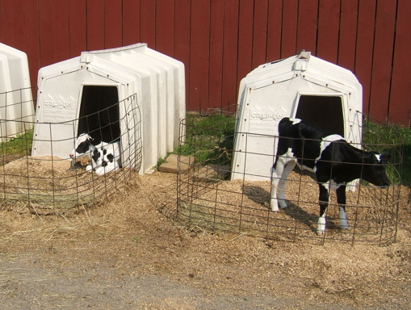
Housing
Protect from temperature extremes and severe weather
Notes:
Animal housing should be comfortable and protect animals from temperature extremes and severe weather, such as snow, wind, rain, and mud. Comfortable and protective housing can reduce animal stress, which in turn can help your animals thrive as well as prevent illness.
Photos: Calf hutches. Benjamin Scott Florin/Flickr, CC BY 2.0; Backyard chickens. USDA APHIS

Slide 7
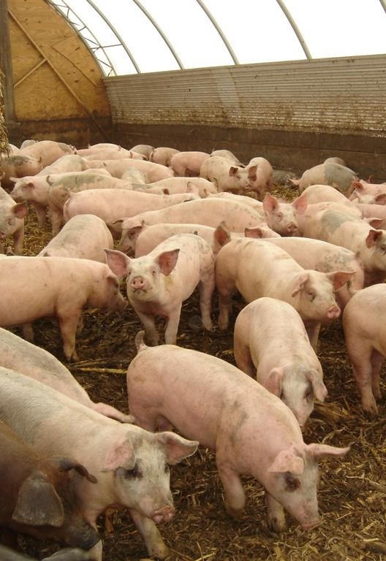
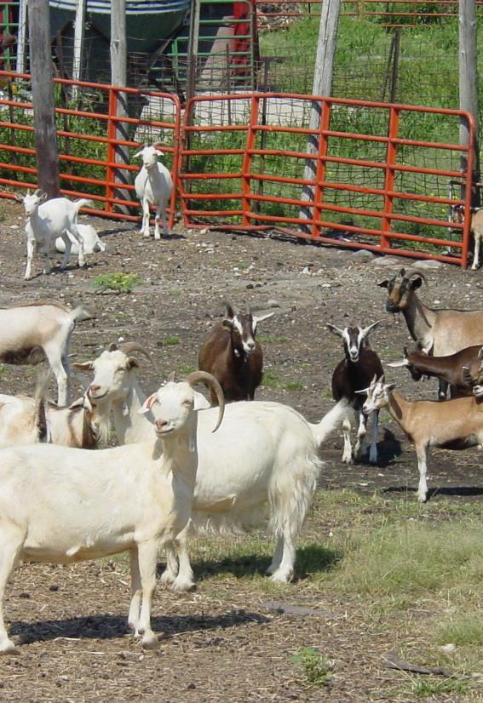
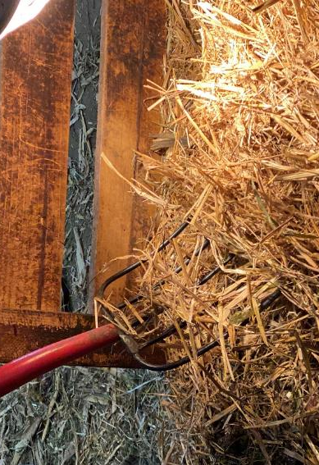
Good Air Flow
Don’t Overcrowd
Dry Bedding
Notes:
Ensure good air flow in animal housing to decrease odor and ammonia buildup, which can cause breathing problems for animals and people. Avoid overcrowding and remove manure often to decrease disease agents and parasites. Providing clean, dry bedding decreases the risk of transmitting certain diseases and lessens the amount of energy animals use to stay warm. Making sure animals have adequate space also decreases disease risk.
Photos: Pigs in indoor pen, Alex Ramirez/Iowa State University; goats, Danelle Bickett-Weddle/Iowa State University; bedding, Renee Dewell/Iowa State University

Slide 8
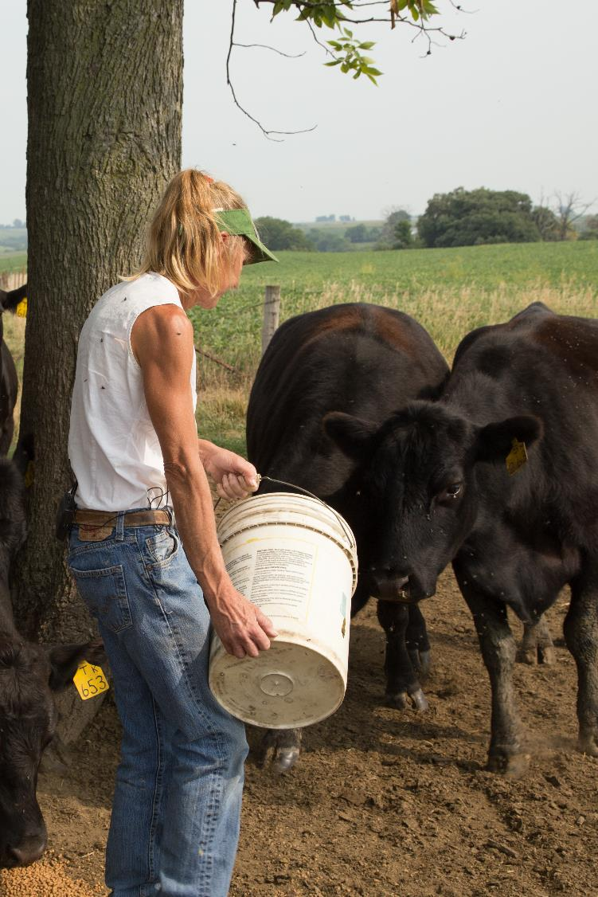
Healthy
When Doing Chores
Young
Older
Sick
Notes:
During chores, work with the healthiest and youngest animals first, then older animals, and sick animals last. This will help prevent the spread of disease to the most vulnerable animals in your herd – young animals.
Photo: feeding cattle, ISU Extension

Slide 9
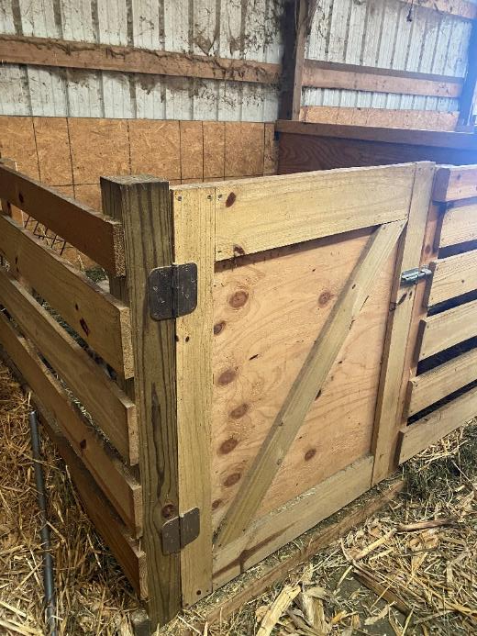
Quarantine Area
New and
returning animals
Quarantine and monitor for
signs of illness
Notes:
Have a holding (quarantine) area for new animals coming onto the farm. This also includes animals that are returning after being at shows, fairs, or out for breeding. The quarantine area keeps new or returning animals separated from the “home” herd/flock for a period of time so they can be closely watched for signs of disease. This helps protect both groups of animals.
Photo: Isolation quarantine stall, Renee Dewell, Iowa State University

Slide 10
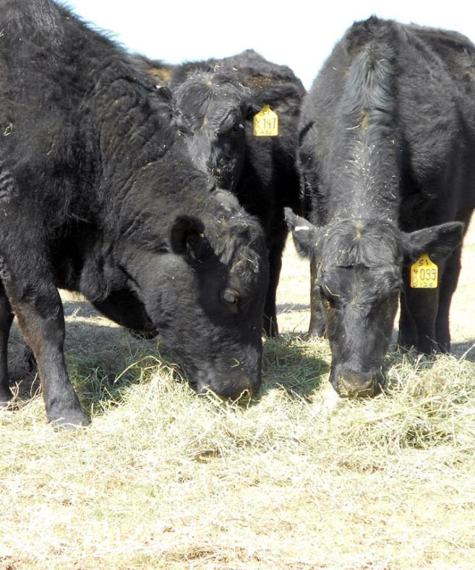
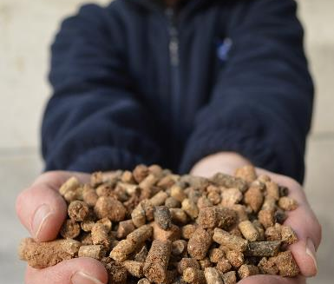
Physical development
Weight gain
Reproduction
Milk or egg yield
Body condition
Strong immune system
Nutrition
feed, water, vitamins, minerals
Notes:
Good nutrition is needed for proper physical development, weight gain, reproduction, milk/egg yield, body condition and the development and maintenance of a strong immune system to fight disease. A balanced diet is important for all animals. Nutritional needs are determined by species, age, health needs and environmental considerations. For example, animals need a diet with higher energy levels in winter compared to summer. Work with someone trained in animal nutrition to create the best diet for your animals.
Photos: Man holding feed. Rural Matters/Flickr, CC BY-NC 2.0; cattle congregating around hay. USDA NRCS Montana/Flickr, public domain; pigs at feeder. A Fagen/Flickr, CC BY-NC-SA 2.0

Slide 11
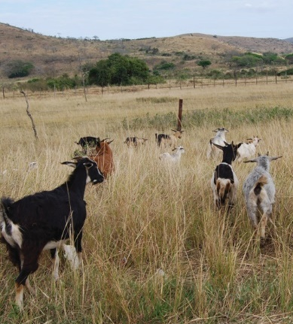
Pastures
Analyze for nutrient value
of forages
Remove poisonous or harmful plants
Notes:
Consider having your pasture analyzed to determine the nutrient value of the forages. Look for and remove poisonous or harmful plants.
Photos: Goats in pasture. Renee Dewell/Iowa State University; cows-4213076_1920_pixabay

Slide 12
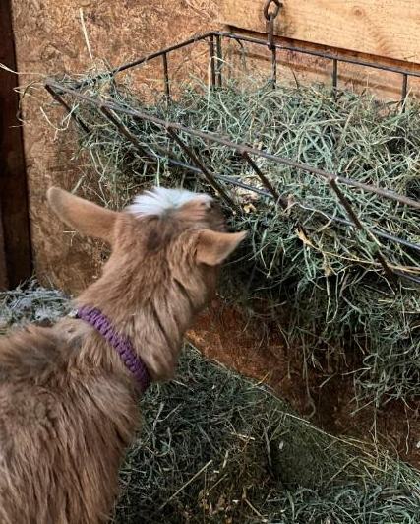
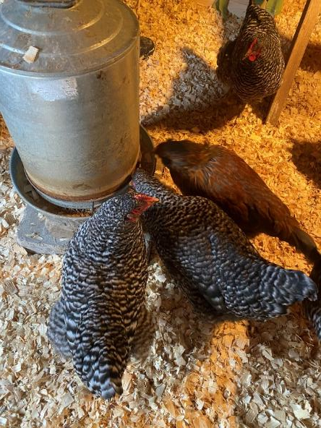
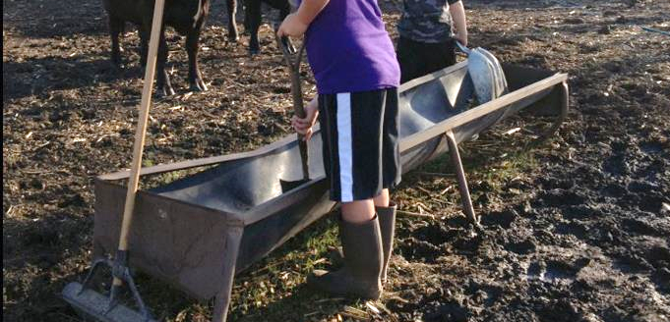
Ensure easy access
For animals to eat
For caretakers to clean
Feeding
Areas
Notes:
Feeding areas should be designed to allow easy access for the animal to eat and for the caretaker to clean. Whenever possible, areas should be kept clean and free of mud and manure. Adequate space for the herd or flock to eat should be provided to avoid overcrowding at feeding areas and problems with some animals not being allowed to eat.
Photos: Cleaning feedbunk, Renee Dewell/Iowa State University; Goat with hay, Renee Dewell/Iowa State University; poultry feeding, Renee Dewell/Iowa State University

Slide 13
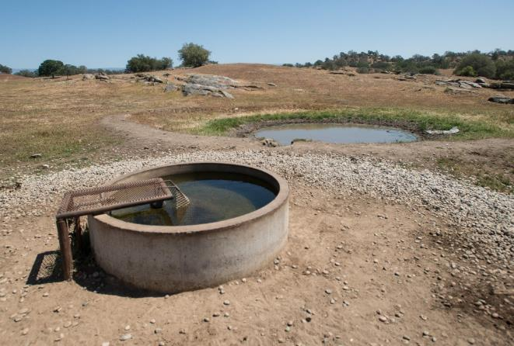
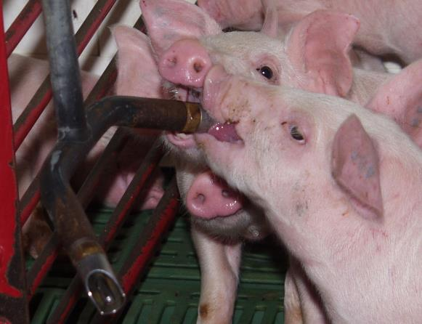
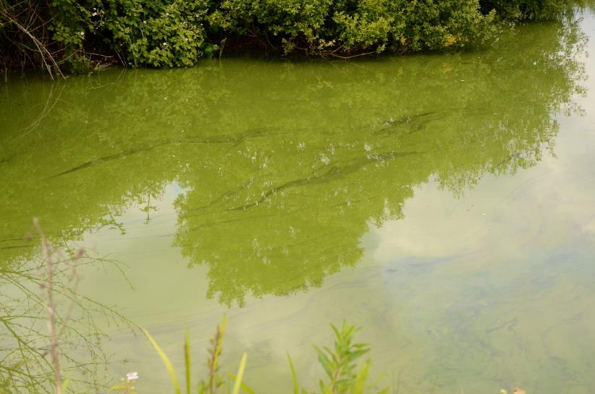
Water
Ensure clean water sources
Test livestock water yearly
Notes:
Fresh water should always be available and easy for animals to access. Ensure animals have clean water or water sources. Consider testing livestock water yearly for pH, presence of blue green algae, total dissolved solids, total soluble salt, mineral and hardness levels, and contaminants such as certain harmful bacteria.
Photos: water trough and pond, USDA/Flickr, CC PDM; automatic pig waterers. Porkcheckoff/Flickr, CC BY-NC-ND 2.0; blue-green algae, Roger Bunting/Flickr,, CC BY-NC-ND 2.0

Slide 14
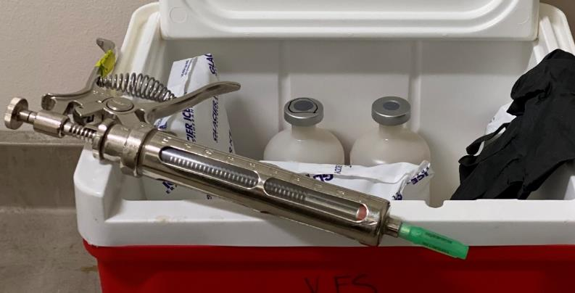
Vaccines and Medical Treatments
Work with your veterinarian on effective disease prevention and treatment plan
Notes:
Vaccines can help prevent common diseases. When animals get sick, medical treatments may help them recover. Work with your veterinarian to set up an effective disease prevention and treatment plan for your herd or flock.
Photo: Syringe and medication. Renee Dewell, Iowa State University

Slide 15
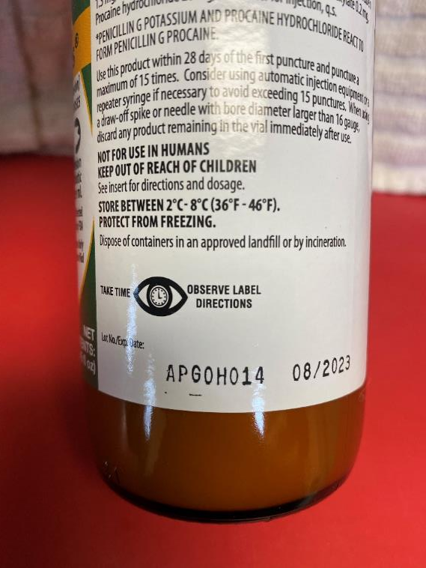
Vaccines and Medical Treatments
Follow label directions
  Storage
  Administration
  Withdrawal times for meat, milk or eggs
Notes:
Follow label directions for giving and storing vaccines and medicines. All food animals should be injected according to their species-specific Quality Assurance Programs (e.g., beef, pork, goats, or sheep). Follow drug label directions for meat, milk, and egg withdrawal times.
Photo: Medicine bottle. Renee Dewell, Iowa State University

Slide 16
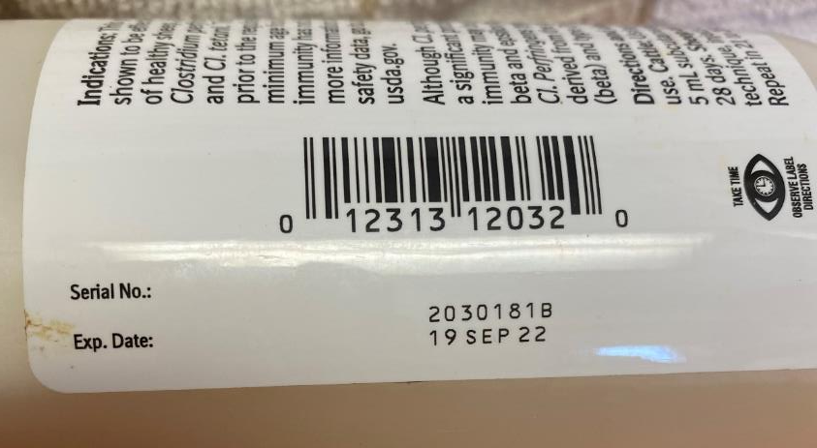
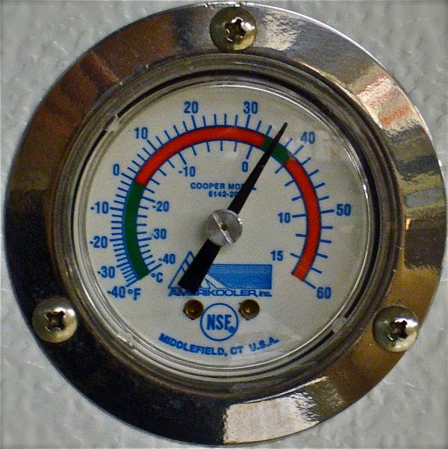
Vaccines and Medical Treatments
Check expiration dates
Store at correct temperature
(36-46 ºF)
Notes:
Check expiration dates. Circle or mark the expiration date on bottles and packages as a reminder.
Store vaccines and medicines at the correct temperature. Refrigerated items should be kept between 36-46ºF. Keep a thermometer in your refrigerator to allow for easy checking.
Throw out products if the temperature becomes too hot or too cold.
Photos: Expiration date and lot. Renee Dewell/Iowa State University; Fridge thermometer. Julia Manzerova/Flickr, CC BY-NC-SA 2.0; Vaccine refrigerator. Dancing Lemur/Flickr, CC BY-NC 2.0

Slide 17
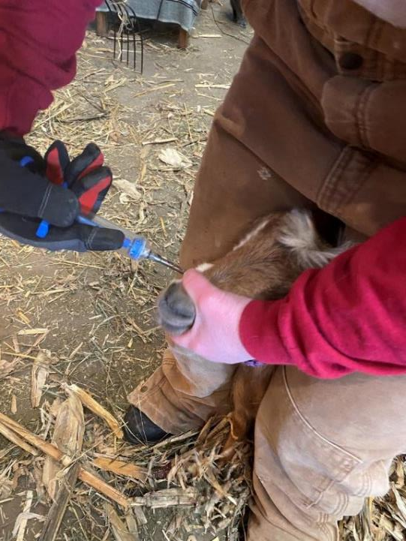
Parasite Control
Parasite Control
Parasites may slow growth and reduce ability to fight disease
Work with your veterinarian to develop effective plan
Notes:
Parasites (such as intestinal worms, or external parasites found on skin or hair ) may slow animal growth and reduce their ability to fight off other diseases. Each animal species has different parasite concerns and require different treatments. Work with your veterinarian to develop a parasite prevention and treatment plan for your herd or flock.
Photo: Deworming a goat. Renee Dewell/Iowa State University

Slide 18
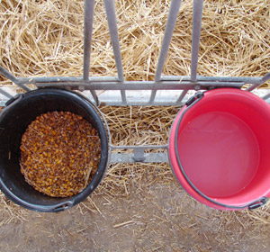
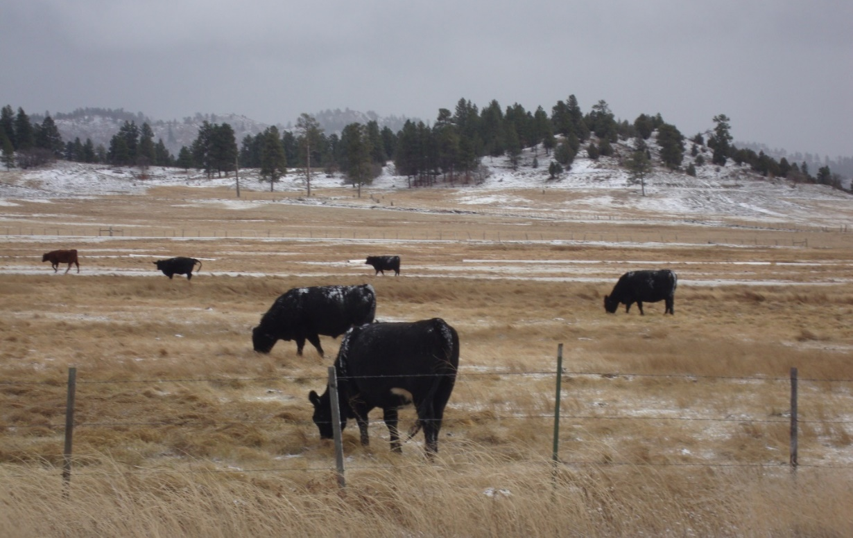
Parasite Control
Keep feed off the ground
Keep animal areas clean
Pasture management
Test fecal samples
Notes:
Reduce the risk of animals ingesting parasites in the environment by using feed containers instead of ground-feeding.
Keep animal areas clean to reduce manure buildup. Many parasites are shed in feces.
Rotate pastures used for grazing to prevent manure and parasite buildup. Allow younger animals to graze cleaner pastures.
Test fecal samples to see how well your deworming program is working.
Photo: Raised feed and water buckets, Danelle Bickett-Weddle; cows grazing. Renee Dewell/Iowa State University

Slide 19
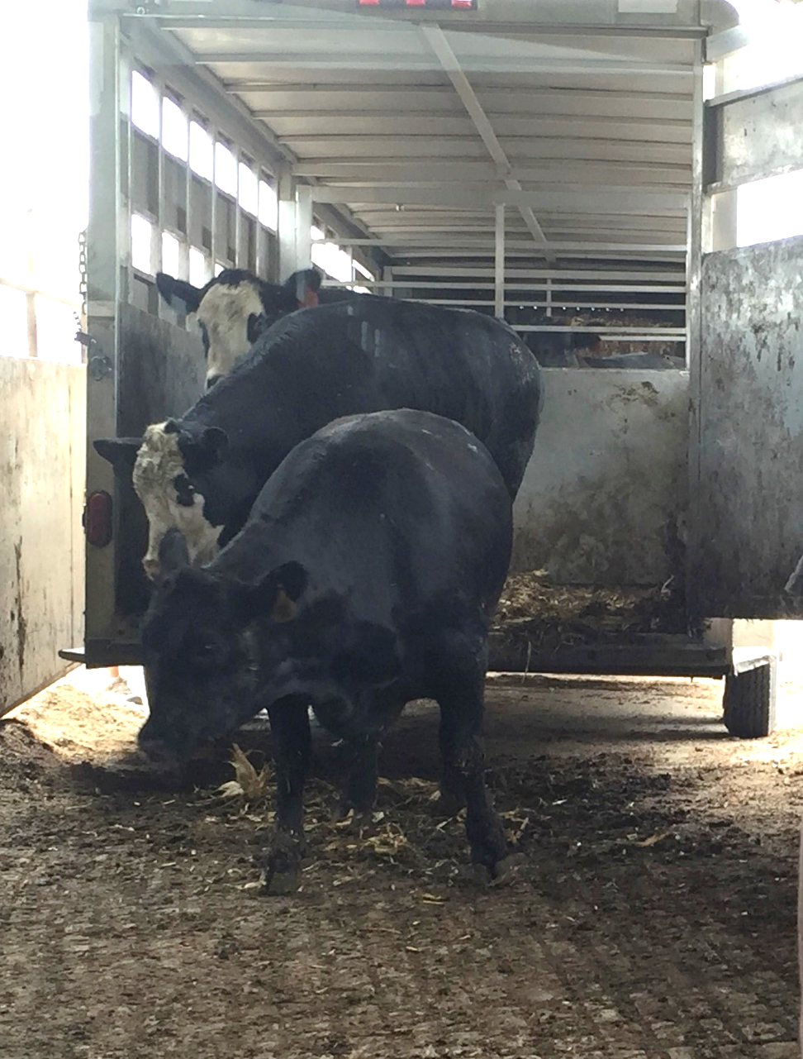
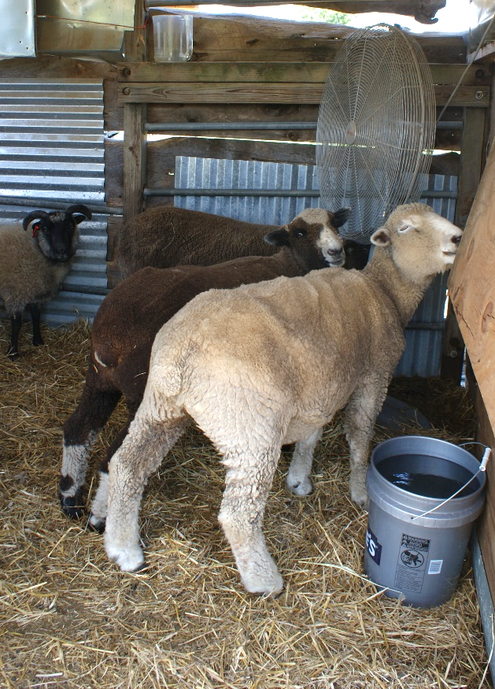
Prevent Stress in the Herd/Flock
Stress affects the immune system and feed intake
Common stressors
  Transportation
  High stocking density
  Improper handling
  Extreme temperatures
Notes:
Stress can have negative effects on animals including changes in the immune system and decreased feed intake, which can increase the chance of disease.
Common causes of stress in livestock and poultry include transportation, new housing, increased stocking densities, stressful/improper handling, and extreme temperatures.
When transporting animals, consider the time of day and number of animals being moved to avoid temperature extremes and over-crowding. Drivers should follow good handling practices during transport and avoid fast starts, stops, or turns. Slow, steady movements are best.
Photo: Cattle unloading from trailer, Renee Dewell/Iowa State University; fans on sheep, Flickr, CC BY-NC-SA 2.0

Slide 20
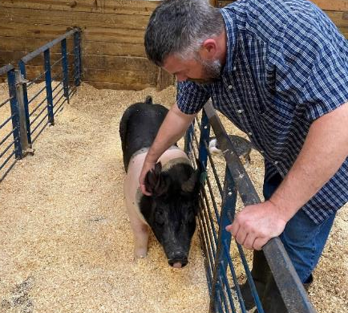
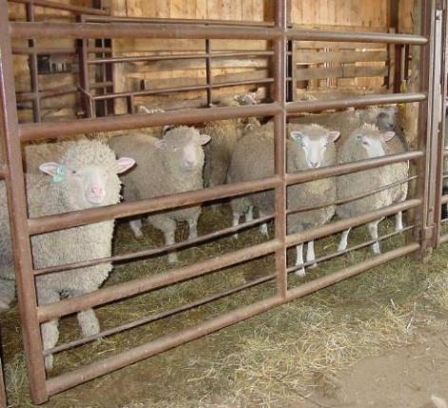
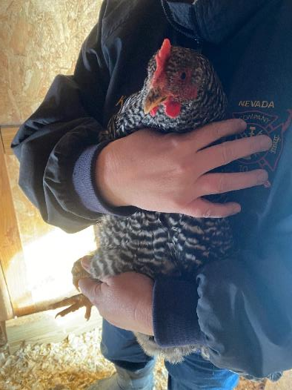
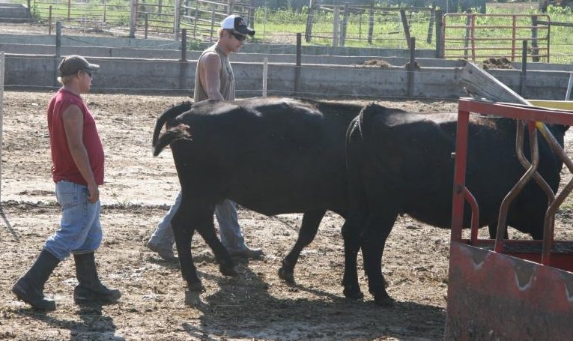
Proper handling
Calm, patient movements
Proper restraint devices
Prevent Stress
Notes:
Animal caretakers should follow good animal handling practices which consider the natural behavior of the animal and include patience, proper use of animal handling and restraint devices, safe handling of aggressive or easily excited animals, moving animals in a calm, quiet manner.
First experiences with corrals, chutes, and equipment should be quiet and controlled to prevent fearful memories. Make practice runs to allow animals to adjust to their surroundings. Work quietly, slowly, and use the animals’ flight zone to calmly move them.
Do not use dogs to work animals in tightly confined areas. Dogs that chase or nip at livestock can induce stress.
Try to keep animals calm before and during breeding. Poor handling before artificial insemination can lower conception rates.
Photos: Moving cattle, Danelle Bickett-Weddle/Iowa State University; Sheep in pen, Danelle Bickett-Weddle/Iowa State University; pig in pen, Renee Dewell, Holding chicken, Renee Dewell/Iowa State University

Slide 21
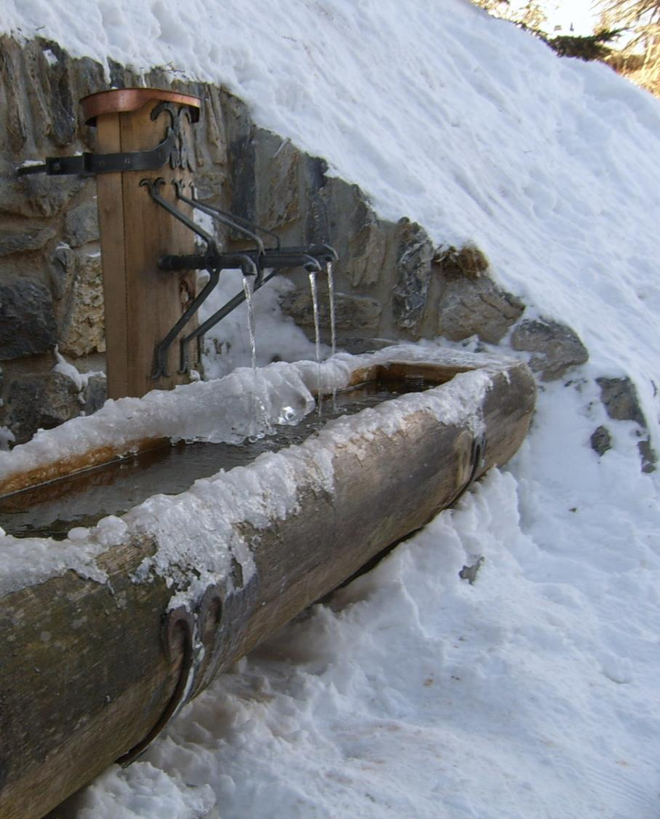
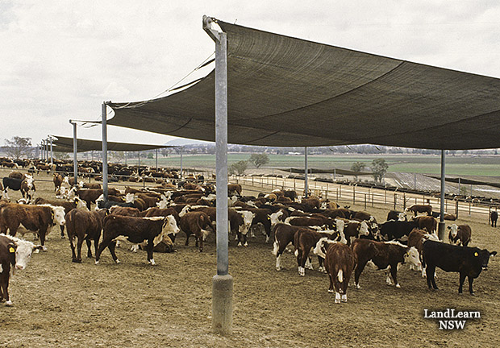
Prevent Stress
  Extra water and shade for high heat
  Wind breaks/protection in winter
  Heaters for animals kept indoors
Notes:
Offer extra water and shade during times of high heat. Ensure good air movement for animals housed indoors. Move animals in the early morning to minimize heat stress.
During extreme cold, water needs to be free of ice. Water heating devices may be necessary. Wind breaks may be needed for protection in winter, but should be removed during the summer to allow for better air flow.
Make sure heaters work well and safely for indoor raised animals.
Photos: water trough in winter, Flickr, CC BY 2.0; cattle under shade, NSW Schools, CC BY-NC-SA 2.0.

Slide 22
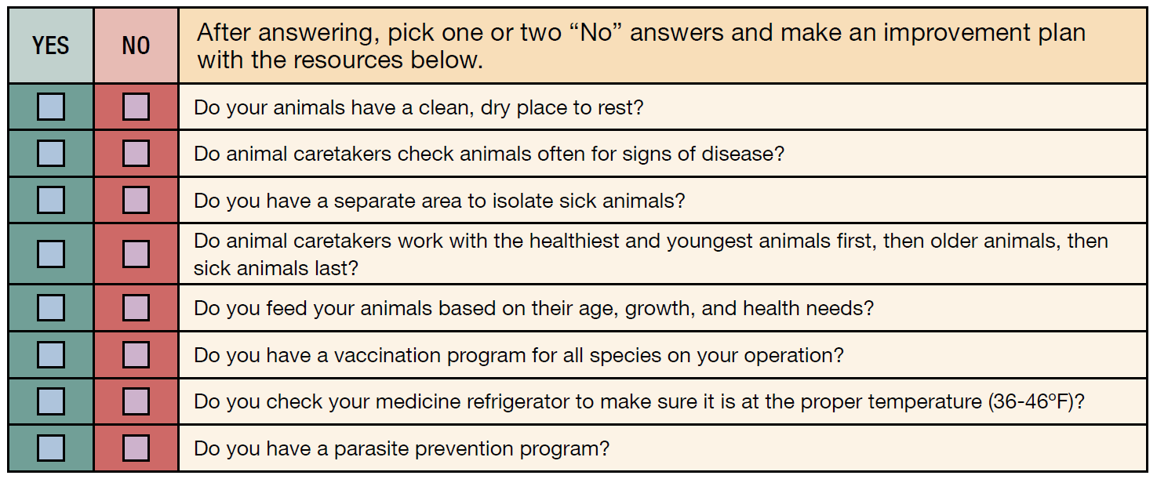
ASSESSMENT CHECKLIST
Notes:
Using the following checklist, determine areas where you are doing well and others that need to improve.
[Read the questions]
After answering, pick one or two “No” answers and make an improvement plan.

Slide 23
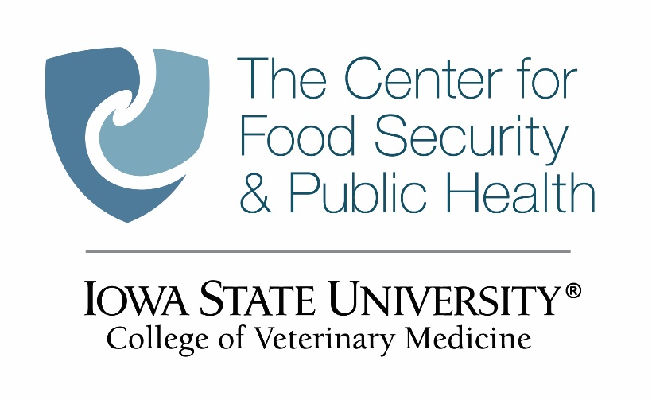

Acknowledgments
Development of this material was made possible through a grant provided to the Center for Food Security and Public Health at Iowa State University, College of Veterinary Medicine from the North Central Region Sustainable Agriculture Research and Education, or SARE program of the USDA National Institute of Food and Agriculture, under award number AWD-021794-00001 and project number ENC19-176. USDA is an equal opportunity employer and service provider. Any opinions, findings, conclusions, or recommendations expressed in this publication are those of the author(s) and do not necessarily reflect the view of the USDA. Iowa State University is an equal opportunity provider. For the full non-discrimination statement or accommodation inquiries, go to www.extension.iastate.edu/diversity/ext.
Content was developed and reviewed by veterinarians at CFSPH:
  Glenda Dvorak, DVM, MPH, DACVPM
  Renée Dewell, DVM, MS
  Brandy R. Sobczak, DVM, MPH
Notes:
Development of this material was made possible through a grant provided to the Center for Food Security and Public Health at Iowa State University, College of Veterinary Medicine from the from the North Central Region Sustainable Agriculture Research and Education, or SARE program of the USDA National Institute of Food and Agriculture, under award number AWD-021794-00001 and project number ENC19-176. USDA is an equal opportunity employer and service provider. Any opinions, findings, conclusions, or recommendations expressed in this publication are those of the author(s) and do not necessarily reflect the view of the USDA. Iowa State University is an equal opportunity provider. For the full non-discrimination statement or accommodation inquiries, go to www.extension.iastate.edu/diversity/ext.
Content was developed and reviewed by veterinarians and staff at CFSPH:
Glenda Dvorak, DVM, MPH, DACVPM
Renée Dewell, DVM, MS
Brandy R. Sobczak, DVM, MPH

