Slide 1
Agritourism
Biosecurity Basics
Notes:
Biosecurity Basics: Agritourism
Biosecurity on the farm is an essential step to keeping your animals healthy and starts with a few key actions. This presentation will address biosecurity tips for operations that have public visitors.

Slide 2
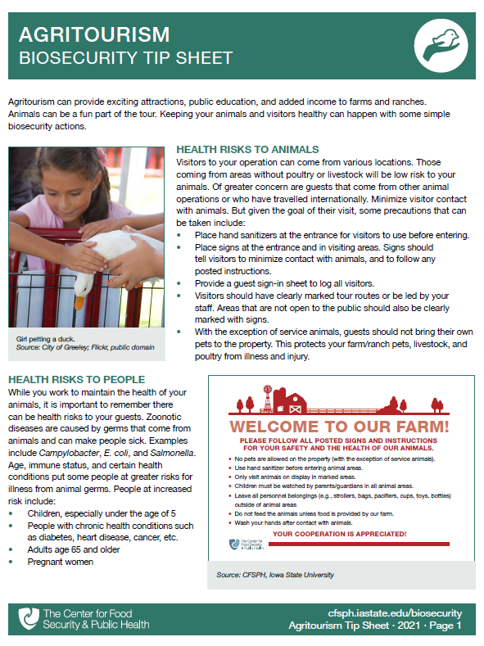
Agritourism
Health Risks to Animals
Health Risks to People
Public Interaction with Animals
Hand Washing Stations
Food Sales
Notes:
Agritourism can provide exciting attractions, public education, and added income to farms and ranches. Animals can be a fun part of the tour. Keeping your animals and visitors healthy can happen with some simple biosecurity actions. Key areas to address are health risks to animals as well as health risk to those visiting, prevention practices when public interaction with the animals is allowed, as well as the importance of hand washing stations in or near animals areas and food locations. A printable PDF containing the tips presented here is available for free download on the CFSPH website.

Slide 3
Health Risks to Animals
Notes:
First let’s look at health risks to animals

Slide 4
People Who Visit
Lower risk
Healthy individuals with no livestock or poultry
Higher risk
Have livestock or poultry
Have travelled internationally
Have health issues
Notes:
Visitors to your operation can come from various locations. Healthy individuals coming from areas without poultry or livestock will be lower risk to your animals. Of greater concern are guests that come from other animal operations, have recently travelled internationally, or who have health issues, such as compromised immune systems.
Photo: Agritourism. Danelle Bickett-Weddle/Iowa State University.

Slide 5
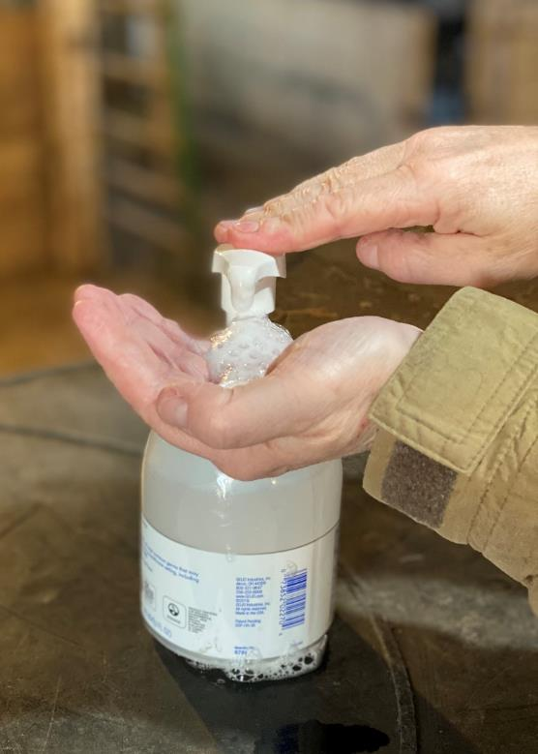
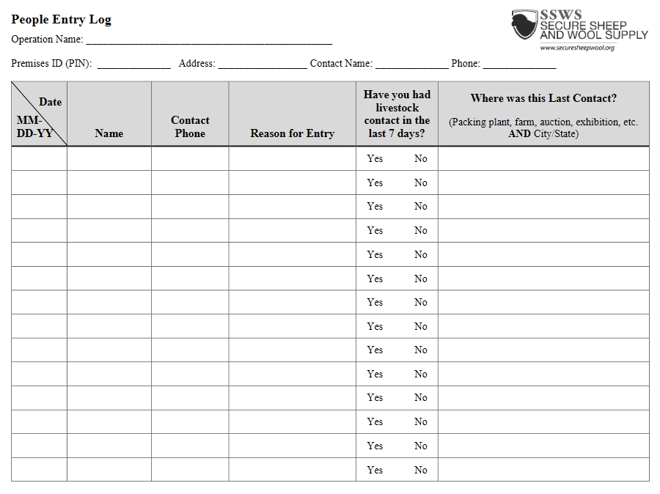
Prevent Health Risks to Animals
Hand sanitizers
Guest sign-in
Notes:
Although minimizing visitor contact with animals would result in the lowest risk, it is not feasible for most agritourism businesses. For agritourism operations that include animal interactions, some precautions that can be taken include:
Provide a guest sign-in sheet to log all visitors.
Place hand sanitizers at the entrance for visitors to use before entering.
Photos: Hand sanitizer. Renee Dewell/Iowa State University; Sign in sheet. Center for Food Security and Public Health.

Slide 6
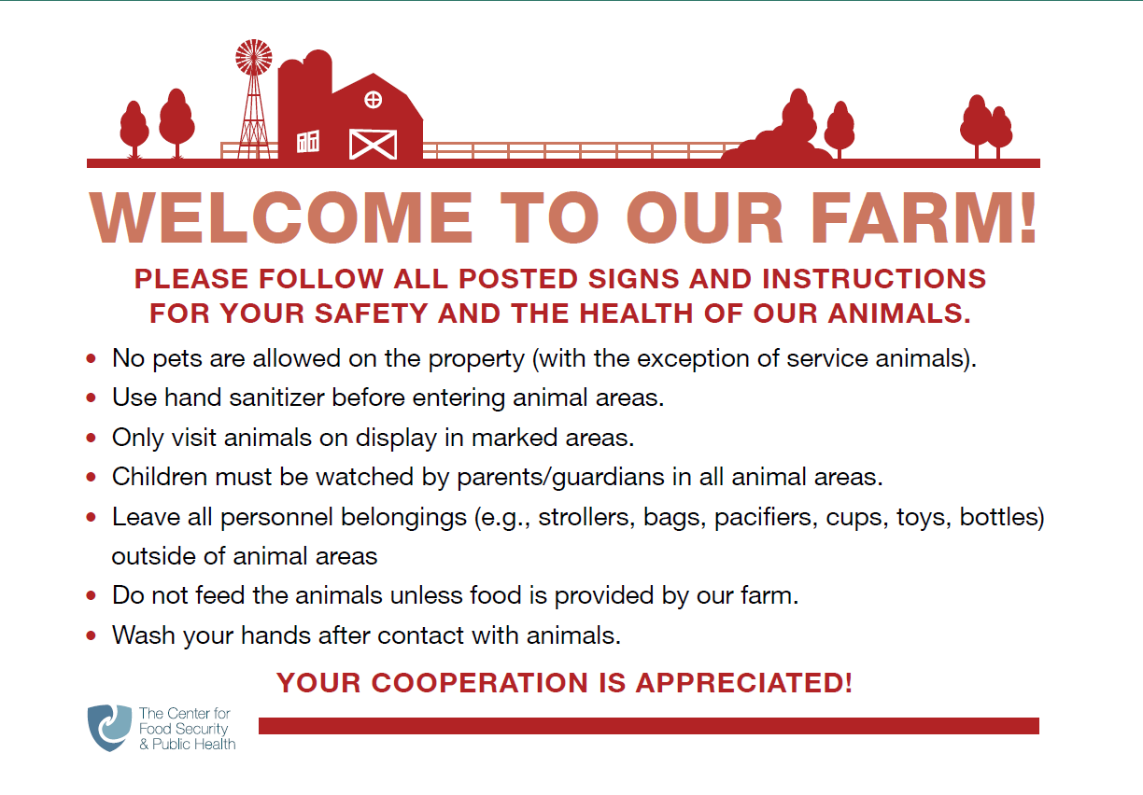
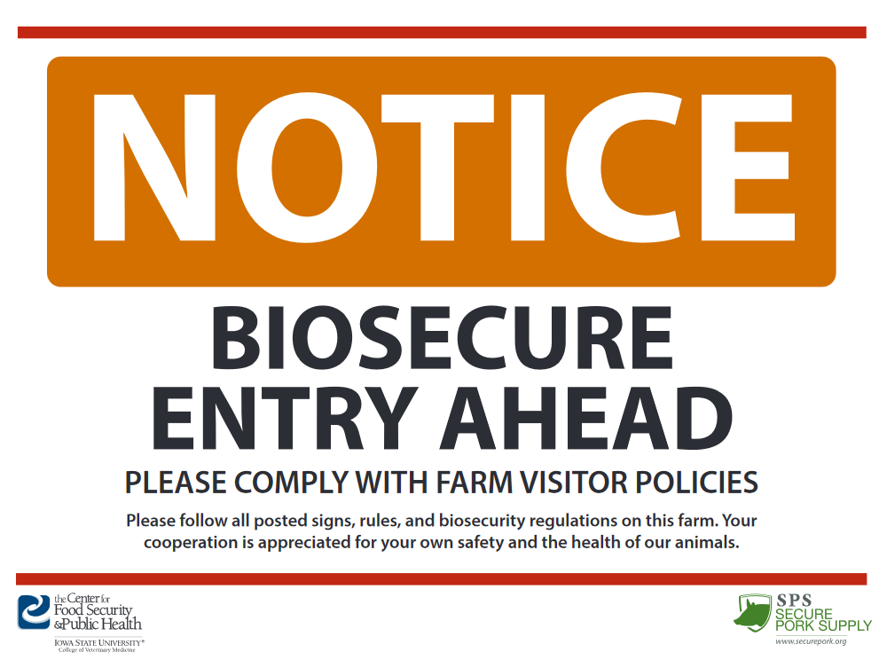
Post Signs at the entrance and in visiting areas
Notes:
Place signs at the entrance and in visiting areas. Signs should provide farm instructions to visitors, such as directing them to wash hands following contact with animals. Areas that are not open to the public should also be clearly marked with signs.
Signs: Center for Food Security and Public Health, Iowa State University

Slide 7
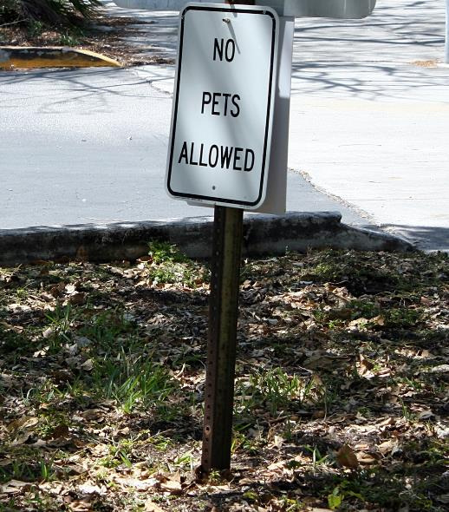
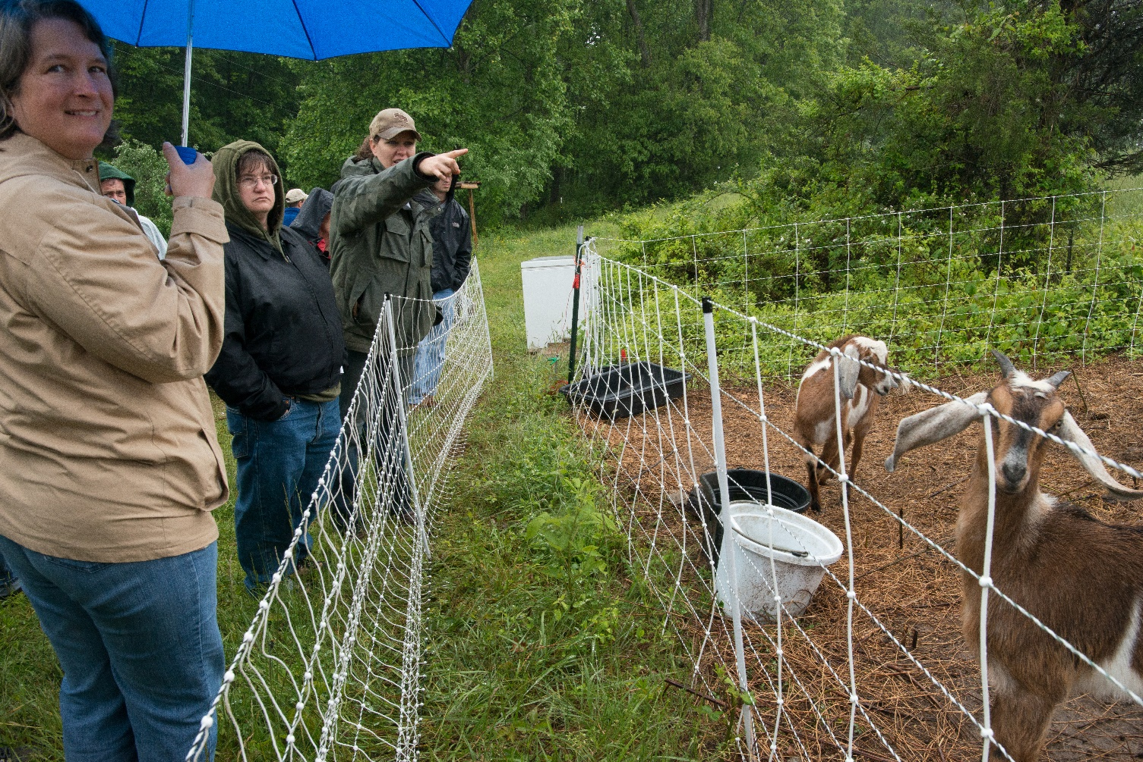
Mark tour routes or have guides
Keep pets at home
Notes:
Visitors should have clearly marked tour routes or be led by your staff. With the exception of service animals, guests should not bring their own pets to the property. This protects the animals on your farm or ranch from potential illness or unintended injury.
Photos: Tour guide with goats. USDA/Flickr, CC PDM 1.0; No Pets Allowed sign. Marit & Toomas Hinnosaar/Flickr, CC BY 2.0

Slide 8
Health Risks to People
Notes:
Without precautions in place, there can also be health risks to people.

Slide 9
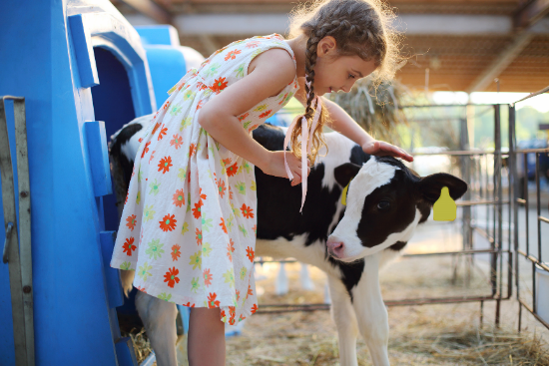
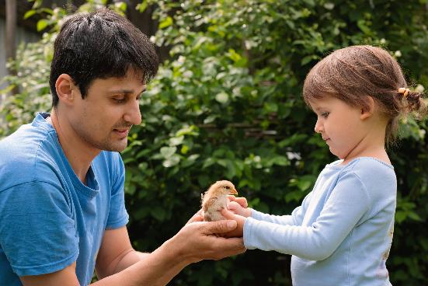
Zoonotic Diseases
Diseases that spread between animals and people
Caused by bacteria, viruses, parasites, and fungi
Notes:
While you work to maintain the health of your animals, it is important to remember there can be health risks to your guests. Zoonotic diseases are illnesses caused by many different organisms, including bacteria, viruses, parasites, and fungi that come from animals and can make people sick. Examples include Cryptosporidia, Campylobacter, E. coli, and Salmonella.
Photo: girl with calf (159971699), father with daughter (1743254246), Shutterstock

Slide 10
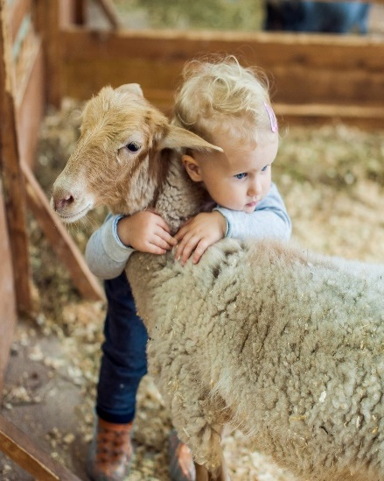
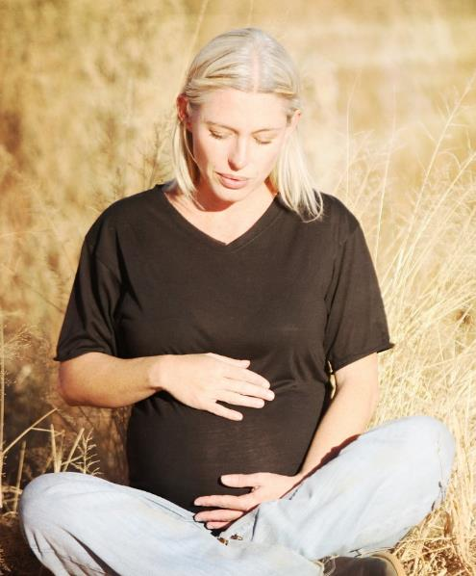
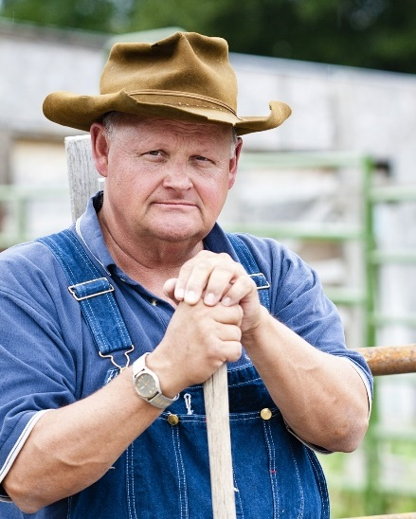
Immunocompromised at greater risk for zoonotic disease
Children, especially under 5
People with health conditions
Adults over 65
Pregnant women
Notes:
Age, immune status, and certain health conditions put some people at greater risk of becoming ill from a disease transmitted by animals. People at increased risk include:
Children, especially under the age of 5
People with chronic health conditions such as diabetes, heart disease, cancer, etc.
Adults age 65 and older
Pregnant women
Photo: Young girl with lamb, Shutterstock, https://www.shutterstock.com/image-photo/girl-hugging-lamb-on-farm-444343156; Pregnant woman, Pixabay 775028_1920; Older farmer, Shutterstock, https://www.shutterstock.com/image-photo/rugged-old-farmer-portrait-144535121

Slide 11
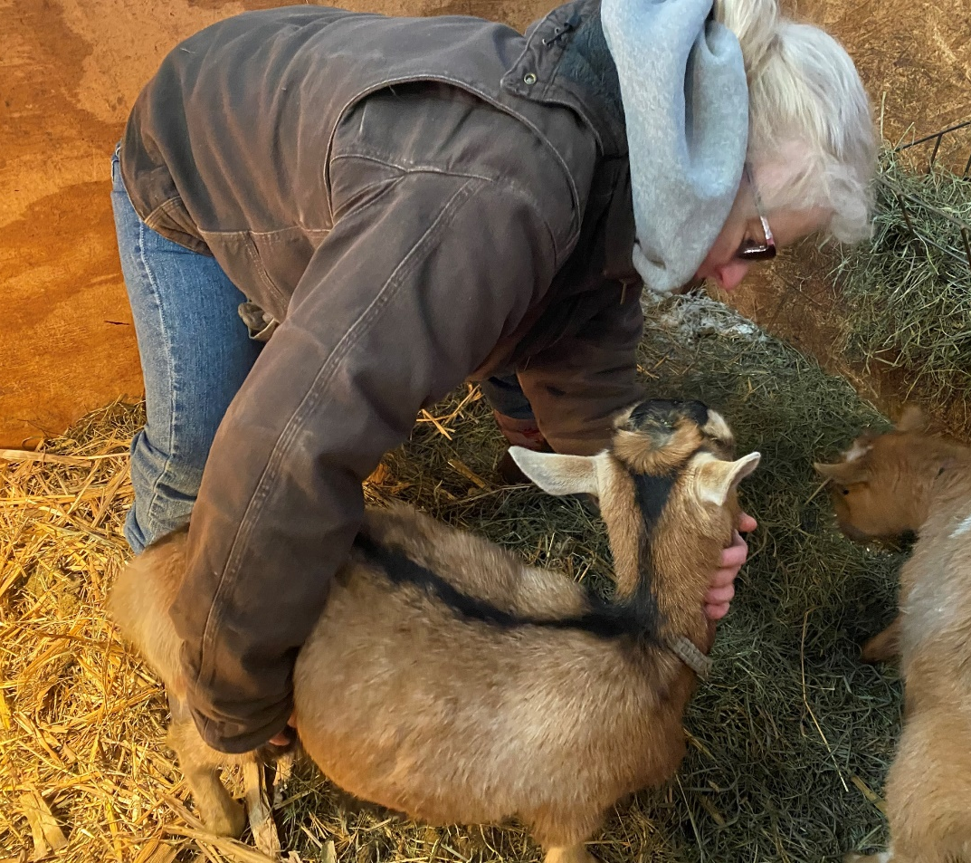
Observe animals every day for signs of illness
Remove and isolate any animals that are sick
Notes:
Animals should be observed daily to check for signs of illness before guests arrive. If any animals appear to be sick, remove them from public areas and isolate them from other animals. When appropriate, provide treatment according to the protocol you have developed with your veterinarian. If you have questions or concerns about the health of your animal, be sure to consult with your veterinarian.
Photo: examining goat, Renee Dewell/Iowa State University

Slide 12
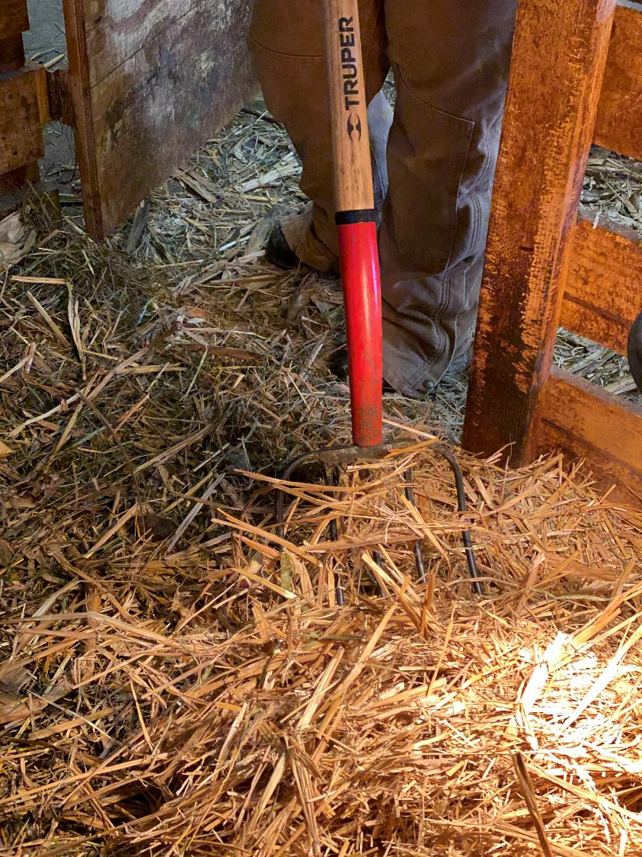
Regularly clean and disinfect animal areas.
Avoid moving manure, bedding or other waste material in public areas where guests walk.
Notes:
Regularly clean and disinfect animal areas. This prevents build-up of manure and potential disease-causing germs. If manure, bedding or other waste material is moved out of animal areas, avoid public areas where guests walk.
Photo: clean bedding, Renee Dewell/Iowa State University

Slide 13
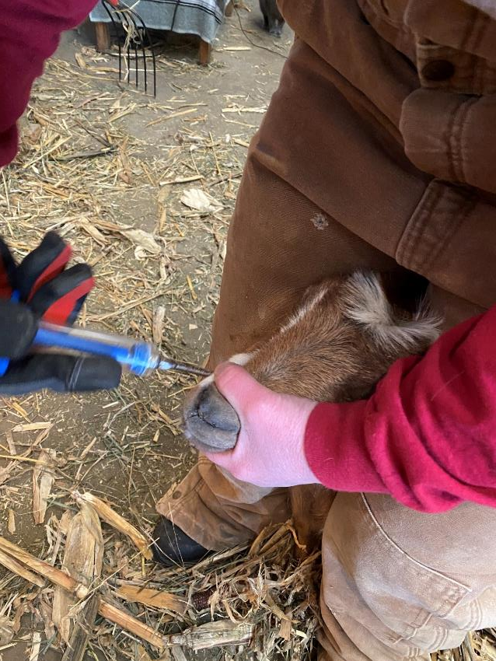
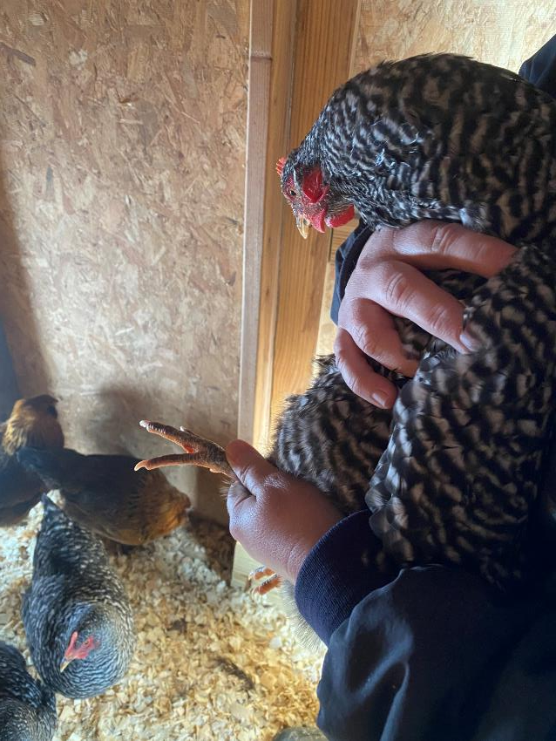
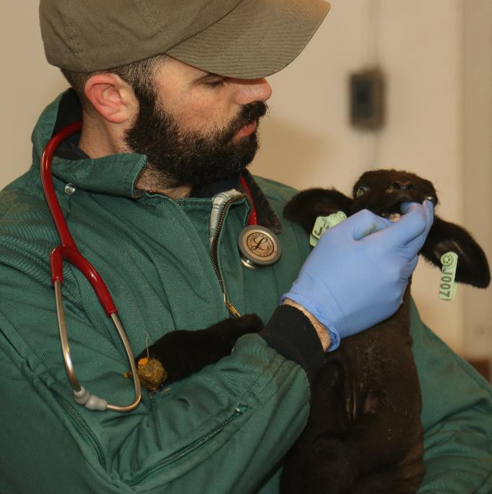
Veterinary Care
Notes:
Keep all exhibited animals current on recommended vaccinations. Work with your veterinarian to schedule regular preventive care as well as to examine animals that do not respond to treatment protocols established with your veterinarian or require immediate attention. If an animal appears ill with an infectious disease, it should be isolated right away.
Photo: vet with lamb; examining poultry; deworming goat. Renee Dewell/Iowa State University

Slide 14
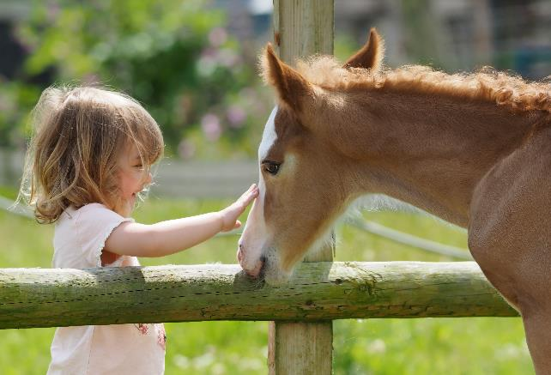
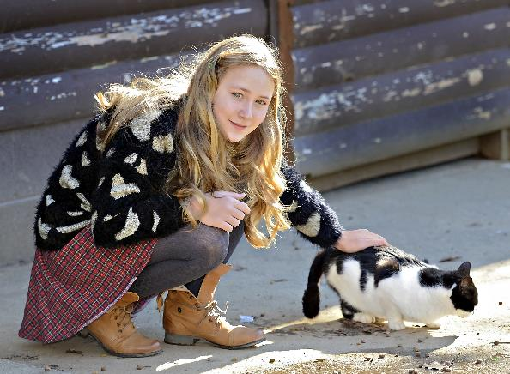
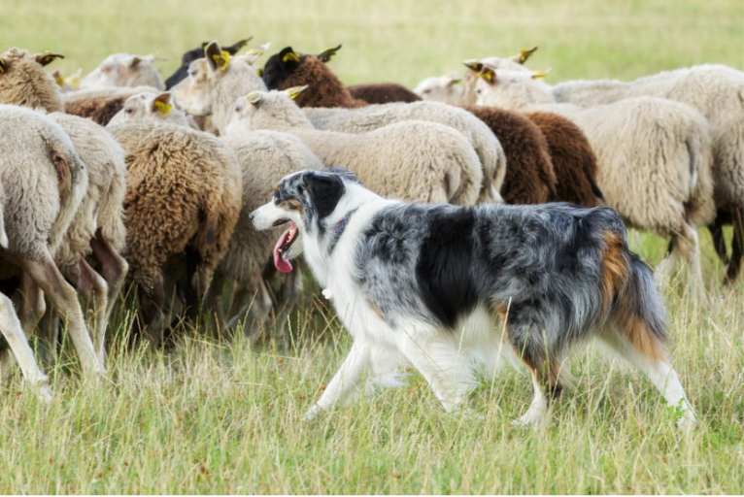
Other Farm Animals
Notes:
If dogs, cats, or other farm animals are part of the operation’s experience for guests, make sure they are also healthy. Keep them current on vaccines, and on a parasite prevention program.
Photos: girl with foal, girl with cat; boy with farm cat, herding dog, all from Shutterstock

Slide 15
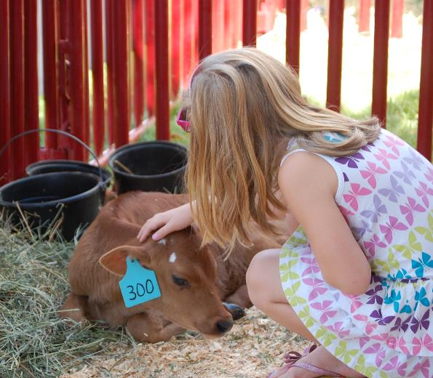
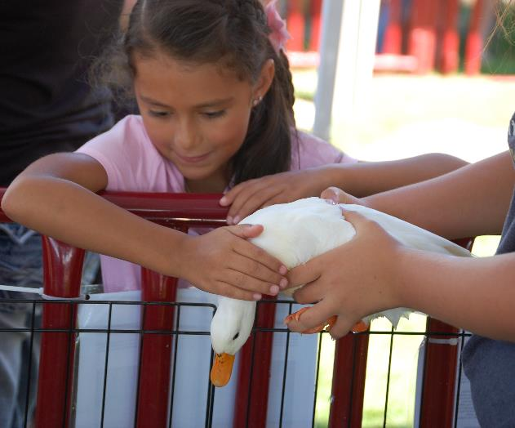
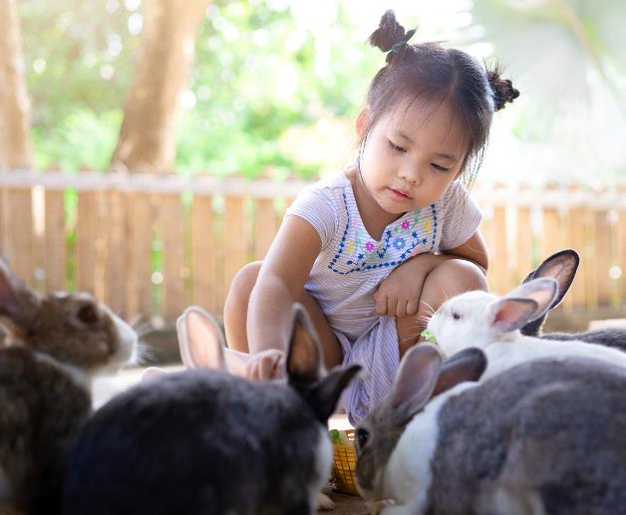
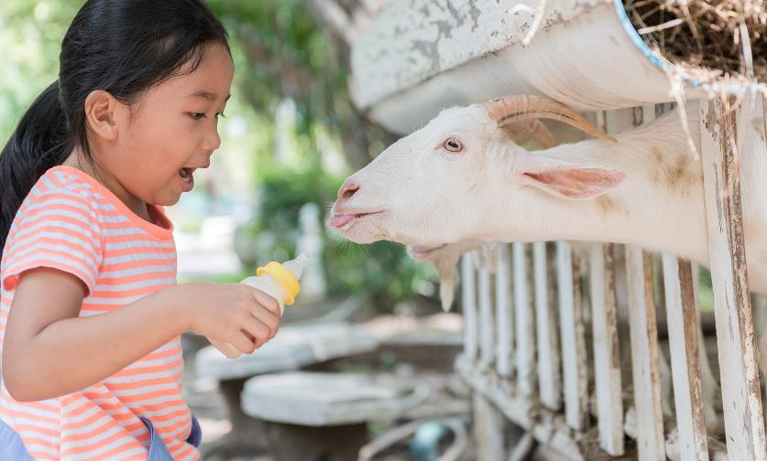
Public Interaction with Animals
Notes:
Young animals have immature immune systems and fragile bodies. Do not allow guests to handle newborn and very young animals. This helps prevent injuries and illness in animals and protects humans from diseases that could be spread by young animals. In areas where guests can touch animals, staff should be present to ensure animals are handled safely. It is also important to frequently clean high contact surfaces in public areas (e.g., railings, gates, door handles) to prevent germs from spreading.
Post signs reminding adults to supervise children and to thoroughly wash hands after animal contact.
Photo: Girl with calf; girl with duck. City of Greeley/Flickr, CC PDM 1.0; girl with rabbits (#1555359950), girl with goats (#621531920). Shutterstock;

Slide 16
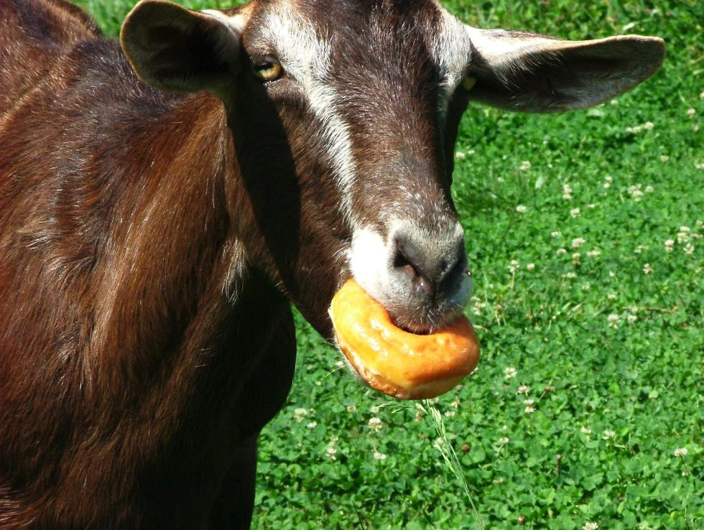
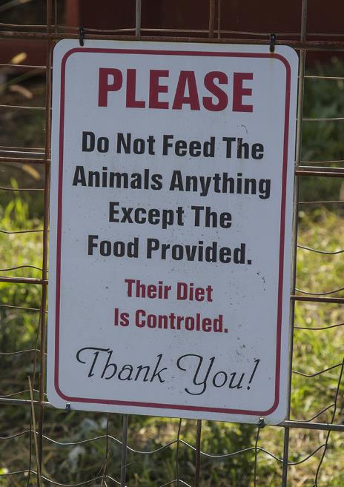
Appropriate feed
Notes:
If the operation has a petting zoo where animals can be fed by guests, only allow animals to be given feed that you provide. Feed should be appropriate for the types of animals eating it.
Photo: goat with donut, and please do not feed sign, Shutterstock; feeding goat through fence, Markus Distelrath/Pixabay

Slide 17
SAMPLE VISITOR MOVEMENT BETWEEN ANIMAL AND NON-ANIMAL AREAS
N
O
N
-A
NIM
A
L
A
RE
A
T
T
R
R
A
A
NS
NS
I
I
T
A
NIMA
L
AR
E
A
T
I
I
ON ARE
ON ARE
A
A
Graphic by Dani Ausen/Center for Food Security and Public Health
Notes:
One way to help minimize exposure of the public to potential disease risks is by establishing the movement flow of visitors on your farm. If possible, groups visiting animal areas should move in one direction only, from entry to exit. This is to avoid spreading germs from non-animal areas into animal areas. Upon entry, signs can be posted to share important information. Prohibiting personal belongings into animal areas, such as strollers, pacifiers, cups, toys, bottles, etc. should be encouraged, since these items can become contaminated with germs from animals. Areas designated for strollers and other items that cannot enter can be established.
After people move through the animal area, it is again important to post signs, encouraging hand washing. And whenever possible have sinks, soap and running water, or at a minimum portable hand washing or sanitizing stations.
Graphic by Dani Ausen/Center for Food Security and Public Health.

Slide 18
The Sale of Food
Notes:
If food or beverages are provided for guests, they should be prepared, served, and consumed in areas that are separate from where animals are kept.
Hand washing stations or hand cleaners/sanitizers should be available in concession areas. This is especially important if “finger foods” will be served to guests.
Protect guests from getting food-borne illnesses. All food should be handled, prepared, and stored according to state and local health department guidelines.
Photos: chicken on picnic table, Trilleum/Flickr, CC BY-SA 4.0; hand washing station with sign, calaggie/Flickr, CC BY-NC-SA 2.0, https://www.flickr.com/photos/calaggie/1318008779

Slide 19
ASSESSMENT CHECKLIST
Notes:
Using the following assessment checklist, determine areas where you are already doing well and others that may need to improve.
[Read the questions]
After answering, pick one or two “No” answers and make an improvement plan.

Slide 20
Acknowledgments
Development of this material was made possible through a grant provided to the Center for Food Security and Public Health at Iowa State University, College of Veterinary Medicine from the North Central Region Sustainable Agriculture Research and Education, or SARE program of the USDA National Institute of Food and Agriculture, under award number AWD-021794-00001 and project number ENC19-176. USDA is an equal opportunity employer and service provider. Any opinions, findings, conclusions, or recommendations expressed in this publication are those of the author(s) and do not necessarily reflect the view of the USDA. Iowa State University is an equal opportunity provider. For the full non-discrimination statement or accommodation inquiries, go to www.extension.iastate.edu/diversity/ext.
Content was developed and reviewed by veterinarians at CFSPH:
Glenda Dvorak, DVM, MPH, DACVPM
Renée Dewell, DVM, MS
Brandy R. Sobczak, DVM, MPH
Notes:
Development of this material was made possible through a grant provided to the Center for Food Security and Public Health at Iowa State University, College of Veterinary Medicine from the National Institute of Food and Agriculture, U.S. Department of Agriculture (USDA), under award number AWD-021794-00001 through the North Central Region SARE program under project number ENC19-176. USDA is an equal opportunity employer and service provider. Any opinions, findings, conclusions, or recommendations expressed in this publication are those of the author(s) and do not necessarily reflect the view of the USDA. Iowa State University is an equal opportunity provider. For the full non-discrimination statement or accommodation inquiries, go to www.extension.iastate.edu/diversity/ext.
Content was developed and reviewed by veterinarians and staff at CFSPH:
Glenda Dvorak, DVM, MPH, DACVPM
Renée Dewell, DVM, MS
Brandy R. Sobczak, DVM, MPH

