Slide 1
Vaccination for Contagious Diseases
Vaccine Delivery Systems and Animal Traceability
Adapted from the FAD PReP/NAHEMS Guidelines: Vaccination for Contagious Diseases (2011)
Notes:
The control of a foreign animal disease outbreak may require large-scale vaccination of food animals to minimize the impact on animal and public health, ensure continuity of the U.S. food supply, and minimize the economic impact on food producers. The principles discussed in this presentation are intended to provide general information to conduct large-scale vaccination of a variety of domestic animal species as may be required in an animal health emergency. Decisions regarding the choice of vaccine and the selection of animals to vaccinate will vary with the disease involved, species affected and the stage of the outbreak, and may change as the situation evolves. As always, it is important to evaluate each situation and adjust procedures to the risks present in the situation. [This information was derived from the Foreign Animal Disease Preparedness and Response (FAD PReP)/National Animal Health Emergency Management System (NAHEMS) Guidelines: Vaccination of Contagious Diseases (2011)].

Slide 2
Syringes, Needles and Other Delivery Systems
Notes:
Selecting the appropriate instrument to deliver a vaccine is critical to the success of a vaccination program. Always consult the vaccine insert for the appropriate dose and route of delivery for a particular vaccine. When selecting a vaccination method, be sure to consider the number of animals being vaccinated, vaccine manufacturer recommendations, efficiency and risks involved.

Slide 3
Syringes and Needles
Single use disposable syringes
Discard after single use
Small groups
Automatic multi-dose syringes
Large groups
Bottle-mount or draw-off syringes
Large groups
Notes:
Single-use disposable syringes come in a variety of sizes, from 1cc to 60cc. They are relatively inexpensive and meant to be discarded after a single use. Single-use syringes are appropriate for parenteral vaccination of small numbers of animals and for vaccines that come in single-dose vials. Automatic multi-dose syringes usually hold a maximum of 50cc of vaccine. They can be adjusted to deliver a dose of 1cc to 5cc. They are efficient for vaccinating multiple animals. These syringes require cleaning and maintenance. Remember to thoroughly rinse away any detergents or disinfectants after cleaning to prevent deactivation of vaccines. Like automatic multi-dose syringes, bottle-mount or draw-off multi-dose syringes are convenient for vaccinating large numbers of livestock. This type of syringe attaches directly to the vaccine vial via a length of flexible tubing, making repeated punctures of the vaccine vial unnecessary. [This photo shows an automatic multi-dose syringe taken apart for cleaning. Photo source: Danelle Bickett-Weddle, Iowa State University]

Slide 4
Needle-Free Injection
Needle-Free Injection Systems
Use compressed air or gas
Injects vaccine into skin
Bodily fluids less likely to contaminate delivery device
Relatively expensive, difficult to maintain
Notes:
Needle-free injection systems are available from the vaccine manufacturer for some vaccines. This device uses compressed air or gas and a pressure amplifier to inject the vaccine into the skin of the animal without using a needle. The advantage to this type of system is that bodily fluids are less likely to contaminate the delivery device. These devices are relatively expensive to purchase and are difficult to maintain. Needle-free injection is not yet licensed for the majority of parenteral vaccines. [This photo is an example of a needle-free injection system for vaccine delivery. Photo source: Michael Dutcher, Pulse Needle Free Systems]

Slide 5
Other Delivery Systems
Intranasal pipettes
Single use
Usually supplied by manufacturer
Ocular drop bulbs/bottles
Single use
Usually supplied by manufacturer
Spray Vaccine
Notes:
Other types of delivery devices include intranasal pipettes, ocular drop bulbs or dropper bottles, and spray vaccine delivery systems. Intranasal delivery devices are meant for a single use and are usually supplied by the manufacturer with the vaccine. There may be stand-alone squeeze pipettes or plastic tubes that can attach to a disposable syringe. Ocular vaccine delivery devices are usually supplied by the manufacturer with the vaccine. The dropper bulb or bottle makes it easy to deliver a single drop to the eye. This type of delivery device is most commonly used for fowl. Spray vaccines are sometimes used to inoculate birds in one of two ways: either by inhalation of small particles or by ingestion and mucous membrane contact.

Slide 6
Animal Traceability
Notes:
Regardless of the nature of the emergency requiring mass vaccination, identifying individual animals or groups/herds/flocks of animals with nationally unique numbers and associating them with a standardized location identifier at a point in time is critical for traceability purposes. It is essential to have accurate information and to keep accurate records on which animals have been vaccinated in order to manage a disease outbreak. In the case of livestock, uniquely identifying individuals, pens, or groups/herds/flocks of animals is necessary to track vaccination records, testing results, or other information for the emergency response.

Slide 7
Types of Identification
Permanent or semi-permanent
Radio frequency identification (RFID)
Tattoos
Brands
Ear notches
Ear tags
Microchips
Notes:
There are multiple animal identification technologies available for livestock traceability. A variety of devices are available for different species. Animals that arrive with permanent or semi-permanent identification should be recorded on entry. This slide lists types of permanent or semi-permanent identification methods - Radio frequency identification (RFID), tattoos, brands, ear notches, ear tags, and microchips.

Slide 8
Radio Frequency ID (RFID)
Long term identification
Unique number identifies individual
Number read by ‘scanner’
Data can be captured on computer
Variety of devices for various species
Ear tags, ear buttons, microchips
Notes:
Radio frequency identification (RFID) is utilized in a variety of permanently attached animal identification devices. These devices contain transponders that use radio waves to transmit the identity in the form of a unique serial number assigned to that individual animal. The number is detected with a reader device (scanner) and the data can be transferred to a computer. Livestock producers in the U.S. are moving toward this form of identification due to advantages of automated data capture systems for eradicating diseases. RFID devices can be used in all livestock as long-term method of unique identification. A variety of identification devices incorporating RFID technology are available for different species, including ear tags and ear buttons, and microchips. RFID devices are commonly used in cattle and sheep as RFID devices placed in ear buttons.

Slide 9
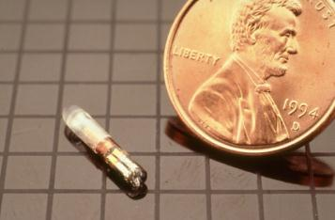
Radio Frequency ID (RFID)
Microchips
Horses - neck
Dogs and cats - shoulder
Read by hand held scanner - specific
Universal scanners are ideal
Notes:
Radio Frequency Identification (RFID) such as a microchip is a long-term method of identifying horses and companion animals. Microchips are small transponders, about the size of a grain of rice, injected under the skin. In horses the microchip is commonly implanted in the nuchal ligament from the left side, in the middle third of the neck, halfway between the ears and withers. In dogs and cats, microchips are regularly placed between the shoulder blades, although some chips may migrate beneath the skin as far as the ventral chest. Most microchips are read by hand held scanners. Many scanners are brand-specific, and are not capable of reading the codes from other brands of microchips, even if they emit at the same frequency. Universal scanners capable of reading any brand of microchip are ideal for emergency situations. [This photo depicts a microchip with a U.S. penny for size comparison. Photo source: USDA]

Slide 10
Tattoos
A permanent mark made by the injection of colored ink under the skin
May provide a unique number
Locations vary with the species
Commonly used in swine, horses, sheep and goats
Notes:
A tattoo is a permanent mark made by the injection of colored ink under the skin. Tattoos comprised of numbers are commonly used to identify livestock. The tattooed number may be unique to that individual animal, or registered and assigned to a particular farm where the identical tattoo is applied to all animals produced by that farm. Tattoo locations vary with species. Horses may be individually identified by a tattoo inside the upper lip. Pigs produced by a particular farm may be tattooed on the outside of the ear. Tattoos are commonly used in horses, swine, sheep and goats.

Slide 11
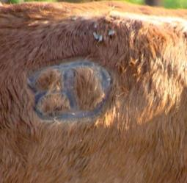
Brands
Permanent mark on hide
Usually identifies owner
Registered with brand inspection agency
Note brand and brand location
Commonly used in horses, cattle, and goats
Notes:
A brand is a permanent mark created on the hide by the application of a hot or cold device, and usually identifies the owner of the animal. The brand is often registered with an official brand inspection agency and accompanied by an official brand inspection certificate. When recording identifying brands, note both the brand and the location of the brand, as the brand location will also be part of the registered information. Brands are commonly used in horses, cattle, and goats. [This photo shows a cow with an identifying brand on its right hip. Photo source: Beth Carlson, North Dakota]

Slide 12
Ear Notches
Small “V” shaped sections removed from the ear edge
Notched for animal health management and husbandry purposes
Common in the swine industry
Notes:
Ear notches are a form of on-farm animal identification where small “V” shaped sections are removed from the edge of the ear using a special instrument. When pigs, sheep or goats are born their ears may be surgically notched for animal health management and husbandry purposes. Ear notching is commonly used in the swine industry, providing identification of the animal as an individual or member of a group. [This photo shows a pig with identifying ear notches. Photo source: Danelle Bickett-Weddle, Iowa State University]

Slide 13
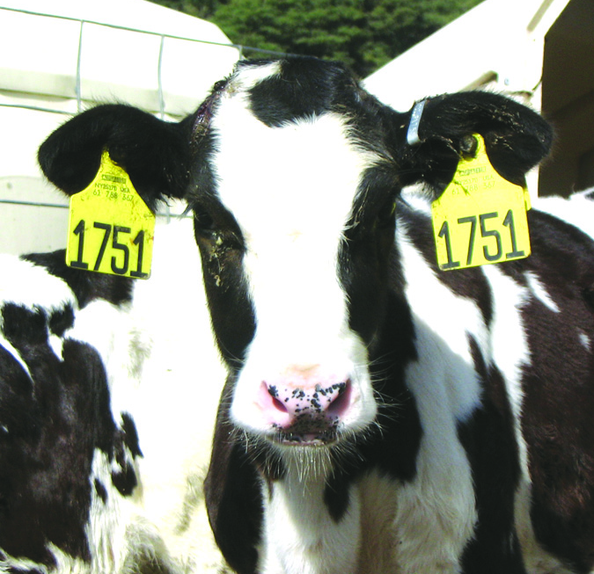
Ear Tags
Plastic hang tags that come in a variety of shapes, sizes and colors
Metal tags (brucellosis)
Commonly used in cattle, pigs, sheep and goats
Notes:
Ear tags often take the form of plastic hang tags and come in a variety of shapes, sizes, and colors. The tags can be purchased either blank or pre-numbered. Each herd has its own numbering system. The shape, color, size and numbering system. The shape, color, size, and numbering system of these tags will vary by facility. Often, animals will have an identical tag in each ear, so that the animal can still be identified should one of its ear tags be lost. In cattle, metal tags (orange brucellosis ear tags and bright ear tags) may also be used. For cattle herds that are vaccinated for brucellosis, metal brucellosis vaccination tags are placed in the right ear. In herds that do not vaccinate calves for brucellosis, a metal ‘bright’ tag can be placed in the right ear and serves as an official form of identification of cattle. Licensed veterinarians can obtain these tags from their State. Ear tags are commonly used in cattle, pigs, sheep and goats. [This photo shows a Holstein calf with matching ear tags in each ear. Photo source: Vicky Olson, Quality Milk Production Services]

Slide 14
Temporary Identification
Temporary Identification
Temporary marks made on hide
Stall cards
USDA back tags
Collars
Notes:
There are several types of temporary identification that can be used in various species. A few common methods of temporary identification are temporary marks made on the hide, stall cards, USDA back tags, and collars.

Slide 15
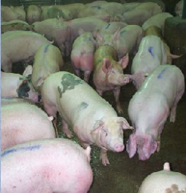
Temporary Marks on Hide
Temporary markings can be made on hide with:
Chalk, wax pen, permanent marker or a paint brand
Commonly used during vaccination or other health care procedures
Commonly used in cattle, swine, and small ruminants
Notes:
Temporary markings can be made on the hide with chalk, wax pen, permanent marker, or a paint brand. This method of identification is frequently used during medical and health care procedures such as vaccination to identify the animals that have completed the process. Temporary marks on the hide are commonly used in cattle, swine, and small ruminants. [This photo depicts temporary blue marks made down the backs of a group of pigs. Photo source: Lowell Anderson, USDA APHIS]

Slide 16
Stall Cards
Simple document attached to a stall, animal enclosure or pen with animal information
Contain a complete physical description
Could contain a photo
Commonly used in horses
Notes:
Stall cards are a simple document attached to a stall, animal enclosure, or pen with animal information. Ideally the stall card should contain a complete physical description such as color, markings, such as leg and face markings, gender, RFID number, brand, or tattoo. Photos could also be used on the stall card to help identify the animal. Equine facilities often use stall cards as an additional form of identification for horses, but are also used for other species.

Slide 17
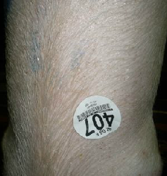
USDA Backtags
A sticky tag placed on the animal’s back, often referred to as an auction or hip tag
Very temporary, often used with other forms of identification
Commonly used in swine, cattle and goats
Notes:
A back tag is often referred to as an auction or hip tag. It is a sticky tag placed on the animal’s back, usually with a visible number. Back tags may be placed on livestock when they are received at an auction market. Because they are so temporary, they are usually used with other forms of identification. Commonly used in swine, cattle, and goats. [This photo illustrates a USDA backtag on a pig. Photo source: Stephen Lewis, USDA Food Safety Inspection Service]

Slide 18
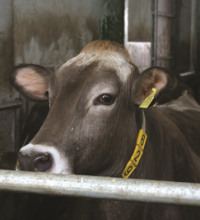
Collars or Neck Straps
Collars or neck straps are similar to dog collars
Larger, with identification
Used with visually identifiable number or radio-frequency device
Commonly used on dairy cows and dairy goats
Notes:
Collars or neck straps are similar to dog collars, but are larger and carry a form of identification. Some operations use neck collars with a visually identifiable number and/or a radio-frequency device that can be scanned with a specialized reader. Collars are commonly used on dairy cows and dairy goats, and frequently used in dairy animals or for judging contests. [This is a photo of a dairy cow wearing an identification collar. Photo source: Danelle Bickett-Weddle, Iowa State University]

Slide 19
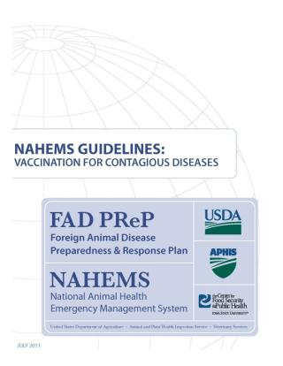
For More Information
FAD PReP/NAHEMS Guidelines & SOP: Vaccination for Contagious Diseases (2011)
http://www.aphis.usda.gov/animal_health/emergency_management/
Vaccination for Contagious Diseases web-base training module
https://naherc.sws.iastate.edu/
Notes:
More details can be obtained from the sources listed on the slide, available on the USDA website (http://www.aphis.usda.gov/animal_health/emergency_management/) and the NAHERC Training Site (http://naherc.sws.iastate.edu/).

Slide 20
Guidelines Content
Authors (CFSPH)
Jim Roth, DVM, PhD, DACVM
Amber Stumbaugh, MS
Anna Rovid-Spickler, DVM, PhD
Danelle Bickett-Weddle, DVM, MPH, PhD, DACVPM
Reviewers (USDA)
Patricia Foley, DVM, PhD
R. Alex Thompson, DVM, PhD
Notes:
This slide acknowledges the authors and reviewers of the Guidelines document.

Slide 21
Acknowledgments
Development of this presentation was by the Center for Food Security and Public Health at Iowa State University through funding from the USDA APHIS Veterinary Services
PPT Author: Patricia Futoma, Veterinary Student
Reviewers: Cheryl L. Eia, JD, DVM, MPH; Janice Mogan, DVM
Notes:
Information provided in this presentation was developed by the Center for Food Security and Public Health at Iowa State University College of Veterinary Medicine, through funding from the US Department of Agriculture, Animal and Plant Health Inspection Service, Veterinary Services.

