Slide 1
Vaccination for Contagious Diseases
Overview
Adapted from the FAD PReP/NAHEMS
Guidelines: Vaccination for Contagious Diseases (2011)
Notes:
The control of a foreign animal disease outbreak may require large-scale vaccination of food animals to minimize the impact on animal and public health, ensure continuity of the U.S. food supply, and minimize the economic impact on food producers. The principles discussed in this presentation are intended to provide general information to conduct large-scale vaccination of a variety of domestic animal species as may be required in an animal health emergency. Decisions regarding the choice of vaccine and the selection of animals to vaccinate will vary with the disease involved, species affected and the stage of the outbreak, and may change as the situation evolves. As always, it is important to evaluate each situation and adjust procedures to the risks present in the situation. [This information was derived from the Foreign Animal Disease Preparedness and Response (FAD PReP)/National Animal Health Emergency Management System (NAHEMS) Guidelines: Vaccination of Contagious Diseases (2011)].

Slide 2
This Presentation
National Veterinary Stockpile
Regulation of veterinary vaccines
Types of vaccines
Vaccine handling and delivery
Vaccine delivery devices: syringes, needles, etc.
Notes:
This presentation will provide an overview of the following topics:
The National Veterinary Stockpile;
Regulation of veterinary vaccines;
Types of vaccines currently available;
Proper handling and delivery of vaccines; and
A brief description of various vaccination delivery systems such as syringes, needles, and other vaccine delivery devices.

Slide 3
National Veterinary
Stockpile
(NVS)
Notes:
The National Veterinary Stockpile (NVS) was established in 2004 under Homeland Security Presidential Directive 9 to protect the nation’s food supply. The NVS is the nation’s repository of veterinary countermeasures, including supplies, equipment, field tests, and commercial support services. The NVS provides the logistical support to deliver large quantities of available vaccines when they are used in a foreign animal disease response. As an example, the NVS will deliver vaccines for foot and mouth disease from the North American Foot and Mouth Disease Vaccine Bank. The NVS mission is to provide States the countermeasures they need to respond to catastrophic animal disease outbreaks that nature or intentional introduction may create.

Slide 4
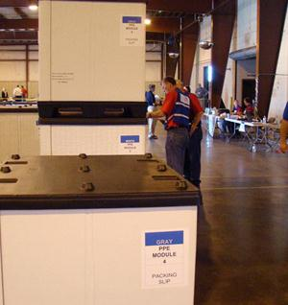
NVS
USDA APHIS
  National Center for Animal Health Emergency Management (NCAHEM)
Repository of countermeasures
Provide to States in event of animal health emergency
Notes:
The National Veterinary Stockpile (NVS) is maintained by USDA APHIS through the National Center for Animal Health Emergency Management (NCAHEM). In addition to its logistical support for vaccine delivery when needed and available, the NVS can deploy countermeasures, such as personal protective equipment and decontamination supplies, within 24 hours of approval and also can arrange service contracts for mass depopulation, disposal, and disinfection of animal production facilities, if required. [This photo shows triwalls of National Veterinary Stockpile supplies being unloaded at a warehouse. Photo source: Randy Schawang, David City, Nebraska]

Slide 5
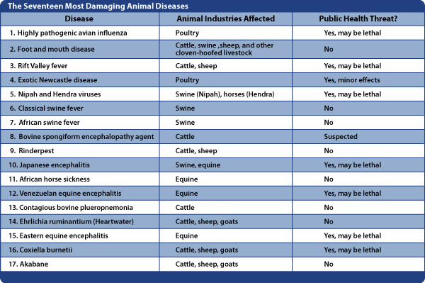
NVS
Notes:
In addition, the NVS intends acquire countermeasures to respond to the top 17 animal disease threats, those most damaging to animal agriculture, human health, and the U.S. economy. The table on this slide lists these diseases in order of importance. The list includes such diseases as highly pathogenic avian influenza, foot and mouth disease, and Rift Valley fever. [This table taken from the Template for a State NVS Plan Version 1, June 2009, shows Damaging Animal Disease Threats in the United States. Illustration by: Dani Ausen, Iowa State University ]

Slide 6
Regulation of Veterinary Vaccines
Notes:
To have an efficient vaccination program, it is essential that the vaccines are safe, potent and effective. Let’s take a closer look at how vaccines are regulated.

Slide 7
Regulation of Vaccines
USDA APHIS Center for Veterinary Biologics (CVB)
  Regulates veterinary biologics
    Such as vaccines, bacterins, antisera
  Pure, safe, potent, and effective
  Virus Serum Toxin Act
Notes:
The USDA APHIS Center for Veterinary Biologics (CVB) regulates veterinary biologics (including vaccines, bacterins, antisera, diagnostic kits, and other products of biological origin) to ensure that the veterinary biologics available for the diagnosis, prevention, and treatment of animal diseases are pure, safe, potent, and effective. The basis for regulation of these items is enforcement of the Virus Serum Toxin Act.

Slide 8
Regulation of Vaccines
CVB - Policy, Evaluation and Licensing (PEL)
  Establishes licensing standards
  Reviews prelicense documentation
  Performs testing
CVB - Inspection & Compliance (IC)
  Inspects production facilities, methods and records
  Investigates suspected violations and consumer complaints
Notes:
Within the Center for Veterinary Biologics, the Policy, Evaluation and Licensing (PEL) unit establishes licensing standards; reviews all prelicense documentation; reviews test methods and labels; and issues, suspends, or revokes licenses and permits. CVB-PEL also performs prelicense and surveillance testing; tests products associated with field problems; and develops references, reagents, and test methods. Also within the Center for Veterinary Biologics, the Inspection & Compliance (IC) unit inspects production facilities, methods and records; and investigates suspected legal violations and consumer complaints.

Slide 9
Types of Vaccines
Notes:
There are several different types of vaccines. This includes modified live vaccines, killed vaccines, and novel vaccines. This section will briefly describe the different types of vaccines.

Slide 10
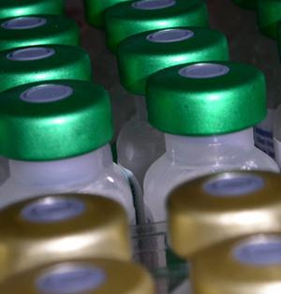
Types of Vaccines
Modified live vaccines (MLV)
  Replicate in host, mild clinical signs
Killed inactivated vaccines
  All or part of inactivated pathogen
  Require adjuvant
Novel vaccines - include
  Gene-deleted vaccines
  Live vectored vaccines
  Plant-derived vaccines
  DNA vaccines
Notes:
Two main types of conventional vaccines are modified live vaccines (MLV) and killed inactivated vaccines. With modified live vaccines, the vaccine organism replicates in the host, but should produce no or only very mild clinical signs. They induce an immune response that will provide protection from severe disease caused by the natural pathogen. Killed vaccines contain part or all of an inactivated pathogen. Killed vaccines generally require an adjuvant to stimulate the host’s immune response and provide protection from disease. An adjuvant is a substance added to vaccines to enhance the capacity to stimulate an immune response. Several types of novel vaccines have been developed using new technologies. These include gene-deleted vaccines, live vectored vaccines, plant-derived vaccines, and DNA vaccines. [This photo depicts the tops of multiple vaccine vials. Photo source: iStockphoto.com]

Slide 11
Modified Live Vaccines
Contain live organisms
Sensitive to improper handling/storage
May cause disease in stressed animals
Can cause disease if given by the wrong route
Do not administer to pregnant animals, unless otherwise stated on label
Notes:
Modified live vaccines are derived from the original pathogen or from a closely related pathogen. These vaccines contain live organisms, and are sensitive to damage by improper handling or storage. Because modified live vaccines generally rely on the vaccine organism replicating in the host to produce a protective immune response, these vaccines must be handled carefully. If the organism in the vaccine loses viability, it will not induce an effective immune response. In stressed or immunocompromised animals, some modified live vaccines may cause disease. Some modified live vaccines can cause significant disease if given by the wrong route. Be sure to follow label instructions. Modified live vaccines should not be used in pregnant animals unless the label specifically states that they are safe for pregnant animals.

Slide 12
Killed Vaccines
Contain inactivated whole organism or portion of organism
Generally combined with an adjuvant
Often require two doses to be effective
Notes:
Killed vaccines can contain the whole organism that has been inactivated by heating or chemical denaturation, or they can contain a portion of the organism (subunit vaccine) capable of inducing an effective immune response. Killed vaccines generally need to be combined with an adjuvant by the manufacturer in order to induce a sufficient protective immune response. Killed vaccines often, but not always, require two doses to induce protective immunity on first vaccination.

Slide 13
Novel Vaccines
Types:
  Gene-Deleted Vaccines
  Live Vectored Vaccines
  Plant-Derived Vaccines
  DNA Vaccines
Notes:
Several different types of vaccines make up the novel vaccine category. Gene-deleted vaccines are made from organisms that have had a specific gene or genes deleted or inactivated. Live vectored vaccines are produced by identifying a protective antigen or antigens for a particular pathogen and then engineering the genes coding for those antigens into another organism that may safely replicate and express the antigen in the target species. Plant derived vaccines use genes from animal pathogens that can be genetically engineered into a plant. The transgenic plant produces large amounts of antigen that can be used as a vaccine. DNA vaccines are produced by engineering genes for protective antigens into bacterial plasmids (circular pieces of DNA). The plasmid DNA is then purified from that of the bacterial expression host and directly administered to animals.

Slide 14
DIVA Vaccines
May be live or killed vaccines
Developed with a companion diagnostic kit
Prevents confusion between vaccinated animals and infected animals
Facilitate disease eradication
Notes:
Conventional vaccines induce antibodies to all of the antigens associated with an infectious agent, masking the ability to detect animals that are actually infected with the agent and complicating efforts to eradicate a given disease or to declare an area disease-free. During a disease outbreak, use of vaccines has been avoided in many instances to prevent confusion in differentiating vaccinated from naturally infected animals, and resulting trade restrictions.
DIVA or Differentiating Infected from Vaccinated Animals (or what some call Detection of Infection in Vaccinated Animals) vaccines are vaccines developed with a companion diagnostic test kit used to identify vaccinated animals that have become infected. These DIVA vaccines may be either live or killed vaccines. The DIVA vaccine provides a protective immune response, but lacks specific antigens associated with the virulent pathogen. The companion diagnostic kit is designed to detect antibody against the antigen that is present in the pathogen but absent in the vaccine. Thus, animals or herds of animals that have been infected with the naturally occurring pathogen (and therefore serve as a reservoir of infection) can be identified and removed. These vaccines are pivotal to some disease eradication programs. DIVA vaccines can facilitate the rapid elimination of a pathogen during an outbreak, while minimizing interruptions in animal trade.

Slide 15
Withdrawal Times
Vaccination Withdrawal Time:
  The period between the administration of the vaccination and the time the vaccinated animal or products from that animal can legally enter the human food chain - specified in the vaccine license
Vaccines used in food animals are subject to withdrawal times
Notes:
When used in food animals, both modified live vaccines and killed vaccines are subject to mandatory withdrawal periods prior to slaughter for human consumption. Animals may not be sent to market until the withdrawal time has elapsed. During the mandatory withdrawal time vaccinated animals or products from vaccinated animals may not enter the food chain. The withdrawal time is determined by the country in which the vaccine is licensed and stated in the product license. Modified live vaccines replicate in the host and during the withdrawal time live vaccine strain virus may be found in animal products or tissues. Animal products from killed vaccines do not pose an infectious risk, but withdrawal times are imposed to allow the adjuvants to clear from the tissues. Withdrawal times are intended to ensure meat, milk, or other products for human consumption from the vaccinated animal are free from adjuvant or vaccine organism contamination.

Slide 16
Vaccine Delivery
Notes:
There are numerous methods to deliver, or administer, vaccines to animals, and each licensed vaccine is intended only for delivery by the routes stated on its label. Always refer to the vaccine label and/or insert to determine the volume of a single dose and the route by which it should be given.

Slide 17
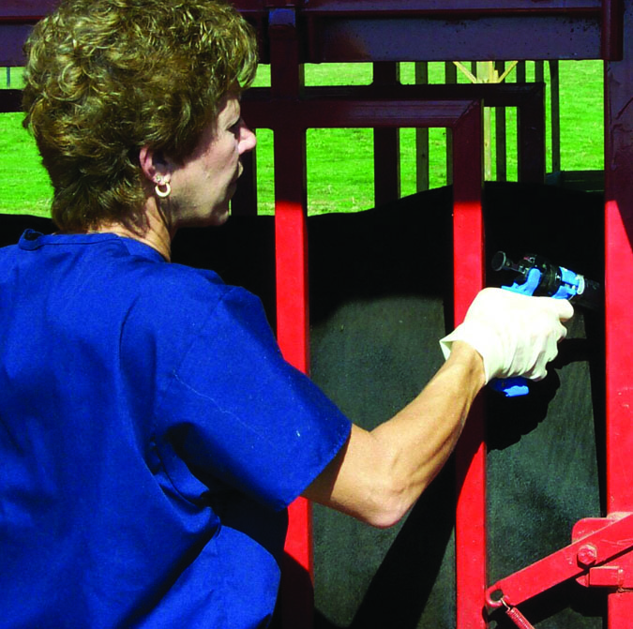
Vaccine Delivery
Routes
  Parenteral Injection
  Needle-Free
  Intranasal
  Ocular
  Oral
  Spray/Topical
Notes:
The common routes of vaccine delivery are parenteral injection, needle-free injections, intranasal, ocular, oral and spray topical. We will discuss each of these briefly in the following slides. [This photo shows a responder at an animal health emergency vaccinating an animal. Photo source: Phil Prater, Morehead State University, Kentucky]

Slide 18
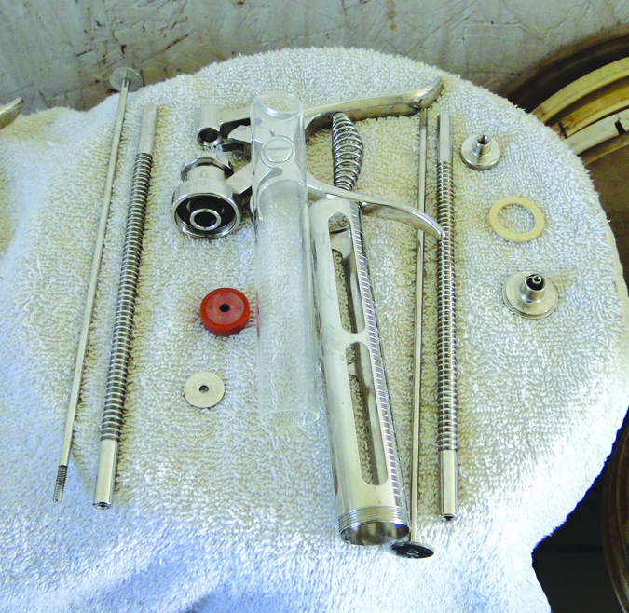
Parenteral Injection
Delivered with a syringe and needle
  In muscle (intramuscular)
  Under skin (subcutaneous)
Use a new needle for each animal
Notes:
Parenteral vaccines are delivered with a syringe and needle, and may be given in the muscle (intramuscularly) or under the skin (subcutaneously). A syringe and needle size should be selected appropriate for the dose, species, and number of animals to be vaccinated. Vaccine may be administered using a single-use syringe for individual animals, or in the case of immunizing a herd, a multi-dose syringe. To prevent cross-contamination and disease spread, a new needle should be used for each animal vaccinated parenterally. [This photo illustrates an automatic multi-dose syringe taken apart for cleaning. Photo source: Danelle Bickett-Weddle, Iowa State University]

Slide 19
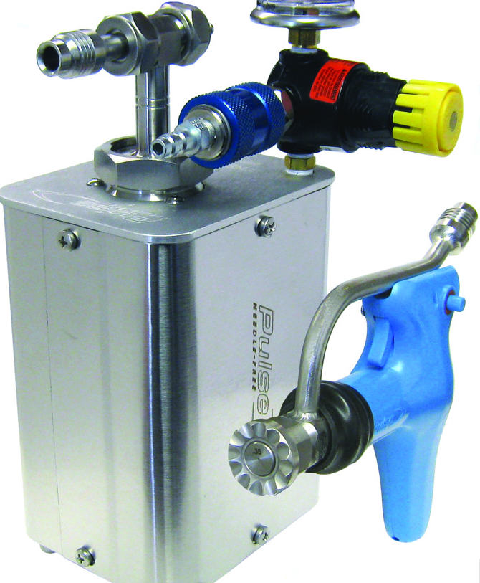
Needle-Free Injection
Transdermal
  Drives vaccine into skin by a burst of air or gas
  Minimal bodily fluid contamination
  Delivery of vaccine to dermis may enhance efficacy
Notes:
Needle-free or transdermal vaccines must be delivered with a specialized system, which usually drives the vaccine into the skin with a burst of compressed air or gas. The main advantage of needle-free vaccines is that there is minimal bodily fluid contamination of the vaccine delivery device. Therefore, the risk of spreading disease from one animal to another by vaccination equipment is low, and there is no need to change needles between animals. Another benefit is that needle-free systems deliver some vaccine to the dermis, which may enhance efficacy of the vaccine. [This photo shows an example of a needle-free injection system for vaccine delivery. Photo source: Michael Dutcher, Pulse NeedleFree Systems]

Slide 20
Intranasal and Ocular
Methods mimic natural route of infection
Intranasal
  Delivered with a squeeze bulb attached to intranasal device
Ocular
  Primarily used for fowl (chickens)
  Applied to surface of the eye
Notes:
Ocular and Intranasal vaccine administration methods mimic the natural route of infection for some pathogens and may produce a more appropriate immune response. Intranasal vaccines are delivered with a squeeze bulb attached to an intranasal delivery device, or with a syringe attached to a plastic intranasal applicator. Ocular vaccines are primarily used for chickens and other fowl. The vaccine is diluted in a colored diluent and applied to the surface of the eye.

Slide 21
Oral Vaccines
May be diluted in drinking water or sprayed onto food
Convenient for mass vaccination
Limited to fowl (chickens) and pigs
Goal: Vaccinate a sufficient percentage of group
Notes:
Oral vaccines may be diluted in drinking water or sprayed onto food. Oral vaccines must be consumed within an allotted time frame to ensure efficacy, and care must be taken to avoid vaccine inactivation by water disinfectants or inappropriate water temperatures. Oral vaccines delivered through automatic waterers are convenient for mass vaccination but are usually limited to use in chickens, other fowl, and pigs. Oral vaccination relies on the animal’s willingness to eat or drink the vaccine, and it must be accepted that some animals in a group will not receive a therapeutic dose of vaccine by this method. The aim is to vaccinate a sufficient percentage of animals to protect the group from serious disease.

Slide 22
Spray/Topical Vaccines
Diluted in water or diluted and misted, sprayed, or nebulized onto a large group of animals
Convenient for mass vaccination
Goal: Vaccinate a sufficient percentage of group
Notes:
Spray vaccinations are diluted in water or diluted and misted, sprayed, or nebulized onto a large group of animals. Spray vaccines, like oral vaccines, are convenient for mass vaccination. As with oral vaccines, not every animal in a group vaccinated by spray will receive a therapeutic dose of vaccine. The aim is to vaccinate a sufficient percentage of animals to protect the group from serious disease.

Slide 23
Vaccine Handling
Notes:
Proper handling of vaccines during transport, storage and reconstitution (when appropriate) and between administrations is critical to ensuring their safety and efficacy. This section introduces the general principles of vaccine handling. Always refer to the vaccine manufacturer’s recommendations for specific handling requirements.

Slide 24
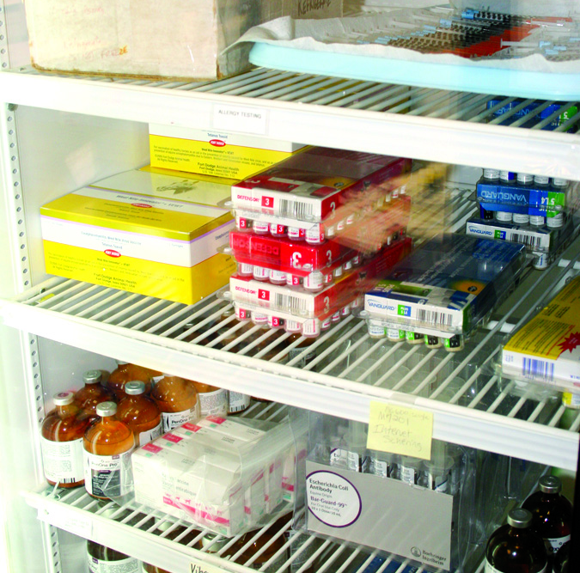
Cold Chain
Appropriate temperature range to ensure efficacy
During transport, storage, and all handling
Do not freeze vaccines intended to be refrigerated
Do not subject to freeze-thaw cycles
Store in box until needed
Notes:
The cold chain refers to the system used to ensure that vaccines stay within an appropriate temperature range from the manufacturer to the point of administration. Maintenance of the cold chain is important for ensuring that the vaccine retains its efficacy. Excessive heat or cold can damage a vaccine and reduce its potency or render it completely ineffective. Once potency is lost, it cannot be restored. Most vaccines do not have any readily detectable changes to their appearance that would indicate that they have been damaged or stored improperly. Do not freeze vaccines that are intended to be refrigerated. Do not subject vaccines to freeze-thaw cycles. Some vaccines are sensitive to light, as a result, it is best to store them in their boxes until they are needed. [Vaccines stored in a refrigerator. Photo source: Andrew Kingsbury, Iowa State University]

Slide 25
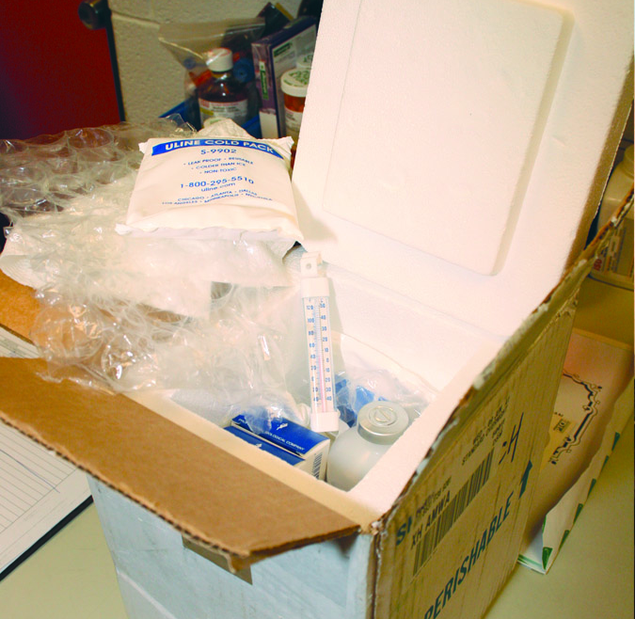
Transporting and Receiving
When transporting:
  Minimize the number of times transported
  Ensure cold chain is maintained
When receiving vaccines:
  Inspect immediately on arrival
  Look for signs of physical damage
  Check expiration dates
Notes:
When transporting vaccines there are key points to keep in mind. First, minimize the number of times a vaccine is transported. When vaccines must be transported, ensure that cold chain, the appropriate temperature range, is maintained during shipping. Inspect all vaccine shipments immediately upon arrival. Examine the shipping container and contents for signs of physical damage. Make sure vaccines are not expired or close to their expiration dates. [This photo shows packaged vaccines with cold packs in an insulated shipping container. Photo source: Andrew Kingsbury, Iowa State University]

Slide 26
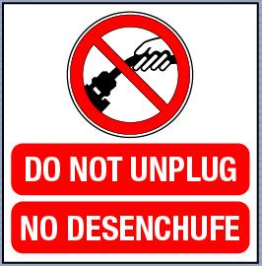
Storage Units
Dedicated to vaccine storage
Avoid temperature fluctuations
Do not use an outlet controlled by a wall switch or power strip
Notes:
Refrigeration and freezing units used for the storage of vaccines should ideally be dedicated to the storage of vaccines and should never be used for the storage of food or beverages. Avoid temperature fluctuation inside the storage unit. Measure and record the inside temperature with a calibrated internal thermometer at least daily. Vaccines should not be kept in the doors of refrigerators or freezers or in the vegetable bins of household refrigerators. Temperatures in these areas vary from the main compartment. Do not plug a cooling unit into an outlet controlled by a wall switch or a power strip, as these switches may be turned off inadvertently. [This illustration is an example of a warning sign not to unplug a refrigerated vaccine storage unit. The warning is both in English and in Spanish. Illustration by: Dani Ausen, Iowa State University]

Slide 27
Diluents
Lyophilized vaccine needs a diluent
Diluents are not interchangeable
Always use the diluent provided with the vaccine and lot number
Follow manufacturer’s instructions for reconstituting vaccine
Notes:
Many vaccines arrive from the manufacturer as a lyophilized (dried powder) component and an accompanying sterile diluent. The dried vaccine must be reconstituted with the diluent provided by the manufacturer for that specific vaccine. Diluents are not interchangeable between vaccine types or manufacturers. Even different lot numbers of the same vaccine are not interchangeable. Make sure that all personnel who will use the vaccine know where the appropriate diluent for each vaccine is kept and that diluents are never switched. Follow the manufacturer’s instructions for reconstituting the vaccine.

Slide 28
Maintaining Sterility
When using multi-dose vials:
  Use sterile technique to withdraw vaccine
  Never remove rubber stopper
  Disinfect rubber stopper before piercing
  Use a sterile needle each time
  Clearly mark vials with date, time, and user’s initials
Notes:
Some vaccines may be packaged in multi-dose vials. To ensure each dose is safe and effective, it is important to prevent contamination of the bottle and store it as recommended by the manufacturer between uses. Use sterile technique to withdraw each dose of vaccine from the vial. Never remove the rubber stopper from the bottle top. Wipe the rubber stopper with an alcohol swab or appropriate antiseptic before piercing. Use a new sterile needle each time the rubber stopper is pierced. Clearly mark multi-dose vials with the date, time they were first opened or reconstituted and the user’s initials.

Slide 29
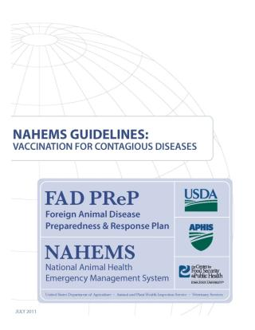
For More Information
FAD PReP/NAHEMS Guidelines & SOP: Vaccination for Contagious Diseases (2011)
  http://www.aphis.usda.gov/animal_health/emergency_management/
Vaccination for Contagious Diseases web-base training module
  http://naherc.sws.iastate.edu/
Notes:
More details can be obtained from the sources listed on the slide, available on the USDA website (http://www.aphis.usda.gov/animal_health/emergency_management/) and the NAHERC Training Site (http://naherc.sws.iastate.edu/).

Slide 30
Guidelines Content
Authors (CFSPH)
Jim Roth, DVM, PhD, DACVM
Amber Stumbaugh, MS
Anna Rovid-Spickler, DVM, PhD
Danelle Bickett-Weddle, DVM, MPH, PhD, DACVPM
Reviewers (USDA)
Patricia Foley, DVM, PhD
R. Alex Thompson, DVM, PhD
Notes:
This slide acknowledges the authors and reviewers of the Guidelines document.

Slide 31
Acknowledgments
Development of this presentation was by the Center for Food Security and Public Health at Iowa State University through funding from the USDA APHIS Veterinary Services
PPT Author: Patricia Futoma, Veterinary Student
Reviewers: Cheryl L. Eia, JD, DVM, MPH; Janice Mogan, DVM
Notes:
Information provided in this presentation was developed by the Center for Food Security and Public Health at Iowa State University College of Veterinary Medicine, through funding from the US Department of Agriculture, Animal and Plant Health Inspection Service, Veterinary Services.

