Slide 1
Health and Safety
Pre-Deployment Preparation
Adapted from the FAD PReP/NAHEMS Guidelines: Health and Safety (2011)
Notes:
During an animal health emergency response, ensuring the health and safety of responders will be essential. Specific hazards encountered during a response may vary depending on the situation. Some of the preparation for health and safety issues will be required prior to deployment. This presentation will overview these measures. [This information was derived from the Foreign Animal Disease Preparedness and Response (FAD PReP)/National Animal Health Emergency Management System (NAHEMS) Guidelines: Health and Safety (2011)].

Slide 2
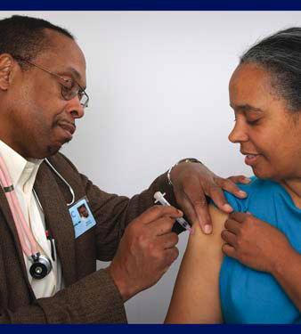
Personal Health
Physical exam
Vaccinations
Rabies
Influenza
Tetanus/diphtheria
Pneumococcal
Chronic disease
Pregnancy
Notes:
Responders reporting for duty must be in good physical and mental condition to perform their assigned duties. To comply with this requirement, responders are encouraged to have regular physical examinations to assess their current health status. Responders should have a current tetanus/diphtheria booster and know their rabies vaccination status and titer. Seasonal influenza vaccination is highly encouraged if responding to avian or novel H1N1 influenza outbreaks. Individuals over 65 years of age or persons with immunocompromising conditions or chronic lung disease should also receive a pneumococcal vaccine. Responders should be aware of any chronic disease conditions which may affect their ability to perform tasks in the field. Pregnancy may impair one’s ability to perform some tasks, and some tasks may put the fetus at risk. Responders should discuss medical issues of concern, including those that may limit a responder’s abilities, with their personal physicians and their supervisor. Less physically demanding assignments may be available. [This photo shows a person receiving a vaccine. Photo source: CDC Image Library]

Slide 3
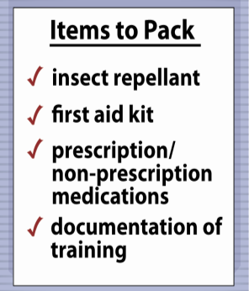
Personal Packing List
30-day supply of prescription medications
Clothing and footwear appropriate for climate
Extra glasses or contact lenses
Notes:
Emergency deployment worksites may be in remote locations or areas affected by natural disasters with limited access to facilities and amenities. Conditions such as weather, terrain or the presence of biological, chemical, or radiological hazards may affect working and living conditions. Responders must be prepared to live and work in areas with limited access to electricity, running water, shelter, air conditioning, telephone, internet, or other services. Upon notification of deployment, responders will receive information identifying specific personal items and equipment, including PPE, they will need to bring to the site. Responders with conditions requiring medication or medical supplies should assume they will not have access to a pharmacy while on deployment and should bring at least a 30 day supply of items to the deployment. [This illustration shows a sample list of things to pack prior to deployment. Illustration by: Oriana Hashemi-Toroghi, Iowa State University]

Slide 4
Personal Packing List
Sunscreen
Insect repellant
Lip balm
First aid kit
Non-prescription medications
Alarm clock
Flashlight, batteries
Cell phone, charger
Notes:
Other items that should be packed include: sunscreen, insect repellant, lip balm, first aid kit, non-prescription medications (e.g., pain relievers, allergy medications, anti-diarrheal medications), a non-electric alarm clock, flashlight and extra batteries, and cell phone and charger.

Slide 5
Training
Notes:
Training on a variety of topics related to the response will be necessary for all responders. Some of these must be completed prior to deployment. Others will be completed on-site, based on the event and tasks at hand. The following slides outline some of the training that will be needed for an animal disease emergency response situation.

Slide 6
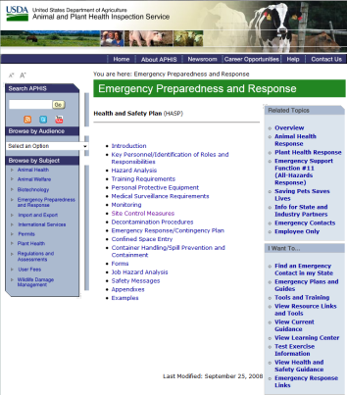
Training
Incident Command System (ICS)
USDA APHIS Emergency Deployment Generic Health and Safety Plan (HASP)
Notes:
All response personnel must have incident command training prior to deployment. This will ensure response chain of command and roles and responsibilities are understood. Personnel should also review the USDA APHIS Emergency Deployment Generic Health and Safety Plan (HASP) which contains the basic health and safety training requirements. This document may be accessed at: http://www.aphis.usda.gov/emergency_response/hasp/health_safety_hs_training.shtml.
[This photo shows the web landing page for the USDA APHIS Health and Safety Plan. Photo source: USDA http://www.aphis.usda.gov/emergency_response/hasp/health_safety_procedures.shtml]

Slide 7
Training
Hazard communication
Reporting an injury
Emergency communication
Evacuation procedures
Shelter-in-place procedures
Health and Safety Plan (HASP)
Notes:
Once on-site, all APHIS personnel working a deployment (including temporary employees) will receive the following training: hazard communication, how to report an injury, emergency communication, evacuation procedures, shelter-in-place, and relevant sections of the APHIS HASP (e.g., medical monitoring). This is to assure the health and safety of all APHIS team members and to assure compliance with 29 CFR 1910 [OSHA Occupational Safety and Health Standards].

Slide 8
Additional Training
PPE use
Defensive driving
Material handling
Confined spaces recognition
Fire extinguisher use
Job task training
Notes:
Personnel involved in fieldwork may require additional training, such as PPE use (inspection, donning, doffing, and disposal), defensive driving, material handling, recognition of permit required confined spaces, and fire extinguisher use. Personnel should also review the Job Hazard Analysis (JHA) for their assigned tasks. [This photo shows a motor vehicle accident. Photo source: Katelyn Harvey, Iowa State University]

Slide 9
HAZWOPER
Notes:
Hazardous Waste Operations and Emergency Response (HAZWOPER) states that all personnel involved in an emergency deployment are to be trained in certain items pertinent to health and safety before they are permitted to take part in actual emergency operations at an incident. The level of training varies based on activities that will be conducted.

Slide 10
HAZWOPER
OSHA - HAZWOPER Training
HAZardous Waste OPerations and Emergency Response
Level based on duties and functions
First Responder, awareness level
Witnesses or discovers hazardous substance and initiates response
Basic HAZWOPER Awareness Course
Notes:
Pursuant to the Occupational Safety and Health Administration (OSHA) - Hazardous Waste Operations and Emergency Response (HAZWOPER) Standard [29 CFR 1910.120(q)], all personnel involved in an emergency deployment are to be trained in certain items pertinent to health and safety before they are permitted to take part in actual emergency operations at an incident. Responders who may be investigating chemical contamination or who may be performing field activities associated with hazardous chemicals must complete the necessary HAZWOPER training. The level of training required is based on the duties and functions to be performed by each responder of an emergency response organization. There are five (5) categories of responder training.
1. First Responder, awareness level: This includes individuals who are likely to witness or discover a hazardous substance release, and who have been trained to initiate an emergency response sequence by notifying the proper authorities. They take no further action beyond notifying the authorities of the release. This training is required of all responders regardless of their duties or function within the response. This training is available through the USDA learning management system: AgLearn (Course title: APHIS Basic HAZWOPER Awareness Course).
10

Slide 11
HAZWOPER
First Responder, operations level
Responds to releases or potential releases of hazardous substances
8-hour HAZWOPER training
Hazardous materials technician
Stops release of hazardous materials
24-hour HAZWOPER training, one day supervised field experience
Notes:
2. First Responder, operations level: These individuals respond to releases (or potential releases) of hazardous substances as part of the initial response to the site. They help protect nearby persons, property, or the environment from the effects of the release. They are trained to respond in a defensive fashion without actually trying to stop the release. Their function is to contain the release from a safe distance, keep it from spreading, and prevent exposures. Training at this level requires awareness level training plus at least 8-hour HAZWOPER training. Examples of individuals in this category include: foreign animal disease diagnosticians, individuals performing surveillance, and site control and security personnel.
3. Hazardous materials technician: These individuals respond to releases (or potential releases) for the purpose of stopping the release. They assume a more aggressive role than a first responder at the operations level; they will approach the point of release in order to plug, patch or otherwise stop the release of a hazardous substance. Training at this level requires awareness level training plus at least 24-hour HAZWOPER training which includes one day actual field experience under the direct supervision of a trained experienced supervisor. Examples of individuals in this category include: cullers, cleaning and disinfection personnel, carcass disposal personnel, transporters, and heavy equipment operators.
11

Slide 12
HAZWOPER
Hazardous materials specialist
Supports hazardous materials technician
24-hour HAZWOPER training, one day supervised field experience
On-Scene Incident Commander
Assumes control of the incident scene
40-hour HAZWOPER training
Three days supervised field experience
Notes:
4. Hazardous materials specialist: These individuals respond with and provide support to hazardous materials technicians. Their duties parallel those of the hazardous materials technician; however, those duties require a more directed or specific knowledge of the various substances they may be called upon to contain. The hazardous materials specialist also acts as the liaison with Federal, state, local and other government authorities with regards to site activities. Training at this level requires awareness level training plus at least 24-hour HAZWOPER training which includes one day actual field experience under the direct supervision of a trained experience supervisor. Examples of individuals in this category include: on-site supervisors and managers, and command staff.
5. On-Scene Incident Commander: Incident commanders who assume control of the incident scene beyond the first responder awareness level must receive 40-hour HAZWOPER training, which includes three days of supervised field experience. All training is valid for one year. First responders at the awareness level (1) shall take the online AgLearn course annually. All other responder categories are required to take the 8-hour HAZWOPER refresher course annually.

Slide 13
For More Information
FAD PReP/NAHEMS Guidelines & SOP: Health & Safety (2011)
http://www.aphis.usda.gov/animal_health/emergency_management/
Health and Safety web-based training module
http://naherc.sws.iastate.edu/
Notes:
More details can be obtained from the sources listed on the slide, available on the USDA website (http://www.aphis.usda.gov/animal_health/emergency_management/) and the NAHERC Training Site (http://naherc.sws.iastate.edu/).

Slide 14
Guidelines Content
Author (CFSPH)
Cheryl L. Eia, JD, DVM, MPH
Reviewers (USDA)
Lori P. Miller, PE
Peter A. Petch, RPIH, CIPS, CIMT, CHS-V
Thomas R. Walker, MD
Notes:
This slide acknowledges the authors and reviewers of the Guidelines document.

Slide 15
Acknowledgments
Development of this presentation was by the Center for Food Security and Public Health at Iowa State University through funding from the USDA APHIS Veterinary Services
PPT Authors: Dawn Bailey, BS; Kerry Leedom Larson, DVM, MPH, PhD, DACVPM; Patricia Futoma, Veterinary Student Reviewers: Glenda Dvorak, DVM, MPH, DACVPM; Janice Mogan, DVM
Notes:
Information provided in this presentation was developed by the Center for Food Security and Public Health at Iowa State University College of Veterinary Medicine, through funding from the US Department of Agriculture, Animal and Plant Health Inspection Service, Veterinary Services.

