Slide 1
Surveillance, Epidemiology, and Tracing
Epidemiology Part 1:
Principles of Epidemiology
Adapted from the FAD PReP/NAHEMS Guidelines: Surveillance, Epidemiology, and Tracing (2011).
Notes:
An animal health emergency could have a detrimental effect on the nation's agriculture, food supply, and economy. Veterinary responders, animal health technicians, and other trained personnel may assist with surveillance, epidemiology, and tracing activities. In order to perform these job duties, a broad understanding of surveillance and epidemiological concepts is required. This presentation reviews the principles of epidemiology. [This information was derived from the Foreign Animal Disease Preparedness and Response (FAD PReP)/National Animal Health Emergency Management System (NAHEMS) Guidelines: Surveillance, Epidemiology, and Tracing (2011).]

Slide 2
What is Epidemiology?
Study of disease in populations and factors that determine the occurrence of disease
Notes:
Epidemiology is the study of disease in populations and the factors that determine the occurrence of disease. The presentation focuses on animal health emergencies, such as foreign animal disease (FAD) outbreaks.

Slide 3
Functions of Epidemiology
Notes:
Epidemiology has four core functions: surveillance, field investigation, analytic studies, and evaluation.

Slide 4
Core Functions
Surveillance
Ongoing data collection, analysis, interpretation, and dissemination
Used to determine specific actions for FAD mitigation
Field investigation
Used to collect additional information about cases identified via surveillance
Disease source, history of disease, etc.
Notes:
Surveillance involves ongoing collection, analysis, interpretation, and dissemination of data related to disease. This data is used to determine specific actions for FAD mitigation (e.g., quarantine, vaccination, depopulation, etc.). Surveillance is conducted to monitor a population for the presence, or absence, of disease. Surveillance provides information for action. In an FAD outbreak, surveillance will be used to detect cases or clusters of disease cases in the field. Epidemiologists will then collect additional information regarding the disease outbreak. This may include identifying the disease source, determining if other animals have been exposed, and learning more about the history of disease.

Slide 5
Core Functions (cont’d)
Analytic studies
Utilizes information gleaned from surveillance activities and field investigations
Disease rates and risk factors
Evaluation
Effectiveness
Efficacy
Impact of activities
Notes:
In an FAD response, information gleaned from surveillance activities and field investigations will be used in analytic studies. Disease rates will be calculated, and parts of the animal population that may be at higher risk than others will be described. This information will aid in identification of risk factors for disease, and determination of the source of disease. Many epidemiologic studies will require advanced analytic techniques. In an FAD response, strategies to contain, control, and/or eradicate a contagious FAD must be constantly evaluated to ensure that appropriate actions are undertaken. Evaluation is the process of determining the effectiveness, efficiency, and impact of activities with respect to established goals.

Slide 6
Disease Characteristics
Notes:
In an FAD outbreak, information collected via surveillance will be utilized by epidemiologists in a number of ways. One of the first tasks of epidemiologists is to describe the characteristics of disease. In some instances, such as a novel FAD outbreak, limited information may be available. Characteristics of disease include the history/spectrum of disease and disease transmission mode(s).

Slide 7
Natural History of Disease
Course of disease progression
Pathogen exposure
Subclinical illness
Onset of clinical signs
Recovery, disability, or death
Notes:
For most infectious diseases, the course of disease progression is predictable (when treatment does not occur). Known as the natural history of disease, the process begins with exposure to a pathogen. The onset of clinical signs marks the transition from subclinical to clinical disease. Most diagnoses are made during the stage of clinical disease. In some animals, disease does not progress to clinically apparent illness (known as subclinical disease); animals may be infectious nonetheless. These animals are known as carriers. Ultimately, the disease process ends either in recovery, disability, or death.

Slide 8
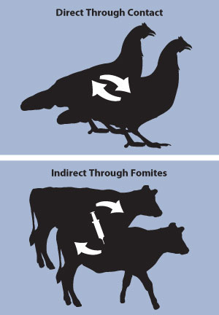
Transmission Modes
Many ways to transmit disease
Direct transmission
Indirect transmission
Zoonotic diseases
Diseases transmissible between animals and humans
May be transmitted directly or indirectly
Notes:
Every pathogen lives, grows, and multiplies in a particular environment known as the reservoir. Humans, animals, and the physical environment can all be reservoirs. The reservoir is often, but not always, the source of infection. Diseases can be transmitted many different ways. Modes of pathogen transmission must be understood when conducting an epidemiological investigation. Generally, transmission may be classified as direct or indirect. Zoonoses or zoonotic diseases are diseases transmissible between animals and humans and may be transmitted directly or indirectly. [Illustrations of examples of the direct and indirect modes of disease transmission. Illustration by: Andrew Kingsbury, Iowa State University]

Slide 9
Disease Occurrence
Notes:
Another important task of epidemiologists is to describe disease occurrence. This includes the level (or amount) of disease occurring in an area and the factors that work together to cause disease.

Slide 10
Levels of Disease
Endemic
Disease present in population or geographical area at all times
Outbreak
Occurrence of more cases of disease than expected
Given area/group, specific time period
May be used interchangeably with the term “epidemic”
Notes:
Epidemiologists must understand the amount of disease that occurs before, and during, an FAD event. The following terms are used to describe amounts of disease in a population or area:
Endemic: present in a population or geographical area at all times
Outbreak: the occurrence of more cases of disease than expected in a given area, or among a specific group, over a particular time period (many epidemiologists use the terms outbreak and epidemic interchangeably)

Slide 11
Levels of Disease (cont’d)
Pandemic
An outbreak/epidemic that has spread over several countries
Notes:
A pandemic is an outbreak/epidemic that has spread over several countries or continents

Slide 12
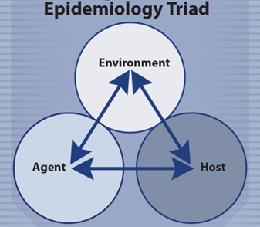
Causation
Environment
Husbandry, housing, climate/season, presence of vectors
Agent
Host range, environmental resistance, tissue affinity, dose, mode of transmission
Host
Species, breed, age, nutritional and immune status
Notes:
Agent, host, and environmental factors interrelate in a variety of complex ways to produce disease. A critical concept in epidemiology is that disease does not occur randomly in a population. The interaction of these three factors explains why some animals are more susceptible to disease than others. It is more likely to occur in some members of the population than others because of risk factors that may not be distributed randomly in the population. Risk factors may be related to the agent, host, or environment. [This illustration depicts the Epidemiology Triad and the interaction of environment, agent, and host. Illustration by: Bridget Wedemeier, Iowa State University]

Slide 13
Risk Factors
A characteristic that is associated with an increase in the occurrence of a particular disease
May include:
Age
Species
Location
Contact
Notes:
The presence of risk factors may make disease more likely to occur in some members of a population than in others. Risk factors related to the agent, host, or environment can include age, species, geographic location, and contact with other animals or fomites. Epidemiologists study the presence and/or absence of risk factors in diseased and non-diseased animals in order to gain a better understanding of an FAD agent.

Slide 14
Understanding Data and Measures of Disease
Notes:
Data are facts such as observations, clinical signs, and laboratory test results that are collected for the purpose of gaining information. Groups of data that are collected are known as data sets. Data may be qualitative or quantitative in nature. Qualitative data are non-measurable and include characteristics such as breed or sex. Quantitative data are numeric and describe amounts such as temperature or weight. There are also various measures of disease in a population which will give you a better understanding of the disease within a population. Different measures of disease in a population include; prevalence, incidence, mortality rate, and case fatality rate. Lets take a closer look at different data measurements and different measures of disease.

Slide 15
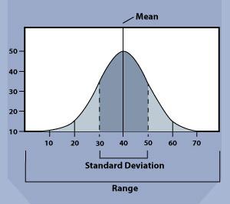
Descriptive Statistics
Measures of central tendency
Mean, median, and mode
Range
Difference between largest and smallest value
Standard deviation
Spread around mean value of data set
Notes:
Quantitative data are often summarized using descriptive statistics. Measures of central tendency (mean, median, and mode) are used to describe the central value of a data set. Range refers to the spread, or width, of a data set and describes the difference between the largest and smallest value in a data set. Standard deviation describes the amount of spread around the mean value in the data set. [This graph shows an example of mean, range and standard deviation. Illustration by: Katlyn Harvey, Iowa State University]

Slide 16
Confidence Interval
Represents range within which the true value lies
Calculated based on a percentage
95% commonly used
95% confidence interval
True value falls within the given range 95 percent of the time
Notes:
For many statistical measures, epidemiologists calculate a corresponding confidence interval. The confidence interval represents the range within which the true value lies. Confidence intervals are calculated based on a percentage; 95% is commonly used. A 95 percent confidence interval means that the true value falls within the given range 95 percent of the time.

Slide 17
Measures of Disease
Prevalence
Total number of cases of a disease in a given population at a specific time
Incidence
Number of new cases of disease in a defined population over a specific time period
Notes:
Epidemiologists use more complex statistics to describe disease in a population. Among these, prevalence, incidence, mortality rate, and case-fatality rate are frequently used. Prevalence: the total number of cases of a disease in a given population at a specific time (a “snapshot” in time). There is no distinction between old and new cases, so prevalence reflects only the presence of disease. As an example, Green Acres Dairy has 100 cows. The first disease case was reported on March 1. On March 14, 25 of the 100 cows showed signs of the FAD. The prevalence of the FAD at Green Acres Dairy on that date is 25/100 or 25%. Incidence: the number of new cases of disease in a defined population over a specific time period divided by the total number in the given population in which the cases occurred. For the week of March 7, Green Acres Dairy reported 10 new cases of the FAD. The incidence of the FAD for that period was 10/100 or 10%.

Slide 18
Measures of Disease (cont’d)
Mortality rate
Number of deaths in a defined population during a specific time period
Case fatality rate
Percentage of animals diagnosed with a specific disease who die as a result of the disease within a specified period of time
Notes:
Mortality Rate: the number of deaths in a defined population during a specific time period. As in our example, during the week of March 7, two cows at Green Acres Dairy died. The mortality rate was 2/100 or 2%. Case Fatality Rate: the percentage of animals diagnosed with a specific disease that die as a result of the disease within a specified period of time. Of 35 cows infected with the FAD at Green Acres Dairy during the outbreak, 7 died. The case fatality rate is 7/35 or 20%.

Slide 19
Measures of Association
Examines the differences in occurrence of disease in different segments of the population
Factors that might influence disease occurrence
Risk ratio and odds ratio
Notes:
Epidemiologists measure the occurrence of disease in different segments of the population and examine the differences in relation to factors that might influence disease occurrence in order to quantify the association between exposure and disease between the different groups. Risk ratio and odds ratio are two common ways of measuring this association. Both ratios compare the likelihood of disease among one group to the likelihood of disease in another group. In an FAD outbreak, animal groups usually differ by exposure to a suspected risk factor. For example, in an African Swine Fever (ASF) outbreak, it may be useful to compare swine that ate garbage with swine that did not eat garbage.

Slide 20
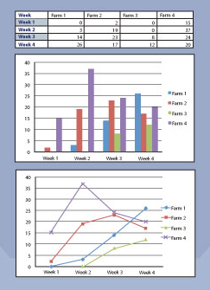
Displaying Data
Tables, graphs, and charts
Visual means for comparing data
Demonstrate patterns, differences, and other relationships
Notes:
Data are often displayed in tables, graphs, and charts. Tables present data arranged in rows and columns. They can demonstrate patterns, differences, and other relationships. Graphs display numeric data in a visual form. They can demonstrate trends, similarities, and differences in data that may not be evident from tables. Charts can exhibit various forms (e.g., bar chart, pie chart). They provide a visual means for comparing data. Maps and geographic information systems (GIS) can also provide a visual representation of data. In an FAD response, epidemiologists work with the GIS Cell to develop maps showing the geographic distribution of disease. Maps may pinpoint the location of disease cases/events. Shading or coloring may be used to show different levels of disease numbers or rates in different areas. [This graphic provides examples of data presented in different formats as a table, graph and chart. Illustration by: Katlyn Harvey: Iowa State University]

Slide 21
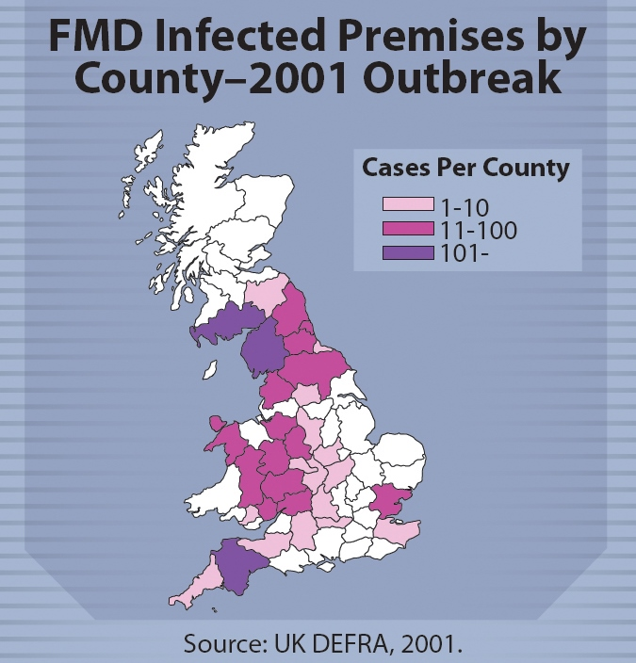
Displaying Data (cont’d)
Maps and GIS
Geographic location of disease
Levels and rates of disease
Notes:
Maps and geographic information systems (GIS) can also provide a visual representation of data. In an FAD response, epidemiologists work with the GIS Cell to develop maps showing the geographic distribution of disease. Maps may pinpoint the location of disease cases/events. Shading or coloring may be used to show different levels of disease numbers or rates in different areas. This is an example of a map of FMD infected premises by counties during the 2001 outbreak in the United Kingdom.
[This illustration is an example of data presented in map format. Content provided by: UK Department for Environment, Food and Rural Affairs. Illustration by: Bridget Wedemeier, Iowa State University]

Slide 22
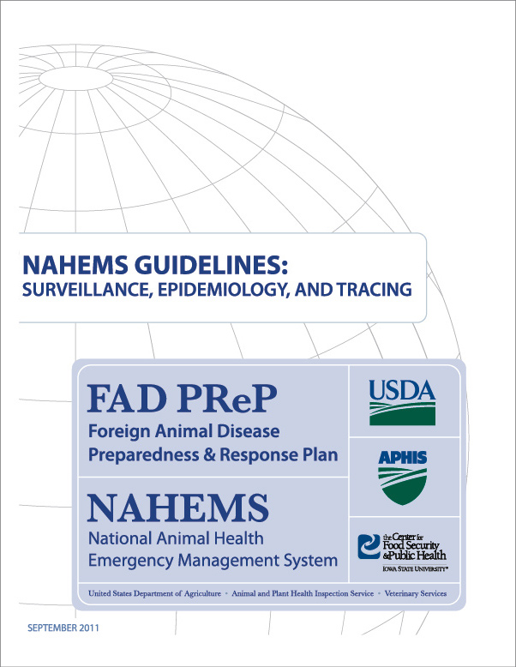
For More Information
FAD PReP/NAHEMS Guidelines & SOP: Surveillance, Epidemiology, and Tracing (2011)
http://www.aphis.usda.gov/animal_health/emergency_management/
Surveillance, Epidemiology, and Tracing web-based training module
http://naherc.sws.iastate.edu/
Notes:
More details can be obtained from the sources listed on the slide, available on the USDA website (http://www.aphis.usda.gov/animal_health/emergency_management/) and the NAHERC Training Site (http://naherc.sws.iastate.edu/).

Slide 23
Guidelines Content
Authors (CFSPH)
Kerry Leedom Larson, DVM, MPH, PhD, DACVPM
Glenda Dvorak, DVM, MPH, DACVPM
Janice Mogan, DVM
Courtney Blake, BA
Reviewers (USDA APHIS VS)
Dr. R. Alex Thompson
Dr. Lowell Andersen
Dr. Steve Goff
Dr. Fred Bourgeois
Notes:
This slide acknowledges the authors and reviewers of the Guidelines document.

Slide 24
Acknowledgments
Development of this presentation was by the Center for Food Security and Public Health at Iowa State University through funding from the USDA APHIS Veterinary Services
PPT Authors: Patricia Futoma, Veterinary Student; Kerry Leedom Larson, DVM, MPH, PhD, DACVPM
Reviewer: Janice Mogan, DVM
Notes:
Information provided in this presentation was developed by the Center for Food Security and Public Health at Iowa State University College of Veterinary Medicine, through funding from the US Department of Agriculture, Animal and Plant Health Inspection Service, Veterinary Services.

