Slide 1
Cleaning and Disinfection
Roles and Responsibilities Basic Protocol
Adapted from the FAD PReP/NAHEMS Guidelines: Cleaning and Disinfection (2011)
Notes:
This presentation outlines general cleaning and disinfection (C&D) roles, protocols, and principles applicable for C&D activities in an animal health or animal disease emergency, such as a foreign animal disease (FAD). Refer to the Site Specific Cleaning and Disinfection Standard Operating Procedures (SOP) developed for C&D for a particular animal health response. This information was derived from the Foreign Animal Disease Preparedness and Response (FAD PReP)/National Animal Health Emergency Management System (NAHEMS) Guidelines: Cleaning and Disinfection (2011) and also the web-based training module.

Slide 2
Roles and Responsibilities of Response Personnel
Notes:
During an animal disease emergency, the Cleaning and Disinfection Group functions as part of the Operation Section of the Incident Command System (ICS) to establish and coordinate on-site C&D efforts. These responsibilities include establishing protocols for cleaning and disinfecting infected, contaminated, or quarantined premises as well as setting up disinfection stations for vehicles, equipment and personnel. C&D personnel may also serve to assess and address compliance with C&D protocols and regulations.
All C&D personnel should understand the procedures discussed in this presentation. C&D personnel should also be trained or familiar with the use and proper maintenance of equipment used for C&D as well as the hazards and factors influencing efficacy of disinfection processes and procedures. Review of additional information sources [see the References and Internet Resources of the FAD PReP/NAHEMS Guidelines: Cleaning and Disinfection (2011)] and participation in educational sessions and/or emergency response exercises will help to expand their knowledge and expertise of C&D principles and procedures for animal health emergency management situations.

Slide 3
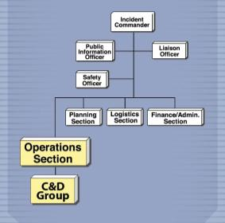
C&D Group Personnel
Key personnel
C&D Group Supervisor
In charge of all personnel assigned to the C&D Group
C&D Team Leaders
Supervise C&D Teams
C&D Teams
Responsible for activities at specific premises
Notes:
The number of personnel for a C&D Group will vary depending on the size and scope of the incident. Key C&D personnel would include:
The C&D Group Supervisor, based at the Incident Command Post, in charge of all C&D Teams and C&D Team Members;
C&D Team Leaders that supervise C&D Teams; and
C&D Teams that are responsible for activities at specific premises, C&D stations, checkpoints, or within Decontamination Corridors; team members may include personnel with expertise from multiple government and private sources.
[Graphic showing the Incident Command System (ICS) for the Cleaning and Disinfection Group. Illustration by: Andrew Kingsbury, Iowa State University]

Slide 4
C&D Group Personnel
Functions
Provide input to Command level
Provide technical advice
Coordinate with Logistics Section
Provide necessary supplies
Ensure ample supply of disinfectant products
Establish, operate, and maintain C&D stations
Schedule and certify C&D procedures
Notes:
C&D Group response personnel may either supervise or perform the actual cleaning and disinfection operations of the infected premises, or of equipment and personnel. Additional functions of the C&D Group include:
Provide input to the Command level on C&D procedures (e.g., technical advice, briefings, daily reports);
Provide technical advice on C&D issues to owners or operators of infected or contact premises;
Coordinate closely with the Logistics Section to secure the necessary equipment and supplies, and ensure an ample supply of chemical disinfectant products;
Establish, operate and maintain C&D stations as needed, including quarantined premises, vehicle entry and movement control checkpoints, and personnel decontamination stations; and
Schedule and certify C&D procedures on the infected premises or other affected areas.

Slide 5
C&D Group Supervisor
Assigned to Incident Command Post
Reports to Disease Management Branch Director/Operations Section Chief
Supervises all C&D Teams
Ensures
C&D measures are implemented
All personnel familiar with C&D techniques
Identifies and assigns Team Members
Establishes training requirements for personnel
Notes:
The C&D Group Supervisor should be identified well before an animal health emergency occurs. This individual has extensive training and/or experience in the proper cleaning and disinfection methods following an animal disease emergency event and possesses the management skills needed to organize and direct all C&D activities for the incident. The C&D Group Supervisor is assigned to the Incident Command Post, and reports to the Operations Section Chief, or if the incident is large, may report to the Disease Management Branch Director. This Supervisor is in charge of all C&D Teams and has the primary responsibility for ensuring that effective C&D measures are implemented during an animal disease emergency, and that all C&D personnel are familiar with the proper C&D techniques to manage or eliminate transmission of the pathogen. The C&D Group Supervisor should work with state emergency management agencies to identify C&D Team Members with required expertise from multiple government and private sources. This Supervisor establishes personnel training requirements, assigns Team Members’ tasks, and briefs new employees on the specifics of their duties within the C&D Group, as well as ensuring that the Safety Officer orients all new personnel regarding on-the-job hazards.

Slide 6
C&D Group Supervisor
Additional duties
Maintains up-to-date contact information, knowledge of regulations pertaining to C&D
Determines C&D needs
Personnel, vehicles, equipment
Coordinates C&D Group activities with other response Groups, farm owners
Establishes and maintains C&D locations
Prepares regular briefings/reports for Operations Section Chief
Notes:
Additional duties may include:
Maintaining a working knowledge of state and federal regulations pertaining to the use of C&D products or processes, and proper effluent management;
Determining C&D needs, including personnel, vehicles, equipment, and supplies. The C&D Group Supervisor should advise the Operations Section Chief of any resource requirements that cannot be satisfied locally so that arrangements can be made to issue contracts and/or leases regarding personnel or equipment for the C&D operations;
Coordinating C&D Team activities with other response Groups (e.g., Surveillance, Appraisal, Biosecurity), and with farm owners and/or managers;
Establishing and maintaining C&D locations as needed – at checkpoints, at C&D stations, and within Decontamination Corridors;
Verifying the accuracy and completeness of all required reports and submitting them promptly to the Operations Section Chief;
Providing information for industry groups concerning the location of C&D stations and the need to use them. Affected industry groups may include renderers, feed-mill operators, transportation company representatives, livestock and poultry producers, processing-plant managers, and others. Information for the public and industry would be released through the Public Information Officer; and
Cooperating with appropriate animal health emergency groups.

Slide 7
C&D Team Leaders
Supervise on-site activities of C&D Teams
Assist C&D Group Supervisor
Orienting and training Team Members
Assigning and supervising tasks
Manage functions of:
Vehicle disinfection stations
Quarantine premises equipment, supplies
Checkpoint equipment, supplies
Premises C&D supervision, coordination
Notes:
A C&D Team Leader supervises the on-site activities of a C&D Team and is typically given responsibility for one of the specific C&D functions which have been identified or determined for a specific incident. The number of C&D Teams, each led by a Leader, will depend on the scope of the incident. In a large incident, different C&D Team Leaders may manage the functions of vehicle disinfection stations, quarantine premises equipment and supplies (which will include on-site coordination with the Biosecurity Team), checkpoint equipment and supplies, and premises C&D supervision.
Additional roles and responsibilities of the C&D Team Leader include:
Assisting the C&D Group Supervisor in such duties as determining the personnel, vehicles, and equipment required to operate the C&D activities efficiently; in orienting and training C&D Team Members on policies, procedures and assigned tasks; and in the preparation of reports;
Assigning tasks (e.g., operation of C&D at a checkpoint or supervision of C&D on premises) to C&D Team Members and supervising their work;
Arranging and coordinating required C&D for all vehicles, equipment, and other materials leaving an infected, contact or suspect premises;
Serving as liaison to premises owner or manager for technical questions related to C&D;
Providing C&D support to the Biosecurity Team including liaison with the assigned Biosecurity Team Member who is the permanent guard on infected premises; and
Maintaining knowledge of disease prevention principles and practices.

Slide 8
C&D Team Members
Perform on-site C&D activities
Personnel come from various sources
USDA APHIS
Fire and HAZMAT Teams
Local pest control companies
Agricultural community
Department of Defense
Local hires
Notes:
C&D Team Members are typically performing on-site C&D. The number of members on each team depends on the assignment, such in decontaminating a premises – the number of buildings, size of buildings and area, sanitary conditions of the premises - and the time frame with which the work can or must be completed. Cleaning and disinfection protocols need to be carefully followed and performed thoroughly. Personnel serving on a C&D Team may be drawn from a number of sources. USDA APHIS and state cooperators have Animal Health Technicians with the training and experience to supervise C&D and, if necessary, to handle and apply C&D products. Some communities have fire personnel and Hazardous Materials (HAZMAT) Teams that may be able to assist. Local pest control companies have experience in working with the spray equipment and pressure pumps commonly used in C&D. In the agricultural community, there are businesses which specialize in C&D of facilities. Members of the military from the Department of Defense may be available through Memorandums of Understanding between Departments. Local hires can be trained for specific application activities.

Slide 9
Basic C&D Protocol
Notes:
The cleaning and disinfection of premises, equipment, vehicles and personnel will be necessary to prevent the spread of animal pathogens during an animal health emergency. The C&D processes should be carried out in a systematic manner to ensure efficacy and efficiency. Regardless of the situation, item, or area, effective C&D involves understanding of the basic C&D protocol – dry cleaning, washing, rinse and dry, disinfecting, rinse and dry. C&D personnel should understand the factors that may influence disinfection efficacy, such as environmental temperatures and wash water quality, as well as any safety issues involved with C&D procedures.

Slide 10
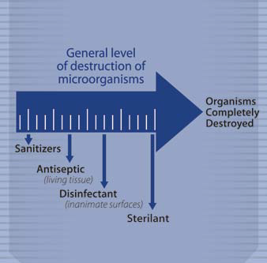
Definitions
Detergent
Disperses and removes organic materials from surfaces
Sanitizer
Reduces bacterial population
Does not destroy or eliminate all bacteria or microorganisms
Notes:
Cleaning and disinfection involves the use of physical or chemical processes to reduce, remove, inactivate, or destroy pathogenic microorganisms. These processes vary in their level of destruction of microorganisms. Understanding the differences between C&D processes and products can help when determining the necessary procedures to implement for a specific situation.
Detergent – Chemical products used to disperse and remove soil and organic materials from surfaces by reducing surface tension and increasing the penetrating ability of water. This can improve a disinfectant’s ability to reach and destroy microorganisms within or beneath the dirt. Some disinfectants (i.e., quaternary ammonium compounds) have detergent properties.
Sanitizer – A substance that reduces the bacterial population in the inanimate environment by significant numbers, but does not destroy or eliminate all bacteria or other microorganisms.
[This graphic shows the level of destruction of microorganisms by disinfection processes. Illustration by: Clint May and Andrew Kingsbury, Iowa State University]

Slide 11
Definitions (cont’d)
Antiseptic (FDA)
Kills or inhibits growth of microorganisms on skin
Disinfectant (EPA)
Destroys or eliminates specific species
Sterilant
Destroys all forms of microbial life
Notes:
Antiseptic – Products approved and used to reduce the risk of infection by killing or inhibiting the growth of microorganisms on the skin. Because these products are used on humans or animals, they are considered drugs and are approved and regulated by the U.S. Food and Drug Administration (FDA).
Disinfectant – A substance used on inanimate surfaces that destroys or eliminates a specific species of infectious or other public health microorganism, but not necessarily bacterial spores. Disinfectants are registered as “antimicrobial pesticides” and regulated by the U.S. Environmental Protection Agency (EPA). Disinfection can also be achieved by physical means (e.g., heat, ultraviolet light).
Sterilant – A substance that destroys or eliminates all forms of microbial life in the inanimate environment, including vegetative bacteria, bacterial spores, fungi, fungal spores, and viruses. Sterilization can also be achieved by physical means (e.g., heat, ultraviolet, irradiation).
[This graphic, repeated from the prior slide, shows the level of destruction of microorganisms by disinfection processes. Illustration by: Clint May and Andrew Kingsbury, Iowa State University]

Slide 12
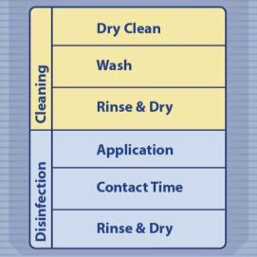
Cleaning
Important steps in the C&D process
Perform prior to application of approved disinfectant
Improved product efficacy
Three cleaning steps:
Dry cleaning
Washing
Rinsing and drying
Notes:
Cleaning is one of the most important steps in the C&D process. When done appropriately, cleaning alone can remove over 90% of microorganisms. This step also helps improve disinfection efficacy since most disinfectants have reduced effectiveness in the presence of organic material. The cleaning process should be conducted prior to the application of ALL EPA-registered disinfectants. The cleaning process involves dry cleaning, then washing, followed by rinsing, and when possible, complete drying. [This graphic shows the steps of the basic C&D protocol. Illustration by: Andrew Kingsbury, Iowa State University]

Slide 13
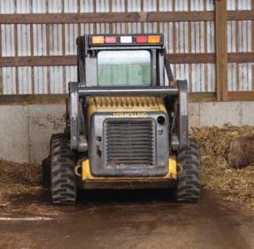
Dry Cleaning
Essential to remove any gross contamination and organic material
Shovels, manure forks, brooms, brushes
Heavy equipment
Dispose of all material
Minimize further spread of microorganisms
Items too difficult to clean
Appraise
Dispose
Notes:
Dry cleaning involves the removal of any gross contamination and organic material (e.g., soil, manure, bedding, feed) from production areas or equipment. Shovels, manure forks, brooms and brushes should be used to scrape, sweep, and remove organic material and debris from surfaces and areas. In situations involving highly contagious foreign animal diseases, moistening the area or item with water may be helpful for controlling dust and minimizing aerosolization of pathogens. Bins may aid in transport of material to the disposal area. Heavy equipment such as bobcats or tractors may be needed to remove large quantities of manure and bedding. Air blowers should not be used for dry cleaning due to the risk of spreading pathogens.
Disposal of all material removed should be in a manner that minimizes further spread of microorganisms and that is compliant with federal, state and local requirements and policies. In highly contagious disease situations, this may involve the burning, burial or composting of material. Items that are difficult to clean or of limited financial value (e.g., wooden gates or bunks, ropes, halters) should be appraised and disposed. The process may require considerable time and effort, depending on the size and type of facility, but it is essential, as this material can harbor microorganisms and reduce the efficacy or inactivate some disinfectants. Surfaces may not necessarily be visibly clean when this step is complete due to organic matter that adheres to the surface.
[This photo shows a skid loader removing organic material from a barn. Photo source: Danelle Bickett-Weddle, Iowa State University]

Slide 14
Washing
Follows dry cleaning
Wash items with detergent
Reduces number of microorganisms
Removes oil, grease, exudates
Turn off electrical equipment
Pre-soak areas with organic material adhered to surfaces
Ensure cleaning products used are compatible with disinfectant
Notes:
Following the removal of gross contamination (dry cleaning), areas or items should be washed with detergent. The washing process helps to further reduce the number of microorganisms as well as removes any oil, grease, or exudates that may inhibit the action of disinfection. Washing, prior to disinfection, is one of the most commonly overlooked steps in the C&D process.
Prior to washing, any electrical equipment should be turned off and removed or covered tightly with plastic sheeting. An electrician may need to be contacted for the removal of thermostats, timing devices, motor controls, and remote sensing equipment prior to washing. An alternative power supply (e.g., adjacent building, portable generator) may be needed to power electrical washing equipment. Some situations will involve specialized equipment (e.g., milk parlor cleaning) and will require extreme care. The owner may be able to assist with this operation to prevent damage to equipment.
Areas and items with organic material adhered to the surfaces should be pre-soaked for several hours. Soaps or detergents can help disperse and remove organic material; however, the cleaning product used must be compatible with the disinfectant selected. Some disinfectant products may be formulated with a detergent component. Washing with a cleaner or detergent is required for any disinfectants that do not contain these components (e.g., are not registered as “one-step” disinfectants.)

Slide 15
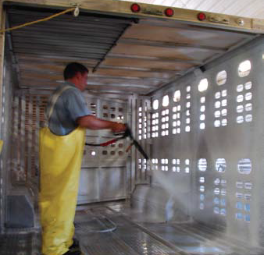
Washing (cont’d)
Mechanical scrubbing to remove oil, grease, exudate
Deep cracks, crevices, pits, pores
High pressure water and detergent
Use caution to avoid dispersal of pathogen
High temperature
90-130ºF/32-54ºC
Increases product efficacy
Notes:
Mechanical scrubbing and scraping (e.g., brushes) may be necessary to remove oils, grease or exudates. Rough surfaces should be scrubbed with a wire brush to ensure that they are as clean as possible. Deep cracks, crevices, pits, pores, or other surface irregularities should be given special attention to dislodge accumulated grime. High pressure water and detergent is very effective in removing the heavy accumulation of urine and feces often present in the environment and for cleaning porous surfaces. However, in cases of highly infectious or zoonotic pathogens, high pressure systems should be avoided or used with caution to avoid further dispersal of the pathogen or risk to the applicator. Whenever possible, warm to hot water (90-130°F [32-54°C] or higher) should be used. This can increase efficacy for some products and may be important for the proper dissolution of certain chemicals (e.g., sodium carbonate); heat may also aid in inactivating some pathogens. Hot water and steam can be effective for cleaning cracks, crevices and the inside of pipework where pathogens are likely to linger. [This photo shows the cargo area of a livestock trailer being washed with a pressure sprayer. Photo source: Danelle Bickett-Weddle, Iowa State University]

Slide 16
Rinsing and Drying
Rinse surfaces after wash
Low pressure, cold water
Inspect to ensure surfaces are visibly clean
Before disinfection, allow surfaces to dry completely
Blowers, fans, compressors
Avoid high pressure systems with highly infectious, zoonotic pathogens
Notes:
After washing, all surfaces should be thoroughly rinsed, as residues from cleaners and detergents can inactivate certain chemical disinfectants. Rinsing should be done at low pressure with cold water. When the rinsing process is completed, surfaces should be carefully inspected to ensure they are visibly clean. Moisture should spread evenly over surfaces and no “beading” should occur as this would indicate the presence of oil or grease. Rewash any areas that may require further attention in order to pass inspection. Whenever possible, surfaces should be allowed to dry completely (if possible overnight) before application of a disinfectant. Excess moisture, especially on porous surfaces, may dilute and reduce the efficacy of the disinfectant applied to the surface; it may also harm equipment. In cool or cold weather, drying can be accomplished by heating the building and circulating the air with auxiliary blowers. In hot weather, drying may be accomplished with blowers or fans. In confined areas or on equipment where air circulation from fans is not enough, the use of high pressure air from a compressor or high volume blowers can aid in the removal of excess moisture so drying can take place. If highly infectious or zoonotic pathogens are suspected, high pressure systems should be avoided or used with caution to avoid inadvertent spread of pathogens.

Slide 17
Disinfection
Application
After surfaces are clean, rinsed, dried
Physical or chemical
Contact time
Allow adequate contact time for the disinfection process to work
Rinse and dry
Thoroughly rinse after disinfection
Air dry prior to restocking animals
Notes:
Once surfaces are completely cleaned, rinsed and dried, application of an appropriate disinfection measure can proceed. Disinfection methods can consist of physical (e.g., heat, ultraviolet light) or chemical (e.g., disinfectant) means; a combination of methods may be needed. When chemical disinfection is chosen, dilute, handle, and apply the disinfectant according to label instructions. Regardless of the disinfection method chosen, one of the most important components of the procedure is to allow adequate contact time for the process to have its impact. In some cases, the chemical disinfectant solution may need to be reapplied to keep the surface wet for the required contact time. Following the application (and subsequent contact time) of chemical disinfectants, items and areas should be thoroughly rinsed. Most chemical disinfectants can be harmful to animals and should be rinsed with potable water or allow surfaces to air dry prior to restocking of the area.

Slide 18
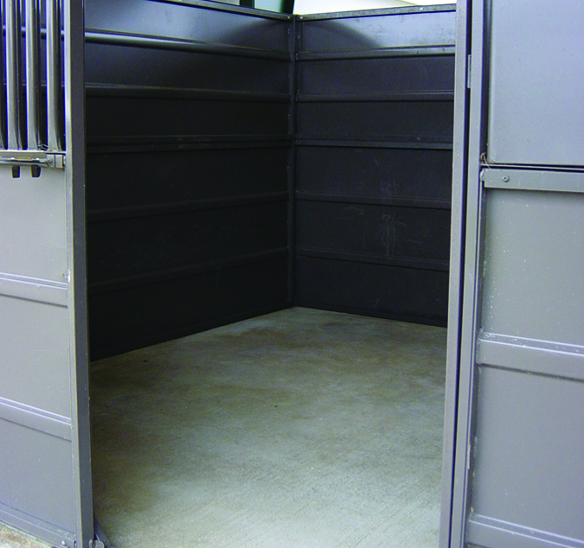
Downtime
Area remains free of animals or activity for a period of time
Allow complete drying
Further reduces any remaining microbes
At least 3x the longest incubation time of targeted pathogen
Notes:
Premises that have been cleaned and disinfected should also have a period of downtime following the procedures. This involves the area remaining free of any animals or activity for a period of time to allow it to completely dry. The application of disinfectant solutions uniformly over large areas (e.g., ceilings, walls, floors) can be very difficult. Adequate downtime serves to further reduce or eliminate any remaining microorganisms on the premises through desiccation. Downtime can begin as soon as the premises is certified as clean and disinfected and should be at least three times the longest expected incubation time of the targeted pathogen. Areas should be cordoned off with marking tape to designate these areas. [This photo shows a cleaned barn stall showing various surfaces. Photo source: Carla Huston, Mississippi State University]

Slide 19
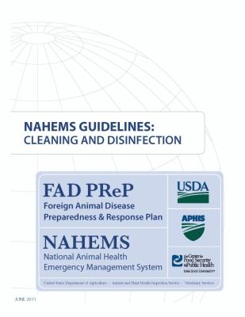
For More Information
FAD PReP/NAHEMS Guidelines & SOP: Cleaning and Disinfection (2011)
http://www.aphis.usda.gov/animal_health/emergency_management/
Cleaning and Disinfection web-based training module
http://naherc.sws.iastate.edu/
Notes:
More details can be obtained from the sources listed on the slide, available on the USDA website (http://www.aphis.usda.gov/animal_health/emergency_management/) and the NAHERC Training Site (http://naherc.sws.iastate.edu/)

Slide 20
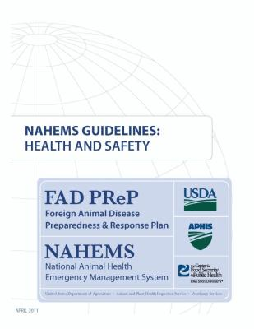
Guidelines Content
Author (CFSPH)
Glenda Dvorak, DVM, MS, MPH, DACVPM
Nichollette Rider, Junior Veterinary Student
Reviewers (USDA)
Nathan G. Birnbaum, DVM
Samantha B. Floyd, Biologist
Notes:
This slide acknowledges the authors and reviewers of the Guidelines document.

Slide 21
Acknowledgments
Development of this presentation was by the Center for Food Security and Public Health at Iowa State University through funding from the USDA APHIS, Veterinary Services
PPT Authors: Dawn Bailey, BS; Kerry Leedom Larson, DVM, MPH, PhD, DACVPM; Reviewers: Glenda Dvorak, DVM, MPH, DACVPM; Patricia Futoma, Veterinary Student;
Janice Mogan, DVM
Notes:
Information provided in this presentation was developed by the Center for Food Security and Public Health at Iowa State University College of Veterinary Medicine, through funding from the US Department of Agriculture, Animal and Plant Health Inspection Service, Veterinary Services.

