Slide 1
Traffic Control and Movement
During Animal Health Emergencies
Notes:
December 2013
During animal health emergencies, the control of vehicle traffic will be an important task. This Just-In-Time training will address recommended practices and procedures associated with traffic control on local and state roads during an animal health emergency.

Slide 2
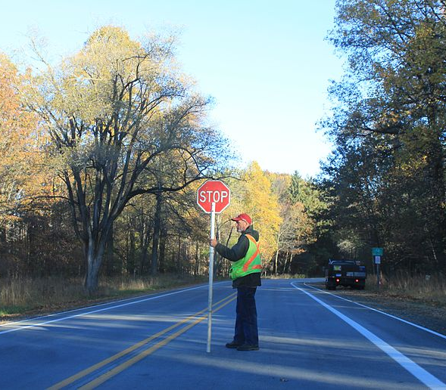
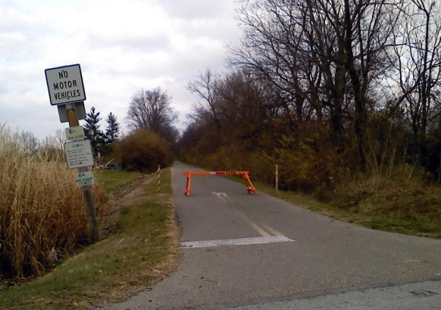
Traffic Control
Function
Inform driver of incident
Subsequent travel direction
Setup
Controlled access
Access corridor
Screening checkpoint
Stop movement
No-access
Unmanned
Manned
Notes:
Traffic control procedures for an animal health emergency may be needed to address vehicles carrying animals that are on the road during the event. This may range from commercial semi trucks or personal trailers carrying livestock or poultry to personal vehicles transporting pets. The establishment of checkpoint stations during an animal health emergency may be needed to identify vehicles transporting affected animals and commodities in efforts to control any disease spread and protect animal health or to redirect traffic away from affected areas.
Traffic control points will serve two functions. The first is to inform the road user of an incident, and secondly to guide or direct vehicles to a particular area. This may involve movement to a screening area, a cleaning and disinfection area, or for re-routing or detouring purposes.
Most traffic control locations will involve personnel directing traffic and conducting vehicle checks when necessary. Vehicles arrive and proceed through traffic controlled access point, and are then detoured or diverted to a new location away from the impacted area. Personnel should be familiar with acceptable detour routes to help guide vehicles.
No-access points, such as at the entrance to a quarantined farm or entry at state border, should have personnel stationed at the location to ensure entry restriction. However, depending on the size of the impacted area and the number of roadways involved, there may not be enough personnel to man all traffic control points. In these situations, the use of unmanned traffic control points may be necessary. Unmanned control points are generally no-access and can be established by placing some sort of physical barrier, such as concrete barricade, hay bales, parked vehicles, to block access to the roadway and aid in travel restriction efforts.
[Photo: Manned traffic control point. Source: Dwight Burdette/Wikimedia Commons]

Slide 3
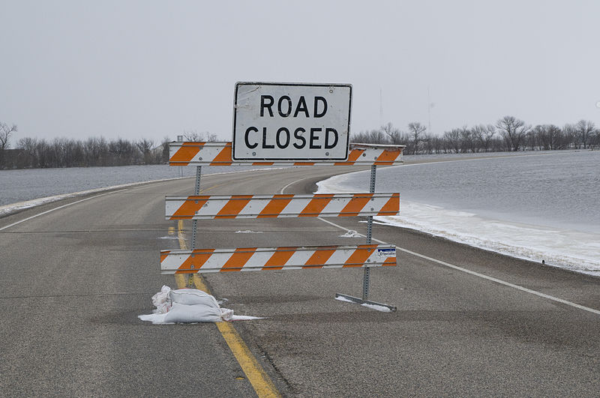
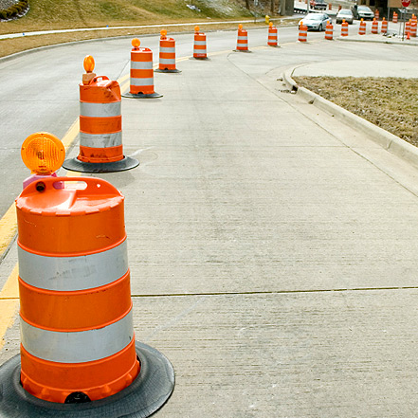
Need for Traffic Control
Highly Contagious Animal Disease Event
Establish quarantine zone
Prohibit vehicle entry
Identify susceptible or at-risk animals on the road
Natural Disaster Event
Direct traffic for evacuation procedures
Notes:
During situations involving highly contagious animal diseases, inhibiting traffic entry into the quarantine area will be essential. Additionally, the screening of vehicles on the road will be necessary to identify any susceptible or at-risk animals. Traffic control procedures will also be necessary during certain natural disaster events, especially those involving evacuation measures. Individuals leaving the area will need to be guided away from the evacuation or impacted areas to safe locations to ensure their safety as well as safety of their animals.
[Photo: (Top) Road closure sign. Source: Wikimedia Commons; (Bottom) Cones used to direct traffic through a controlled access point. Source: American Traffic Safety Services Association at http://www.highwaysigning.com/traffic-control.html]

Slide 4
Personnel
Personnel | Job Description | Examples
Law Enforcement | Enforce general traffic laws and special checkpoint laws and help with checkpoint screening protocols | State and local police, reserve departments, conservations officers, park rangers, military police
Animal Health | Tend to animals and answer questions regarding animal health | State or local veterinarians, veterinary technicians, livestock extension agents
Cleaning & Disinfection | Conduct cleaning and disinfection procedures on vehicles | Local fire and rescue teams, HazMat teams, trained state and local authorities
Support | Help with traffic flow and administrative tasks | Vehicle flaggers, volunteer groups, administrative coordinators
Notes:
Regardless of the purpose or type of traffic control points, personnel will be needed to establish, operate, and maintain the traffic control points. There are four main types of personnel that should be involved in traffic and movement control at checkpoints: law enforcement, animal health, cleaning and disinfection, and support staff. Law enforcement officials are responsible for enforcing general laws, any special checkpoint laws, and helping with checkpoint screening protocols. Law enforcement personnel that may be able to assist at a vehicle checkpoint would be state and local police, conservation officers, park rangers, and military personnel. At least one animal health expert should be present at all checkpoints involving animals to answer questions regarding animal health. This could be a local or state veterinarian, veterinary technician, or livestock extension agent. Personnel properly trained in cleaning/disinfection and decontamination procedures should be present. Members of local fire and rescue teams or HazMat teams may have experience and training in setting up and operating decontamination areas and serve as an useful asset. Local public works personnel can aid in traffic control setup and as vehicle flaggers. Support staff and personnel will be needed for various administrative tasks to ensure efficient processing. All traffic control and movement procedures should follow Incident Command System procedures. Due to the dynamic nature of animal health emergency response communication between the traffic control point and incident commander is essential.

Slide 5
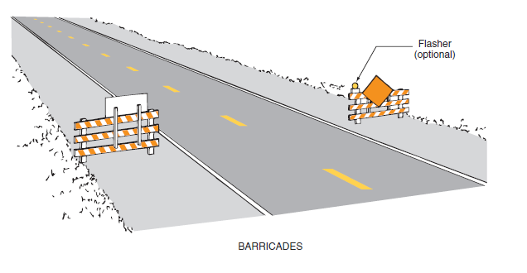
General Equipment
Barricades
Contain and direct vehicles
Signs
Direct drivers
Shelter
House volunteers
Lighting
Warn drivers
Volunteer needs
Reflective vests, communication
Animal needs
Cooling equipment
Water source
Notes:
Traffic control equipment such as signage, cones, barricades, will be needed to guide vehicles through the traffic control access corridor. Barricades can be any object that can stop the flow of traffic or direct vehicles to necessary areas. Signage will be needed to warn and inform drivers on how to proceed through the checkpoint, as well as identify alternate detours. Signs should be able to withstand all kinds of weather. For operations occurring at night, lighting and flashing lights should be used to warn drivers of the checkpoint as well as provide light for administrative purposes. However, the use of too many lights at an incident scene can be distracting and can create confusion, especially at night.
Volunteers will need equipment such as reflective vests, portable radio communication devices. Shelters for personnel may be needed in situations involving inclement weather. Depending on the situation, equipment and supplies to address animal needs may be necessary, an example would include shade, fans, or sprayers to cool down animals in the summer.
[Photo Source: Source: NCHRP Report 525, Vol 13: A guide to traffic control of rural roads in an agricultural emergency. Available at http://www.nap.edu/download.php?record_id=14184]

Slide 6
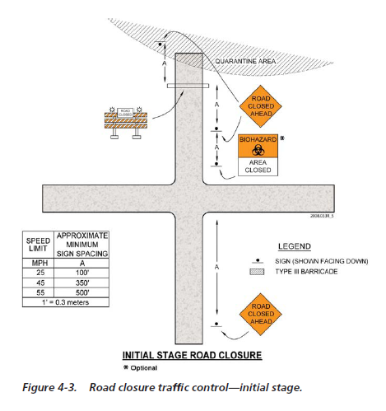
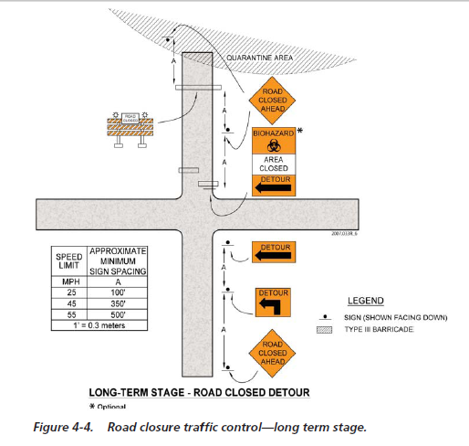
Initial/Temporary Traffic Control
Long Term Traffic Control
Notes:
For all traffic control points, all necessary signs should be in place prior to opening any detour or temporary routes to traffic and placed so as to provide drivers with adequate advanced warning to assist in guiding and traffic flow. The image on the left shows a basic temporary traffic control set up. The image on the right shows additional signage needed when control access points are longer term.
All personnel working at traffic control points should be familiar with or trained in the installation and removal of traffic control devices, the layout for traffic control zones, and the operation and maintenance of traffic control zones, including appropriate flagging techniques and hand signaling.
[Photo Source: NCHRP Report 525, Vol 13: A guide to traffic control of rural roads in an agricultural emergency. Available at http://www.nap.edu/download.php?record_id=14184]

Slide 7
Components of Temporary Traffic Control Zones
Advance Warning Area
Tells traffic what to expect ahead
Transition Area
Moves traffic out of its normal path
Activity Area
Where work takes place
Termination Area
Lets traffic resume normal flow
Notes:
Traffic control points should follow the same basic design to ensure efficient vehicle flow to “safe” locations. Traffic control points should have an advance warning area, a transition area, an activity area, and a termination area. The advance warning area tells road users about the upcoming incident area and tells traffic what to expect ahead (e.g., detour). The transition area is where road users are directed out of their normal path, either to a screening area or toward the detour point. The activity area is where any work activity, such as screening or cleaning and disinfection, takes place. Finally, the termination area is where the road users are returned to normal traffic flow.

Slide 8
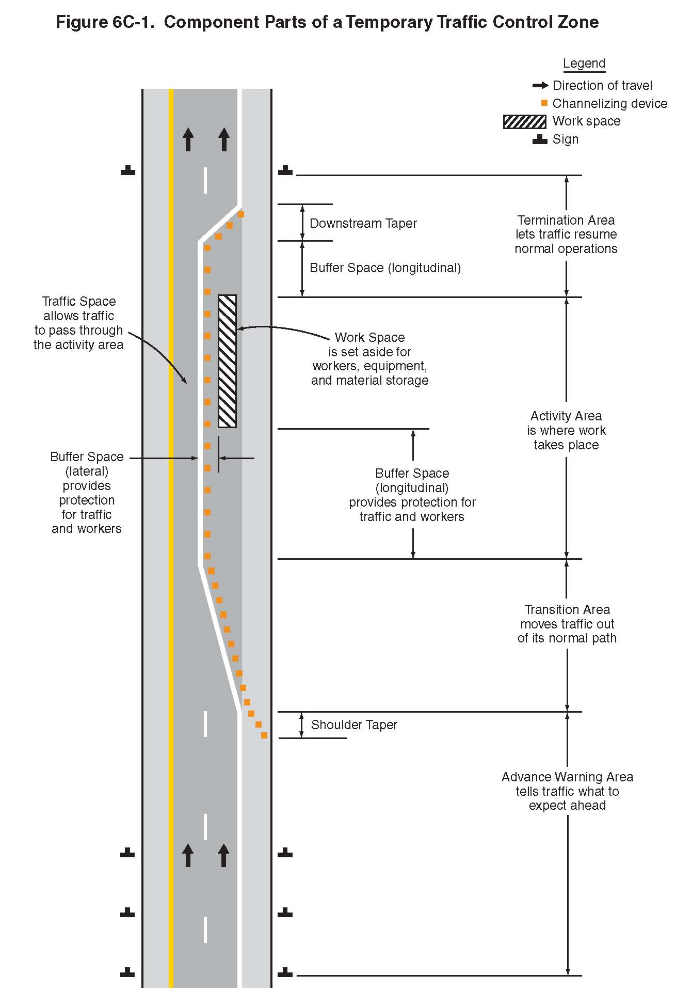
Termination Area
Activity Area
Transition Area
Advance Warning Area
Notes:
This illustration shows the layout of the four components of a temporary traffic control zone: the advance warning area, the transition area, the activity area, and the termination area. Source: Manual on Uniform Traffic Control Devices, 2012 edition; Part 6: Temporary Traffic Control. Available at http://mutcd.fhwa.dot.gov/pdfs/2009r1r2/pdf_index.htm]

Slide 9
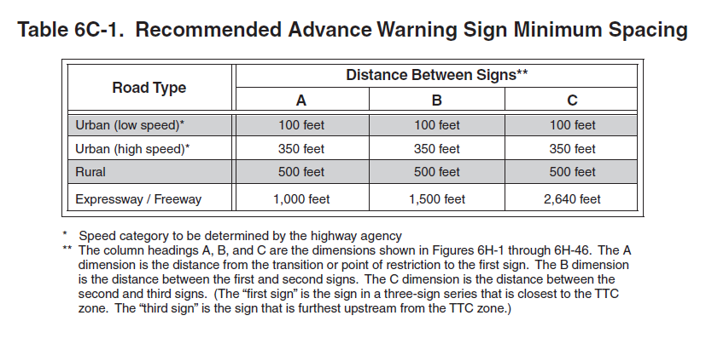
Notes:
The placement of advance warning signage, in general, should be at least ½ mile or more from the traffic control point; however, this may change depending on the type of road. This table shows the recommended minimum distancing for advance warning signage for various road types.

Slide 10
Biosecurity
Especially for infectious disease outbreak situations
Same standards used for the response situation
To prevent the spread of disease agents
To assist in the eradication of disease agents
Notes:
Traffic control points used for infectious disease outbreak situations will need to implement and follow the same biosecurity standards used for the disease response. Biosecurity is a set of activities designed to: 1) prevent the spread of disease agents to healthy livestock and poultry populations and 2) assist in the eradication of a highly contagious disease by minimizing the potential for a disease agent to spread to additional areas. Cleaning and disinfection measures may need to be implemented.

Slide 11
Animal Welfare
Weather can have dramatic impact
Equipment to warm or cool animals in vehicle checkpoint line
Keep vehicles moving in timely manner
Notes:
Animal welfare issues will need to be taken into account at traffic control checkpoints. Weather – especially heat – can have a dramatic impact on the health and well-being of animals, particularly livestock, stopped at traffic check points. Every effort to keep vehicles moving in a timely and efficient manner is essential. Portable fans and misting devices may be needed to keep animals cool.

Slide 12
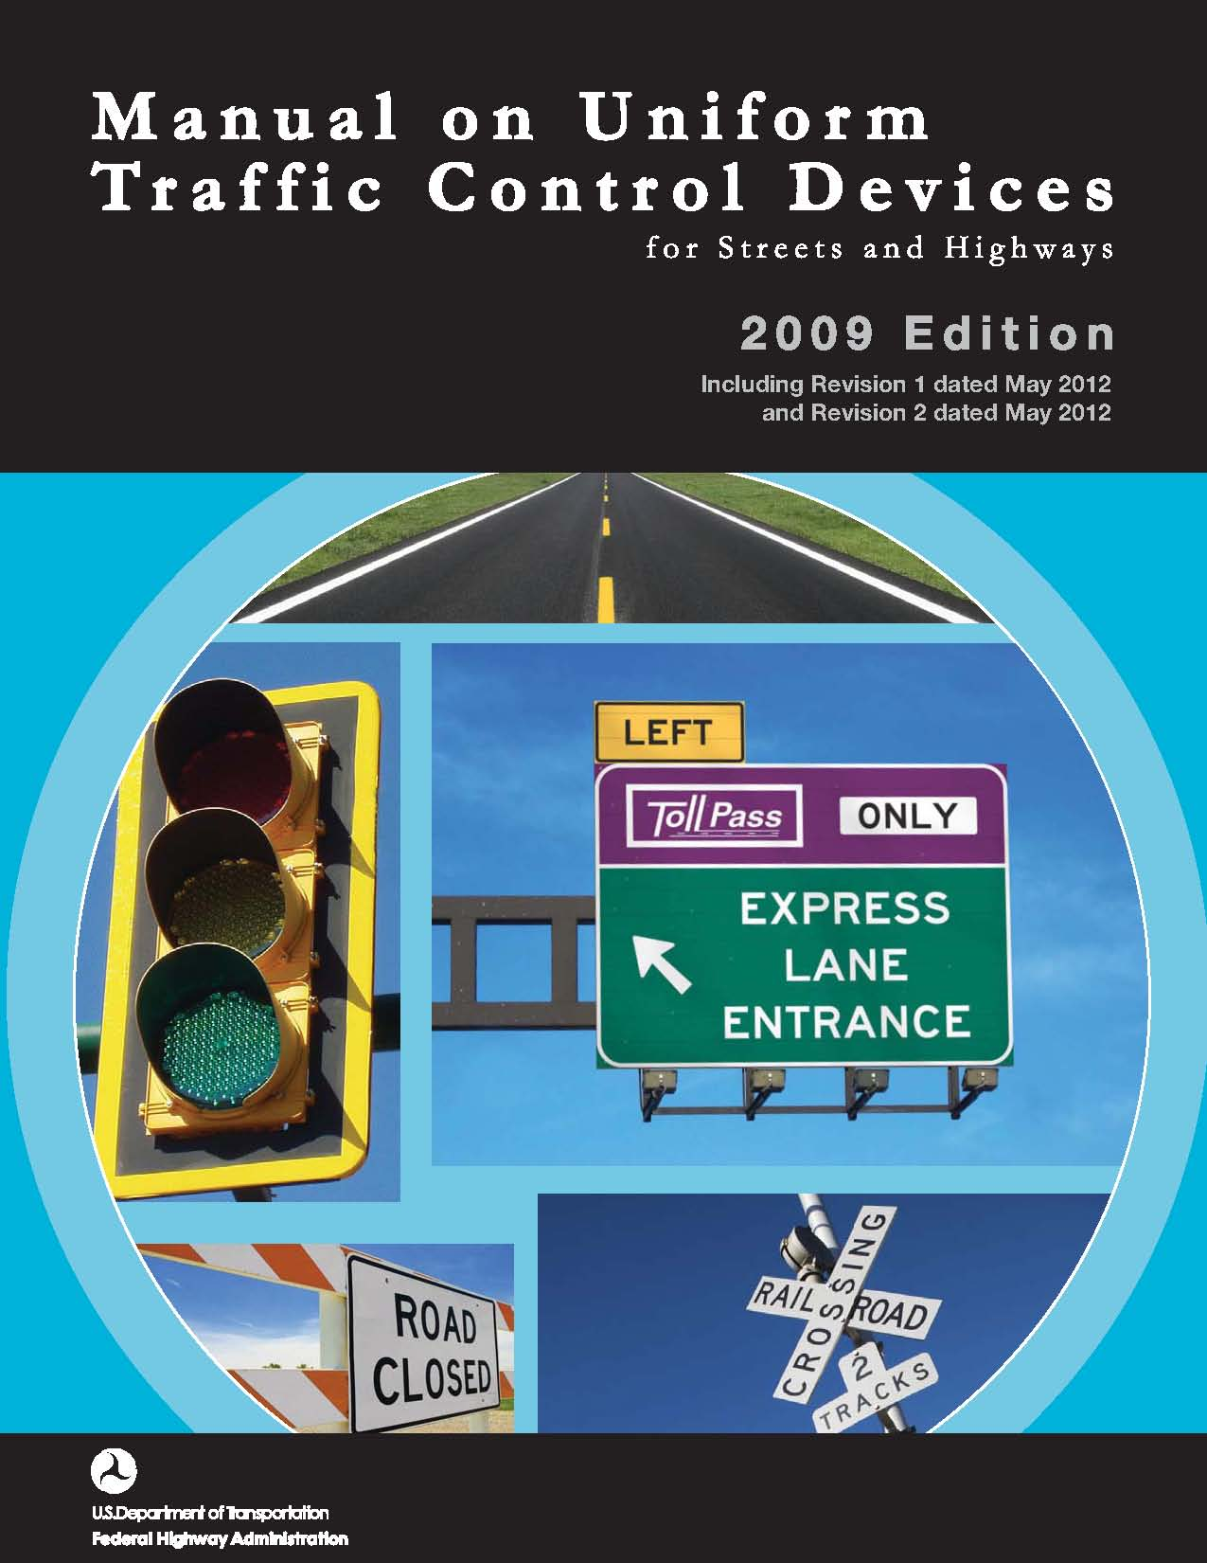
Additional Information
Checkpoint Setup and Operation JIT http://www.cfsph.iastate.edu/Emergency-Response/just-in-time-training.php
Manual on Uniform Traffic Control Devices
http://mutcd.fhwa.dot.gov/pdfs/2009r1r2/pdf_index.htm
Notes:
Additional information on the setup and operation of vehicle checkpoints for animal health emergencies can be found in the “Checkpoint Setup and Operation Just-In-Time training presentation. Extensive detail on the proper setup and implementation of traffic control procedures can be found in the Manual on Uniform Traffic Control Devices at http://mutcd.fhwa.dot.gov/pdfs/2009r1r2/pdf_index.htm

Slide 13
Resources
Graham JL, Hutton J, Cao S, Fagel M, Wright W. 2008. National Cooperative Highway Research Program (NCHRP) Report 525, Volume 13: A guide to traffic control or rural roads in an agricultural emergency.
http://www.nap.edu/catalog.php?record_id=14184
Emergency Agriculture Movement Control Checkpoint Selection Guidance. Multi-State Partnership for Security in Agriculture.
http://www.nasda.org/File.aspx?id=4076
Traffic Control – Agricultural Response Monograph No. 001. Nebraska Department of Agriculture
http://www.nda.nebraska.gov/homeland_security/monograph_001.pdf
Notes:
Additional information on checkpoint set up and operation during an animal health emergency response can be found in these resources.

Slide 14
Acknowledgments
Development of this presentation was by the Center for Food Security and Public Health at Iowa State University through funding from the Multi-State Partnership for Security in Agriculture
Authors: Abbey Smith; Glenda Dvorak, DVM, MPH, DACVPM
Notes:
Information provided in this presentation was developed by the Center for Food Security and Public Health at Iowa State University College of Veterinary Medicine, through funding from the Multi-State Partnership for Security in Agriculture.

