Slide 1
Animal Behavior & Restraint
Swine
Notes:
June 2012
During animal health emergency situations involving swine, tasks requiring the handling and restraint of the animals are likely. Having a basic understanding of swine behavior will allow for more effective efforts, thereby minimizing stress on the animals and reducing the risk of injury to responders. This Just-In-Time presentation will overview basic swine behavior, as well as handling and restraint measures that may be needed for animal health emergencies.
Additional information can be found at Kittawornrat A, Zimmerman JJ. Toward a better understanding of pig behavior and pig welfare. Animal Health Research Reviews 2010. www.fao.org/fileadmin/user_upload/animalwelfare/1_download.pdf

Slide 2
Behavior
Notes:
Let’s first look at normal swine behavior. Understanding a pig’s natural instincts will help a handler use proper low-stress handling techniques.

Slide 3
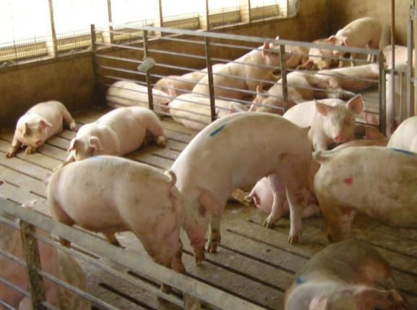
Swine Characteristics
Gregarious, social animals
Social order
Panoramic vision
Follow each other
Maintain visual and body contact
Inquisitive nature
Very susceptible to hot temperatures or conditions
Notes:
Swine are gregarious and social animals. They have a panoramic (310º) range of vision and have a natural tendency to follow each other and maintain visual or body contact. They do however, establish a social order, with one animal becoming the dominant individual for the group. Every time a pig is removed or added to the group (regardless of that animal’s social order) pigs in the group will fight to re-establish social order. Isolation from a social group is very stressful for pigs. Swine also have an inquisitive nature and spend much of their time in forage-related activities, such as rooting, grazing and exploring with their snout. They also like to chew on objects, including each others ears or tails at times. Pigs are unable to sweat and thus are very susceptible to hot temperatures or conditions; therefore handling under these conditions should be avoided. [A photo of a group of pigs. Source: Alex Ramirez, Iowa State University] Kittawornrat A, Zimmerman JJ. Toward a better understanding of pig behavior and pig welfare. Animal Health Research Reviews 2010. www.fao.org/fileadmin/user_upload/animalwelfare/1_download.pdf

Slide 4
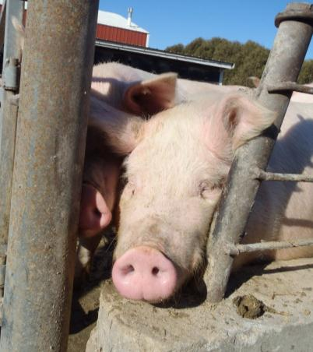
Normal Swine Behavior
Grunt/bark when agitated
Squeal loudly when restrained or frightened
Use hearing protection
Strong natural urge to escape
Gaps between pens, alleys, ramps, side gates, chutes
Often injure themselves
Notes:
Pigs will grunt or bark when agitated and may squeal loudly when restrained or frightened. Hearing protection should be used when handling swine. Pigs have a strong natural urge to escape. Small gaps between pens, alleys, ramps, side gates, chutes, or anywhere else may encourage a pig to try to escape. During these escape attempts, pigs frequently injure themselves. Swine prefer lighted areas, opposed to darkness; this characteristic can be used to encourage movement (e.g., facilitate loading). [A photo of a pig exploring a gap in the fencing. Source: Alex Ramirez, Iowa State University]

Slide 5
Handling
Piglets
Finisher pigs
Boars
Sows
Notes:
Proper handling of swine ensures animals are treated humanely during response actions. It also serves to minimize stress and injury to the animals as well as responders. Responders should understand and be proficient in stress-free handling techniques. Capable handlers are essential to the safety and well-being of both the animals and responders.

Slide 6
Handling
Notes:
Proper animal handling plays a key role in the health and welfare of the pig. Animal handlers should be trained to use behavioral principles of handling such as flight zone and point of balance, as illustrated in the figure shown. The flight zone (as shown by the circle) is the animal’s personal space. The size of an animal’s flight zone is determined by the level of “tameness,” or how accustomed they are to being around humans. Completely tame animals have no flight zone. When the flight zone is entered, the animal will turn and move away. When you are standing outside the flight zone, the animal will turn and face you.
To make an animal move forward, the handler should stand at the edge of the flight zone behind the point of balance. The point of balance is the area at the animal’s shoulder. The animal will move forward if the handler stands behind the point of balance, and will back up if the handler stands in front of the point of balance. It ideal location for the handler is between position A and B on the diagram, at the edge of the flight zone. Note: the blind spot behind the animal (light gray) should be avoided.
Pigs do not like to move in reverse. They will take a few steps in reverse but then will plunge forward. Always move pigs in a forward direction. [An illustration showing a pig’s flight zone, point of balance, and blind spot. Content source: Transport Quality Assurance™ Handbook, National Pork Board, 2008]

Slide 7
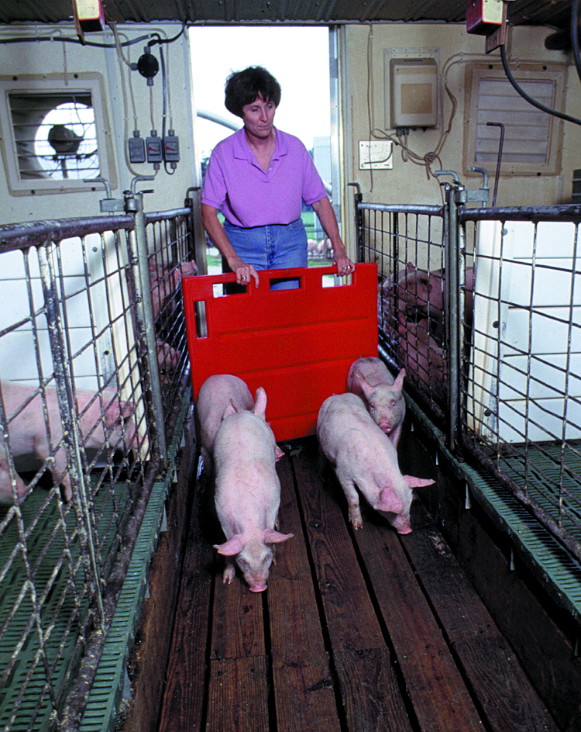
Handling
Non-slip flooring critical
Primary movement aids
Flags, plastic paddles, panels
Frequent electric prod use is detrimental
Move pigs in small groups of 5 or 6 to prevent turning around, bunching, piling up
Distractions: Shadows, reflections, moving objects, air drafts, people, noises
Notes:
Before handling any animals, be sure to have all necessary equipment close at hand. Non-slip flooring is critical to stress-free handling. Flags, plastic paddles, or panels should be used as the primary movement aids. Pigs should be moved in small groups of 5 or 6 to prevent them from turning around or causing them to bunch or pile up. Use slow deliberate movement, and avoid loud noise or sudden movement. In double runway chutes, pigs like to move up ramps side-by-side. Single chutes should be 16-18 inches wide for market pigs, forcing them to remain single file. Pigs are very sensitive to distractions such as shadows, reflections, and small moving objects. These small distractions can impede pig movement through single raceways, alleys, and ramps. Common distractions on farm sites are poor lighting, air drafts, people, and noises. Frequent use of electric prods is detrimental to pig welfare because shocking increases body temperature, heart rate, and the incidence of stressed or non-ambulatory pigs. [Photo: A woman herding four pigs with a plastic panel. Source: National Pork Board]

Slide 8
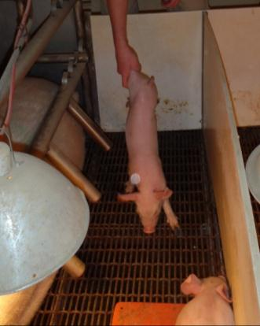
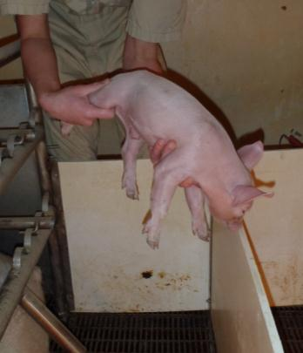
Handling: Piglets
Pick up and carry
Pick up by hind leg
Avoid swinging
Support chest if moving a distance
Never pick up by the ear
Herding
Noise shakers
Move with sorting board using flight zone principles
Notes:
Weaned piglets can be moved by being picked up and carried, or by herding. Piglets should be picked up by a hind leg, without swinging them as they’re being lifted. The chest should then be supported with the other hand when moving the piglet over any distance. When setting the piglets down, they should be lowered gently, front legs first. Piglets should never be picked up by the ear, as this can be painful and lead to ear hematomas. Noise shakers can be used to herd piglets down hallways for loading into trucks or trailers. At a nursery, pigs are usually unloaded by herding them out of the trailer in groups and sorting them by number and size into pens. Towards the end of the nursery phase, pigs may become too large to lift and should be moved using a sorting board, relying on their flight zone and point of balance. Piglets have sharp teeth and can bite; exercise caution when picking them up by scooping under the rib cage or lifting a rear leg above the hock. Sows may become aggressive when piglets are removed; use care when reaching into the pen. [Photos: A piglet being picked up by the back leg and lifted with its chest supported. Source: Alex Ramirez, Iowa State University (both)]

Slide 9
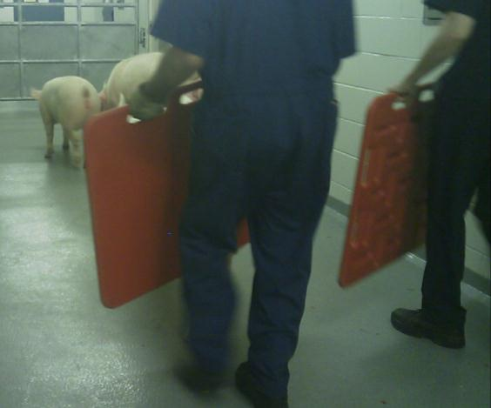
Handling: Grower/Finisher Pigs
Work in pairs
Move small groups
Utilize flight zone
Use sorting board to turn/stop pigs
Watch for fatigue
Open mouthed breathing
Inability to move
Splotchy skin
Notes:
Grower/finisher pigs are those that weigh 50-250 pounds. The most effective technique for moving pigs of this size is to have handlers work in pairs, using flight zone principles. Always move in small groups of 5 or 6 pigs. A sorting board can aid in turning or stopping grower-finisher pigs. It is also important to watch for signs of fatigue such as open mouthed breathing, inability to move, or splotchy skin. Pigs are extremely susceptible to heat and over-heating. Careful and proper handling will reduce stress to the animal and minimize the risk of animals becoming fatigued. [Photo: Two people using plastic panels to move pigs. Source: Danelle Bickett-Weddle, Iowa State University]

Slide 10
Handling: Grower/Finisher Pigs
Ensure path is clear, secure, obvious
Move from dark to light areas with no shadows
Move in calm, unhurried manner
Allow pigs to walk at their own pace
Do not kick pigs
Do not use sticks/prods to hit pigs
Notes:
When moving pigs, ensure that the way forward is clear, secure, and obvious to the pigs. Moving them from dark areas to lighter areas with no shadows will make handling much easier for both handler and pigs. Pigs should be moved in a calm, unhurried manner and allowed to walk to the destination at their own pace. Do not kick the pigs or use sticks/prods to directly hit the pigs.

Slide 11
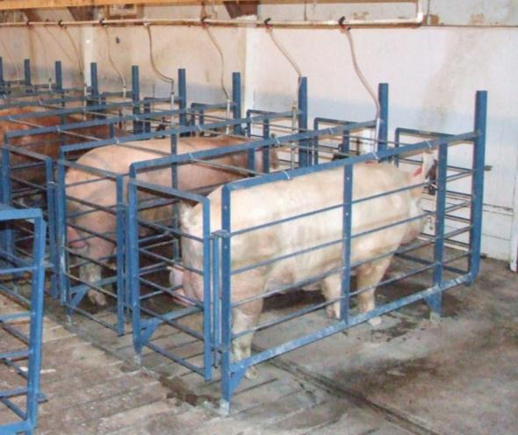
Handling: Boars
Minimize aggression
Move and load individually
Separate pens to prevent injuries
Allow extra time to become comfortable with new environment
Notes:
Male pigs, or boars, require extra precautions when moving or transporting. These animals can be quite aggressive and should be moved and loaded individually. Boars should be penned separately to prevent injuries from fighting with finisher pigs or other boars. Allow extra time for them to become comfortable with their new environment. [Photo: Boars penned separately. Source: Alex Ramirez, Iowa State University]

Slide 12
Handling: Sows
Older, large in size
Require extra time for movement, becoming comfortable with environment
Move and load 2 or 3 at a time
Increased aggression at points in reproductive cycle
Use caution when handling aggressive sows
Notes:
Sows are often older and large in size, requiring extra time for movement and to become comfortable with their environment. Only move 2 or 3 sows at a time. Sows can display aggression during estrus or at/near farrowing. Be aware of where sows are at in their reproductive cycle and handle them cautiously.

Slide 13
Restraint
Piglets
Older pigs
Notes:
The restraint of swine may be necessary during an animal health emergency. Tasks such as blood collection, vaccination or in some instances euthanasia may require restraint.

Slide 14
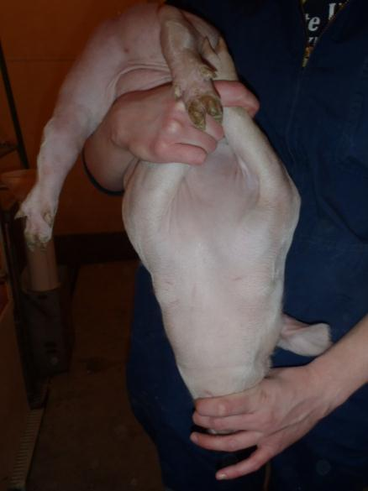
Restraint: Piglets
Lift piglet by back leg
Never by ear, front leg, tail
Place hand under piglet’s chest
Hold pig firmly
Alternative: Place piglet over forearm with piglet’s chest in palm, legs hanging on either side of arm
Notes:
To restrain a piglet for inspection or other purposes, first lift the piglet by a back leg. Again, piglets should never be picked up by their ear, front legs or tails. Next, place your other hand under the piglet’s chest for support. Hold the piglet firmly to minimize its ability to move. As an alternative method of restraint, after the piglet is picked up, it can be placed over the forearm with the piglet’s chest in the palm of your hand and the legs hanging on either side of the arm. [Photo: A piglet immobilized in preparation for a blood draw. Source: Alex Ramirez, Iowa State University]

Slide 15
Restraint: Pigs
Ensure work area is of proper size
Apply pressure to hindquarters/flank to keep pig(s) still
Perform procedure as quickly as possible, return to pen promptly
Notes:
Before restraining pigs, ensure that the work area is large enough to perform the task safely, but small enough to restrict the pigs’ movement. Apply gentle pressure with the pig board/your leg to the hindquarters and flank of the pig(s) to keep them still. Treat the pigs or perform the required procedure as quickly as possible, and return them to their pen promptly.

Slide 16
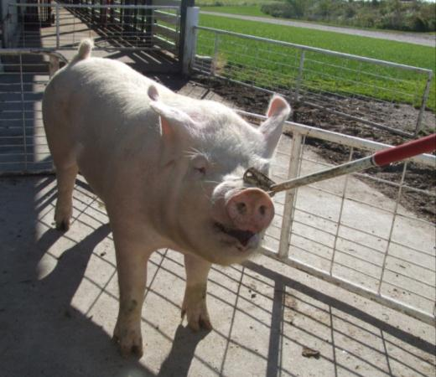
Restraint: Pigs (cont’d)
Use of snare may be necessary
Only used when absolutely necessary
Properly trained, competent handler
Place loop in mouth, over top jaw/snout
Hold snare handle vertically
Move loop back before tightening
Second person performs task
Notes:
If the task to be performed is going to take a significant period of time, the use of a restraining snare may be necessary to adequately restrain the pigs. Snares should only be used when absolutely necessary, and the handler should be properly trained and competent at snaring pigs. The snare loop should be placed in the mouth and over the top jaw and snout of the pigs, with the snare handle held vertically in the other hand. Move the snare loop as far back in the mouth as possible before tightening it. Hold the snare securely while a second person performs the required task. [Photo: A snare being used to restrain a pig. Source: Alex Ramirez, Iowa State University]

Slide 17
Restraint: Pigs (cont’d)
Release pig as soon as possible
Loosen, release snare
Do not restrain for prolonged periods of time
Do not move pig with snare
Do not tie pig up with snare
Notes:
Release the pig as soon as possible by smoothly loosening and releasing the snare. Pigs should not be restrained with a snare for prolonged periods of time, and they should not be moved or tied up with the snare.

Slide 18
Acknowledgments
Development of this presentation was by the Center for Food Security and Public Health at Iowa State University through funding from the Multi-State Partnership for Security in Agriculture
Author: Shaine DeVoe, BS; Glenda Dvorak, DVM, MPH, DACVPM
Reviewer: Alex Ramirez, DVM, MPH, PhD, DACVPM
Notes:
Information provided in this presentation was developed by the Center for Food Security and Public Health at Iowa State University College of Veterinary Medicine, through funding from the Multi-State Partnership for Security in Agriculture.

