Slide 1
Personal Protective Equipment (PPE)
Overview, Donning, Doffing
Notes:
June 2010
During an animal health emergency, hazards from zoonotic diseases or chemical exposures may occur. The use of personal protective equipment, or PPE, can protect you from these exposures and help prevent the further spread of pathogens to other animals, personnel or premises. This Just-In-Time training will overview the use of PPE and proper donning and doffing procedures. Safety considerations while wearing PPE will also be addressed.

Slide 2
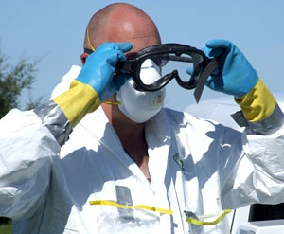
What is PPE?
Special clothing and equipment that places a barrier between an individual and a hazard
Includes
Body covering
Respiratory protection
Gloves
Boots and more
Notes:
The phrase “personal protective equipment” or PPE refers to special clothing and equipment designed to act as a barrier between an individual and a hazard, such as a zoonotic or highly contagious pathogen. PPE includes items to protect the eyes, face, respiratory tract, hands, body, feet, head and ears. [This photo shows a veterinarian is wearing a variety of PPE items: a tear-resistant suit, a disposable respirator, and chemical-resistant gloves. He is also putting on goggles. Photo source: Travis Engelhaupt, Iowa State University]

Slide 3
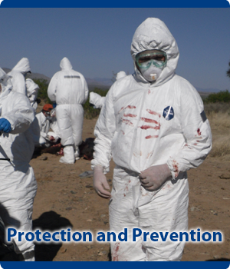
Why is PPE Needed?
Protects responders from potentially life-threatening hazards
Zoonotic diseases
Chemical exposures
Prevents the spread of pathogens between animals or locations
Biosecurity
Notes:
Personal protective equipment serves two purposes: to protect the responder against potentially life-threatening hazards such as zoonotic diseases or chemical exposures, and to prevent the spread of disease agents between animals and locations. Both of these purposes must be taken into consideration when selecting PPE. [This photo shows a veterinary responder in a Tyvek suit with an air purifying respirator and several sample bags taped to his suit. Photo source: John Wenzel, New Mexico State University]

Slide 4
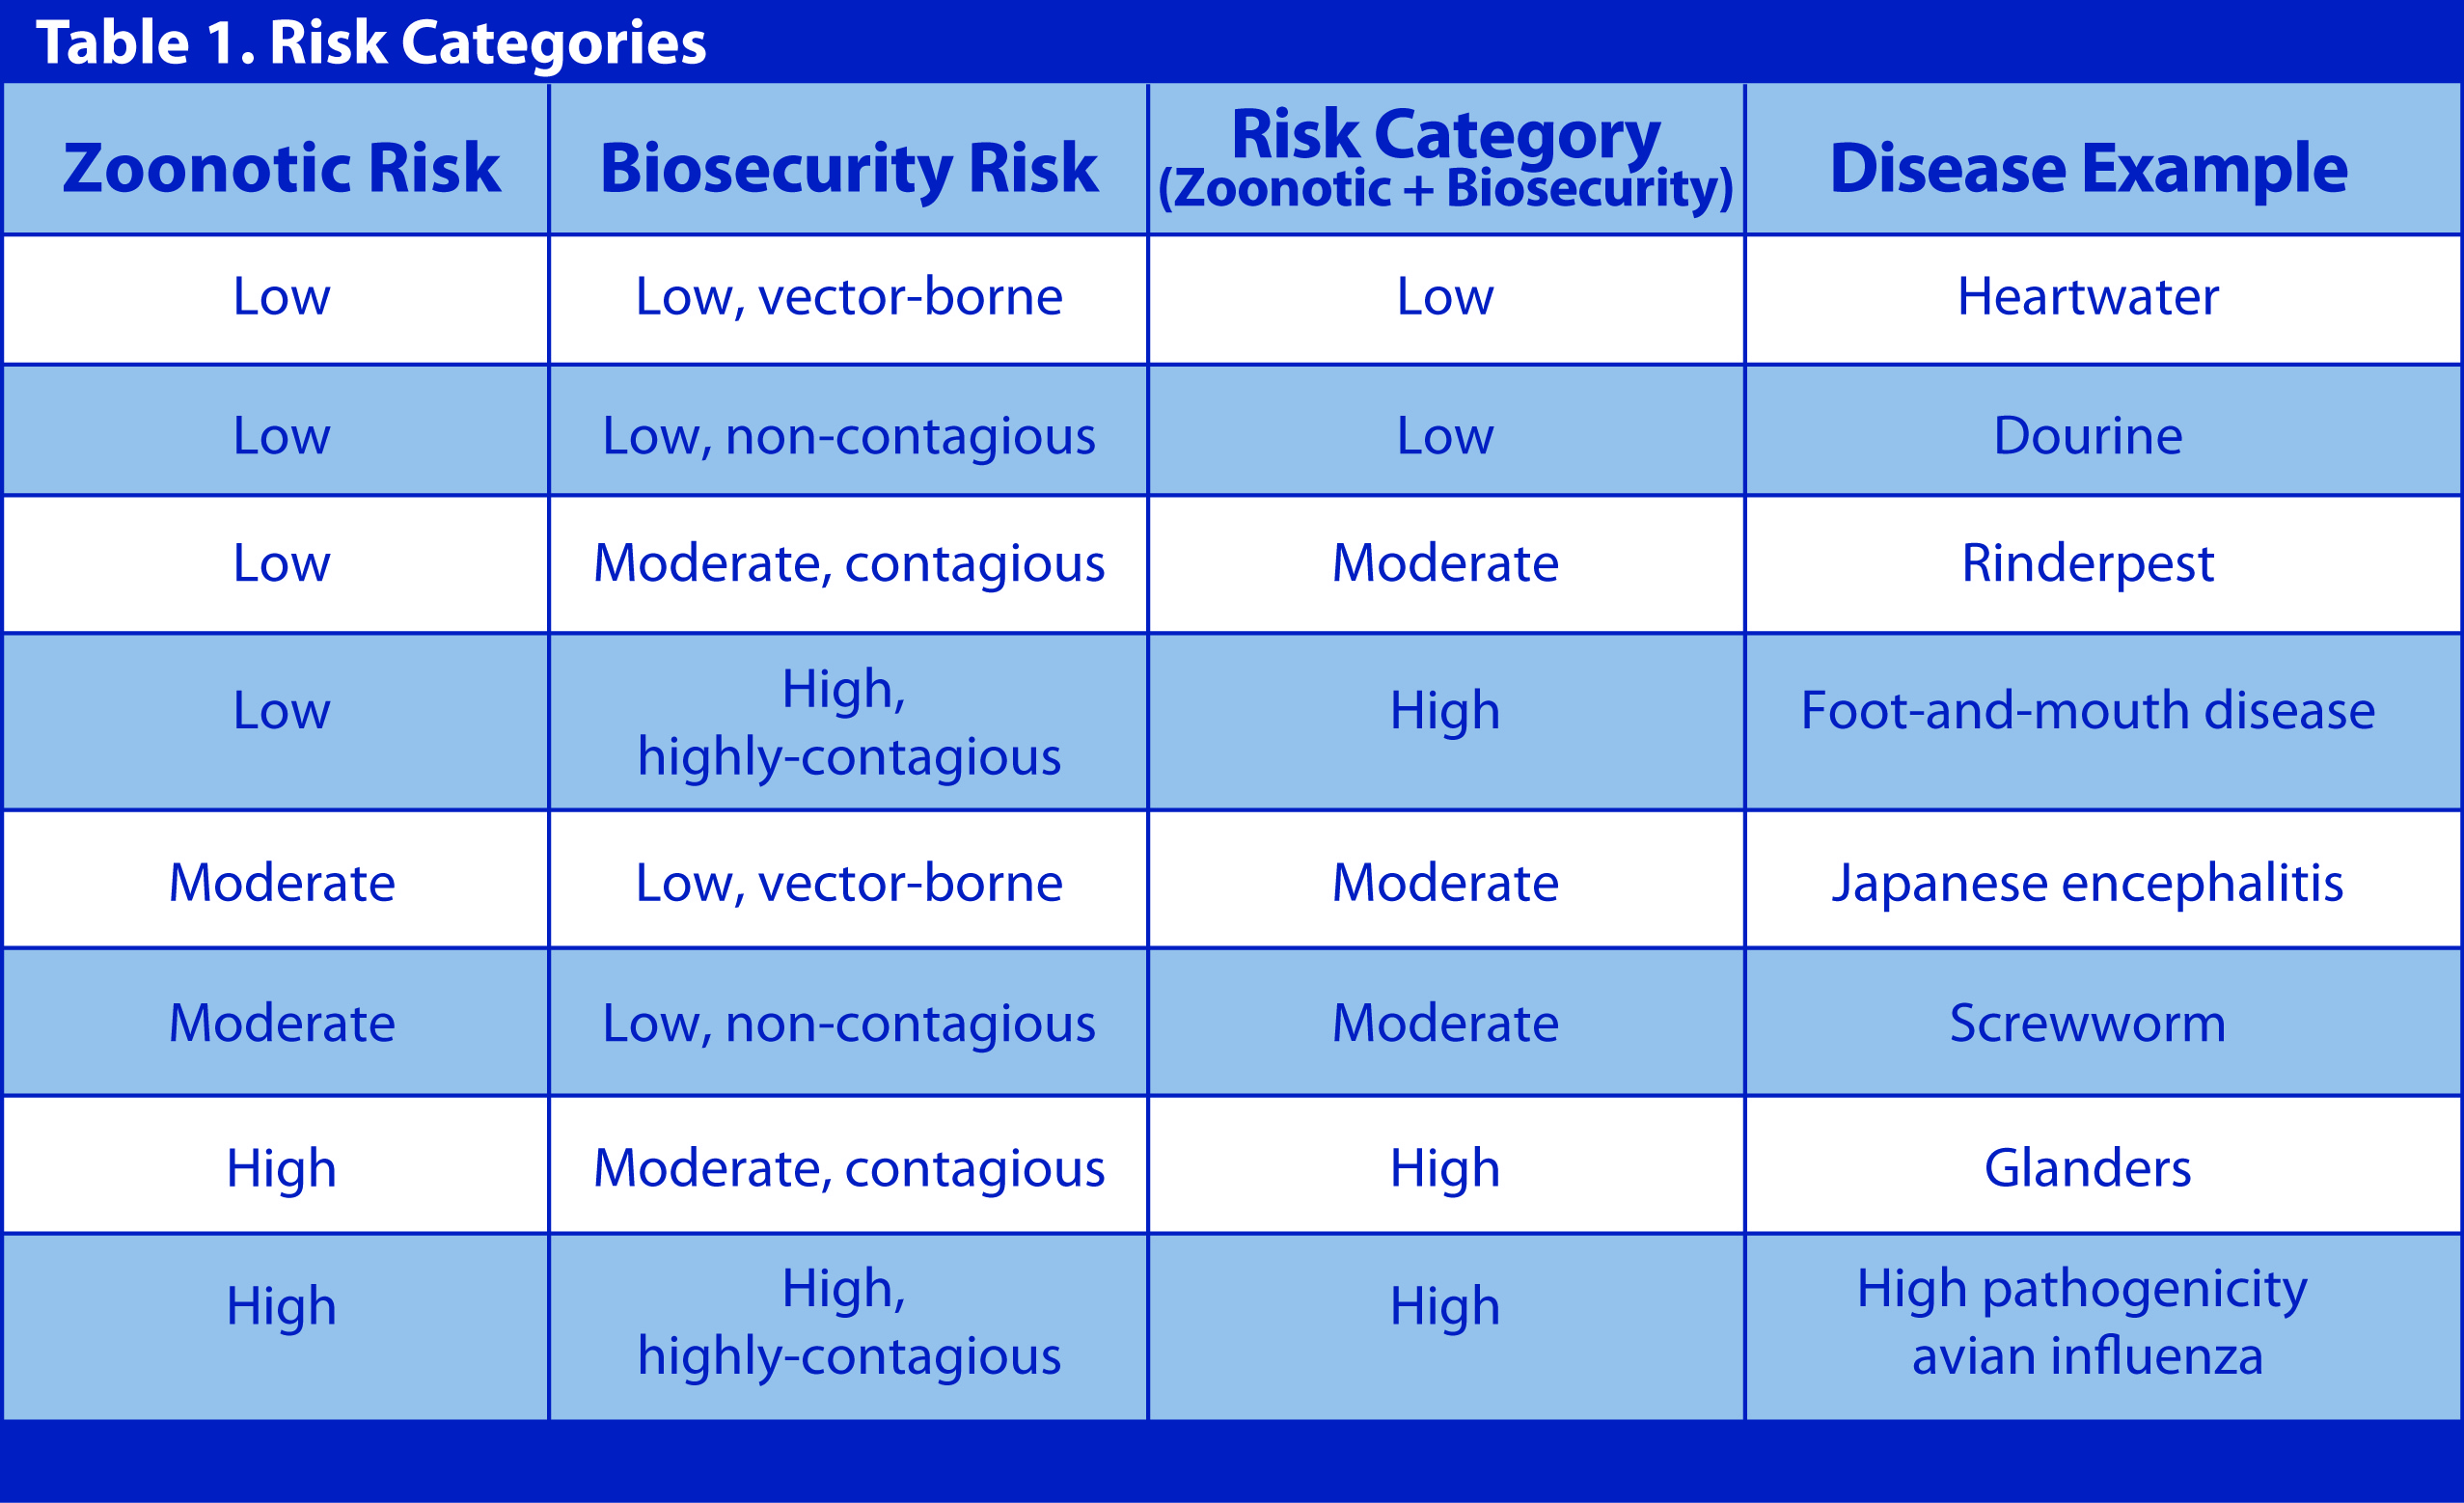
Risk Categories
Notes:
The complex process of PPE selection for potential disease exposures must include consideration of the zoonotic and biosecurity risks. Animal diseases that threaten human health are referred to as zoonotic and the action taken to prevent the spread of disease to other animals or locations is referred to as biosecurity. The zoonotic and biosecurity risks can be divided into low, moderate and high risks. Where the zoonotic risk of a disease is greater than its biosecurity risk, zoonotic risk takes precedence. Table 1 illustrates this concept. This table converts the various combinations of zoonotic and biosecurity risks into low, moderate, and high risk categories and provides an example of a disease that falls into each category.

Slide 5
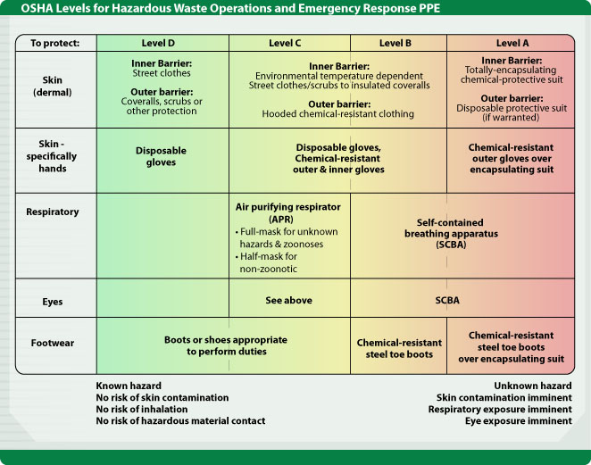
Levels of PPE
Notes:
The Occupational Safety and Health Administration (OSHA) classifies PPE into four levels of protection: A, B, C and D. Level D is the lowest level of protection, while Level A is the highest level of protection.
This table shows the PPE levels and the equipment appropriate to provide that level of protection.
Level D, the lowest level of protection, consists of a basic work uniform and disposable gloves. It would be used for situations of a known hazard with no risk of skin contamination, inhalation threat, or risk of hazardous material contact.
Level C is used when the concentration and types of airborne substances is known. The use of chemical–resistant items are added to allow for disinfection procedures following activities. Face and respiratory protection (such as air purifying respirators) are also used. General agreement exists that Level C PPE would be adequate protection for veterinary responders in most situations. This level would be recommended when responding to a highly pathogenic avian influenza (HPAI) outbreak.
Level B is used when the highest level of respiratory protection is necessary but a lesser level of skin protection is needed than in Level A, such as for a Nipah virus outbreak). At this level a self-contained breathing apparatus would be necessary.
Level A is the level of protection selected when the greatest level of skin, respiratory, and eye protection is required, such as when responding to a large chlorine spill. The use of a totally-encapsulating chemical protective suit would be used.
Emergency response activities in which veterinary responders are involved will almost never necessitate the use of Level B or A PPE. [Graphic illustration by CFSPH, Iowa State University]

Slide 6
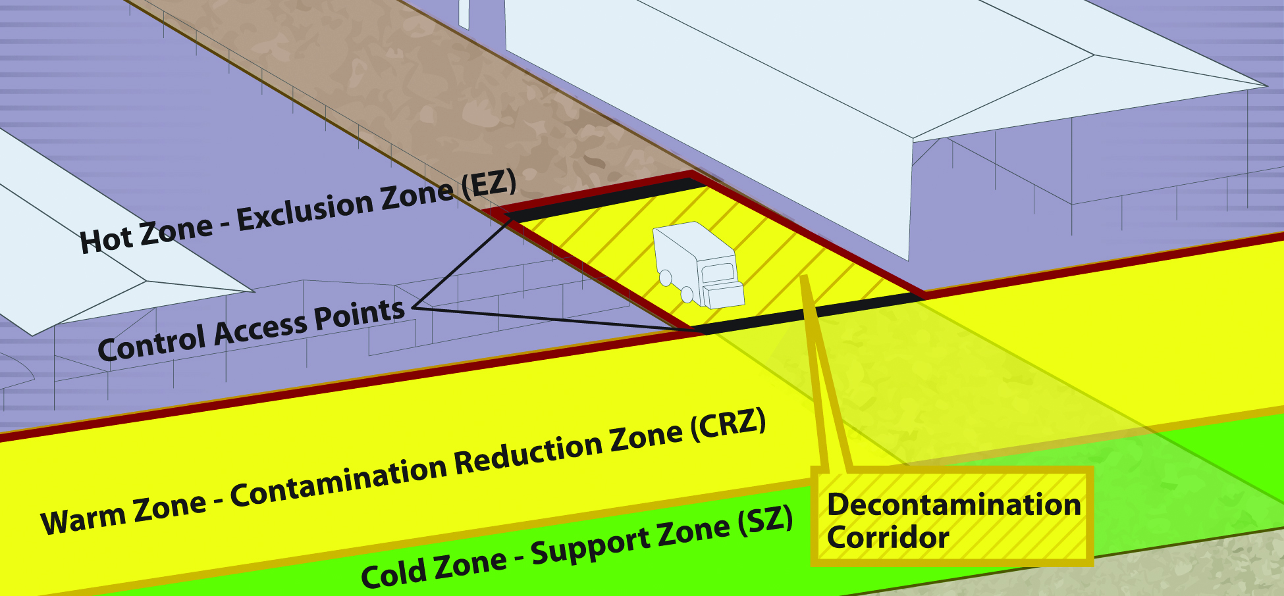
Biosecurity Work Zones
Notes:
Upon arriving at the premises, veterinary responders should follow premises specific protocols and biosecurity procedures. Designated work zones are established to help protect responders and prevent the accidental spread of any hazards. Donning and doffing of PPE within areas of these work zones will be required.
The Hot Zone or Exclusion Zone (EZ) is the potentially contaminated or unsafe area (e.g, infected animal premises). Appropriate PPE must be worn in this area.
The Warm Zone or Contamination Reduction Zone (CRZ) is also considered a high risk area due to the potential for exposure to pathogens and chemical disinfectants. All personnel are required to wear PPE.
The Decontamination or Decon Corridor is the area between the Hot Zone and the Warm Zone. Decontamination of personnel and disinfection of equipment occurs here. Entry and exit into the Hot Zone occurs through Control Access Points along this corridor. Once responders have doffed, disinfected, and decontaminated in the Warm Zone, they should move to the Cold Zone/Support Zone (SZ) through the designated access points.
The Cold Zone or Support Zone (SZ) is the clean/uncontaminated area of the site, where responders should not be exposed to hazardous conditions; support functions are based here. Donning of PPE prior to entry into the Hot Zone occurs here. [Graphic Andrew Kingsbury, Iowa State University. Definitions from USDA FAD PReP Guidelines].

Slide 7
Donning PPE
Level C
Notes:
The terms donning and doffing are often used with PPE. Donning is the procedure of assembling PPE on the user and doffing is the procedure for removal of PPE. Responders should only don PPE for which they have been thoroughly trained, medically cleared to use, and fit tested to wear. Level C protection is adequate for most biological exposures that could potentially occur in an animal health emergency, including a highly pathogenic avian influenza outbreak. Therefore, the donning and doffing process for Level C PPE will be described on the following pages.

Slide 8
Safety
Always use the “buddy system”
Be aware that PPE can create additional responder hazards
Heat stress
Physical injury
Slips, trips, falls
Psychological stress
Impaired vision, movement, and communication
Notes:
Safe and effective donning and doffing of Level C or higher PPE requires assistance so the buddy system should always be used. Wearing PPE can create responder hazards such as heat stress, physical and psychological stress, and impaired vision, movement, and communication. When involved in an incident response, a responder’s time in PPE will be limited to maintain responder safety. Responders must be aware of their physical abilities and overall health when engaged in activities requiring PPE.

Slide 9
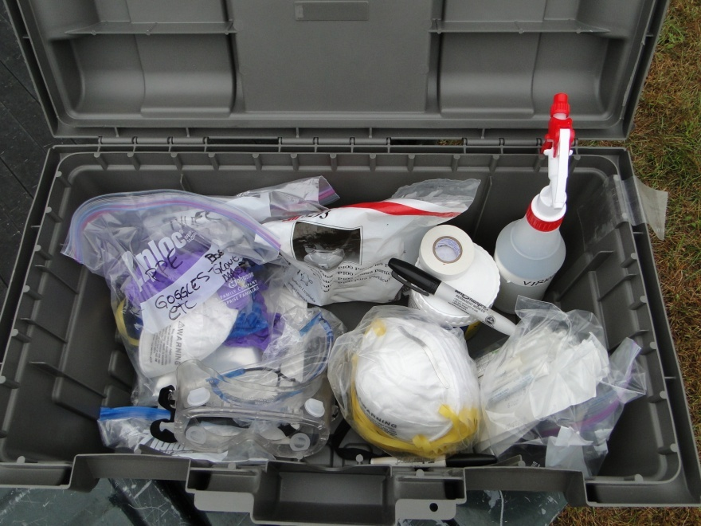
Collect Needed Supplies
Blunt nosed scissors
Chemical resistant tape
Two pairs of gloves (minimum)
Two-piece scrub suit
Long socks
Tyvek® or similar protective suit with boot pouches and hood
Steel toed rubber boots
Disposable or reusable respirator
Goggles
Biohazard bags
Supplies needed to perform tasks on-site
Notes:
Before donning PPE, make sure you have all needed supplies. This should include: blunt-nosed scissors, two pairs of gloves – minimum, a two-piece scrub suit, long socks, (minimum) of gloves, a Tyvek® or similar suit with boot pouches and hood, steel toed rubber boots, a N95 respirator or reusable air purifying respirator (APR), goggles, biohazard bags and any supplies needed to perform tasks on-site. [Photo source: Danelle Bickett-Weddle, Iowa State University]

Slide 10
Preparing to Don PPE
Prepare items
Measure and cut supply of chemical resistant tape
Tabs on end for easy removal
Inspect PPE
Safety features and devices provided
Any damage or rips before, during, and after each use
Notes:
In a changing room or other suitable place in the Cold Zone, lay out PPE items and prepare to don following these steps. Measure and cut a supply of chemical resistant tape long enough to fit all junctions of the suit and facepiece. Cut several extra pieces in case one accidentally sticks to itself and becomes unusable. Put tabs on end of the tape to assist with removal. Remove the Tyvek® or similar suit from the cellophane wrapping. Inspect all PPE items for any damage (e.g, tears, rips, or other imperfections); this should be done before donning, as well as during and after each use. Ensure you have the necessary safety features and devices needed for your assigned activity.

Slide 11
Donning Level C PPE
Pull on chemical-resistant suit
Notes:
After putting on a clean two-piece scrub suit, begin the donning process by pulling on a the chemical resistant suit. [This image shows a responder pulling on a Tyvek® suit. Photo source: Travis Engelhaupt, Iowa State University]

Slide 12
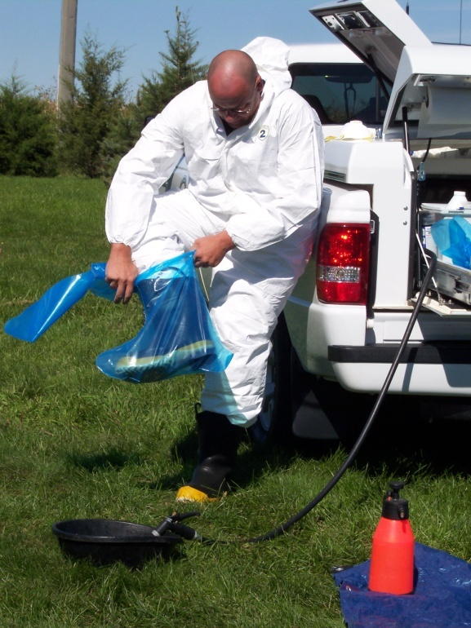
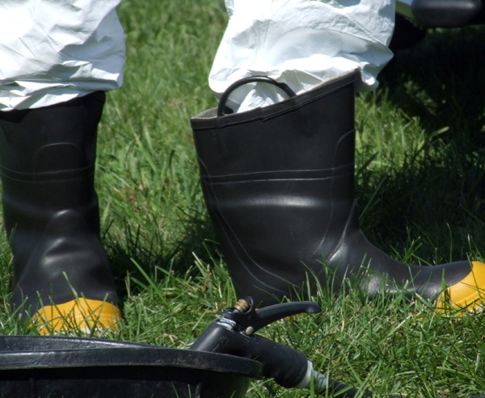
Donning Level C PPE
Step into chemical-resistant boots
Pull on disposable boot covers
Notes:
Next, step into chemical-resistant boots, being careful not to trip or fall down. Pull on disposable boot covers if necessary. [Photos by Jane Galyon, Iowa State University]

Slide 13
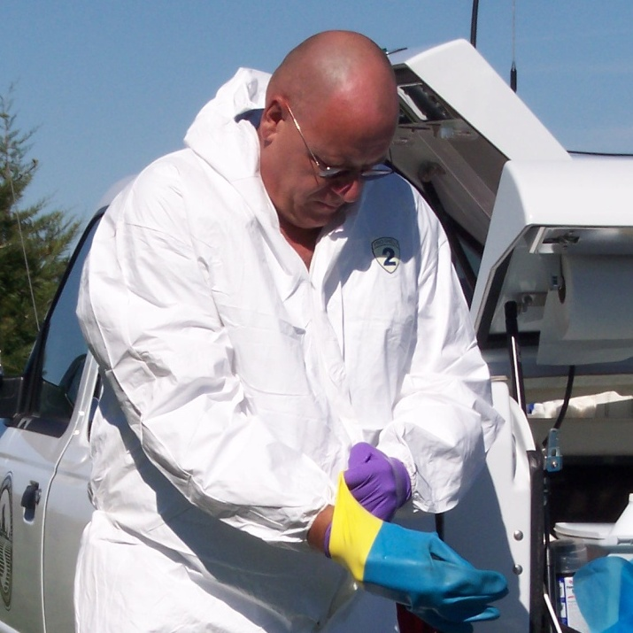
Donning Level C PPE
Pull on inner latex or nitrile gloves
Then outer chemical resistant gloves
Notes:
Next, pull on a pair of latex or nitrile gloves, followed by an outer layer of chemical-resistant gloves. This double-layered protection provides safety against the majority of hazards. [Photo source: Jane Galyon, Iowa State University]

Slide 14
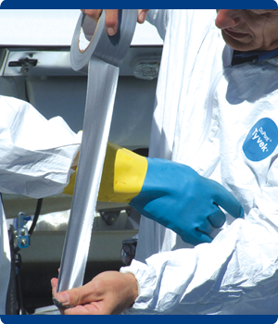
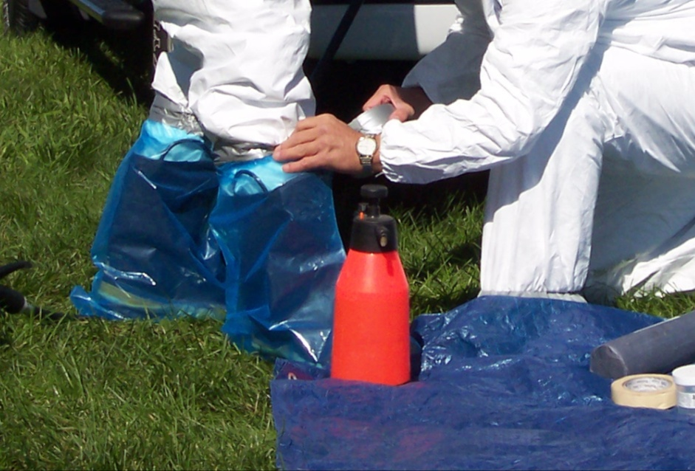
Donning Level C PPE
With a team member
Tape-seal suit and boot junctions
Be sure to leave room to bend, walk, prevent ripping
Notes:
Using the buddy system, wrap chemical-resistant tape around the top of boots around the junction of the protective coveralls and around each wrist at the junction of the glove and coverall cuff. This will help to ensure no fluid enters from the outside. One to three turns should be sufficient. Leave a tab on the tape end to help when doffing. When taping be sure to leave enough “give” to bend and walk and to prevent ripping. [These photos shows a veterinarian tape-sealing the junctions between the suit and gloves/boots. Photo source: Jane Galyon and Travis Engelhaupt, Iowa State University]

Slide 15
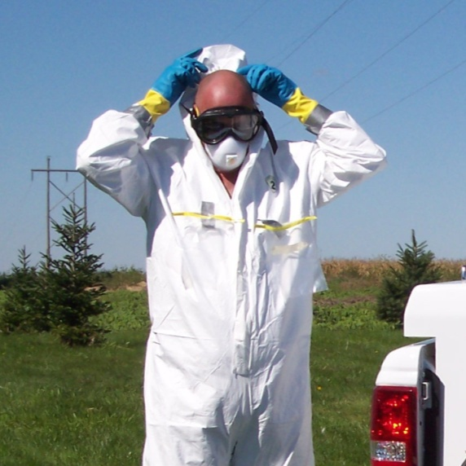
Donning Level C PPE
Put on APR
Fit testing required prior to wearing
Adjust straps
Conduct an APR user seal check
Put on goggles
Pull on coverall hood
Notes:
Next, put on the assigned APR respirator for which you have been medically cleared and fit tested for. Using the buddy system, conduct a check to ensure your APR seals properly. If a proper fit cannot be achieved, do not enter the area where protection is required. Put on goggles, if eye protection is not provided by the APR, taking care not to disrupt the respirator seal. Pull the hood of your chemical-resistant suit up over your head, being sure to completely cover your hair and ears. [Top image shows two responders properly fitting APR facepieces. Photo source: Gordon Harman, Center for Domestic Preparedness; Bottom image shows a responder pulling on the hood of his Tyvek® suit. Photo source: Jane Galyon, Iowa State University]

Slide 16
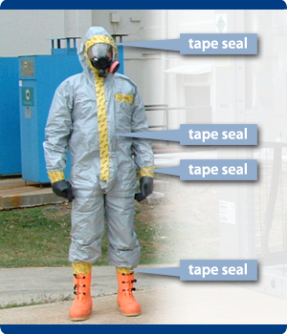
Donning Level C PPE
Zip up the suit completely
Tape seal with chemical-resistant tape
Zipper
Face piece
Enter to work zone
Notes:
Zip up the suit completely and seal the length of its zipper with chemical-resistant tape. If a face piece is worn, tape seal around the face-piece and suit junction. Make sure the tape is centered along each junction. Enter the work area and perform the necessary duties. [The image shows the location of every tape seal on someone wearing complete, Level C PPE. Each junction and zippered area is tape sealed for additional protection. Photo source: Dr. Tegwin Taylor, Iowa State University]

Slide 17
DoFFing PPE
Notes:
After response tasks are completed, responders should begin doffing PPE upon leaving the Hot Zone. When doffing PPE, it is important to take precautions and follow the proper procedure to ensure contaminants are not carried or spread off of the premises. Use of the buddy system can aid in safely and easily removing PPE.

Slide 18
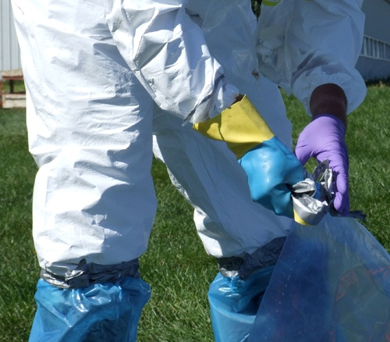
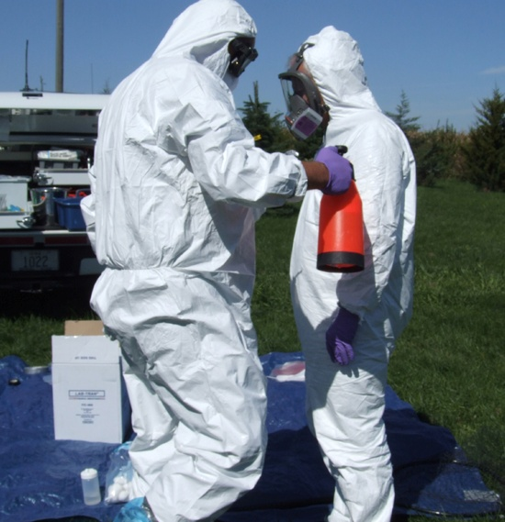
Doffing Level C PPE
Begins in Hot Zone
Dry brush PPE exterior
Clean bottom of boots
Enter Warm Zone
Remove all tape seals
Dispose properly
Spray suit with disinfectant
Notes:
Doffing begins in the Hot Zone/Exclusion Zone (EZ) by dry brushing off the exterior of PPE. Scrub organic debris off the bottom of boots. Enter the Warm Zone/Contamination Reduction Zone (CRZ) to continue the doffing procedure. Remove all chemical-resistant tape from your suit and dispose of it in the proper provided container. Spray the exterior of PPE with an appropriate disinfectant product. [Top image shows a responder removing tape from the suit-glove junction. Bottom photo shows use of the buddy system to disinfect exterior PPE. Photo source: Jane Galyon and Travis Engelhaupt, Iowa State University]

Slide 19
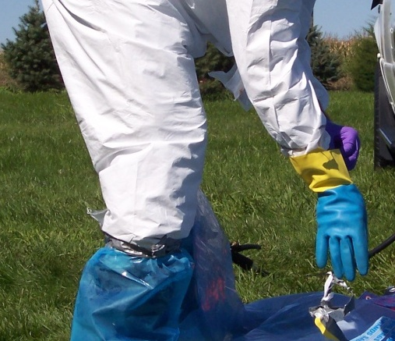
Doffing Level C PPE
Remove outer gloves
Unzip protective suit
Remove hood by
Reaching inside hood
Rolling it back
Touch only the inside surface
Notes:
Remove the outer layer of chemical-resistant gloves. Unzip your chemical-resistant suit. Remove the hood by reaching inside the hood and rolling it back carefully, touching only the inside surface. This may be easier with the assistance of a team member. [Top image shows a responder removing his outer layer of gloves. Bottom image shows a responder unzipping his Tyvek® suit. Photo source: Jane Galyon and Travis Engelhaupt, Iowa State University]

Slide 20
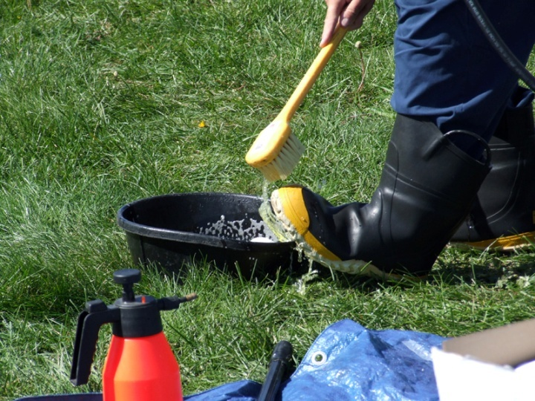
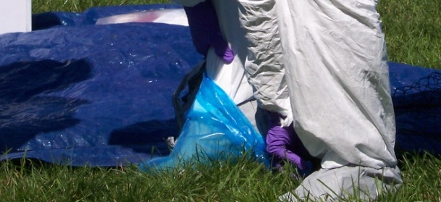
Doffing Level C PPE
Pull suit off shoulders
Turn it inside out as moved down
Remove outer boot covers
Scrub inner boots with disinfectant
Notes:
Pull the suit off your shoulders and pull it down, turning it inside out as you go to prevent contamination. Carefully remove disposable boot covers. Scrub your chemical-resistant boots with disinfectant. [Top image shows a responder taking off his Tyvek® suit, turning it inside out as he goes. Bottom image shows a responder removing his disposable boot covers. Photo sources: Travis Engelhaupt and Jane Galyon, Iowa State University]

Slide 21
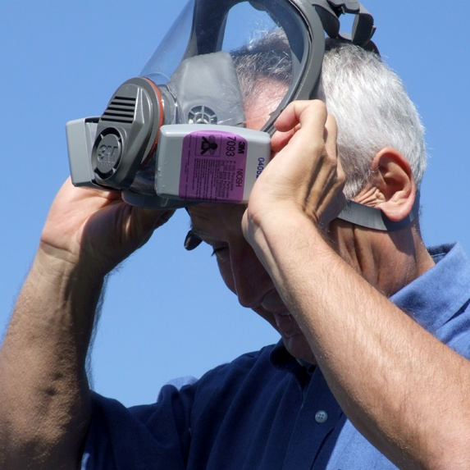
Doffing Level C PPE
Peel suit down; step out
Remove APR and inner gloves
Notes:
Remove the chemical-resistant suit completely and carefully step out of it. Remove the APR and the inner layer of gloves, in this order, to prevent contaminating your hands. (Left image shows a responder stepping out of his Tyvek® suit. Right image shows a responder removing his APR. Right image shows hands being washed. Photo source: Travis Engelhaupt, Iowa State University)

Slide 22
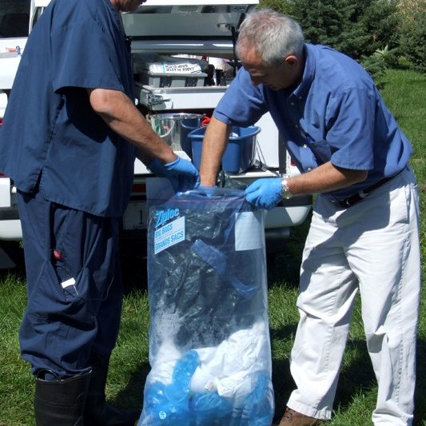
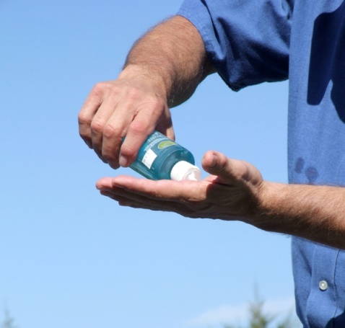
Doffing Level C PPE
Dispose of gloves and suit in containers provided
Place APR in designated container
Wash hands
Shower
Inspect under fingernails
Blow your nose
Notes:
Dispose of all doffed PPE in the proper containers provided in the Cold Zone/Support Zone (SZ). Place APR in the proper container for decontamination and reuse. Take care to prevent contamination during doffing procedures, even at lower levels. After doffing all PPE, wash hands. Take a complete shower and change to clean clothing. Inspect under fingernails and blow your nose to clear your respiratory passages. This should be done immediately after leaving the infected or exposed area and before visiting public places. [Top image shows a responder putting his Tyvek® suit and other contaminated materials in a safe container. Bottom image shows hands being washed. Photo source: Travis Engelhaupt, Iowa State University]

Slide 23
Precautions and Limitations
Evaluate proper fit frequently
Do not eat, drink, smoke, apply cosmetics or lip balm or handle contact lenses while wearing
Don and doff in proper order
Wash hands immediately after removing PPE
Notes:
While PPE can prevent exposure to aerosols, direct contact, and injections, there are certain precautions and limitations that must be considered.
Evaluate proper fit on a frequent basis.
To prevent exposure and contamination, never eat, drink, smoke, apply cosmetics or lip balm, or handle contact lenses while wearing PPE.
Don (put on) and doff (remove) PPE in the proper order to prevent contamination.
Wash hands immediately after removing PPE
Protective clothing and respiratory protection can be insulating, take measures to prevent heat stress

Slide 24
Acknowledgments
Development of this presentation was by the Center for Food Security and Public Health at Iowa State University through funding from the Multi-State Partnership for Security in Agriculture
Authors: Shaine Devoe
Reviewers: Glenda Dvorak, DVM, MPH, DACVPM
Notes:
Information provided in this presentation was developed by the Center for Food Security and Public Health at Iowa State University College of Veterinary Medicine, through funding from the Multi-State Partnership for Security in Agriculture.

