Slide 1
Biosecurity
Overview
Notes:
June 2010
During an animal health emergency, controlling the spread of diseases to other animals, premises and responders will be necessary. This Just-In-Time training presentation will discuss biosecurity issues and procedures for infectious animal disease outbreaks.

Slide 2
Biosecurity
Series of management practices
Prevent introduction
Keep disease agents out of animal populations where they are not present
Prevent further spread
From infected to uninfected groups
By animals, personnel, equipment
To other animals, premises, responders
Notes:
Biosecurity involves a series of management practices designed to prevent the introduction and spread of pathogenic agents onto or off of an animal production or housing premises. This includes keeping the disease agents out of animal populations where they are not already present as well as preventing further spread of disease agents to other groups or locations. The use of various biosecurity measures, when properly implemented, will help reduce the risk of disease spread by the movement of animals, personnel, equipment and other materials during response activities.

Slide 3
ICS: Biosecurity Group
Biosecurity Group Supervisor
Ensure appropriate biosecurity measures
Develops site-specific biosecurity plan
With the Safety Officer and Incident Commander
Biosecurity Team Members
Front line assistance in containing and controlling disease outbreak
Notes:
Biosecurity procedures for an animal health emergency are coordinated and managed by the Biosecurity Group of the Operations Section of ICS. The Biosecurity Group Supervisor ensures the appropriate biosecurity measures are implemented and also develops the site-specific biosecurity plan in coordination with the Safety Officer and Incident Commander. Biosecurity Team Members provide front-line assistance in containing and controlling the disease outbreak. All responders should receive a biosecurity briefing upon arrival to the incident site.

Slide 4
Basic Biosecurity Elements
Awareness of importance
Understand disease transmission
Biosecurity measures
Movement control or restriction
People, animals, vehicles, equipment
Personal protective equipment
Isolation of infected and suspected animals
Proper C&D procedures
Notes:
During an animal health emergency, it is important to implement biosecurity procedures as quickly as possible. Basic elements of any biosecurity plan include an awareness and understanding of the importance of biosecurity measures and how disease agents can be transmitted. Movement control or restriction measures for people, animals, vehicles and equipment, isolation of infected and suspected animals, and health assessment of susceptible and exposed animals are also important components of any biosecurity plan. Cleaning and disinfection procedures are critical to reduce or eliminated pathogen transmission.

Slide 5
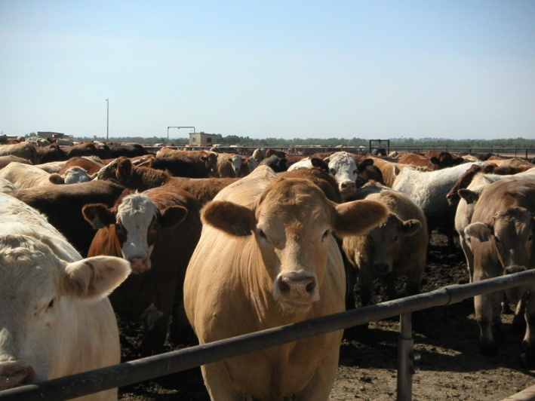
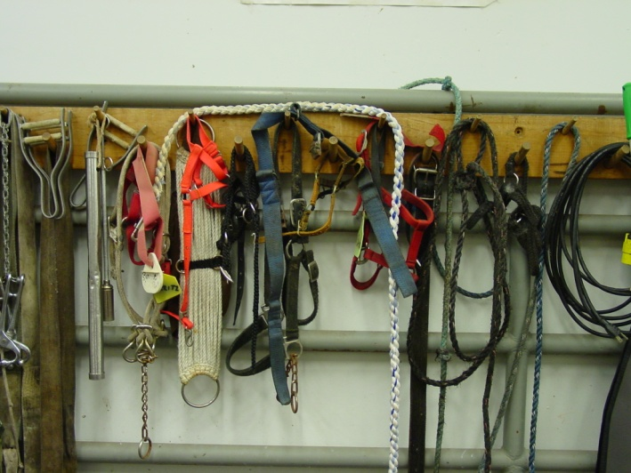
Routes of Transmission
Direct
Physical contact
Biting, nose-to-nose, open wounds
Fomites
Inanimate object
Equipment, clothing, boots, vehicles
Aerosol
Inhalation of droplets with pathogens
Notes:
Pathogenic agents can be transmitted from animal-to-animal through a variety of ways. Understanding these routes can help in implementing necessary biosecurity actions for the response situation. There are 5 main routes of transmission for pathogenic agents: direct contact, indirect transfer by fomites, aerosol, oral, and vector transmission.
Direct contact transmission occurs by physical contact of a susceptible animal with an infected animal or pathogen; this may occur by rubbing, biting or contact of open wounds or mucous membranes with infectious blood, saliva or other body fluids.
Indirect transmission may occur by fomites. These are inanimate objects such as equipment, clothing, boots or vehicles, that can carry or transfer pathogens from one susceptible animal to another.
Aerosol transmission involves the inhalation of droplets containing pathogens by a susceptible animal.
[Photo (top): Renee Dewell, Iowa State University; (bottom) Danelle Bickett-Weddle, Iowa State University]

Slide 6
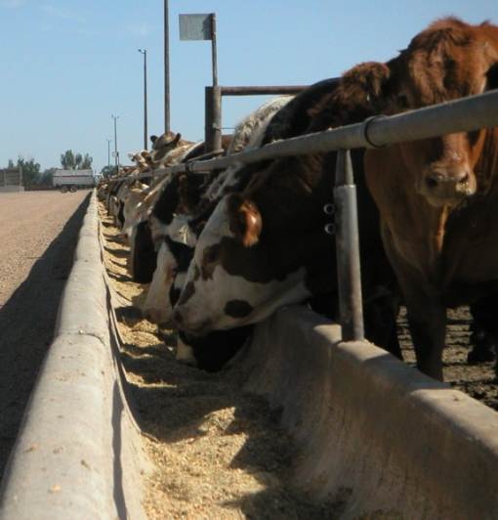
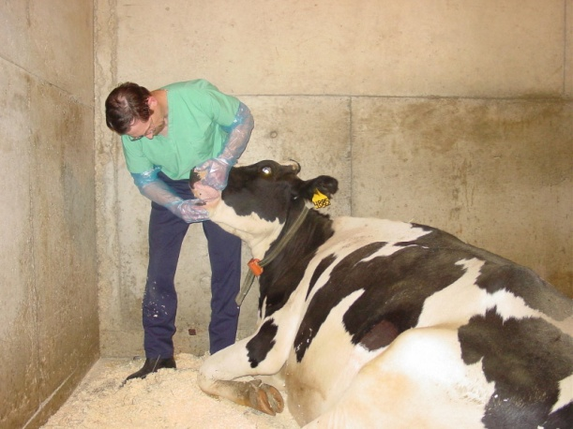
Routes of Transmission
Oral/Ingestion
Pathogens consumed
Contaminated feed or water, licking/ chewing on contaminated object
Vectors
Insects transmit pathogens
Mosquitoes, fleas, ticks
Zoonotic
Pathogens spread from animals to humans
Notes:
Oral transfer occurs when a susceptible animal consumes pathogenic agents either by contaminated food or water or by licking or chewing on contaminated environmental objects; fecal-oral transmission of diseases is a common means of infection.
Vector-borne diseases are those transmitted by insects (e.g., mosquitoes, ticks) which are capable of transferring pathogens from an infected animal to a susceptible one.
Finally, some animal pathogens may be transmitted to humans by any of the routes described; these diseases are called zoonotic diseases or zoonoses.
[Photo (top): feedlot cattle at feed bunk, Renee Dewell, Iowa State University; (bottom) oral examination of a dairy cow, Danelle Bickett-Weddle, Iowa State University]

Slide 7
Biosecurity and Routes
Route of Transmission | Possible Biosecurity Measures
Direct Contact | Isolation of infected animals; personal protective equipment
Fomites | Cleaning and disinfection procedures; personal protective equipment
Aerosol | Isolation of infected animals; personal protective equipment
Ingestion | Cleaning and disinfection procedures
Vectors (e.g., insects) | Pest management procedures
Notes:
This table shows some of the possible biosecurity measures that may be used to limit transmission of pathogenic agents based on their routes of transmission. For pathogens spread by direct contact and aerosols, the isolation of infected animals and use of personal protective equipment, such as gloves, can limit and prevent transmission by these routes. For pathogens spread by fomites, such as equipment or vehicles, cleaning and disinfection measures can be effective in reducing contamination. For pathogens spread by oral routes, cleaning and disinfection measures can be effective. Control of vector-borne diseases will involve the use of pest management procedures to limit transmission.

Slide 8
Biosecurity measures
Movement control and restriction
Personal protective equipment
Cleaning and disinfection
Isolation
Vector control
Notes:
Let’s look at the various biosecurity measures that can be used to control and prevent the introduction of pathogens onto or off of a farm. These include movement control and restriction for animals, vehicles and personnel; the use of personal protective equipment; cleaning and disinfection, isolation of animals, and vector control measures.

Slide 9
Movement Control: Animals
Stop movements
Movement restrictions
Animals should not be moved if:
From a confirmed or suspected premises
Contact with infected or suspect animal
Susceptible animal near infected or suspected premises
Transport vehicles do not meet biosecurity standards
Notes:
Movement control and restriction efforts will be necessary to minimize the spread of pathogens by any number of items, including infected animals, vehicles on the site, and even response personnel. Depending on the situation, this may involve complete movement restrictions (i.e., stop movement orders) or restricted measures which may allow limited movement following additional biosecurity measures (such as cleaning and disinfection). During highly contagious disease outbreaks, the movement of all affected or susceptible animals on the premises should be restricted until the scope of the outbreak can be determined. Movement restriction measures should include:
Any animals from a premises confirmed or suspected of the disease;
Any animals that have had contact with infected or suspected animals within at least 2 incubation periods of the disease of concern;
Any susceptible animals near the infected or suspected premises, until veterinary evaluation has occurred; and
Any transport vehicles that do not meet biosecurity standards (e.g., proper C&D measures).

Slide 10
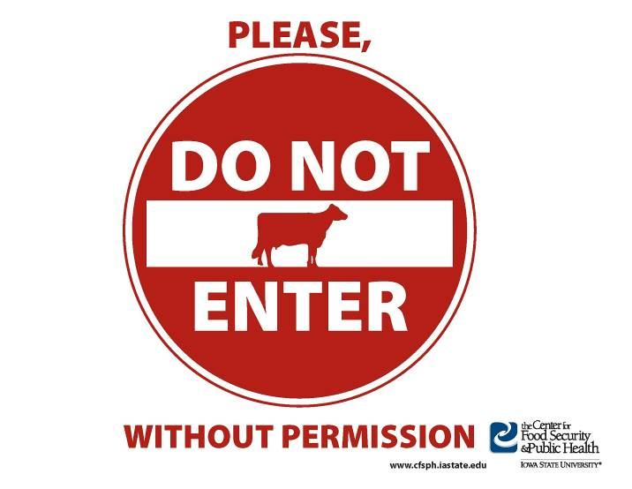
Movement Control: Personnel
Restrict access
Control movement on and off premises
Log book for those allowed to access
Post signs at premises boundary
Notes:
Movement control and restrictions should also be applied to people entering and exiting the infected or suspected premises. This might include any visitors to the site, such as feed delivery personnel, as well as any response personnel. Access to the premises should be restricted to only those necessary for farm functions and/or the response procedures. Movements onto or off of the premise should be tightly controlled and biosecurity measures (e.g., PPE and cleaning and disinfection measures) should be used prior to entry and upon exiting the premises. A log book should be maintained to record individuals and vehicles accessing the premises. The use of warning or restriction signs at the premise boundary can be helpful in informing visitors to stay away. [Graphic illustration by Clint May, Iowa State University]

Slide 11
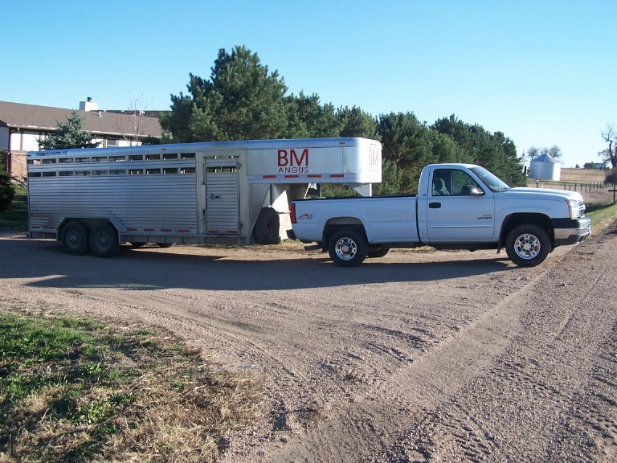
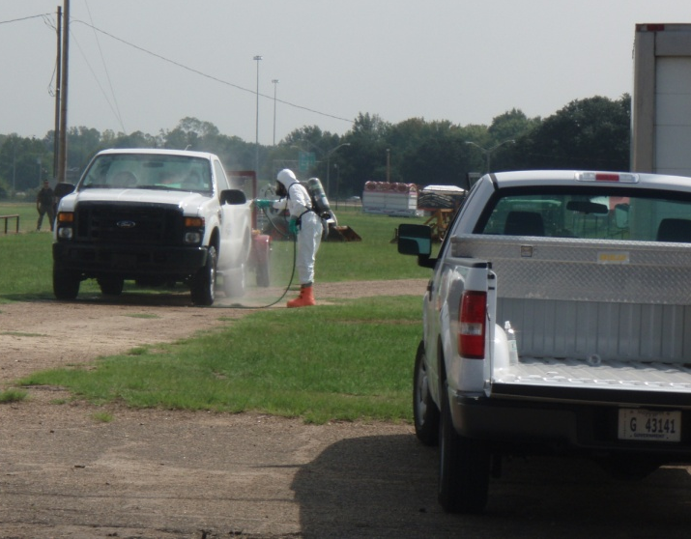
Movement Control: Vehicles
Potential fomite transfer
Park in designated areas away from animal locations
Clean and disinfect before entering and exiting premises
Notes:
Vehicles can serve as fomites and transfer pathogens to additional locations if proper biosecurity measures are not taken. Any responders or visitors allowed access to the premises should park their vehicles in a designated area away from animal housing locations. This will help to prevent possible contamination of vehicles and fomite transmission of the disease. Any vehicles or equipment allowed on the premises must be cleaned and disinfected before entering and before exiting the premises to prevent potential spread to additional locations. This includes animal transport trailers or trucks, delivery trucks, personal vehicles or any other response vehicles entering the site. [Photo (top) from Bryan Buss, Iowa State University; (bottom) Carla Hueston, Mississippi State University]

Slide 12
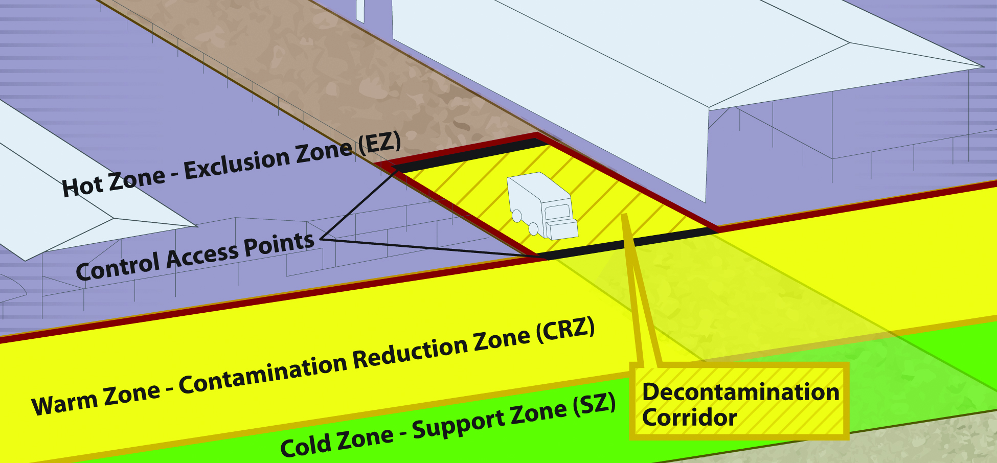
Biosecurity Work Zones
Notes:
During an animal emergency response, the establishment of biosecurity work zones will enable and enhance access control procedures(e.g., entry, exit) in efforts to minimize the spread of pathogen onto or off of an infected or suspected premises. Responders should understand the location and implications of each of the biosecurity work zones. These work zones apply to personnel and vehicle traffic onto the site as deemed necessary.
The Hot Zone or Exclusion Zone (EZ) is the potentially contaminated or unsafe area (e.g, infected animal premises). Appropriate PPE must be worn in this area.
The Warm Zone or Contamination Reduction Zone (CRZ) is also considered a high risk area due to the potential for exposure to pathogens and chemical disinfectants. All personnel are required to wear PPE.
The Decontamination or Decon Corridor is the area between the Hot Zone and the Warm Zone. Decontamination of personnel and disinfection of equipment occurs here. Teams exit and enter the site through this corridor. Once responders have doffed, disinfected, and decontaminated in the Warm Zone, they should move to the Cold Zone/Support Zone (SZ) through the designated Control Access Points.
The Cold Zone or Support Zone (SZ) is the clean/uncontaminated area of the site, where responders should not be exposed to hazardous conditions; support functions are based here. Donning of PPE prior to entry into the Hot Zone also occurs here. [Graphic Andrew Kingsbury, Iowa State University. Definitions from USDA FAD PReP Guidelines].

Slide 13
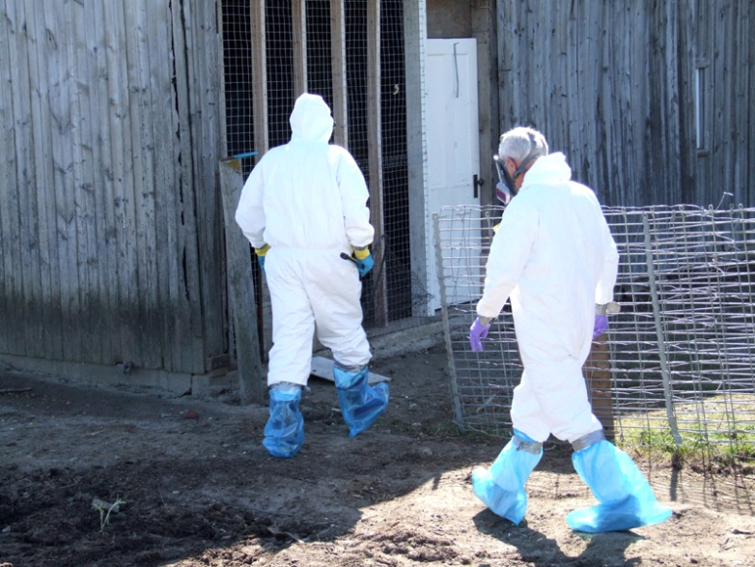
Personal Protective Equipment
Two functions
Prevent further spread
Protect responders
Don PPE prior to entry into area
Disposable Outerwear
Tyvek® coveralls, gloves, boot covers, masks
Reusable Outerwear
Cloth coveralls, rubber boots, goggles
Notes:
As previously indicated, the use of Personal Protective Equipment, or PPE, can also serve as a useful biosecurity measure to prevent the spread of disease agents. Personal protective equipment serves two functions during an animal health emergency response. First it can help minimize the spread of pathogens off of a premises as well as between locations on a premises. PPE items are donned prior to entry to the site and doffed prior to exiting the site, thereby containing any contamination at the location. PPE also serves as a protective barrier to responders in situations involving zoonotic disease, thereby protecting the responder from potential exposure. The appropriate PPE required for a response will be determined by the pathogen involved and protective measures needed. [Photo from Jane Galyon, Iowa State University]

Slide 14
Personnel Biosecurity
Once on infected premises, do not return to Cold Zone until
PPE doffed
Disposable items left on premises or placed in designated area
Clean/disinfect reusable items on site
WASH HANDS!
Notes:
Once a worker has entered the infected premises, they should not return to the Cold Zone/Support Zone until all PPE has been properly cleaned and disinfected or disposed of prior to exiting the premises. All contaminated disposable items (e.g., Tyvek coveralls, boot covers, latex gloves) should be discarded in a plastic garbage bag to be left on the premises or in the designated area. Contaminated cloth coveralls and rubber boots should be scrubbed to remove dirt and debris and then sprayed with a disinfectant. The items should be placed into a clean plastic garbage bag or other container that is sealed until they can be washed further. Hands should always be washed after doffing all PPE.

Slide 15
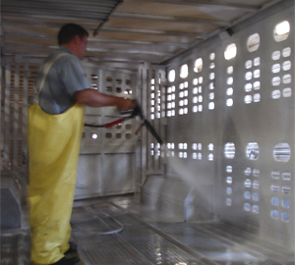
Cleaning and Disinfection Procedure
Cleaning
Remove all organic matter
Manure, dirt, feed
Wash and rinse
Disinfection
Use proper concentration
Allow proper contact time
Read safety precautions
Wear appropriate PPE
Notes:
Cleaning and disinfection procedures will be vital for controlling and containing any disease outbreak situation and minimizing the transmission between premises. C&D procedures should be established for animal housing areas as well as any vehicles, equipment and PPE used on the site. The proper cleaning and disinfection procedure is a 2-step process. Cleaning involves the physical removal of any organic material such as manure, dirt, feed, or bedding, followed by a Wash step to clean surfaces and remove any adhered debris, residual oils or body fluids. The cleaning step often overlooked, however, most disinfectants are inactivated by organic material, thereby making the cleaning step an essential part of the process. Once the area or item has been cleaned and rinsed, an appropriate (EPA-approved) disinfectant can be applied. There are various disinfectant products, application methods and use concentrations; therefore always read the label instructions for proper use. Another often overlooked step is not allowing for the proper contact time after application of the disinfection solution. The chemical disinfectant needs time to do its job, so it should remain on the surface being disinfected for the necessary time according to the product label. All chemical disinfectants have some degree of hazard with use, so always read the safety information on the label and wear the appropriate PPE when preparing and applying products. [Photo source: Danelle Bickett-Weddle, Iowa State University]

Slide 16
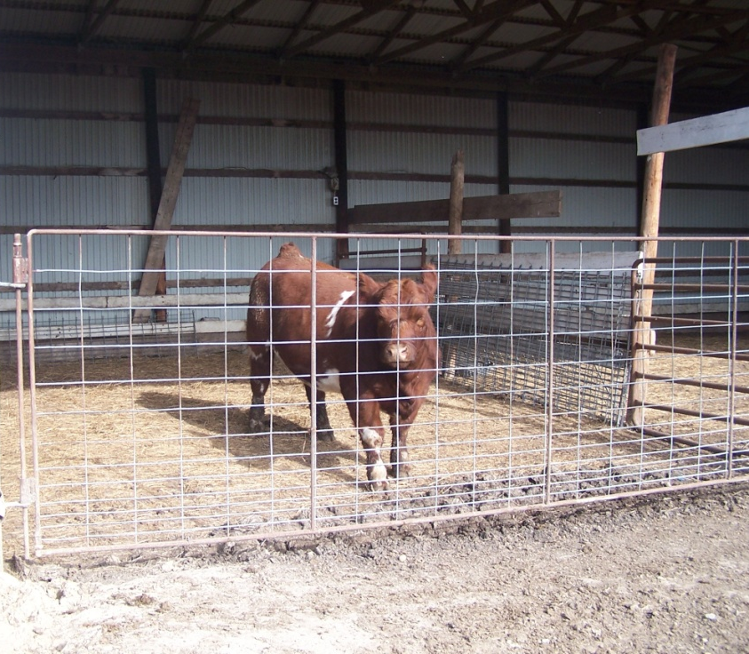
Isolation
Infected or exposed animals should be housed in separate areas
Proper carcass disposal of euthanized or dead animals
Notes:
Additional biosecurity measures necessary to minimize the spread of pathogens from the premise include isolation procedures and wildlife and vector control measures. The isolation of infected or exposed animals is necessary to minimize the transfer of pathogenic agents to other susceptible animals on the site or additional locations. Isolation areas should preferably be at a distance from susceptible animals if possible. Additionally, in the event of animal deaths or euthanasia, proper carcass disposal methods should be used to prevent animals or tissues from being carried off by wildlife. [Photo from Bryan Buss, Iowa State University]

Slide 17
Wildlife Control
Wildlife can carry diseases on and off the property
Keep animals isolated from wildlife contact
Ensure boundary measures are checked regularly and maintained
Store food in a way that does not attract wildlife
Notes:
For some diseases, wildlife may carry disease agents on and off of the property and infect additional susceptible animals. Wildlife can pose a difficult problem to biosecurity, especially on premises where livestock are not kept in an enclosed area. Keep infected, suspect or susceptible animals in areas that prevent wildlife contact. Boundary fences and barriers should be checked regularly and maintained. Ensure feed is stored in a manner that does not attract or allow access to wildlife (e.g., secure containers or building).

Slide 18
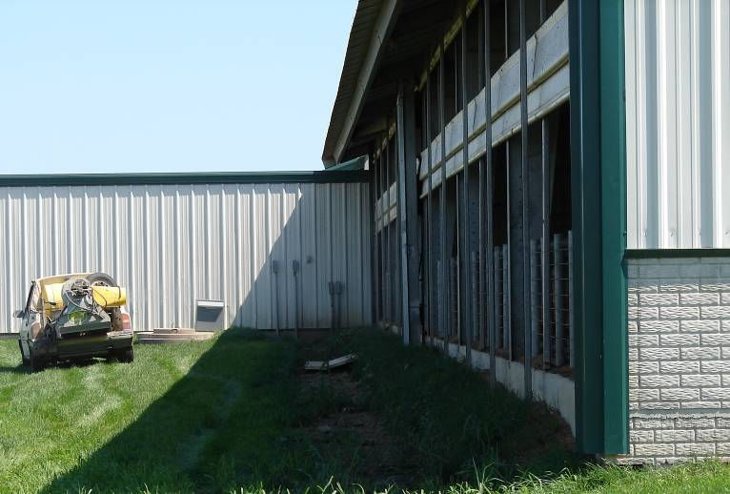
Vector Control
Source reduction
Prevent egg laying
Minimizing long vegetation (e.g., mowing)
Control adults
Insecticides
Spraying, fogging, baiting
Minimize animal interaction
Screens on buildings
Animal treatment
Notes:
Some animal health emergencies will involve insect vectors (e.g., mosquitoes, biting midges) capable of spreading disease agents. Control measures should be taken to limit the spread of disease by these insects. Vector control begins with an understanding of the insect’s life cycle, as these can vary among vectors, as will effective control measures. For instance, egg laying grounds for flies are different than those of mosquitoes or midges. Controlling adult insects often involves the use of insecticides; fogging and baiting may also work to a limited extent. Most effort should be focused on reducing the vector source (i.e., egg laying sites) and limiting the exposure of animals on the premises (e.g, through the use of screens on barns, animal treatment with approved chemicals, and minimizing tall vegetation or standing pools of water). [Photo source: Danelle Bickett-Weddle, Iowa State University]

Slide 19
Resources
USDA Foreign Animal Disease Preparedness (FAD PReP) Guidelines: Biosecurity
http://www.aphis.usda.gov/animal_health/emrs/nahems.shtml
Notes:
For more information on biosecurity issues during an animal health emergency response, consult the USDA FAD PReP Biosecurity Guidelines.

Slide 20
Acknowledgments
Development of this presentation was by the Center for Food Security and Public Health at Iowa State University through funding from the Multi-State Partnership for Security in Agriculture
Authors: Sarah Viera, MPH; Glenda Dvorak, DVM, MPH, DACVPM
Notes:
Information provided in this presentation was developed by the Center for Food Security and Public Health at Iowa State University College of Veterinary Medicine, through funding from the Multi-State Partnership for Security in Agriculture.

